Slide 1
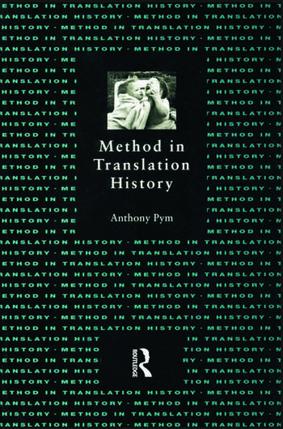
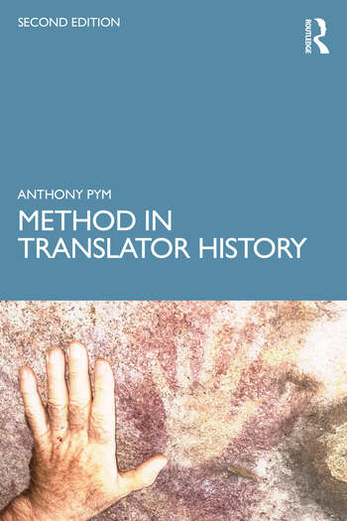
Translator history
Anthony Pym

Slide 2
A slow paradigm shift over 25 years…
Process rather than product
The particular rather than the general
Many variables rather than a few
Lived experience; 4EA: embodiment, affect, enactment (performance), extendedness, affect, emotions, empathy, trust, authenticity
Complexity
Materiality
Multimedia
Peirce, Bakhtin, Deleuze, Latour
unfalsifiable theory, hyper-descriptivism
Notes:
Here I will only point out that professional translators produce much less than 1% of all the words translated in the world.

Slide 3
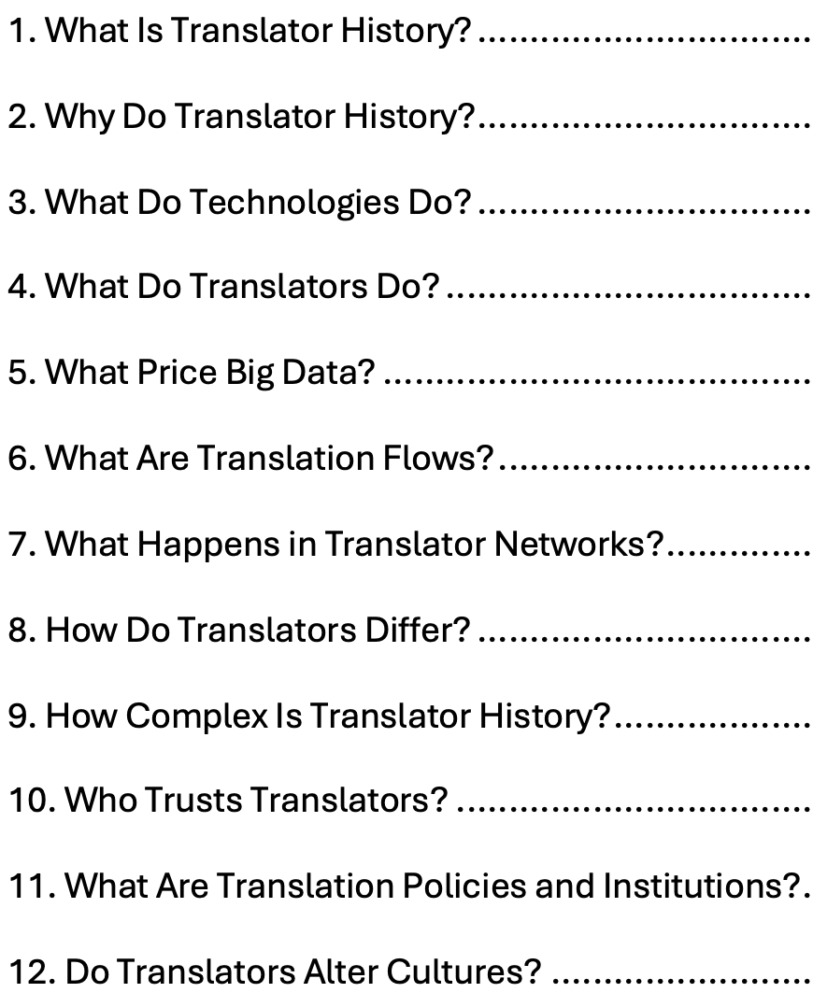
A slow paradigm shift over 25 years…
Eurocentric vs. decolonization
A focus on people rather than texts.
New chapters on:
Technologies
Complexity
Trust
Policy
Effects
Notes:
Here I will only point out that professional translators produce much less than 1% of all the words translated in the world.

Slide 4
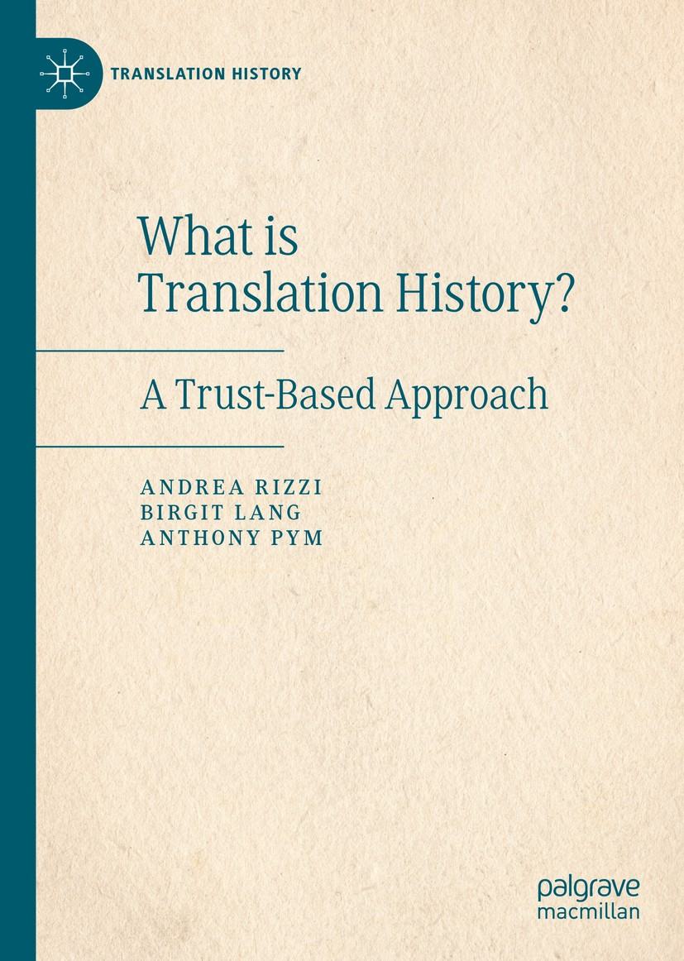
Septem Circumstantiae?
Who? What? Where? When? Why? How? With what means?
With whose help?
For whom?
Over what distance?
In exchange for what?
With what effect?
In accordance with what kind of trust?

Slide 5
Case study 1:
What does altjira mean?
Notes:
Here I will only point out that professional translators produce much less than 1% of all the words translated in the world.

Slide 6
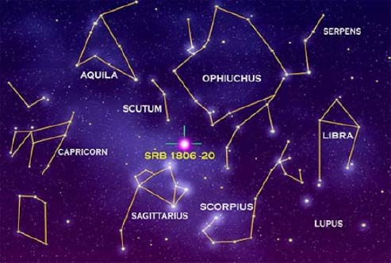

Not seeing what is in plain sight (the bodies in the night sky)

Slide 7
Strehlow on Altijira (1907)
According to the tradition of the ancients, there is a highest good (mara) being, Altjira. Altjira is eternal (ngambakala) and is presented as a big, strong man of red complexion whose long, fair hair (gola) falls down over his shoulders.
His many sons have emu feet and his many daughters have dingo feet.
His dwelling is the sky (altkira), which has been from eternity (ngambakala).

Slide 8
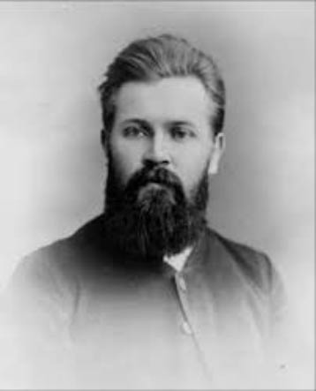
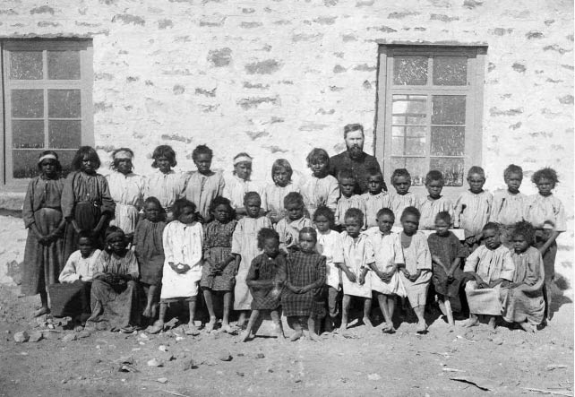
Who?

Slide 9
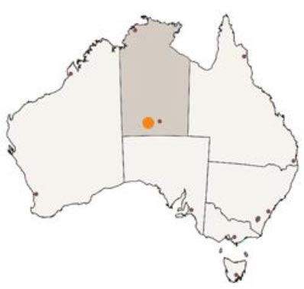
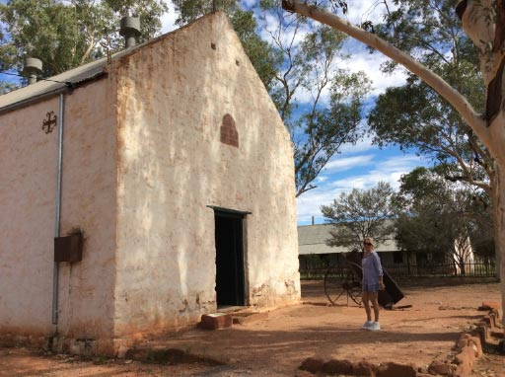
Where?

Slide 10
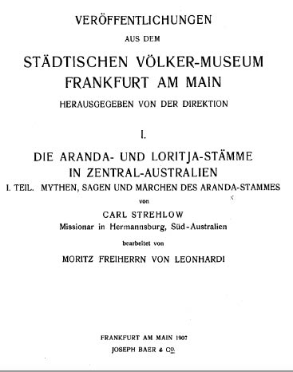
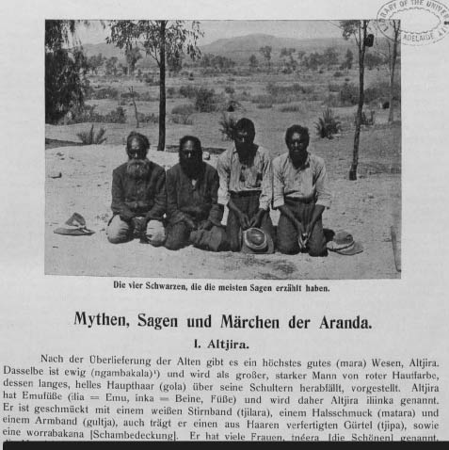
How?

Slide 11
A Lutheran translation (1907)
When Spencer and Gillen (Northern Tribes of Central Australia, p. 745) say “the word alcheri means dream”, the assertion is not correct.
“To dream” is altjirerama, derived from altjira (God) and rama (to see), thus “to see god”.

Slide 12
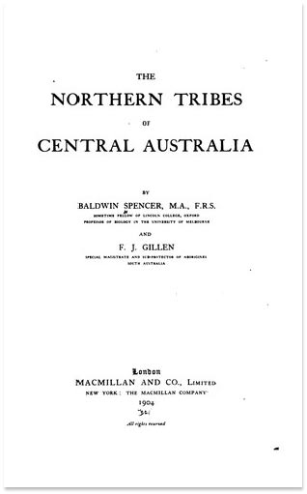
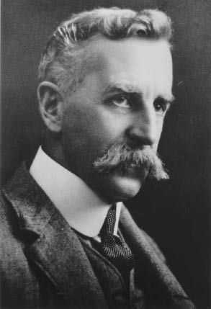
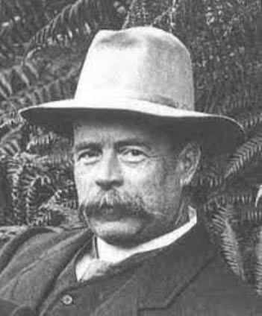
Spencer and Gillen translate the Arrernte (Arunta, Aranda)

Slide 13
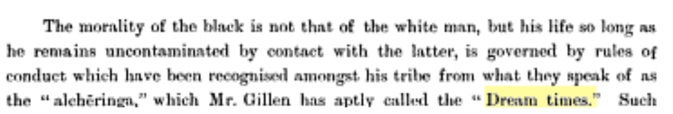
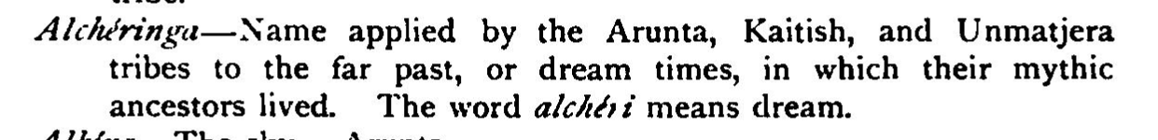
A first translation (1896, 1904)

Slide 14

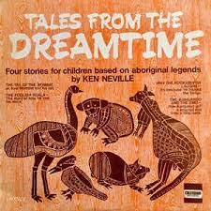
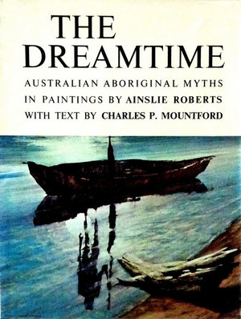
Gillen’s translation has long-term effects

Slide 15

The two translations cross paths
1901 January 8: Letter from Strehlow in the Kirchliche Mitteilungen: Altjira is a “being of the highest order”.
1901: Moritz von Leonhardi writes to Strehlow with questions on Arrernte culture; Strehlow replies (on December 20, 1901?).
1901-3: Leonhardi sends the reply to Lang, who sends it to Spencer.
1903: Spencer cites and responds to Strehlow in a letter to Sir James Frazer.

Slide 16
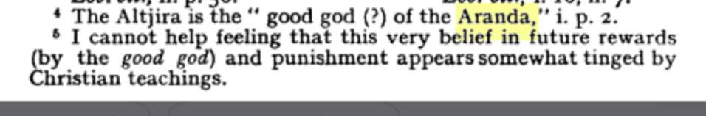
Who trusted Spencer?
Frazer deleted Strehlow from later editions of The Golden Bough.
Malinowski in The Family among the Australian Aborigines (1913) cites both Spencer and Strehlow, but does not know whom to trust:

Slide 17
Case study 2:
What does a translator do?
Notes:
Here I will only point out that professional translators produce much less than 1% of all the words translated in the world.

Slide 18
“To translate” in Australian Indigenous languages
Arrernte: amalelama (verdolmetschen, übersetzen), Strehlow 1909
Eastern and Central Arrernte: akngarte‑iweme (to turn something over, change, translate)
Western Arrernte: kngartiwuma (translate, change), from wuma (sound) and knharta (become, grow)
Birarra: burrgurdanyja (to give in exchange, to translate), includes gurdanyja (to return in kind)

Slide 19
Was there any need for translation?
“their general information and knowledge of several distinct dialects – in some instances four, besides fair English – gratified as well as surprised me.” (Dawson, 1991, p, iv)
Dawson, James. 1881. Australian Aborigines. The Languages and Customs
of Several Tribes of Aborigines in the Western District of Victoria, Australia. George Robertson.

Slide 20
Selection of messengers
“The messenger was usually one of the younger men, and if possible one whose sister was married to some one in that part of the tribe to which the messenger was to go, for under such circumstances a man could go and return in safety, being known to and protected by the people he visited.” (Howitt, 1889, p. 315)
Also selected “for their intelligence and their ability as linguists” (Dawson, 1881, p. 74)
Howitt, Alfred William. 1889. “Notes on Australian Message Sticks and Messengers.”
The Journal of the Anthropological Institute of Great Britain and Ireland 18: 314–332.
Dawson, James. 1881. Australian Aborigines. The Languages and Customs
of Several Tribes of Aborigines in the Western District of Victoria, Australia. George Robertson.

Slide 21
Orality with many functions
The agamlong (“reporter of speech”), in South Sudanese courts:
He is the interpreter, the one who makes quiet voices louder, the repeater: mutarjim [translator] in Arabic. We call it nve wandi so: one who makes the word wider. Or nve vagbi so: one who makes clear, who reveals secrets; who doesn’t hide things; who goes straight, not around the bush. (Balanda Viri elder, Wau, in English, cit. Leonardo et al. 2010, p. 33; with thanks to Harold Lesch )
Leonardi, C., Moro, L. N., Santschi, M., & Isser, D. H. (2010). Local Justice in Southern Sudan. United States Institute of Peace, Rift Valley Institute.

Slide 22
Orality vs. written?
Arabic tarjama ترجم :
- to explain the meaning of; bring out the meaning of (tafseer)
to make something clear (tafseer)
to give reason or explanation why something happens (tafseer)
to convey speech
to transfer speech from one language to another
to give a title (e.g. to a chapter, a book, etc.)
to write/narrate someone's biography.

Slide 23
Orality vs. written?
Latin interpretatio
Quintilian and Cicero: to a range of activities, from ‘making clear’ in the one language (as in the hermeneutics of a legal interpretation) through to ‘making clear’ in another language (as in an interlingual translation). This extended usage is in Jerome, Augustine, and Boethius (Romo Feito, 2012, pp. 5ff.).
Bruni: De interpretatione recta (1424/2008) discusses the correct way to produce both spoken translations (Cicero) and written translations (Aristotle), using the verb traducere in the text despite putting interpretatio in the title.

Slide 24
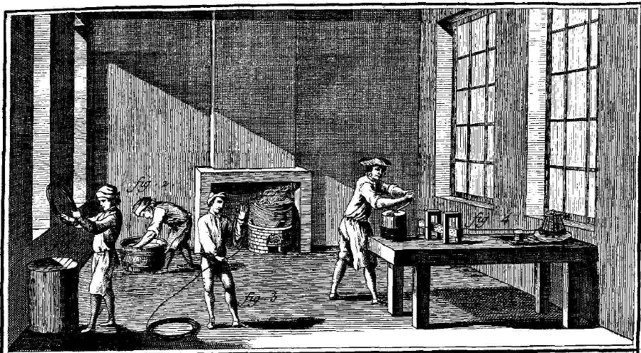
How to do the history?
Redressing the split:
Translation = retelling + language change
There is a progressive division of labor expressed in the terms.
Print: Pronounced division between the written and the spoken.
Electronic media: The division becomes less operative.

Slide 25
Case study 3:
Why is there turbulence in translation flows?
Notes:
Here I will only point out that professional translators produce much less than 1% of all the words translated in the world.

Slide 26
Rosa, A. A. (2017). Rethinking the Hegemony of English in Twentieth-century Portugal:
Some Figures and Beyond. The Translator, 23(4), 441–455.

Slide 27
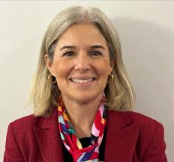
Many possible causes
Hierarchy of the world language system (Swaan, 2001)
Different class locations for main readerships
Merging of publishing companies
Pre-censorship by the Franco regime
Rise of “crime, mystery, detective, and western,” all mostly English-derived, with a surprising number of English-sounding pseudonyms being used by Spanish writers.

Slide 28
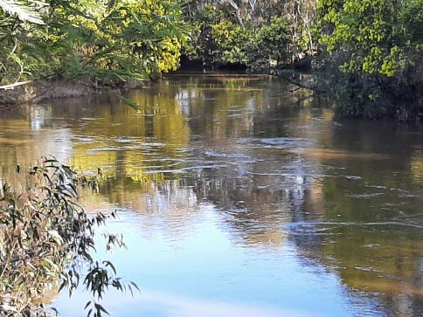
Why turbulence?
When water moves in rivers, a truly straight line would take you down to the sea at about 2,000 km per hour, instead of a much more livable one km per hour.
Flows also involve countless points of resistance: eddies, walls, breakwaters, drag, backflows, all components of turbulence.
Marusic, I., Damousi, J., & Broomhall, S. (2018). Turbulence Isn’t Just a Science Problem.
The Conversation. https://theconversation.com/turbulence-isnt-just-a-science-problem-97171

Slide 29
Why turbulence?
The entanglement of causes produces cultural energy, the translation as event and effect.
Events, trust, and policies reduce complexity.
Marusic, I., Damousi, J., & Broomhall, S. (2018). Turbulence Isn’t Just a Science Problem.
The Conversation. https://theconversation.com/turbulence-isnt-just-a-science-problem-97171

Slide 30
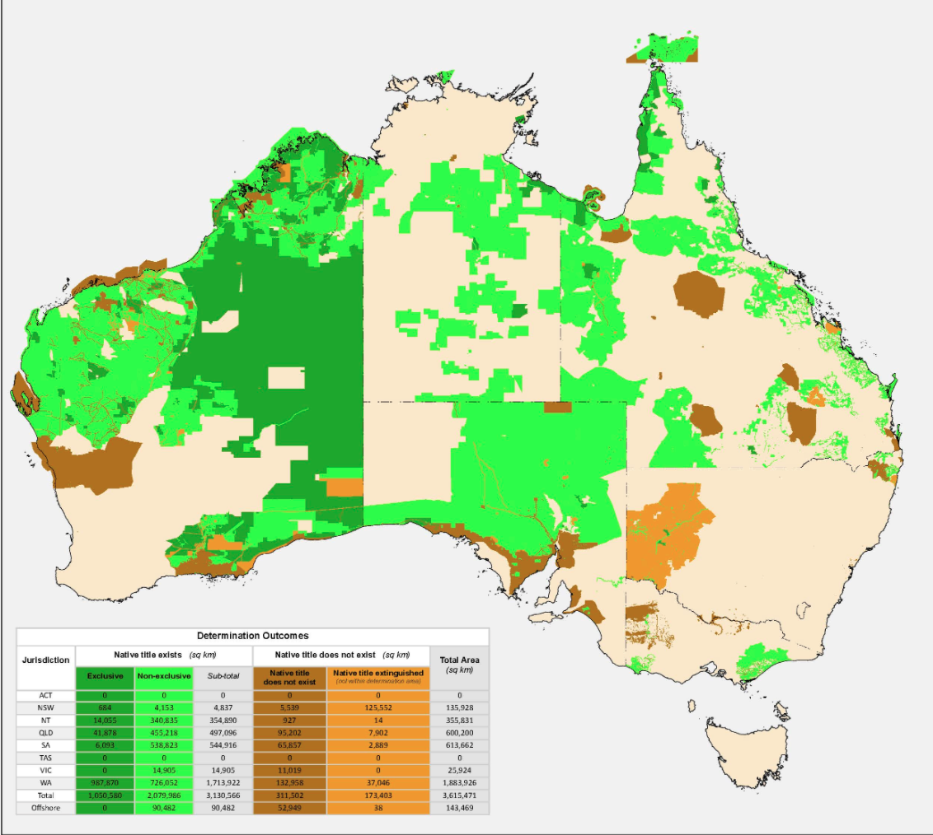
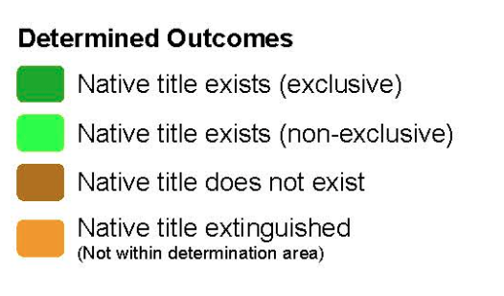
The good of turbulence
Aboriginal Land Rights (Northern Territory) Act 1976
Native Title Act of 1993 (Commonwealth)

