Slide 1
Measuring the future of AI translation
Anthony Pym
Research carried out as part of the project Alfabetizaciones y ocupación en la era digital (Spanish Ministry of Science and innovation, PID2021-122575NB-I00).

Slide 2
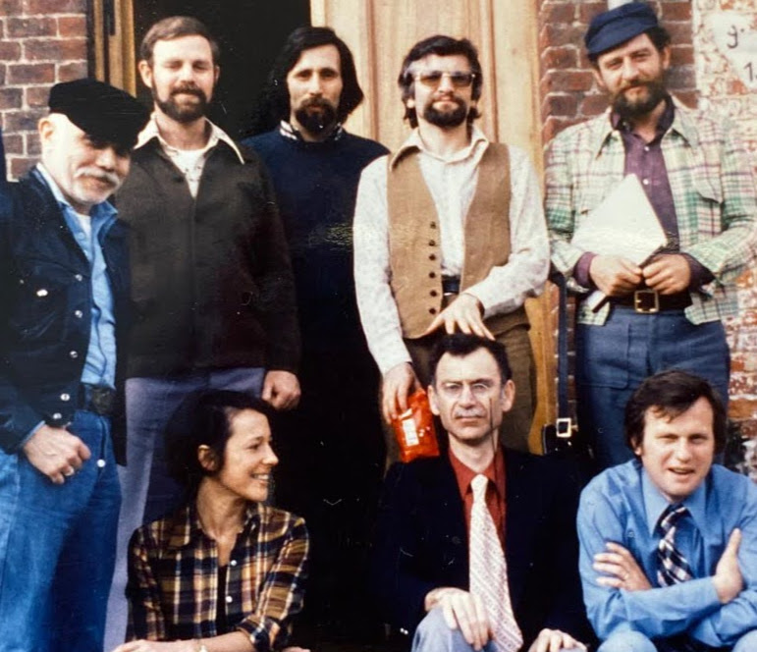
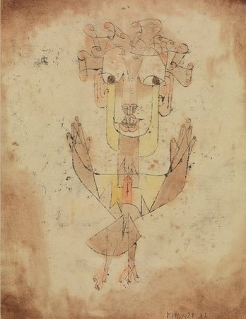
Notes:
Translator of Dutch poetry into English and pioneer of queer studies; translator of English novels into Hebrew; historian of Dutch literature; translator of classical literature into German, scholar of German literature; historian of French literature; semiotician, theorist of intercultural relations; scholar of comparative literature, German to French.
Gideon Toury (Israel)
Theo Hermans (Belgium)
André Lefevere (Belgium)
Raymond van den Broek (Belgium)
James S Holmes (US / Netherlands)
Bernadette Schreurs (Belgium)
Itamar Even-Zohar (Israel)
José Lambert (Belgium)

Slide 3
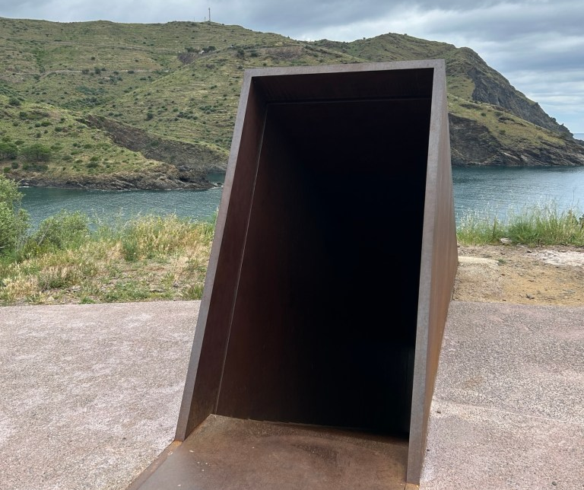
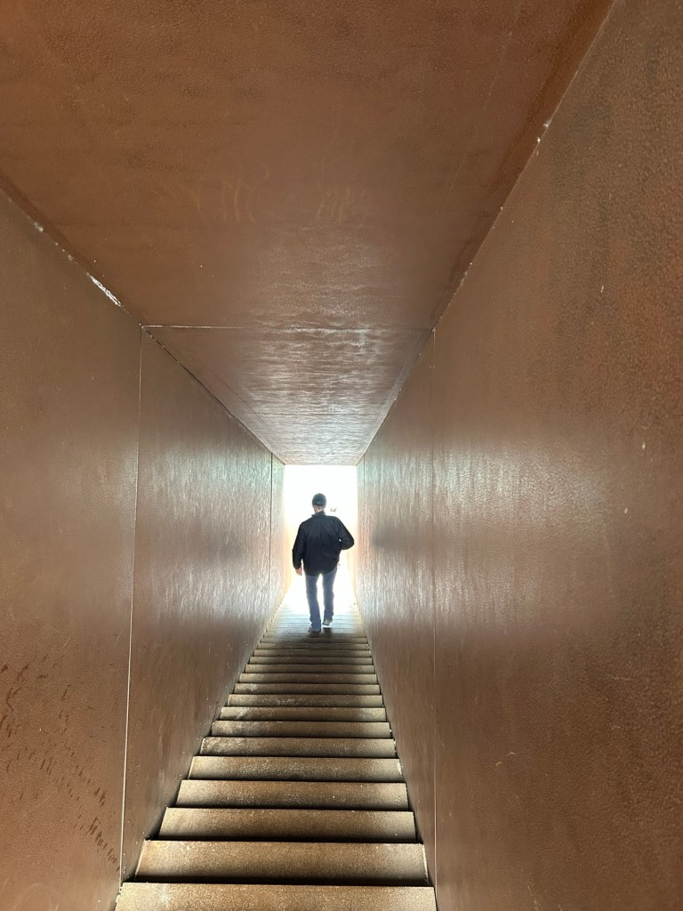
Dani Karavan, Passatjes, Port Bou, 1994

Slide 4
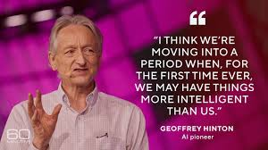

¿Pánico total?

Slide 5
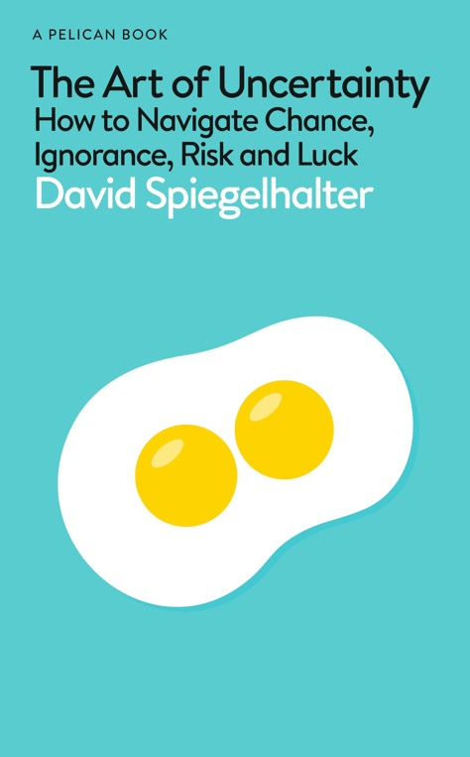
The starting point: deep uncertainty
“Just try to quantify the social impacts of generative AI in 25 years’ time. This has become known as ‘deep uncertainty’. Of course, this assumes that people have the insight and humility to admit what they don’t know.”
“[without humility] This arrogance has been termed meta-ignorance, when they don´t know what they don’t know.”
Spìegelhalter, D. (2024). The Art of Uncertainty. Pelican (audiobook).
Notes:
The problem is not mind vs. machine
It is not about ethical control over automation vs. use of automation for profit.
It is about what trained professionals can do in an age where their basic skills are within reach of all.
To ask that question properly, I will look at some bad ways of answering it, then at the history of translation automation.

Slide 6
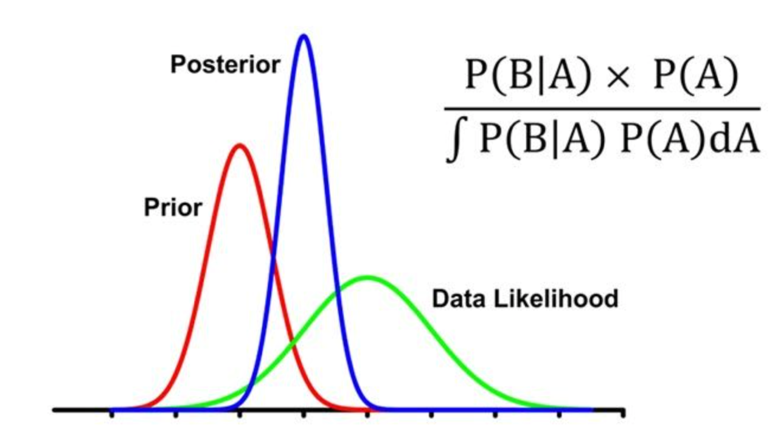
Bayes’ Theorem shifts uncertainty bands

Slide 7
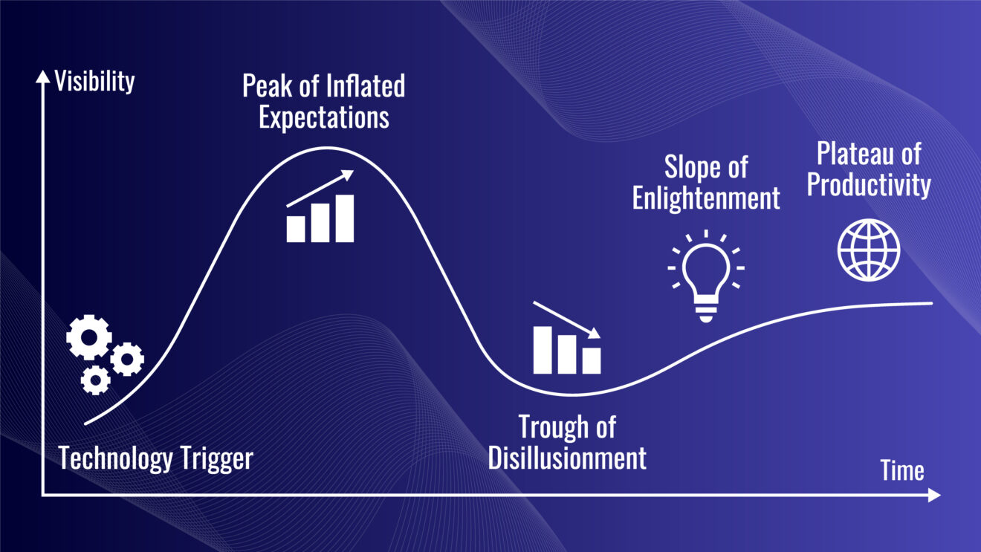
Ciclo de sobreexpectación (hype) de las tecnologías emergentes
Based on: https://www.gartner.com/en/newsroom/press-releases/2024-08-21-gartner-2024-hype-cycle-for-emerging-technologies-highlights-developer-productivity-total-experience-ai-and-security
Notes:
The problem is not mind vs. machine
It is not about ethical control over automation vs. use of automation for profit.
It is about what trained professionals can do in an age where their basic skills are within reach of all.
To ask that question properly, I will look at some bad ways of answering it, then at the history of translation automation.

Slide 8
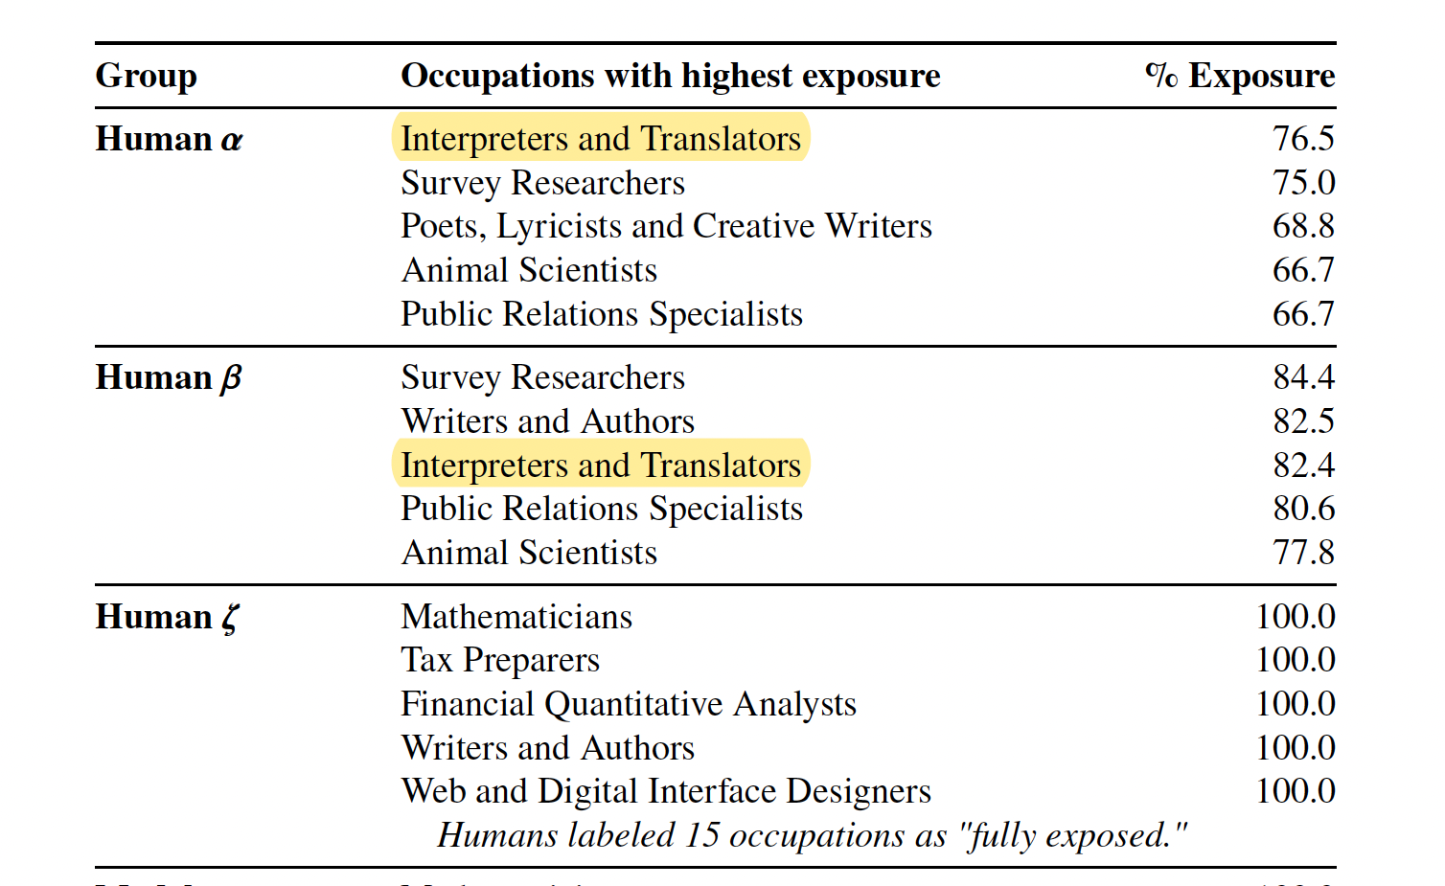
“Exposure” to automation
Eloundou, T. et al. (2023) say that 76.5% of interpreters and translators’ tasks are exposed to automation.
“Exposure” = “labor-augmenting or labor-displacing effects”
Working from O*Net data on occupation in the US.
Eloundou, T. et al. (2023, March 20) GPTs are GPTs: An Early Look at the Labor Market Impact Potential of Large Language Models. https://arxiv.org/abs/2303.10130
Ayvazyan, N., Torres-Simón, E., & Pym, A. (2024). What kind of translation literacy will be automation resistant? In Y. Peng, H. Huang, & D. Li (Eds.) New Advances in Translation Technology: Applications and Pedagogy, pp. 121-140. Springer. https://doi.org/10.1007/978-981-97-2958-6_7
⍺ = share of an occupation’s task that is exposed to GPTs
ß =share of an occupation’s task that is exposed to GPT-powered software
Notes:
In 2023, it is at the top of the list.
Note that “exposure” means that skills shift or change. It does not mean that the technology replaces 76.5% of the humans,
O*Net is a US database with updated self-report data on 923 occupations.

Slide 9
What did automation ever do for us?
  Recall and revise your previous translations
  Give alternative translations to choose between
  Reduce alternative proposals as you type
  Adjust a translation when you make a change
  Align your previous translations
  Pre-edit the start text (for plain language)
  Adapt the translation to specific readerships
  Exchange notes with other translators
  Speech to text: Speak your translations
  Text to speech: Read your translation back to you
  Revise your translation for spelling and punctuation
  Revise your translation for grammar
  Revise your translation for readability
  Revise your translation for a specific reader or purpose
  Evaluate translations
  Extract and manage your terminology
  Give notes on terms in context
  Provide background information quickly
  Propagate translation choices
  Record your translation preferences
  Check for consistency in numbers, terms, and formatting

Slide 10
What did automation ever do for us?
  Recall and revise your previous translations
  Give alternative translations to choose between
  Reduce alternative proposals as you type
  Adjust a translation when you make a change
  Align your previous translations
  Pre-edit the start text (for plain language)
  Adapt the translation to specific readerships
  Exchange notes with other translators
  Speech to text: Speak your translations
  Text to speech: Read your translation back to you
  Revise your translation for spelling and punctuation
  Revise your translation for grammar
  Revise your translation for readability
  Revise your translation for a specific reader or purpose
  Evaluate translations
  Extract and manage your terminology
  Give notes on terms in context
  Provide background information quickly
  Propagate translation choices
  Record your translation preferences
  Check for consistency in numbers, terms, and formatting

Slide 11
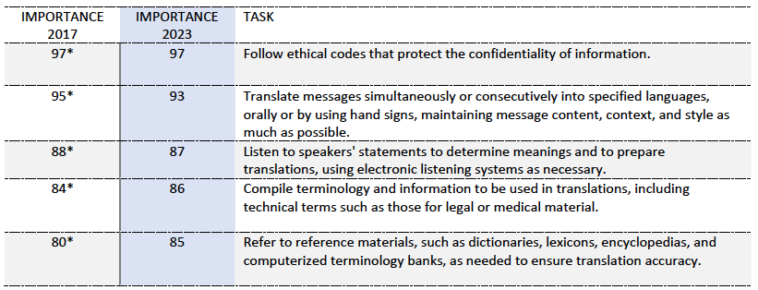
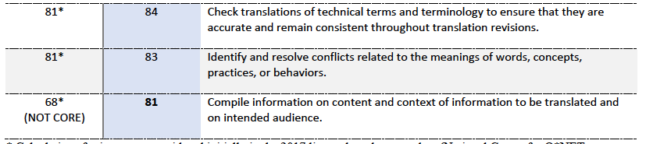
“Exposure” to automation
Notes:
In 2023, it is at the top of the list.
Note that “exposure” means that skills shift or change. It does not mean that the technology replaces 76.5% of the humans,
O*Net is a US database with updated self-report data on 923 occupations.

Slide 12
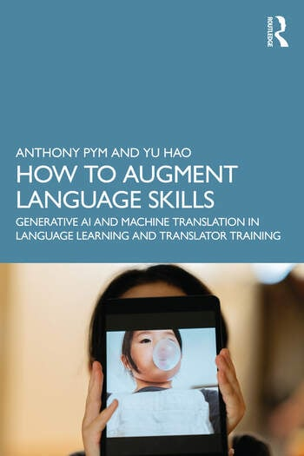
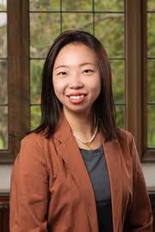
A book that you don’t have to buy
Chapter 1: What are language technologies and why should we know about them?
Chapter 2: How do we know which skills to teach?
Chapter 3: Will all language professionals need translation technologies?
Chapter 4: What methods do we use to teach translation technologies?
Chapter 5: What activities can help students use technologies better?
Chapter 6: Who assesses what?
Chapter 7: How do we answer students’ questions about language technologies?
Chapter 8: Ways forward

Slide 13
An emerging list of learning outcomes (which imply skills)
Learning to learn:
Learn to use new technology
Locate reliable information quickly
Evaluate different sources of information critically
Use technology to augment creativity
Explore the limits of language automation
Language use:
Use automation tools to self-evaluate writing skills
Make spoken presentations
Formulate balanced arguments
Resolve problems of non-corresponding language systems
Apply appropriate metalanguage to translations
Use of automation tools:
Understand the variability of automated translation
Post-edit translations
Pre-edit texts for automated translation
Create/transfer translation memories
Write effective prompts
Understand media transfer
Produce effective transcreations
Manage terminology
Translation management:
Assess critically the advantages and risks of automated translation
Select optimal translation workflows
Plan and manage time
Work efficiently in teams
Adjust translations to clients’ and users’ needs
Communicate effectively with clients
Apply ethical criteria to the use of technologies

Slide 14
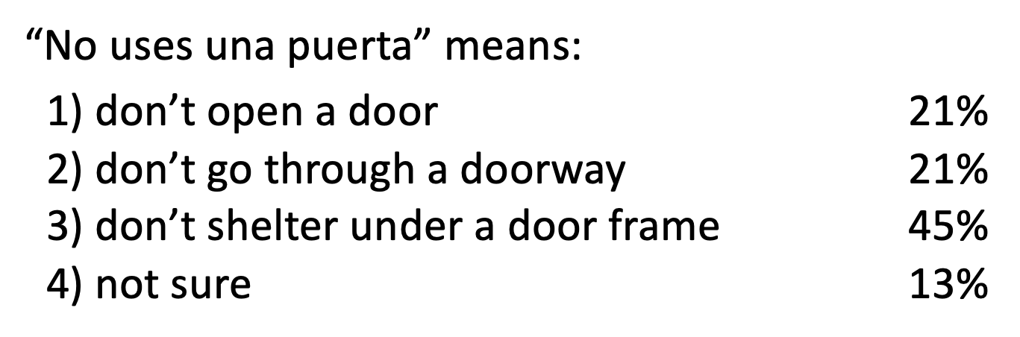
The problem of the door
No uses una puerta a menos que sepas que es una puerta con soporte fuerte…
Notes:
This slide is only for emergencies.

Slide 15

The problem of the door(way)
Have you made a change to this sentence when revising?
Yes: 20% (7 students)
GPT revision: No uses el marco de una puerta [Do not use the frame of a door]
Notes:
This slide is only for emergencies.

Slide 16
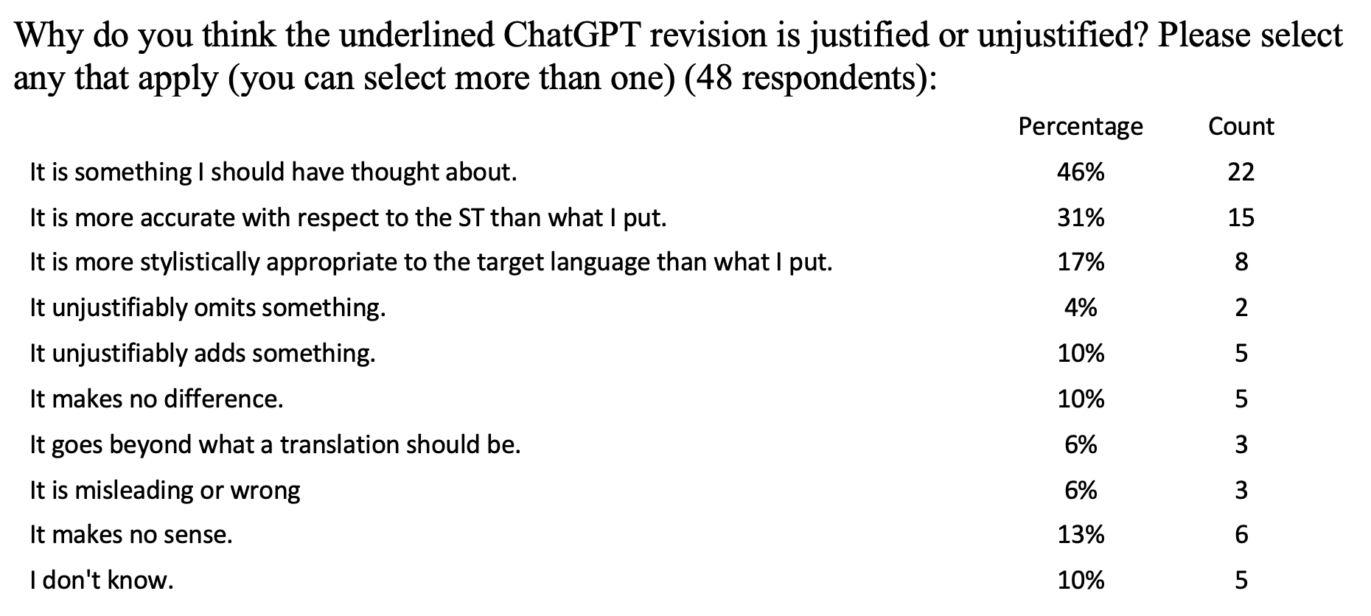
The problem of the door(way)
Notes:
This slide is only for emergencies.

Slide 17
Evaluation of GenAI revision by 48 third-year students
Segment | Change |  |  | No change | Should have…
 | Worse | Similar | Better
1 | 2 | 8 | 1 | 34 | 20
2 | 6 | 5 | 3 | 31 | 5
3 | 0 | 2 | 2 | 41 | 17
4 | 2 | 16 | 3 | 24 | 11
5 | 0 | 4 | 4 | 37 | 22
6 | 2 | 6 | 2 | 35 | 7
7 | 2 | 9 | 1 | 31 | 13
8 | 3 | 2 | 2 | 38 | 13
9 | 9 | 4 | 2 | 30 | 7
10 | 4 | 2 | 4 | 35 | 14
11 | 2 | 3 | 0 | 40 | 8
12 | 4 | 7 | 2 | 32 | 10
13 | 14 | 3 | 2 | 26 | 7
14 | 7 | 9 | 2 | 27 | 11
15 | 1 | 1 | 0 | 43 | 12
16 | 4 | 8 | 6 | 27 | 19
17 | 4 | 1 | 0 | 40 | 13
Total | 66 | 90 | 36 | 571 | 209

Slide 18
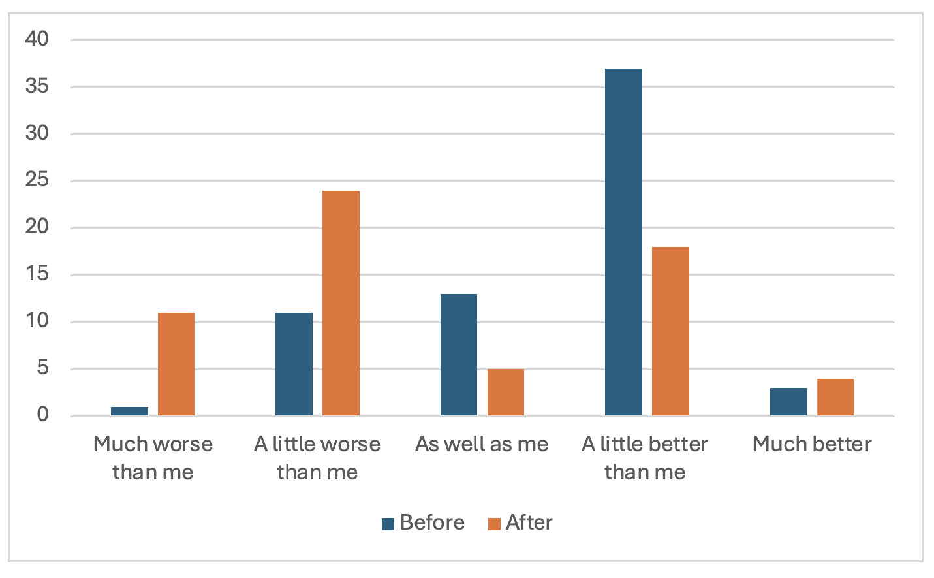
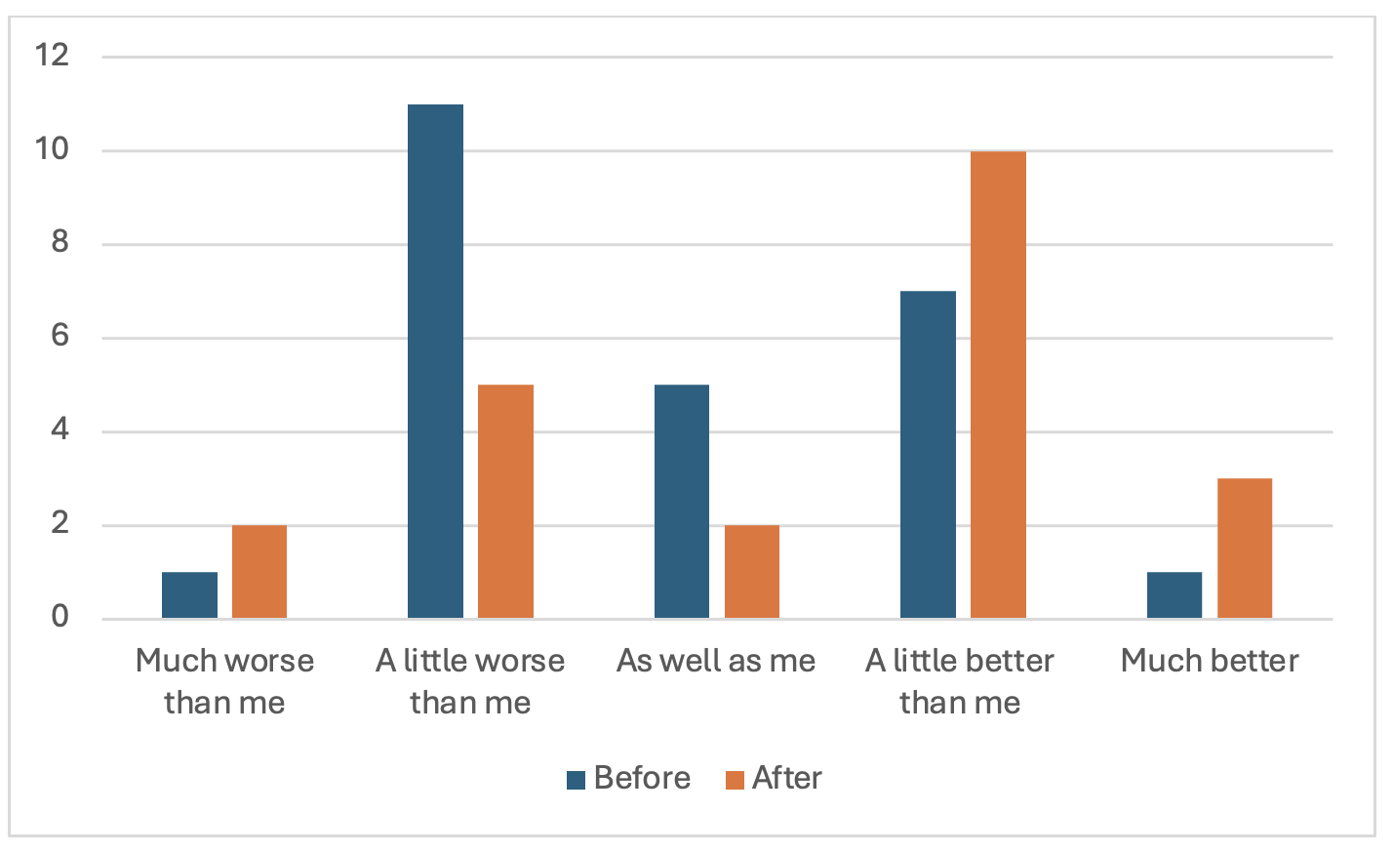
Chinese:
Spanish:
Hao, Y., Ayvazyan, N., & Pym, A. (2024). Augmenting revision skills.
University of Melbourne, Universitat Rovira i Virgili

Slide 19

The translator´s trust in the technology
In the discussion (with Nune Ayvazyan) that followed…
GenAI is misleading:
The perfect combo:
GenAI must be checked:
Most students moved from for/against to a “work with” attitude, with low, vigilant trust.
Notes:
This slide is only for emergencies.

Slide 20

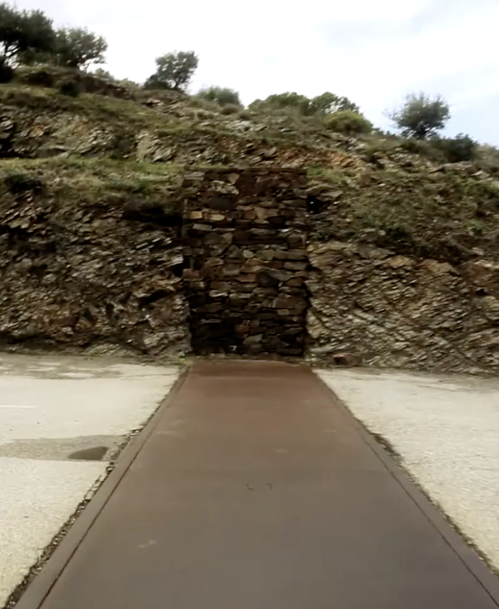
Clues for ways forward…

Slide 21
Clues for ways forward…
Teach translation technologies
Sell trustworthiness rather than words
Emphasize Spoken Communication Skills
Do more than translate
Offer joint programs: Translation and…

