Slide 1
Please describe your research project.

Slide 2
How comfortable are you with saying ‘I’ in your written research report?

Slide 3
Why do we say ‘I’ but not write ‘I’?

Slide 4


1998
2026

Slide 5
Process rather than product.
The particular rather than the general: situatedness rather than the search for laws.
Many variables rather than a few.

Slide 6
Lived experience; 4EA: embodiment, affect, enactment (performance), extendedness, affect, emotions, empathy, trust, authenticity

Slide 7
Complexity
Materiality
Multimedia
Peirce, Bakhtin, Deleuze, Latour

Slide 8
Unfalsifiable theory
Hyper-descriptivism

Slide 9
1. History
2. Importance
3. Lists
4. Working definitions
5. Frequencies
6. Networks
7. Norms and systems
8. Regimes
9. Causes
10. Translators
11. Intercultures
12. Interdisciplinarity
1. What is Translator History?
2. Why Do Translator History?
3. What Do Technologies Do?
4. What Do Translators Do?
5. What Price Big Data?
6. What Are Translation Flows?
7. What Happens in Translator Networks?
8. How Do Translators Differ?
9. How Complex is Translator History?
10. Who Trusts Translators?
11. What Are Translation Policies and Institutions
12. Do Translators Alter Cultures?

Slide 10
1. History
2. Importance
3. Lists
4. Working definitions
5. Frequencies
6. Networks
7. Norms and systems
8. Regimes
9. Causes
10. Translators
11. Intercultures
12. Interdisciplinarity
1. What is Translator History?
2. Why Do Translator History?
3. What Do Technologies Do?
4. What Do Translators Do?
5. What Price Big Data?
6. What Are Translation Flows?
7. What Happens in Translator Networks?
8. How Do Translators Differ?
9. How Complex Is Translator History?
10. Who Trusts Translators?
11. What Are Translation Policies and Institutions
12. Do Translators Alter Cultures?

Slide 11
Research is part of conversations.

Slide 12
What is your population?
How do you sample it?

Slide 13
There are always more data.

Slide 14
You are always selecting.

Slide 15
You need reasons for selecting.

Slide 16
Research question
Hypotheses
Variables
Selection of data
Testing of hypotheses
Each step is a subjective selection!

Slide 17
Allow the data to say no.

Slide 18
Question: Does the world language system cause translation flows?
Hypothesis: Translation flows come from central languages.
Variables: Centrality, flows

Slide 19
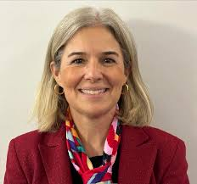
Sample: Literary translations into Portuguese, 1930-1980
Method: Quantification of flows from different languages.
Rosa, A. A. (2017). Rethinking the Hegemony of English in Twentieth-century Portugal:
Some Figures and Beyond. The Translator, 23(4), 441–455.

Slide 21
Hierarchy of the world language system (Swaan, 2001)
Different class locations for main readerships
Merging of publishing companies
Pre-censorship by the Franco regime
Rise of “crime, mystery, detective, and western,” all mostly English-derived, with a surprising number of English-sounding pseudonyms being used by Spanish writers.

Slide 22
Question: How to increase vaccination in superdiverse societies?
Hypothesis: Increase community engagement in translations.
Variables: Vaccinations, translation workflows

Slide 23
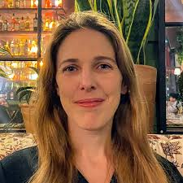
Sample: Translations into Arabic in Melbourne in 2021.
Method: Increase community engagement.
Macreadie, R. (2025). Changing translation practices and policies:
Trust and partnerships in healthcare crisis communication in Melbourne
during COVID-19. PhD thesis. University of Melbourne / KU Leuven

Slide 24


Slide 25
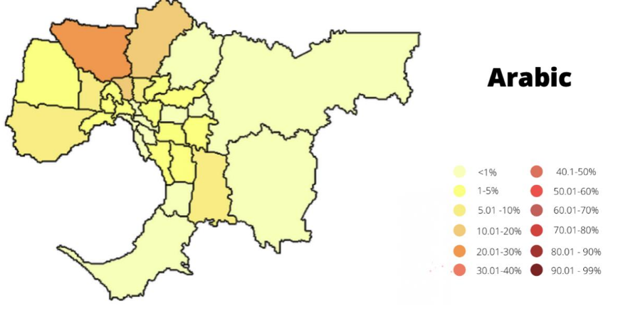

Slide 26
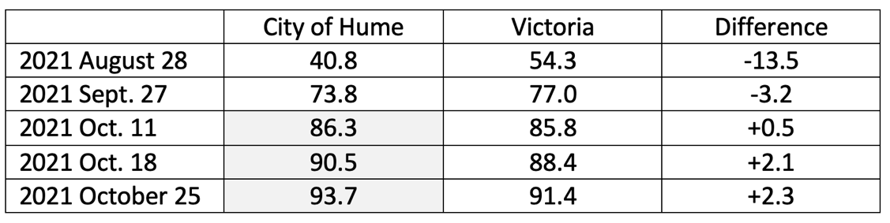
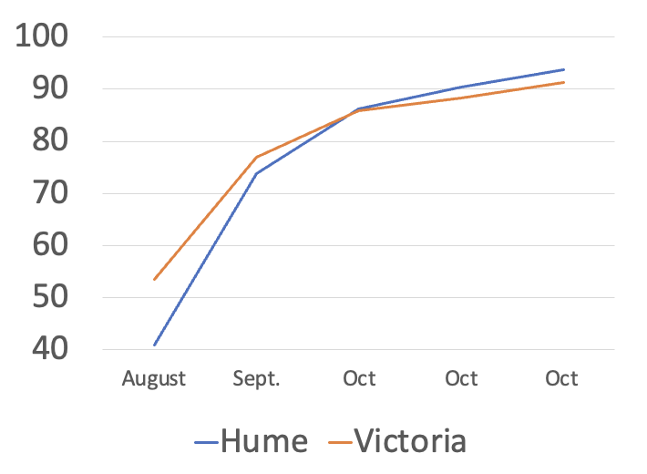

Slide 27
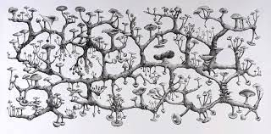
The rate of deaths increases.
Messaging comes from religious and community organizations (“attractor 1”)
Audiovisual messaging comes from medical staff (“attractor 2”)
Anti-vaccination social-media messaging increases.
Press reports increase.
There is debate around family tables.
The energy in the system increases.
Uncertainty increases.
Trust increases.
The number of vaccinations increases.
Even-Zohar, I. (2016). Ideational labor and the production of social energy. Intellectuals, Idea Makers and Culture Entrepreneurs. Culture Research Lab.

Slide 28
Where can you say ‘I’?

Slide 29
When explaining the selection of the topic.
When positioning yourself with respect to others.
When reflecting on your position in the methodology.

Slide 30
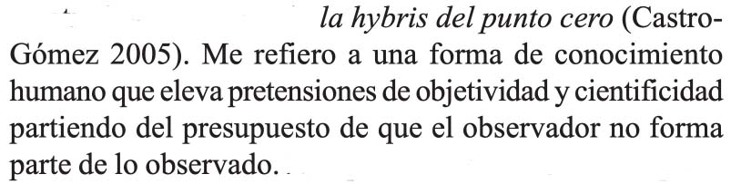
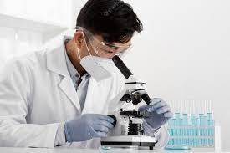
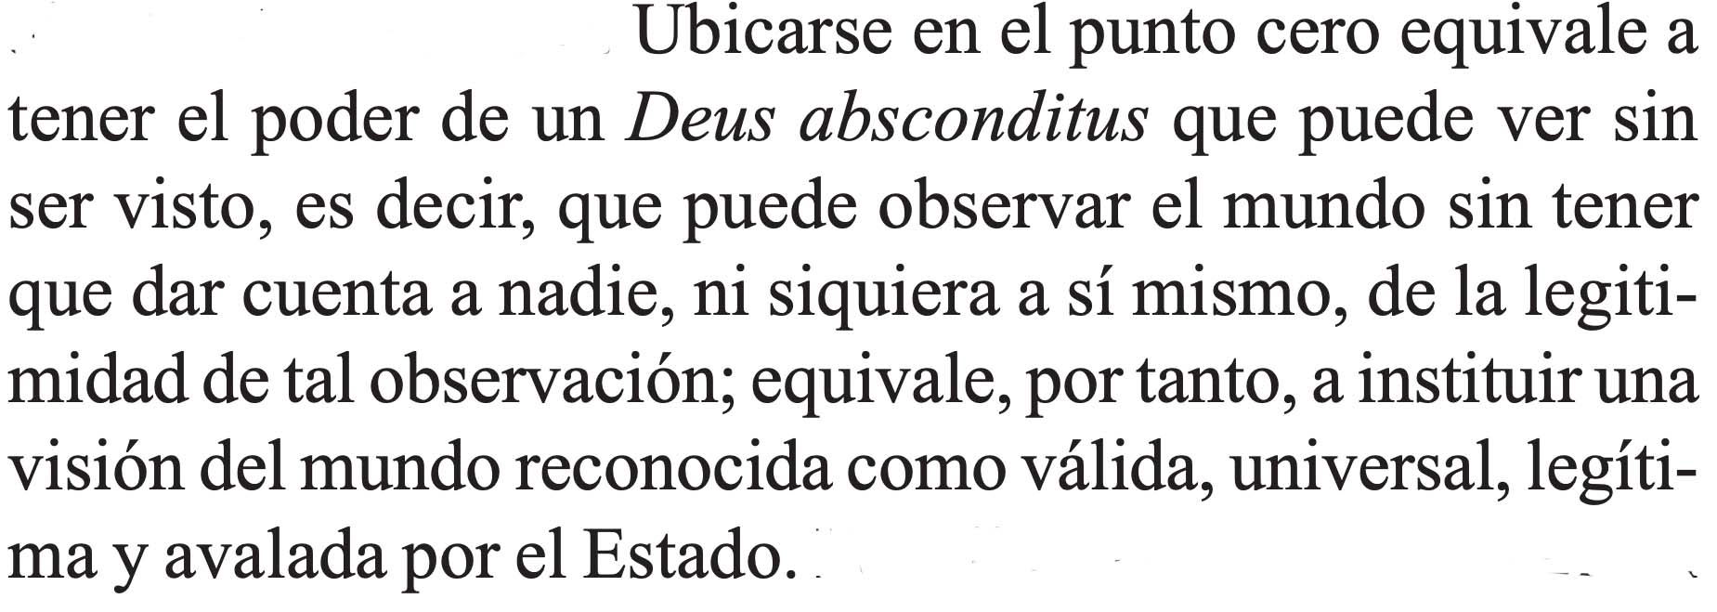
Modernist perspectivism (with thanks to Jorge López)
Castro-Gómez, S. (2005). La Poscolonialidad explicada a los niños. Editorial Universidad del Cauca.

Slide 31
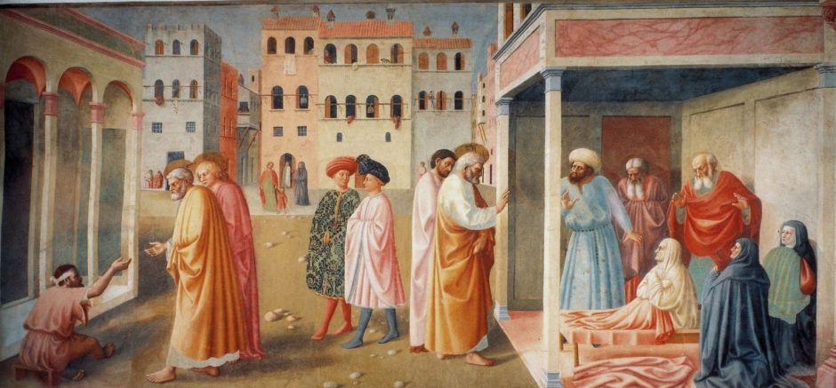
Early Modern perspectivism
Masolino’s ‘St. Peter Healing a Cripple and the Raising of Tabitha’ (1425).

Slide 32
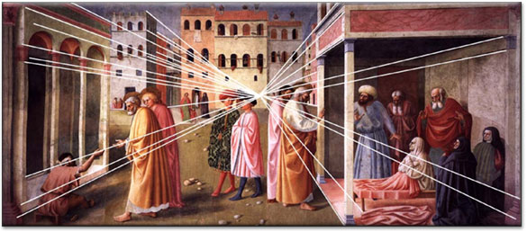
Early Modern perspectivism
Masolino’s ‘St. Peter Healing a Cripple and the Raising of Tabitha’ (1425).

Slide 33
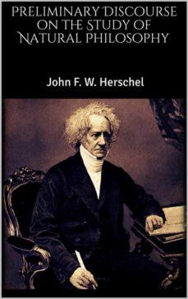
Modernist perspectivism
“Science is the knowledge of many, orderly and methodically digested and arranged, so as to become attainable by one.“
John Herschel, A Preliminary Discourse on the Study of Natural Philosophy (1831)
Ray, C. R. (2004). Imperialism and empiricism: Science and state in the age of empire. Doctoral thesis, Duke University

Slide 34
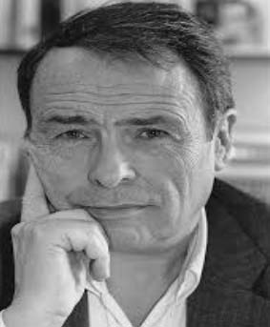
An empiricism with involvement
“The possibilities of helping to produce truth depend on two main factors: the interest one has in having the truth known (or inversely, in hiding it from others and from oneself) and the capacity one has to produce it. As Bachelard put it, there can only be a science of that which is hidden. Sociologists are best armed to dis-cover what is hidden when they have the best scientific weapons, when they best use the concepts, methods and techniques developed by their predecessors […]. And they are most “critical” when their conscious or unconscious intention is most subversive, when they are most interested in revealing that which is censored or suppressed in the social world.” (1980, 22-23, italics in the text)
Bourdieu, Pierre. 1980. “Une science qui dérange.” Interview with Pierre Thuillier,
La Recherche 112 (June 1980). Reprinted in Questions de sociologie. Paris: Minuit. 19-36

