Slide 1

Triage and reception in multilingual crisis communication
Some basics of risk management
Anthony Pym

Slide 2
Two separate questions
If you want to work for governments…
… you have to talk the talk of policies.
If you want to talk about translation policies now…
… you have to talk about AI.

Slide 3
The wrong starting point: Justify a position
GenAI does not have…
Authentic language
Knowledge of receivers
Creativity
Real understanding
Cultural nuances / empathy / emotions
Respect for intellectual property
To demonstrate this:
Do not use prompts or fresh data
Test isolated sentences and phrases
Compare with a very creative human, and don’t touch the temperature
Use academic authorities
Forget how children learn to express empathy and emotions.
Forget how languages change.

Slide 4
What did automation ever do for us?
  Recall and revise your previous translations
  Give alternative translations to choose between
  Reduce alternative proposals as you type
  Adjust a translation when you make a change
  Align your previous translations
  Pre-edit the start text (for plain language)
  Adapt the translation to specific readerships
  Exchange notes with other translators
  Speech to text: Speak your translations
  Text to speech: Read your translation back to you
  Revise your translation for spelling and punctuation
  Revise your translation for grammar
  Revise your translation for readability
  Revise your translation for a specific reader or purpose
  Evaluate translations
  Extract and manage your terminology
  Give notes on terms in context
  Provide background information quickly
  Propagate translation choices
  Record your translation preferences
  Check for consistency in numbers, terms, and formatting

Slide 5
What did automation ever do for us?
  Recall and revise your previous translations
  Give alternative translations to choose between
  Reduce alternative proposals as you type
  Adjust a translation when you make a change
  Align your previous translations
  Pre-edit the start text (for plain language)
  Adapt the translation to specific readerships
  Exchange notes with other translators
  Speech to text: Speak your translations
  Text to speech: Read your translation back to you
  Revise your translation for spelling and punctuation
  Revise your translation for grammar
  Revise your translation for readability
  Revise your translation for a specific reader or purpose
  Evaluate translations
  Extract and manage your terminology
  Give notes on terms in context
  Provide background information quickly
  Propagate translation choices
  Record your translation preferences
  Check for consistency in numbers, terms, and formatting

Slide 6
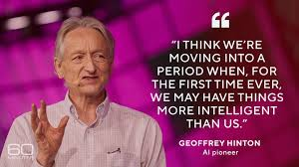

A totalizing threat?

Slide 7

The starting point: deep uncertainty
“Just try to quantify the social impacts of generative AI in 25 years’ time. This has become known as ‘deep uncertainty’. Of course, this assumes that people have the insight and humility to admit what they don’t know.”
“[without humility] This arrogance has been termed meta-ignorance, when they don´t know what they don’t know.”
Spìegelhalter, D. (2024). The Art of Uncertainty. Pelican (audiobook).
Notes:
The problem is not mind vs. machine
It is not about ethical control over automation vs. use of automation for profit.
It is about what trained professionals can do in an age where their basic skills are within reach of all.
To ask that question properly, I will look at some bad ways of answering it, then at the history of translation automation.

Slide 8

The next step: empirical exploration
Notes:
The problem is not mind vs. machine
It is not about ethical control over automation vs. use of automation for profit.
It is about what trained professionals can do in an age where their basic skills are within reach of all.
To ask that question properly, I will look at some bad ways of answering it, then at the history of translation automation.

Slide 9
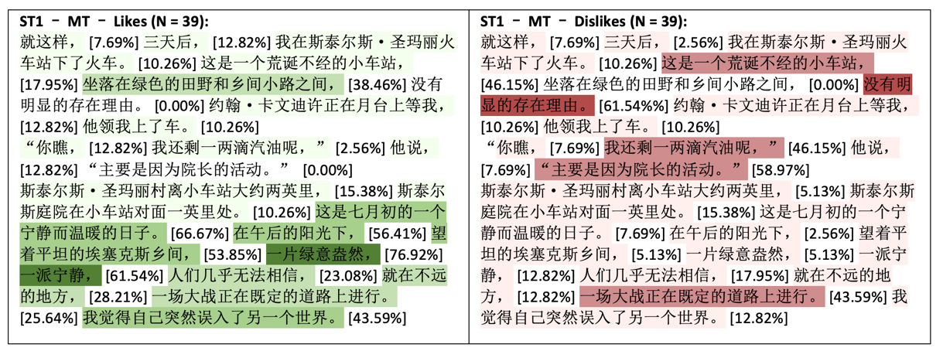
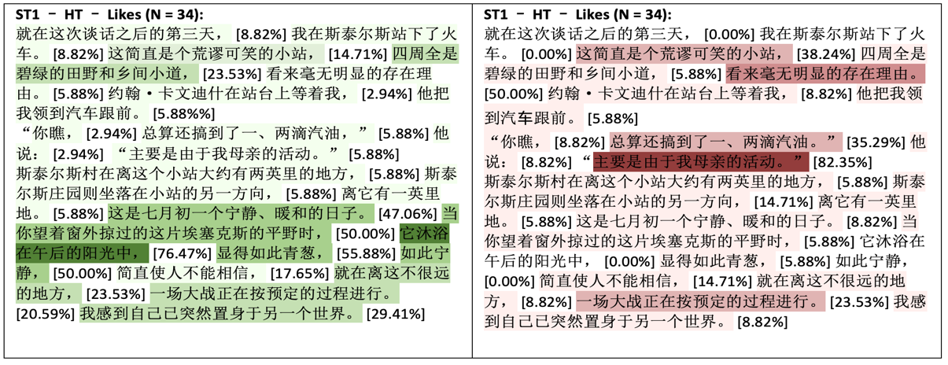
Annotation heatmaps (research by Ke Hu)
Instruction:
In this text, please mark the parts you like in green and mark the parts you dislike in red.
(One of these is raw NMT, the other is unaided.)
Hu Ke (2022). Comparing the Quality of Machine and Human Translation of Literary Texts Using Reader-based Evaluation Methods. PhD thesis. University of Melbourne

Slide 10
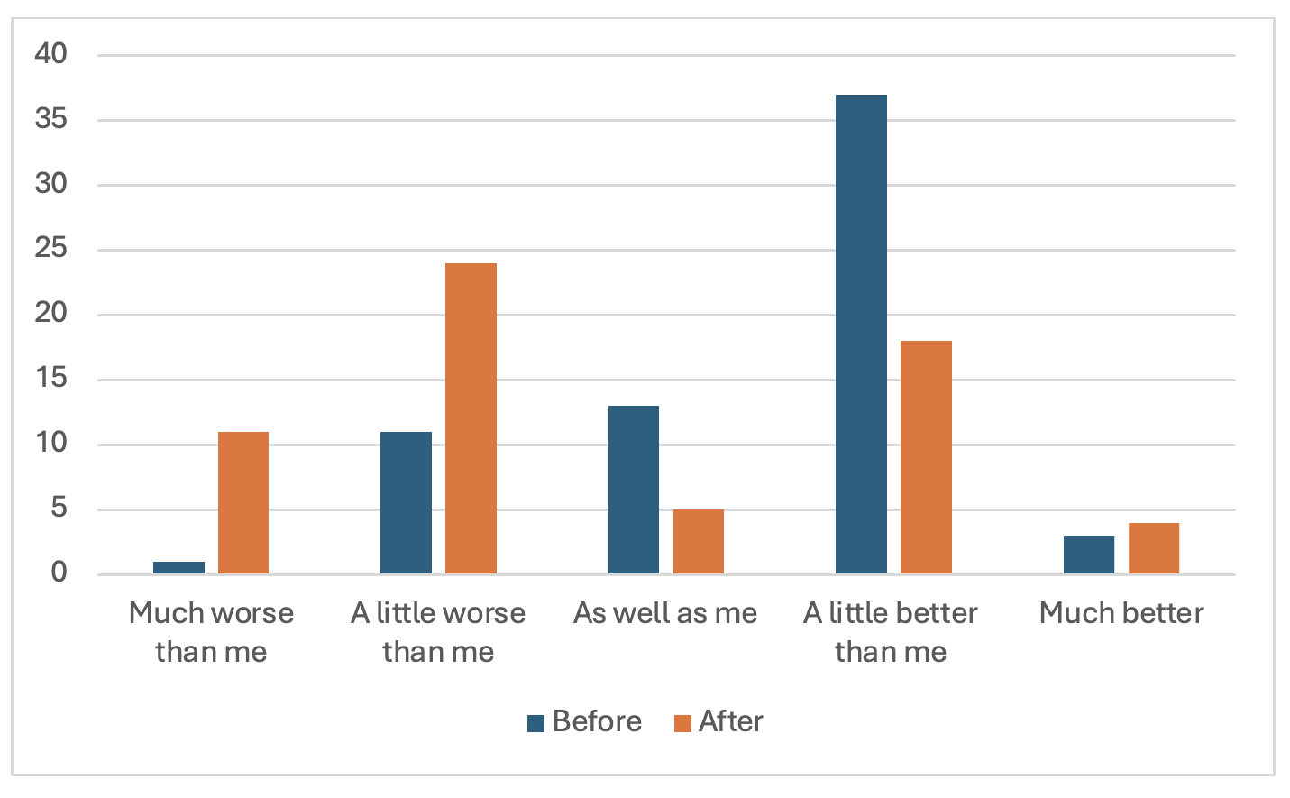
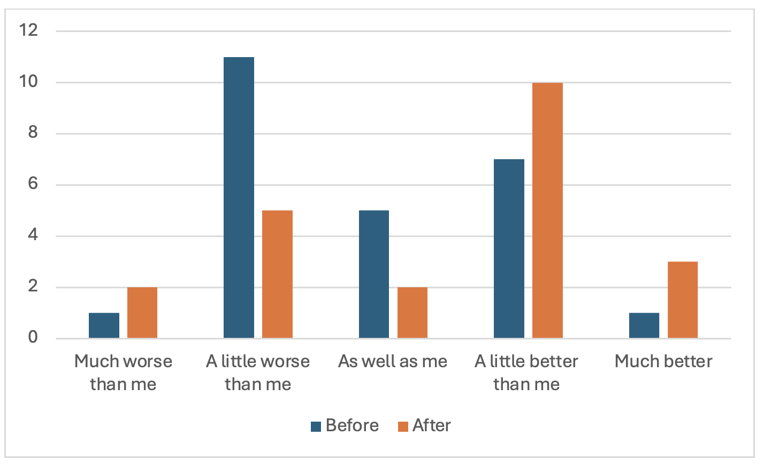
Chinese:
Spanish:
Hao, Y., Ayvazyan, N., & Pym, A. (2024). Augmenting revision skills.
University of Melbourne, Universitat Rovira i Virgili

Slide 11


Where is translation policy?
Human rights
Language rights
Language policy or planning
Translation policy
Translation practice
Reine Meylaerts: ”No language policy without translation policy.”
Gabriel González-Núñez: “Translation policy as management, practice and beliefs.”

Slide 12

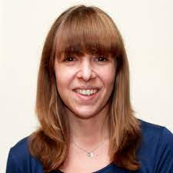
Where is translation policy?
Wine Tesseur (2023):
“… critical questions around the ways in which translation can redress power dynamics between INGOs and the people they work with, and the role of activist researchers in contributing to these debates”
At Oxfam and Trias Belgium:
“We have a translation policy but no language policy.”

Slide 13
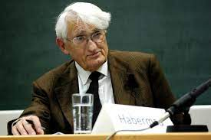
What do we have a right to?
Habermas: The citizen has a right to participation in public space, to “feel they are co-authors of the laws”:
Right to cultural practices that do not reduce public space
Right to pay to the state and receive services from the state
No right to have their language used by the state
More than 7,100 languages in the world. The cost of providing a service cannot be more than the value of the service.

Slide 14
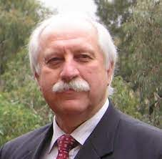
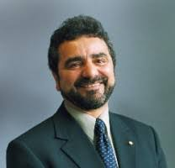
Translation policy without language policy
1950s: European immigration
1973: Free telephone interpreting
1975: Henderson Report: Language problems as a cause of poverty. (cf. Gentile 2018)
1977: National Accreditation Authority for Translators and Interpreters 1987: National Language Policy:
“Interpreting and translating ought to be regarded as an aspect of service provision in Australia rather than a welfarist program for the disadvantaged” (LoBianco 1987)

Slide 15
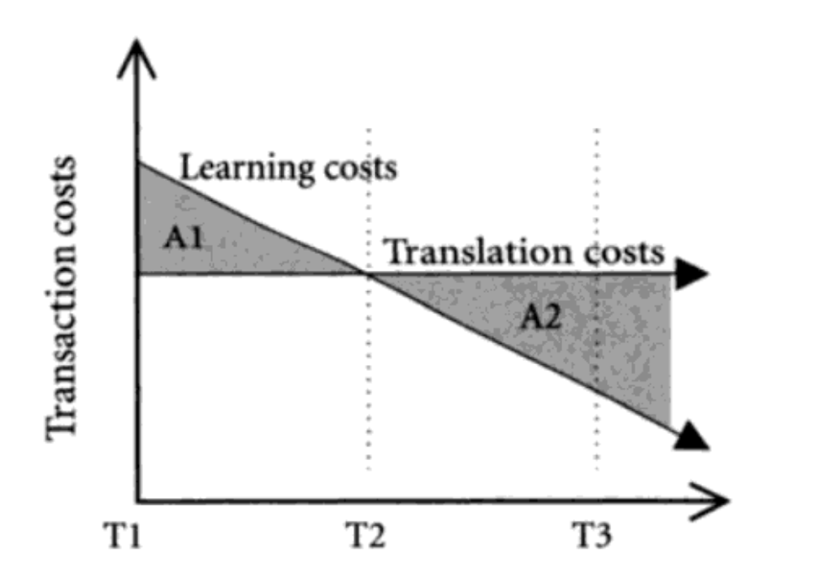
Short-term vs. long-term translation costs

Slide 16

Does everything have to be in a policy?
Ozolins (2000, 2010):
no service
ad hoc services
generic language services (e.g. telephone interpreting)
“comprehensiveness”

Slide 17
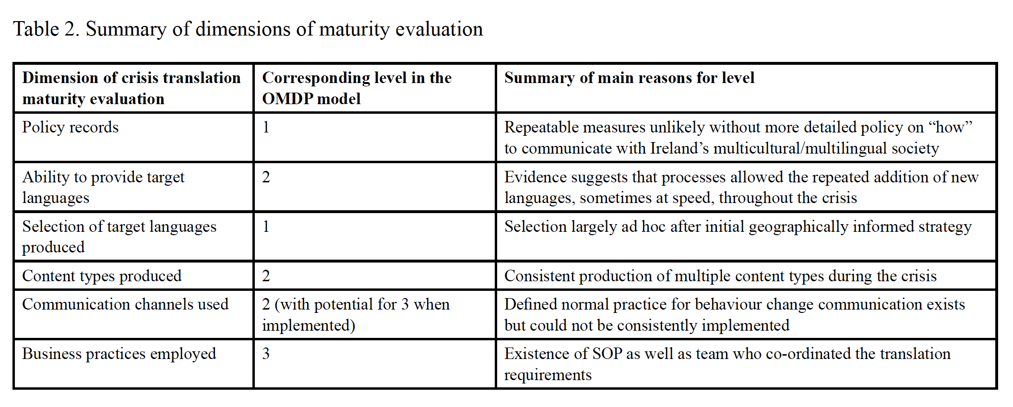
OMPD policy maturity model (O’Brien and Cadwell 2022)

Slide 18
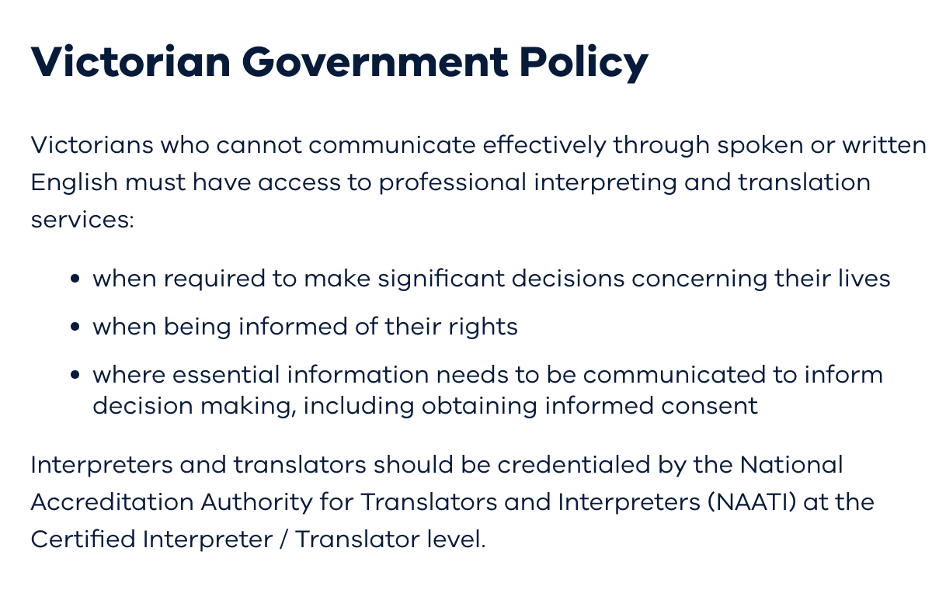
Multilingual communication policy in Victoria

Slide 19
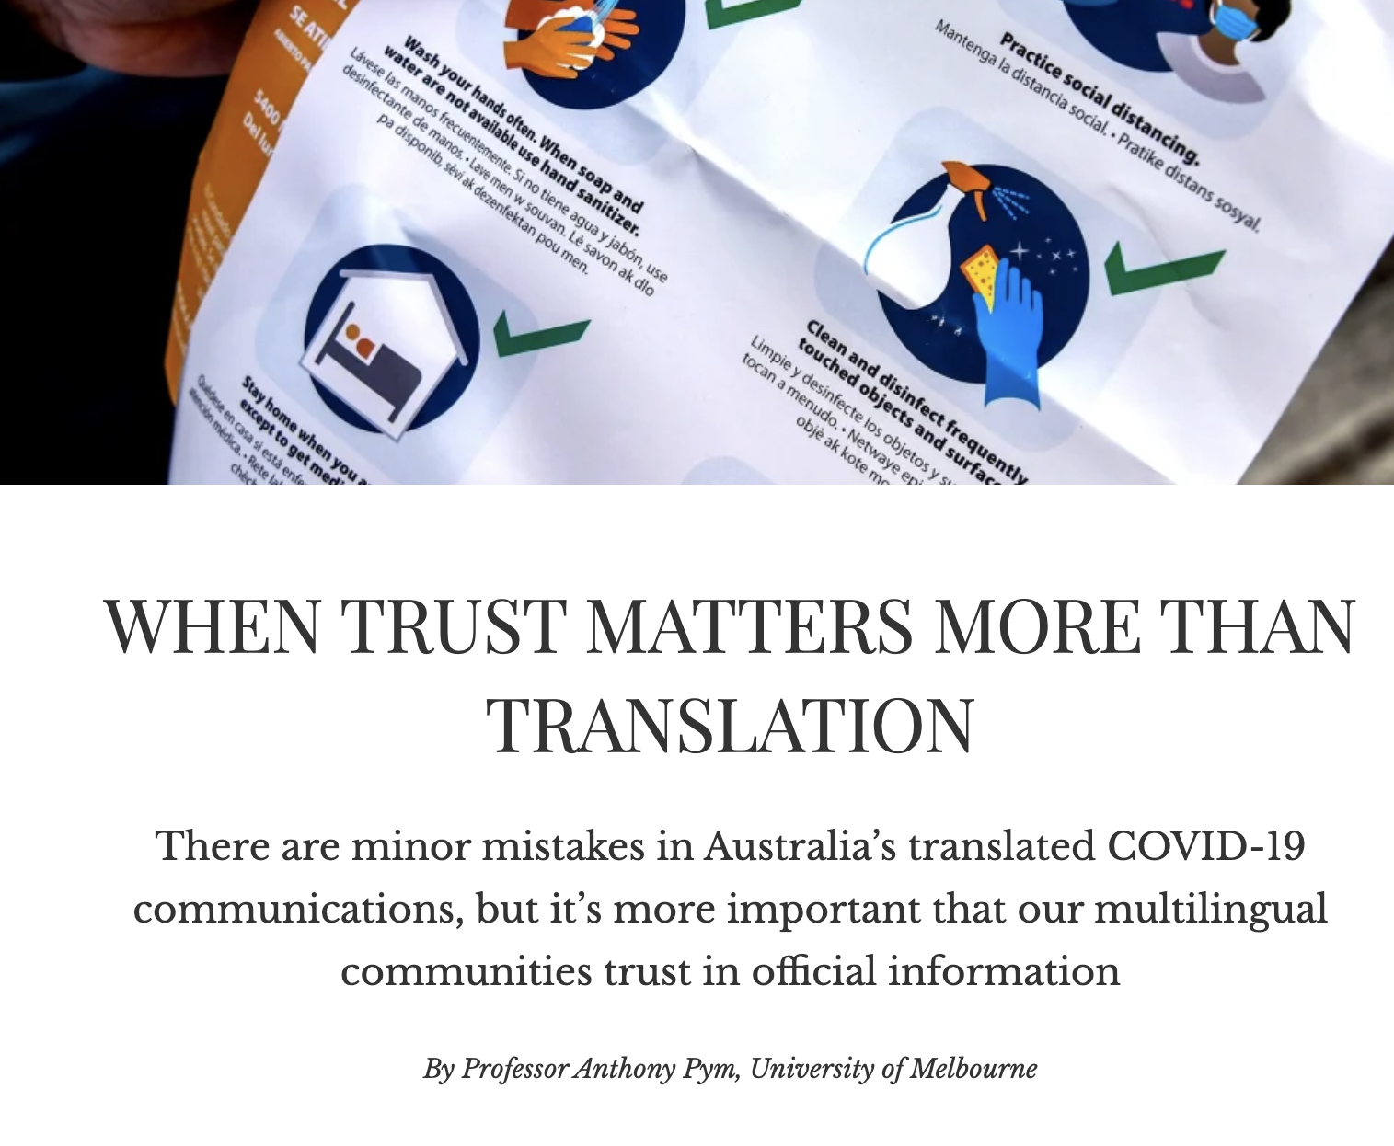
What we learned from COVID
Official translations were slow and error-prone
Move to re-narration by community leaders and medical staff.
Languages were selected by local language communities
Decisions about practice were moved from policy to practice

Slide 20
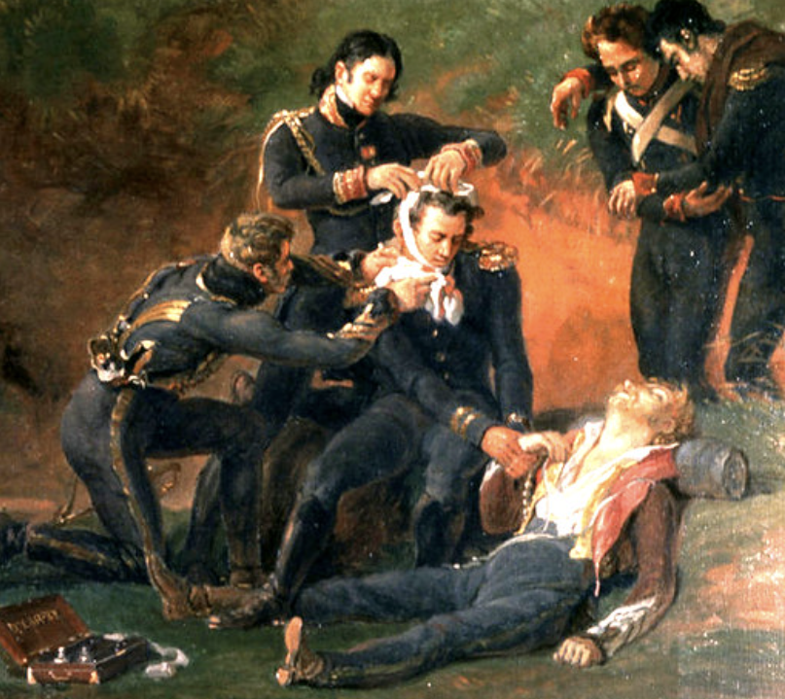
How to select languages: triage (after Dominique-Jean Larrey)
If the purpose is high-stakes, what are the risks of failure?
For whom is that risk the greatest?
What languages and discourses are most likely to affect those people?
Which communication channels are most likely to reach those people?
What material and financial resources are available?
How much time is available?
What combinations of resources and time are possible?

Slide 21
All workflows have their time and place
Raw machine translation
Light post-editing
Heavy post-editing
A translation memory suite
Fully human translation with no revision
Collaborative translation by a group of volunteers
Collaborative translation by a group of professionals from different areas of knowledge
Fully human translation with revision and review
Testing with a sample of end-users
Post-test revision and review
Re-narration

Slide 22

Should automation be used?
Yes, if and when appropriate preparations have been made.

Slide 23
Some basic preparations
Some pressure:
At-risk languages identified
  Use controlled writing to produce clear templates in English.
  Test machine translations in main languages.
  Do pre-editing in major languages.
No pressure:
Time to prepare
  Employ professionals to translate templates into at-risk languages.
  Create translation memories and glossaries from the human translations.
  Produce machine translations aided by pre-editing, translation memories and glossaries.
  Post-edit the machine translations.
  Revise the machine translations in generative AI.
Some urgency
Urgency
Use machine translations, if and when the above preparations have been made and a community mediator can check and explain the text to users.
Last resort
Use machine translations, if and when the above preparations have been made.

Slide 24
Does this replace translators?
The work of translators is displaced to pre-translation processes.

Slide 25
What is new in genAI?
Solutions at text level (second-person pronouns).
Preparation of texts in clear language.
Revision in terms of target-side usage.
Suggestions for intersemiotic translation.

Slide 26

A logic of trade-offs

