Slide 1

Research questions, hypotheses, and why data go beyond them
Anthony Pym
Università per Stranieri di Siena, May 28, 2026

Slide 2
To see where we are….
If you are motivated, then you bring in your own ideologies, expectations, and desires.
If you are doing research, you offer knowledge that is of use to all and can be applied in many situations.
So how do we fit between subjectivity (motivation) and inter-subjectivity (knowledge for all)?
(Do you use the first-person singular when you write?)

Slide 3

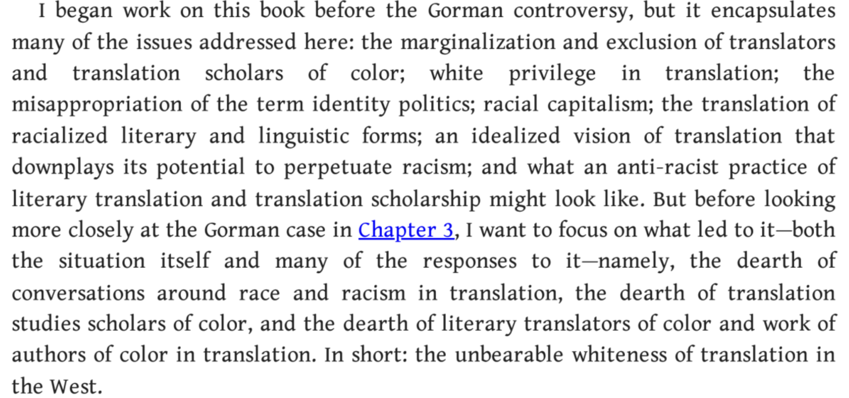
An example….

Slide 4
To see where we are….
Not a simple opposition between ESP and LAP (Gile).
A third option looms…

Slide 5
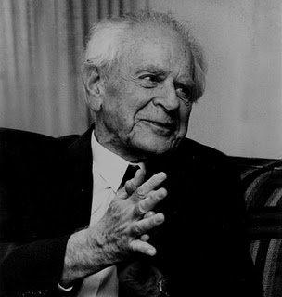
What is strong empiricism?
You ask a research question.
You formulate possible answers to that question (hypotheses) on the basis of conceptual analysis.
You collect data pertinent to the hypotheses.
You test the validity of the hypotheses on the basis of the data.
You reformulate the hypotheses.
You get more data.
You reformulate the hypotheses.
Etc.
Knowledge is the set of discarded hypotheses (Popper).

Slide 6
What is strong empiricism?
You ask a research question.
You formulate possible answers to that question (hypotheses) on the basis of conceptual analysis.
You collect data pertinent to the hypotheses.
You test the validity of the hypotheses on the basis of the data.
You reformulate the hypotheses.
You get more data.
You reformulate the hypotheses.
Etc.
Knowledge is the set of discarded hypotheses (Popper).
Can MT be used for crisis communication?
Yes, raw / Only when post-edited / Never
Do translations and have them evaluated by prospective users.
See when MT works and when it doesn’t.
Try fixed glossaries and translation memories.
Test those translations.
Try simplifying start texts.
Test those translations…
We will know when MT fails and we will have some strategies for improving it.

Slide 7
What is strong empiricism? (A classical thesis structure)
You ask a research question.
You formulate possible answers to that question (hypotheses) on the basis of conceptual analysis.
You collect data pertinent to the hypotheses.
You test the validity of the hypotheses on the basis of the data.
You reformulate the hypotheses.
You get more data.
You reformulate the hypotheses.
Etc.
Knowledge is the set of discarded hypotheses (Popper).
Introduction (question)
Literature review (old answers)
Methodology (how to get new answers)
Hypotheses
Variables
Operationalization
Results (Data)
Discussion (test hypotheses on data; relate findings to literature review)
Conclusion (findings, limitations, new hypotheses)

Slide 8
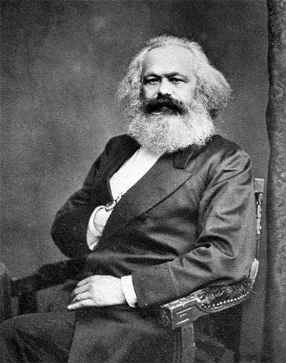
What is dialectical empiricism (to risk a characterization)?
You set out to show what your group thinks is ethical or true and yet concealed.
You gather illustrations of what you think is unethical or untrue.
You show how the unethical or untrue can be revealed and corrected.
You urge others to do the same.
Optional step: You formulate a call to action beyond research.
Knowledge comes when you try to change the world (“es kommt aber darauf an…”)

Slide 9
What is dialectical empiricism (to risk a characterization)?
You set out to show what your group thinks is ethical or true and yet concealed.
You gather illustrations of what you think is unethical or untrue.
You show how the unethical or untrue can be revealed and corrected.
You urge others to do the same.
Optional step: You formulate a call to action beyond research.
Knowledge comes when you try to change the world (“es kommt aber darauf an…”)
Translators in the US try to be invisible.
Invisibility leads to low pay, low social status, few translations and xenophobic culture.
Visible translators can change all of that.
Denounce invisibility!
Translators of the world, be visible!

Slide 10
What is dialectical empiricism (to risk a characterization)?
You set out to show what your group thinks is ethical or true and yet concealed.
You gather illustrations of what you think is unethical or untrue.
You show how the unethical or untrue can be revealed and corrected.
You urge others to do the same.
Optional step: You formulate a call to action beyond research.
Knowledge comes when you try to change the world (“es kommt aber darauf an…”)
Introduction (the idea to be demonstrated)
Theory (concepts and history of the idea)
Application of theory 1
Application of theory 2
Application of theory 3
…
Conclusion (optional call to action)

Slide 11

How much data?
Positivism: Data produce truth.
Induction: Data correct bad ideas.
Deduction: Clear, falsifiable ideas tell us which data to collect.
Activism: Data demonstrate an argument.
The question is not just how much data, but what is the role of ideas and motivations.

Slide 12
Kinds of data
Quantitative: numbers
Qualitative: language
Mixed methods: both
In the humanities, quantitative data alone will not indicate causation.

Slide 13
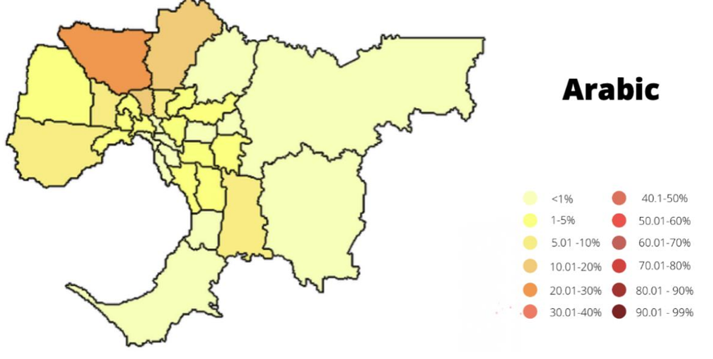
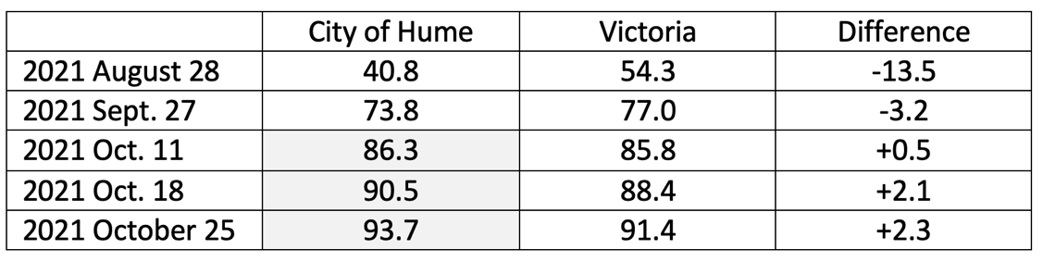
Spot the cause
When I get on a plane, the earth’s water levels rise.
When I get vaccinated, the community’s wellbeing is enhanced.
When translation is community-based, vaccination increases.

Slide 14
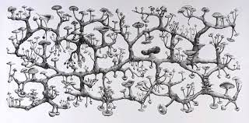
Rhizomatic causation
The rate of deaths increases.
Messaging comes from religious and community organizations (“attractor 1”)
Audiovisual messaging comes from medical staff (“attractor 2”)
Anti-vaccination social-media messaging increases.
Press reports increase.
There is debate around family tables.
The energy in the system increases.
Uncertainty increases.
Trust increases.
The number of vaccinations increases.
Macreadie, R. (2022-25) Doctoral project: ““Language is (not) a barrier”: Towards
effective translation policies and practices for official communication with
culturally and linguistically diverse (CALD) communities in linguistically superdiverse
cities”. University of Melbourne / KU Leuven.
Even-Zohar, I. (2016). Ideational labor and the production of social energy.
Intellectuals, Idea Makers and Culture Entrepreneurs. Culture Research Lab.

Slide 15

Can I trust the facts? – Spencer to Frazer, 1903
“Doch scheint aus der Verwandtschaft dieser Wörter Altjira (Gott) und altjirerama (träumen) hervor zu gehen, dass ihr Gott ihnen mehr ein traumhaftes Wesen ist sogleich er wie gesagt Realität besitzt.“
Pym, A. (2023). Translating the Indigenous. Carl Strehlow’s Word for God
in Central Australia. Chronotopos - A Journal of Translation History, 4(1), 11–29.

Slide 16
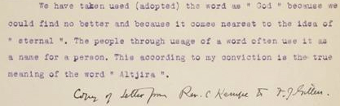
Can I trust the facts? – Kempe to Francis Gillen, undated

Slide 17
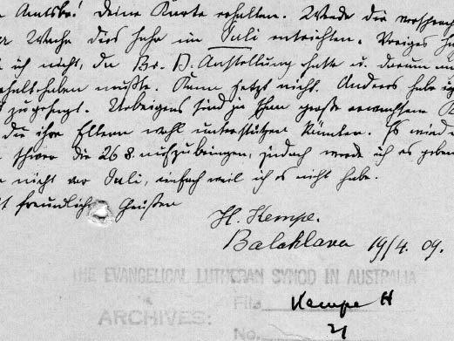
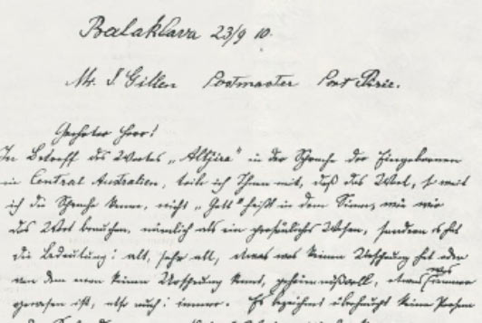
Can I trust the facts? – Kempe 1909, 1910
Strehlow, J. (2020). False Witness: Was Walter Baldwin Spencer
a forger and a fraud?, The Australian 10 November, 12.

Slide 18

Can I trust the facts?
Every text is transmitted in search of gain.
Every translator needs to be trusted.
Every translator preface is an appeal to trustworthiness.
The historian may choose to trust or not, as in a conversation.
Rizzi, A., Lang, B., and Pym, A. (2019). What is translation history?, Palgrave Macmillan
Pym, A. (2020). Trust-based translation history. Guideline questions and an illustration.
Chronotopos, 2, 146-160. https://doi.org/10.25365/cts-2020-2-1-6.

Slide 19

An epistemology without data
Bullshit is related to, but distinct from, lying; the liar tells untruth, the bullshitter aims to convey a certain impression of themselves without being concerned about whether anything at all is true.
Harry Frankfurt, On bullshit (2005)
Within organizations bullshitting is considered to be a social practice that people engage with to become part of a speech community, to get things done in that community, and to reinforce their identity.
André Spicer, Playing the Bullshit Game: How Empty and Misleading Communication Takes Over Organizations (2020)

Slide 20
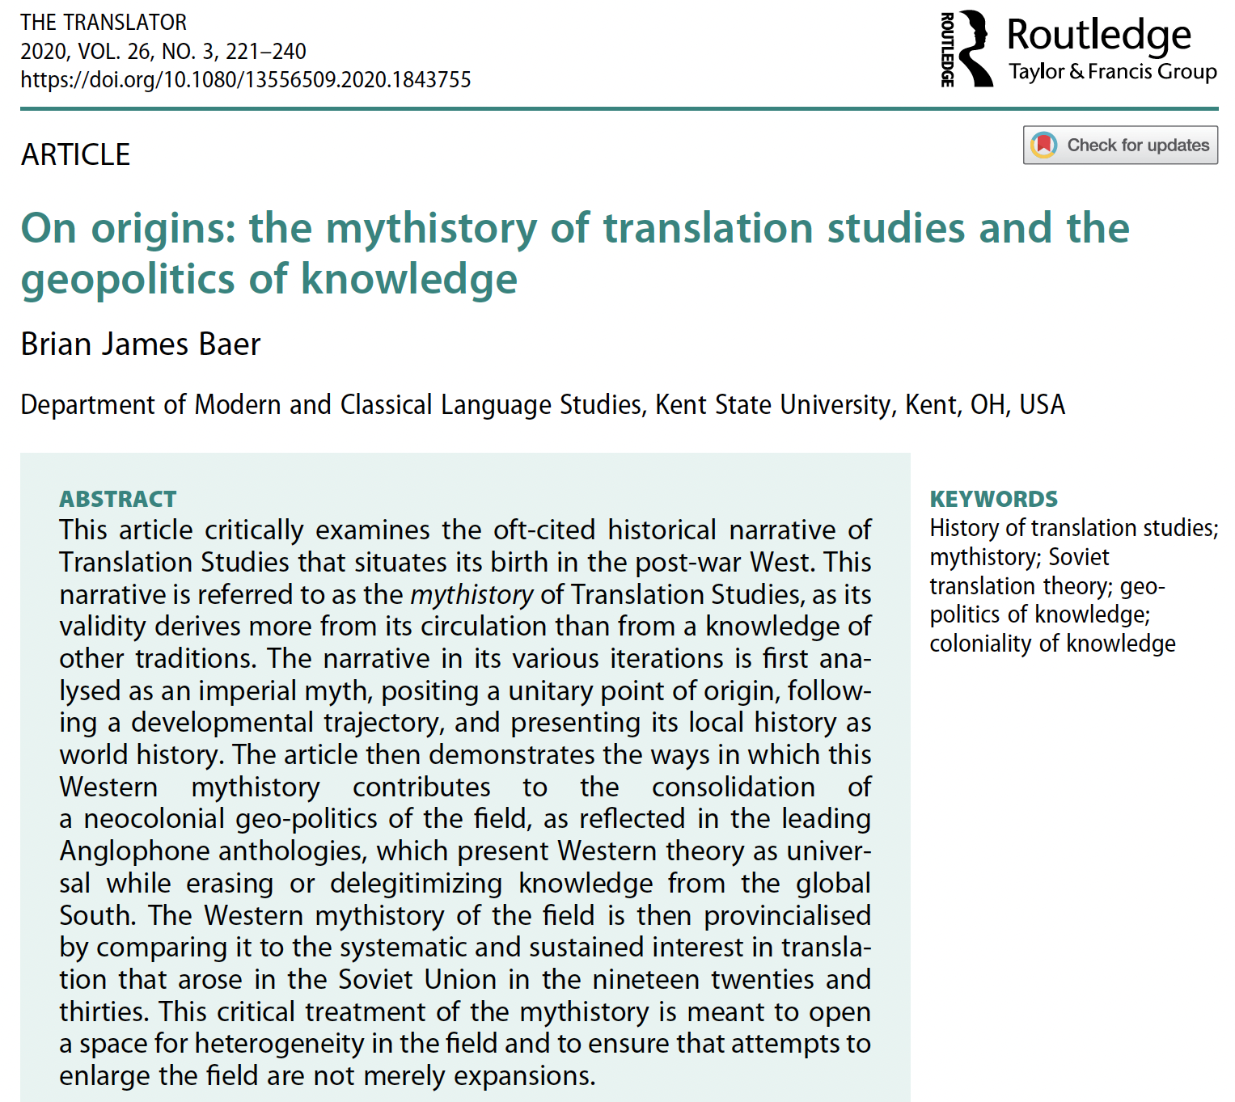
Empiricism is bad?
Pym writes: ‘Translation Studies started to take shape as an academic discipline. That history is extremely important’ (2010, 64). The importance that Pym, the then President of the European Society of Translators, ascribes to that history is linked to his deep investment in the consolidation of Translation Studies as an independent discipline. The value of Pym’s iteration of the originary myth of the field, while no less Eurocentric than the others, and perhaps in some ways more so, lies in the fact that it is easily quantifiable.

Slide 21
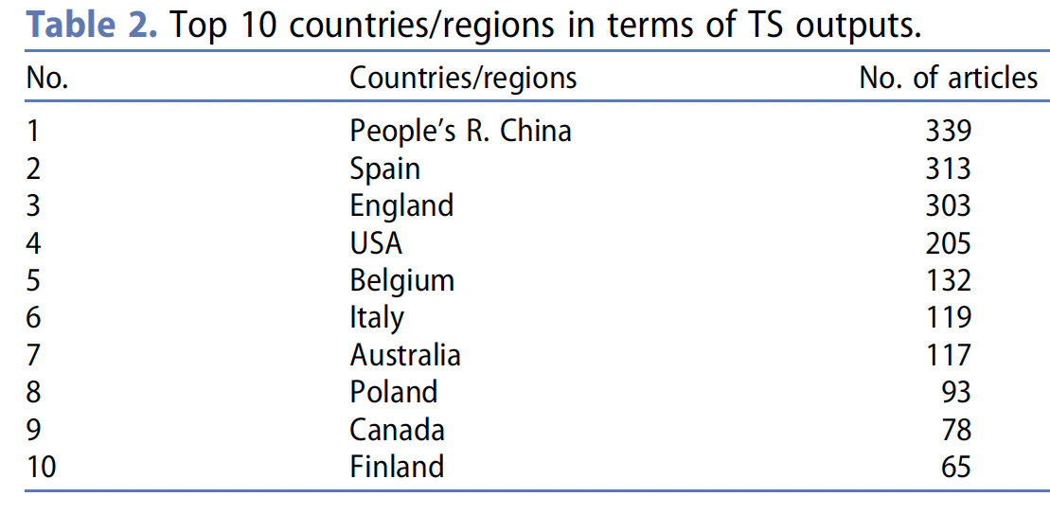
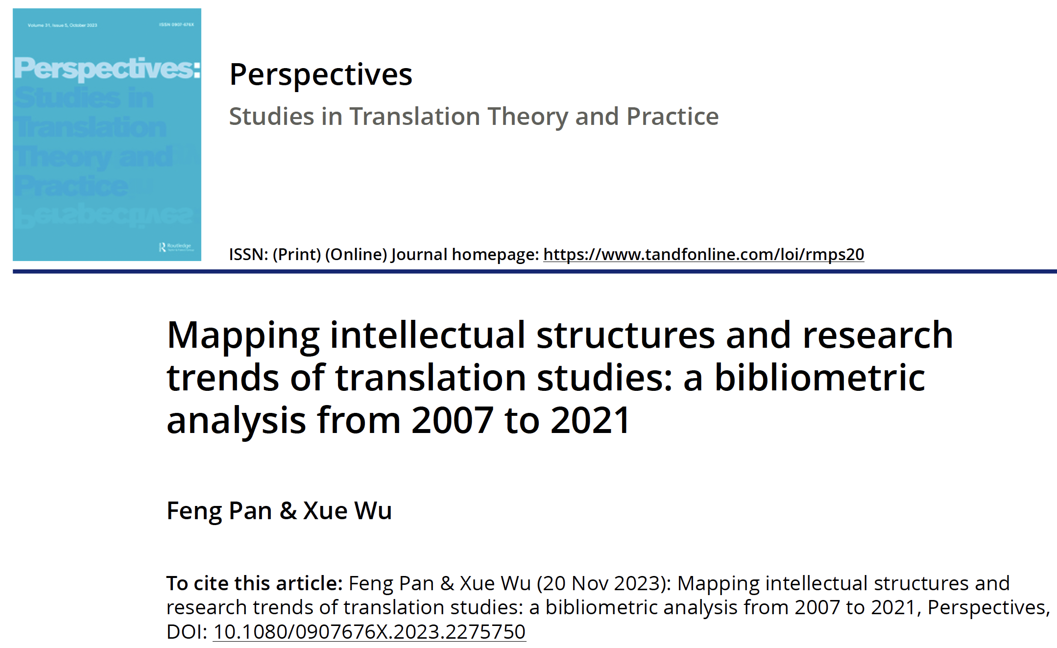
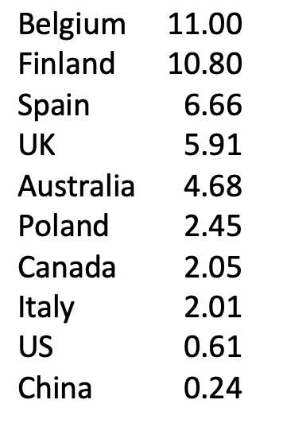
And if you want to talk about race….
Publications divided by population

Slide 22
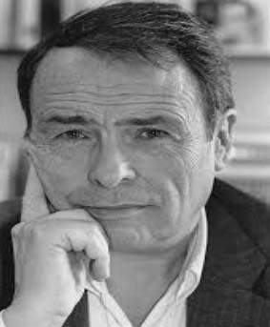
An empiricism with involvement
“The possibilities of helping to produce truth depend on two main factors: the interest one has in having the truth known (or inversely, in hiding it from others and from oneself) and the capacity one has to produce it. As Bachelard put it, there can only be a science of that which is hidden. Sociologists are best armed to dis-cover what is hidden when they have the best scientific weapons, when they best use the concepts, methods and techniques developed by their predecessors […]. And they are most “critical” when their conscious or unconscious intention is most subversive, when they are most interested in revealing that which is censored or suppressed in the social world.” (1980, 22-23, italics in the text)
Bourdieu, Pierre. 1980. “Une science qui dérange.” Interview with Pierre Thuillier,
La Recherche 112 (June 1980). Reprinted in Questions de sociologie. Paris: Minuit. 19-36

Slide 23
A plea and some recommendations
Confront bullshit by asking “How do you know?”
Use whatever model communicates best in your discipline.
Be aware of your motivations and limitations.
State your motivations.
Confess initial ignorance.
Test your hopes and desires on the basis of evidence.
If “uncertainty” doesn’t sell, try “self-discovery”.

