Slide 1
The impact of genAI on (student) translators
Managing uncertainties
Università per Stranieri di Siena, May 27, 2026
Research carried out as part of the project Alfabetizaciones y ocupación en la era digital (Spanish Ministry of Science and innovation, PID2021-122575NB-I00).

Slide 2
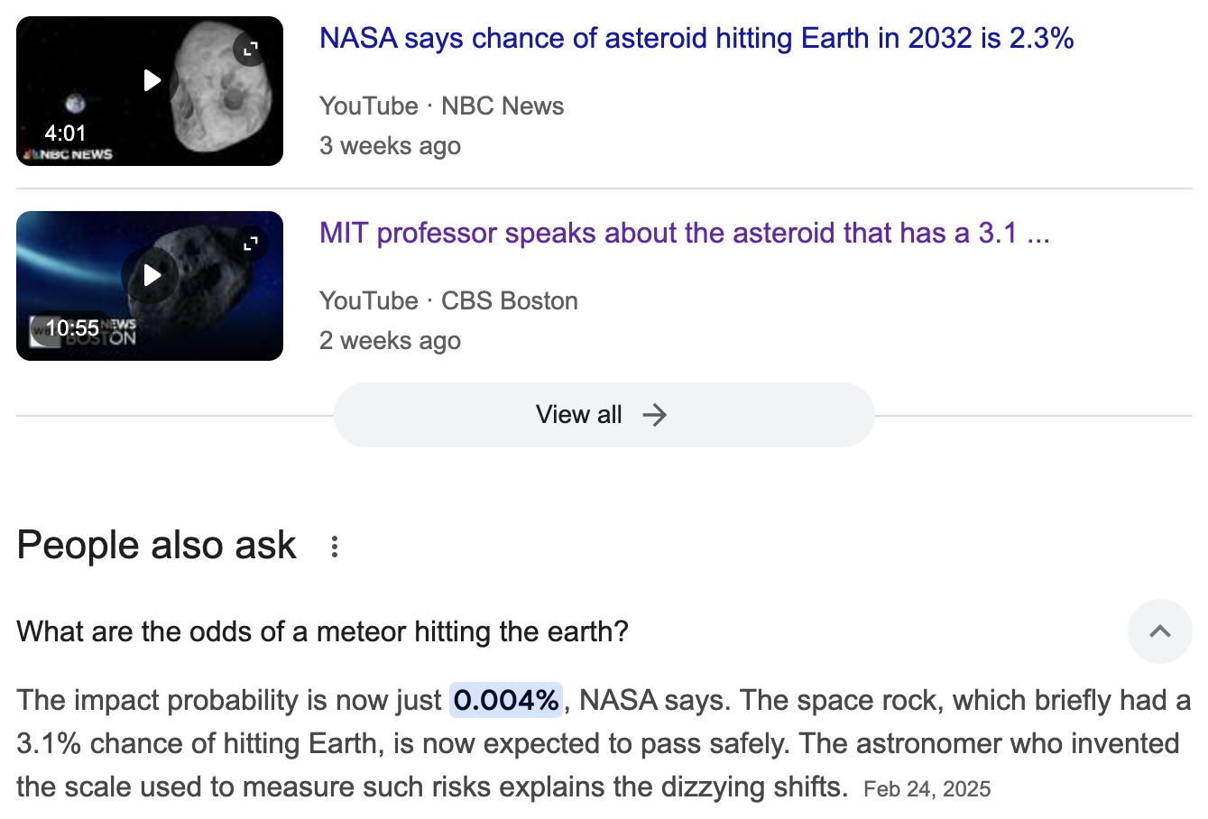
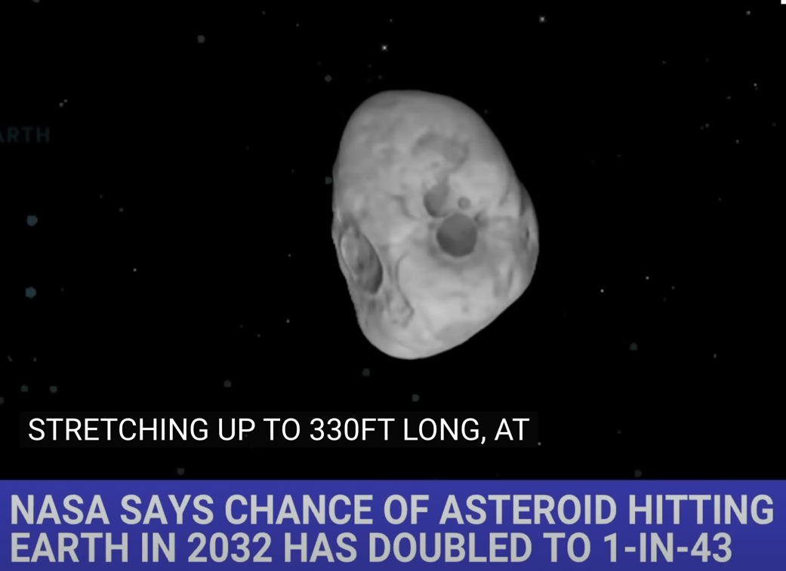
What is uncertainty? (And can we be sure about it?)
Notes:
The problem is not mind vs. machine
It is not about ethical control over automation vs. use of automation for profit.
It is about what trained professionals can do in an age where their basic skills are within reach of all.
To ask that question properly, I will look at some bad ways of answering it, then at the history of translation automation.

Slide 3
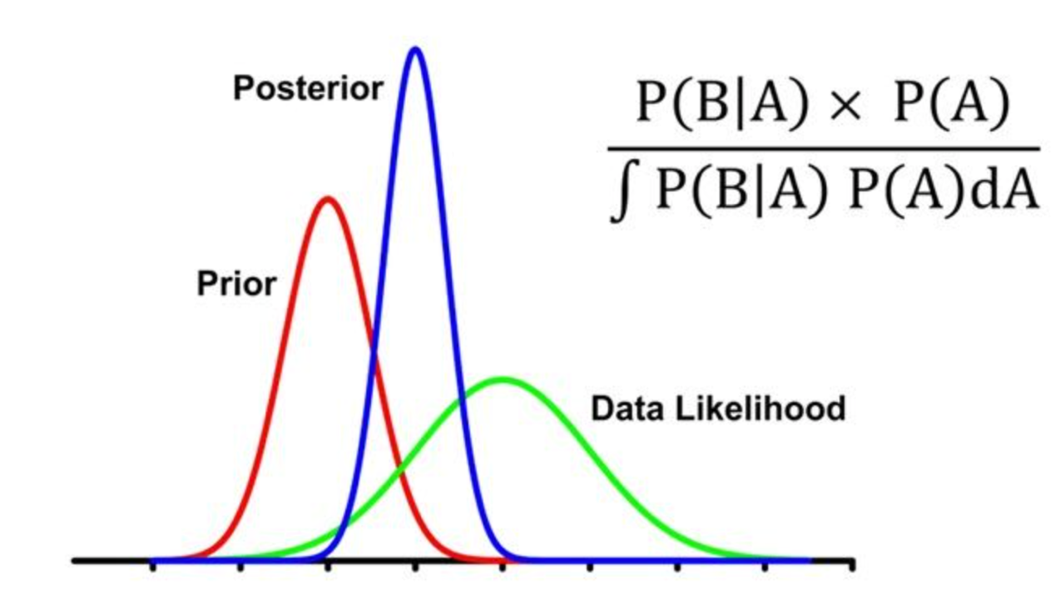
Bayes’ Theorem shifts uncertainty bands

Slide 4
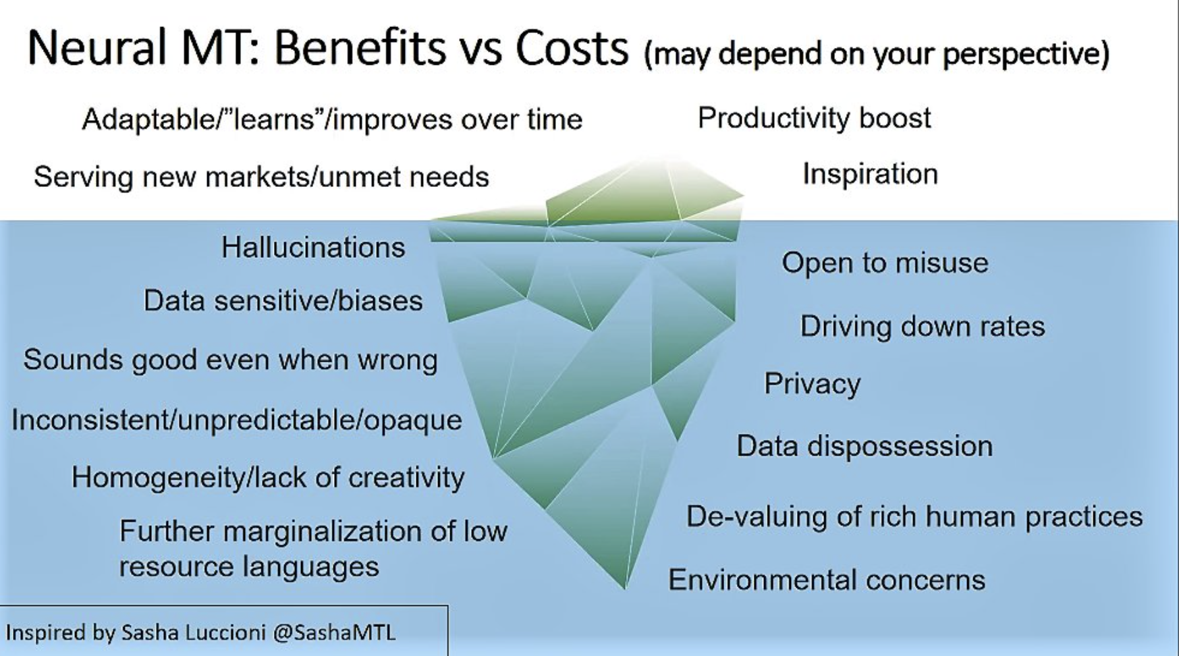
Cost-benefit analysis (Lynne Bowker at FIT Europe, May 2023)

Slide 5
What did automation ever do for us?
  Recall and revise your previous translations
  Give alternative translations to choose between
  Reduce alternative proposals as you type
  Adjust a translation when you make a change
  Align your previous translations
  Pre-edit the start text (for plain language)
  Adapt the translation to specific readerships
  Exchange notes with other translators
  Speech to text: Speak your translations
  Text to speech: Read your translation back to you
  Revise your translation for spelling and punctuation
  Revise your translation for grammar
  Revise your translation for readability
  Revise your translation for a specific reader or purpose
  Evaluate translations
  Extract and manage your terminology
  Give notes on terms in context
  Provide background information quickly
  Propagate translation choices
  Record your translation preferences
  Check for consistency in numbers, terms, and formatting

Slide 6
What did automation ever do for us?
  Recall and revise your previous translations
  Give alternative translations to choose between
  Reduce alternative proposals as you type
  Adjust a translation when you make a change
  Align your previous translations
  Pre-edit the start text (for plain language)
  Adapt the translation to specific readerships
  Exchange notes with other translators
  Speech to text: Speak your translations
  Text to speech: Read your translation back to you
  Revise your translation for spelling and punctuation
  Revise your translation for grammar
  Revise your translation for readability
  Revise your translation for a specific reader or purpose
  Evaluate translations
  Extract and manage your terminology
  Give notes on terms in context
  Provide background information quickly
  Propagate translation choices
  Record your translation preferences
  Check for consistency in numbers, terms, and formatting

Slide 7
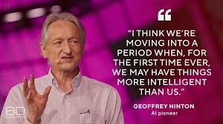
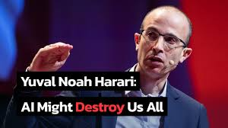
A totalizing threat?

Slide 8
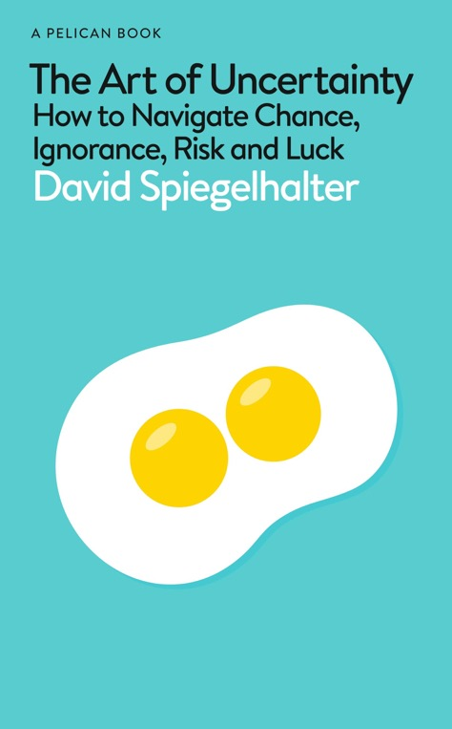
The starting point: deep uncertainty
“Just try to quantify the social impacts of generative AI in 25 years’ time. This has become known as ‘deep uncertainty’. Of course, this assumes that people have the insight and humility to admit what they don’t know.”
“[without humility] This arrogance has been termed meta-ignorance, when they don´t know what they don’t know.”
Spìegelhalter, D. (2024). The Art of Uncertainty. Pelican (audiobook).
Notes:
The problem is not mind vs. machine
It is not about ethical control over automation vs. use of automation for profit.
It is about what trained professionals can do in an age where their basic skills are within reach of all.
To ask that question properly, I will look at some bad ways of answering it, then at the history of translation automation.

Slide 9
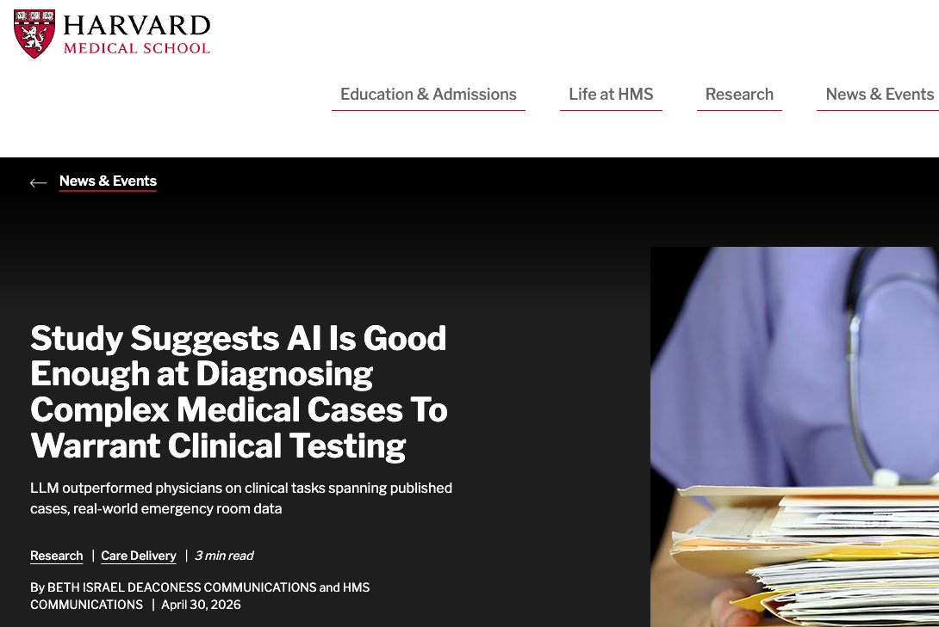
The next step: empirical exploration
Notes:
The problem is not mind vs. machine
It is not about ethical control over automation vs. use of automation for profit.
It is about what trained professionals can do in an age where their basic skills are within reach of all.
To ask that question properly, I will look at some bad ways of answering it, then at the history of translation automation.

Slide 10
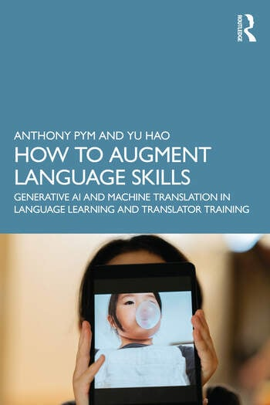
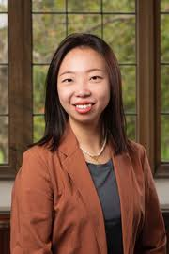
A book that you don’t have to buy
Chapter 1: What are language technologies and why should we know about them?
Chapter 2: How do we know which skills to teach?
Chapter 3: Wthem?ill all language professionals need translation technologies?
Chapter 4: What methods do we use to teach translation technologies?
Chapter 5: What activities can help students use technologies better?
Chapter 6: Who assesses what?
Chapter 7: How do we answer students’ questions about language technologies?
Chapter 8: Ways forward

Slide 11
What is there to fear in automated literary translation?
The richness of the distribution of Spanish lexical equivalents of a set of 50 frequent English nouns is clearly impoverished in machine-translated output, as attested by comparing the Shannon entropy of that distribution in the corpus and that of the distribution in machine-translated versions of the same sentences. For all but a few words, there is a reduction of entropy, that is, of richness.
Mikel Forcada: ”When AI language is copied and
fed back into AI, what will happen to
authentic speech?”
Miriam Espinosa-Giménez & Mikel L. Forcada (2024). Lexical impoverishment in neural machine translation: automatic and human study of Spanish-English noun translation. Tradumatica , 22, 162-180.
Mikel L. Forcada (2025, Feb. 14). Harmful Effects of Machine Translation and their Mitigation: A Preliminary Taxonomy. https://youtu.be/JIZRGIL57C8?si=n3e6tryezPV890Rd

Slide 12
What is there to fear in automated literary translation?
Creative shifts: All translations that deviate from the ST in any of the following ways:
—“Abstraction” refers to instances when translators use more vague, general or abstract TT solutions.
—“Concretisation” refers to instances when the TT evokes a more explicit, more detailed and more precise idea or image.
—“Modification” refers to instances when translators use a different solution in the TT (e.g. express a different metaphor without the image becoming more abstract or concrete).
Ana Guerberof Arenas and Antonio Toral. 2022. CREAMT: Creativity and narrative
engagement of literary texts translated by translators and NMT. In Proceedings of the
23rd Annual Conference of the European Association for Machine Translation, pages 357–358,
Ghent, Belgium. European Association for Machine Translation.

Slide 13
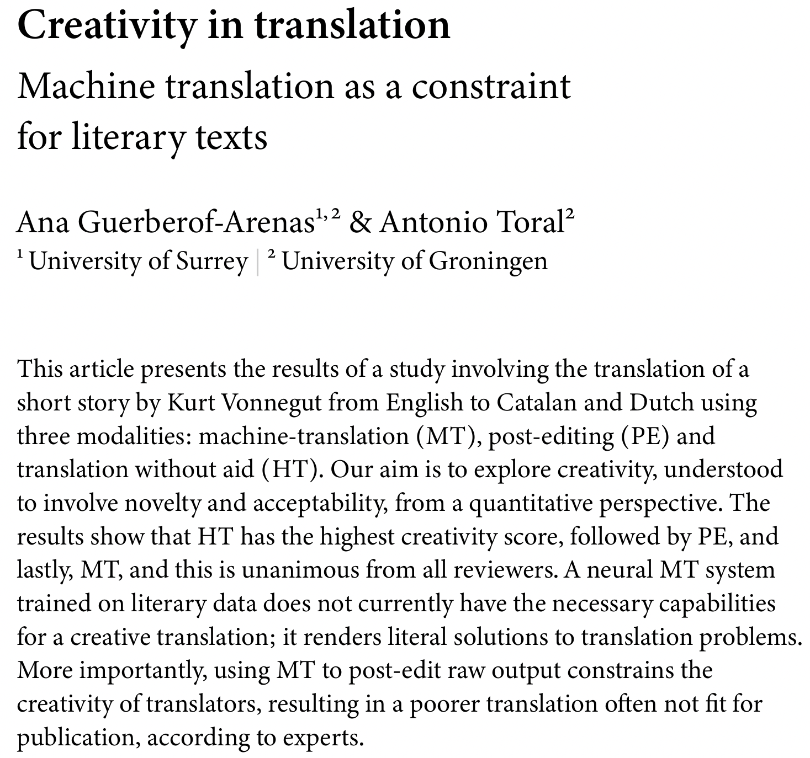
What is there to fear in automated literary translation?
Ana Guerberof Arenas and Antonio Toral. 2022. CREAMT: Creativity and narrative
engagement of literary texts translated by translators and NMT. In Proceedings of the
23rd Annual Conference of the European Association for Machine Translation, pages 357–358,
Ghent, Belgium. European Association for Machine Translation.

Slide 14
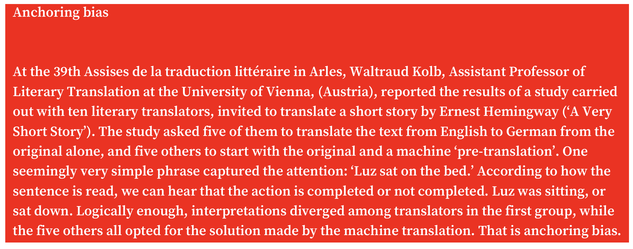
What is there to fear in automated literary translation?

Slide 15
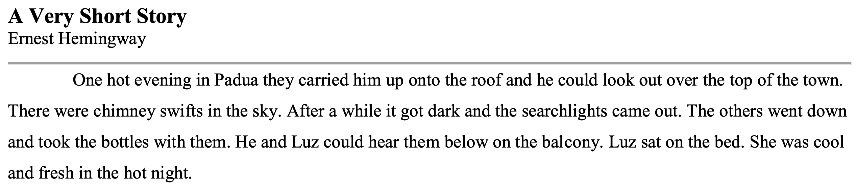
Does automation change how we work? MT dependency

Slide 16

Does automation change how we work? MT dependency?
ChatGPT5.2 Luz se sentó en la cama (sat down) x 3
Gemini Luz se sentó en la cama (sat down) x 3
Grok Luz se sentó en la cama (sat down) x 3
GoogleTranslate Luz se sentó en la cama (sat down) x 3
Luz estaba sentada en la cama (was sitting) x 1
DeepL Luz estaba sentada en la cama (was sitting)
Luz se sentó en la cama (Option 3) (sat down)
Translator 1 Luz se sentó en la cama
Translator 2 Luz se sentó en la cama
Translator 3 Luz se sentó en la cama

Slide 17
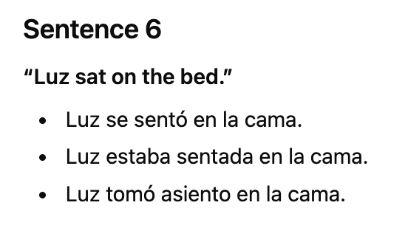
So, there is no creativity?
Simple solution: Use the prompt “Suggest acceptable but creative alternatives for each sentence”:

Slide 18
The wrong starting point: Justify a position
GenAI does not have…
Authentic language
Knowledge of receivers
Creativity
Real understanding
Cultural nuances / empathy / emotions
Respect for intellectual property
To demonstrate this:
Do not use prompts or fresh data
Test isolated sentences and phrases
Compare with a human gold standard, with no prompts
Use academic authorities
Forget how children learn to express empathy and emotions.
Forget how languages change.

Slide 19
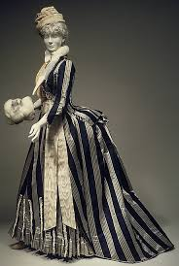
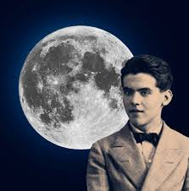
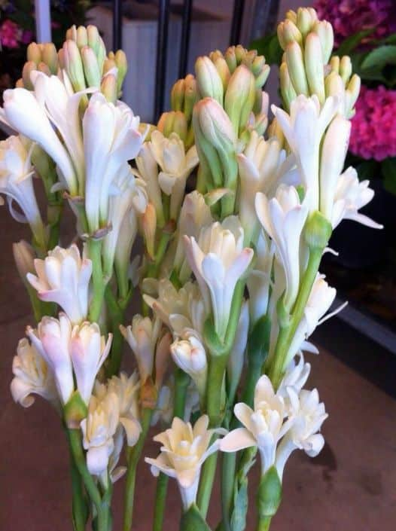

Let’s test this
B. Romance De La Luna, Luna
The moon came to the forge
with her tub of nard.
The boy is looking at her.
The child is looking at her.
In the moving air
the moon moves her arms
and shows, lubricious and pure,
her breasts of hard pewter.
Romance de la luna, luna
La luna vino a la fragua
con su polisón de nardos.
El niño la mira mira.
El niño la está mirando.
En el aire conmovido
mueve la luna sus brazos
y enseña, lúbrica y pura,
sus senos de duro estaño.
A. Moon Romance, Moon
The moon came to the forge
with its tuberose bustle.
The boy looks at her.
The boy is looking at her.
in the shaken air
the moon moves its arms
and teaches, lubricious and pure,
her breasts of hard tin.

Slide 20
Let’s test this: Please avoid literal solutions
Romance de la luna, luna
La luna vino a la fragua
con su polisón de nardos.
El niño la mira mira.
El niño la está mirando.
En el aire conmovido
mueve la luna sus brazos
y enseña, lúbrica y pura,
sus senos de duro estaño.
Moon Ballad
The moon drifted into the smithy,
her skirts woven from star-jasmine.
The boy stares, transfixed—
his wide eyes never leaving her.
In the quivering air,
she sways her silver limbs,
baring herself—luminous, untouchable—
her body a sculpture of molten metal.
Key Liberties:
"Polisón de nardos" → "skirts woven from star-jasmine" (evokes both fabric and fragrance without "bustle").
"Senos de duro estaño" → "sculpture of molten metal" (avoids "tin breasts" but keeps metallic sensuality).
"Need more darkness/whimsy? Just say. 🌒

Slide 21
Let’s test this: Please come closer to the rhythm and rhymes
Romance de la luna, luna
La luna vino a la fragua
con su polisón de nardos.
El niño la mira mira.
El niño la está mirando.
En el aire conmovido
mueve la luna sus brazos
y enseña, lúbrica y pura,
sus senos de duro estaño.
Ballad of the Moon, Moon
The moon stepped into the smithy,
her gown of spikenard flowing.
The boy gazes, lingers, gazes—
his wide eyes ever-glowing.
Through the shivering air,
she sways her silver light,
baring herself—bright and wanton—
her breasts of frozen white.
Rhyme & Rhythm:
ABAB scheme in stanzas 1–2 (flowing/glowing, light/white)
AABB in warnings (come/dumb, appear/dear)
Trochaic trimeter (e.g., "The moon stepped in-to the smith-y") mirrors Lorca’s lullaby-like cadence.
Key Choices:
"Polisón de nardos" → "gown of spikenard flowing" (keeps floral elegance + internal rhyme with "glowing").
"Lúbrica y pura" → "bright and wanton" (balances purity/sensuality; rhymes with "light").
Closer to Lorca’s incantatory rhythm while avoiding clunkiness. Want more musicality? I’d tweak line lengths for stronger singsong. 🔥

Slide 22
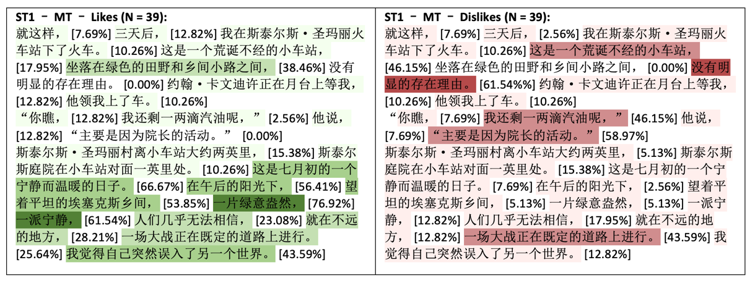
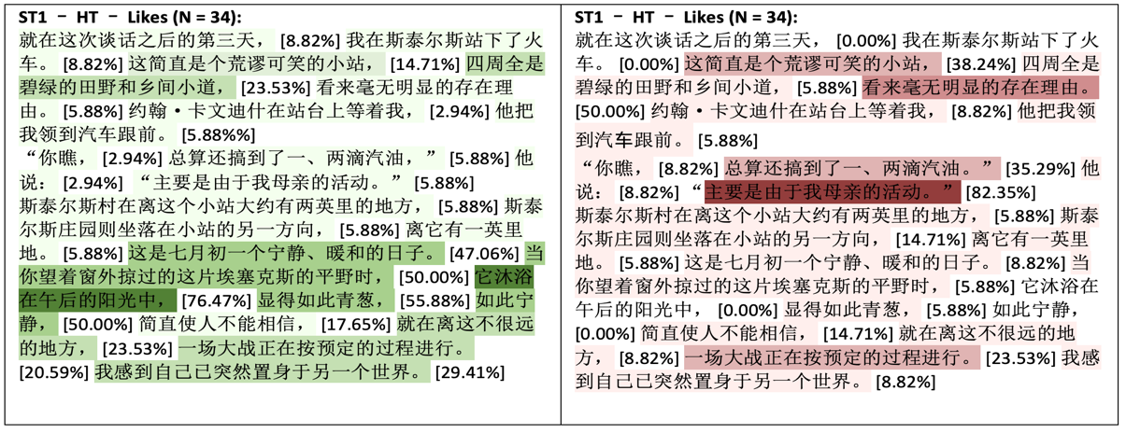
Annotation heatmaps (research by Ke Hu)
Instruction:
In this text, please mark the parts you like in green and mark the parts you dislike in red.
(One of these is raw NMT, the other is unaided.)
Hu Ke (2022). Comparing the Quality of Machine and Human Translation of Literary Texts Using Reader-based Evaluation Methods. PhD thesis. University of Melbourne

Slide 23
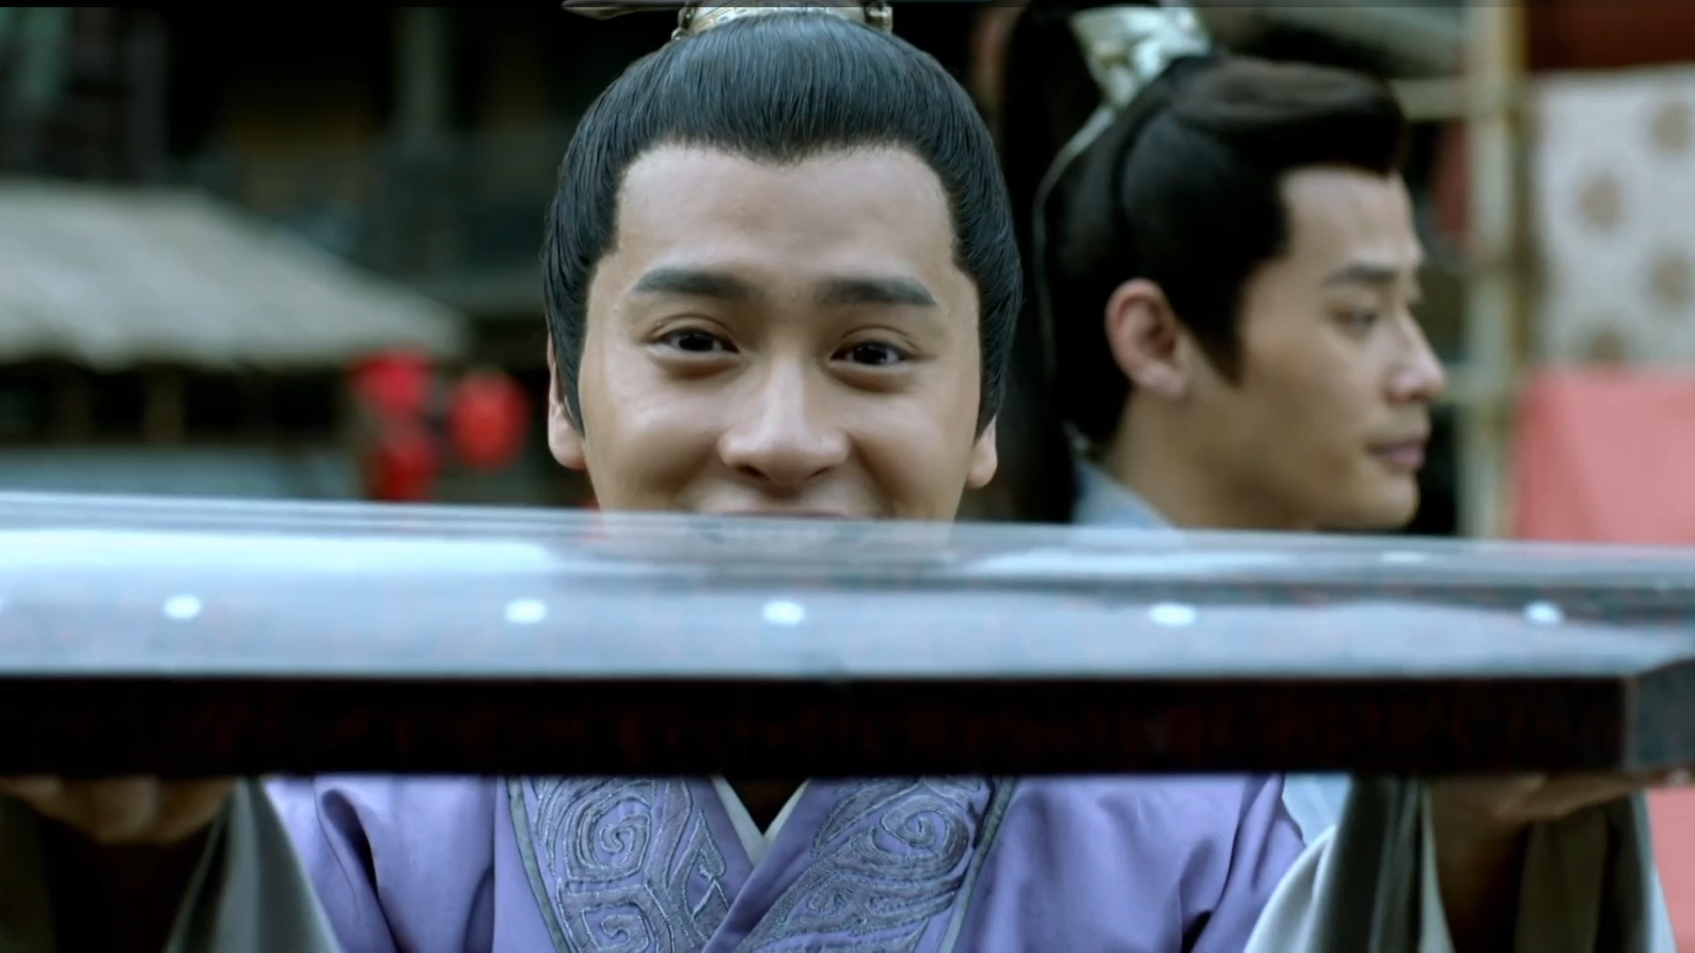
Please watch this clip from Nirvana in Fire (research by Qiu Juerong)

Slide 24
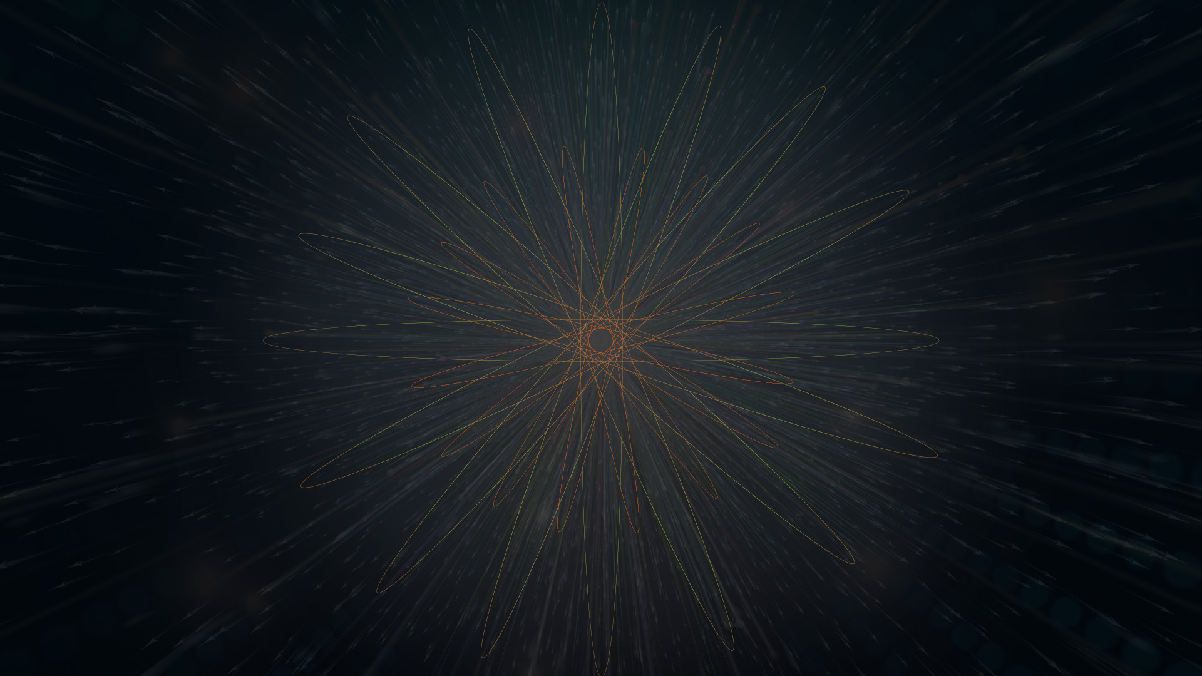



$ IMMERSION
When Yan asks the girl how much a guqin is, she says “twelve wen”, so “wen” is…
The time of day
A unit of currency
A:
B:
A unit of language
I don’t know
C:
D:

Slide 25
$ IMMERSION
When Yan asks the girl how much a guqin is, she says “twelve wen”, so “wen” is…
The time of day
A unit of currency
A
B:
A unit of language
I don’t know
C:
D:

Slide 26
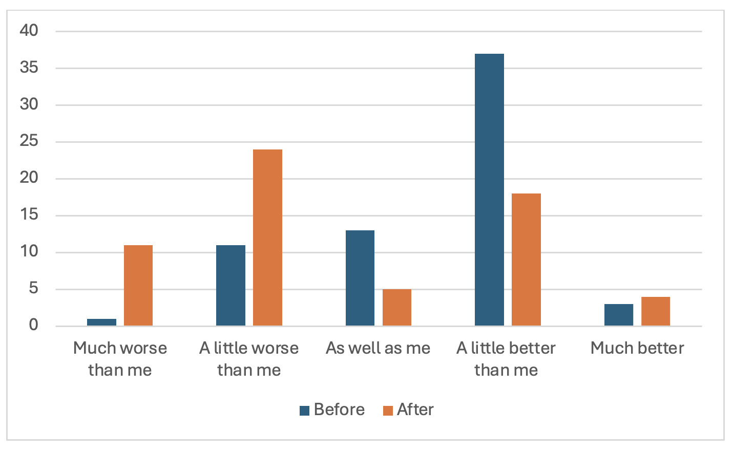
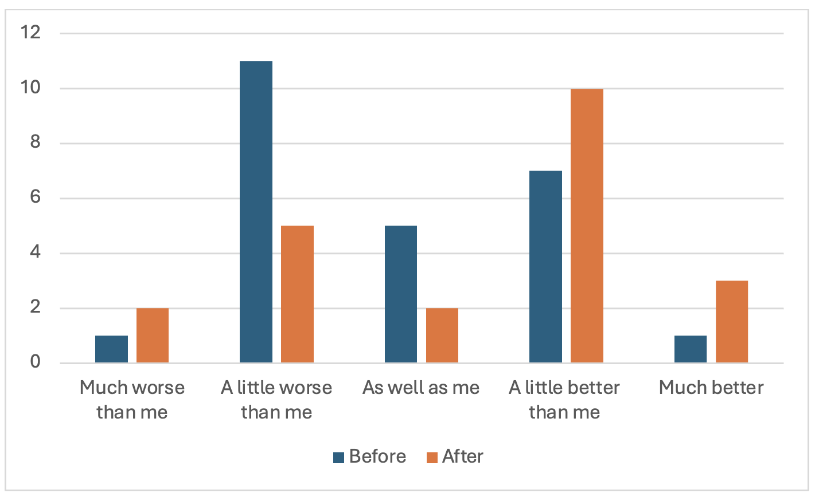
Chinese:
Spanish:
Hao, Y., Ayvazyan, N., & Pym, A. (2024). Augmenting revision skills.
University of Melbourne, Universitat Rovira i Virgili

Slide 27
In the discussion (with Nune Ayvazyan) that followed…
GenAI is bad:
The perfect combo:
GenAI must be checked:
Most students moved from for/against to a “work with” attitude, with low, vigilant trust.
Notes:
This slide is only for emergencies.

