Slide 1
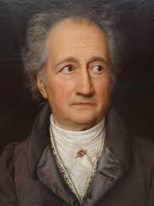
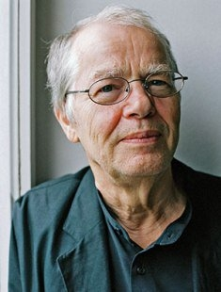
On cyclical models of retranslation
Anthony Pym

Slide 2
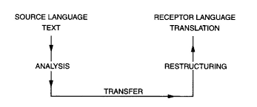
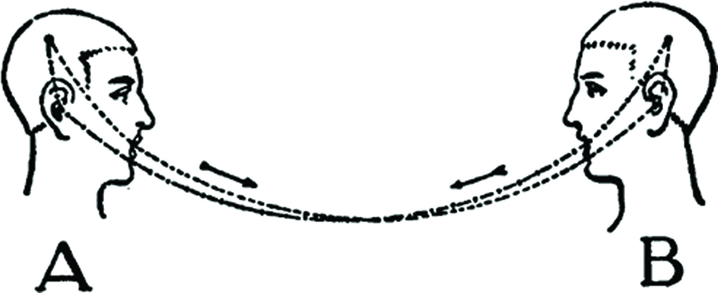
What is a cyclical model?
Translation is a complete and finite transfer.

Slide 3
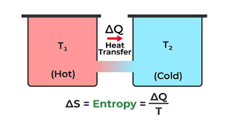
Why would the cyclical model be wrong?
First law of thermodynamics: There is equilibrium in the transfer of energy (heat).
Second law (Carnot, 1824): There is loss in transfer, hence irreversibility, an arrow of time in nature, and entropy.
Ilya Prigogine: Complexity derives from this irreversibility of time in the natural sciences.

Slide 4
So why is there retranslation?
The retranslation hypothesis:
Freer earlier, closer later. (Chesterman, 2000, p. 22).

Slide 5
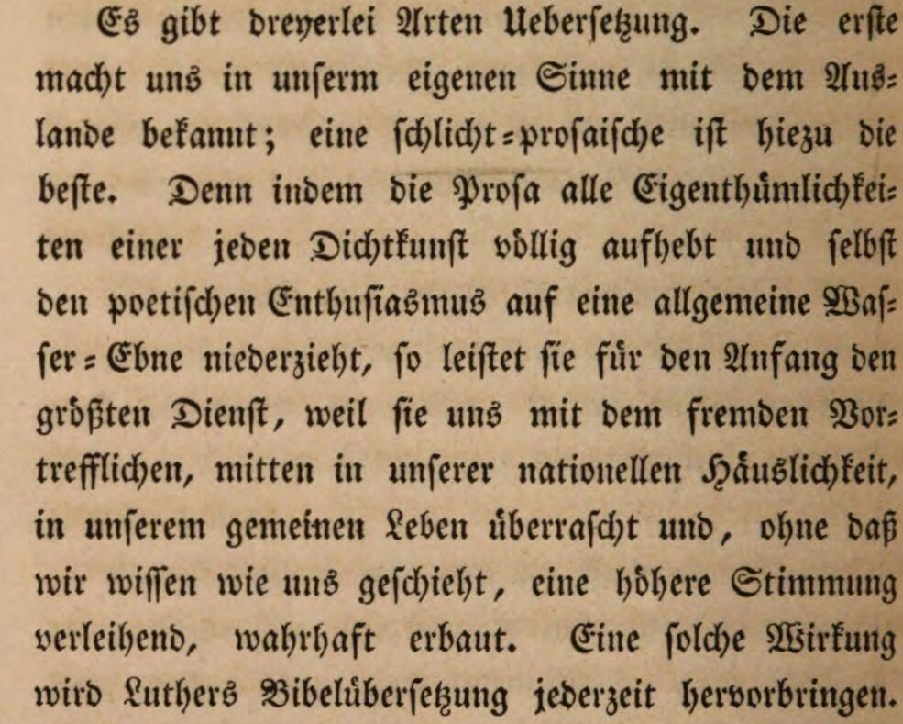
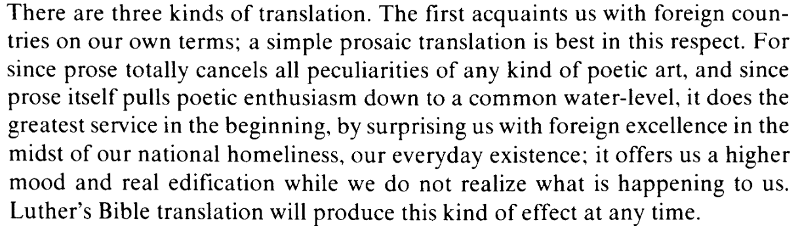
Goethe on retranslation: first step
Lefevere, A. (1977). Johann Wolfgang Goethe, 1749–1832. In Translating
Literature: the German Tradition from Luther to Rosenzweig, pp. 35-39.
Van Gorcum.
Goethe, Johann Wolfgang von (1819/1827) Noten und Abhandlungen zu besserem Verständnis des West-östlichen Divans. Vol. 6 of Goethe’s Werke, Stuttgart: Cotta, 237-239.

Slide 6
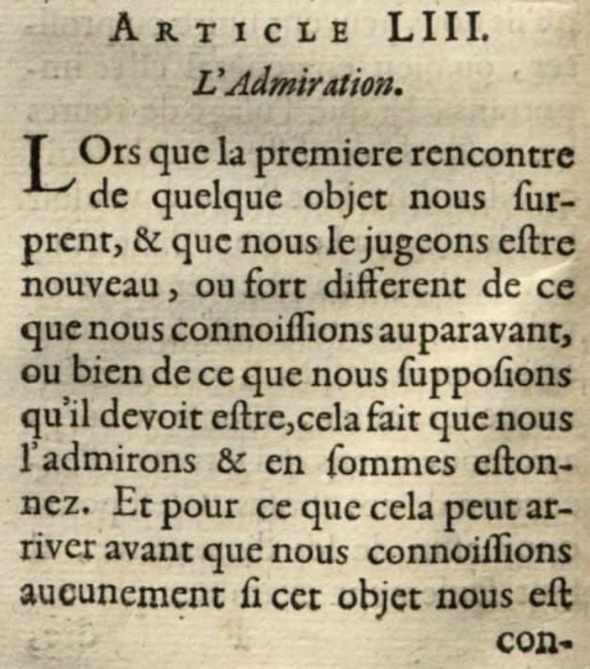
A wink to Descartes?
When, upon first encounter, an object surprises us and we esteem it new or quite different from whatever we knew before, or from what we supposed it should be, then we admire it and we are astonished by it.
And given that this can happen before we know whether this object suits us or not, I think admiration is the first of all passions. It has no opposite, since if the object has nothing that surprises us, we are not moved by it and we observe it without passion.
Des Cartes, R. (1650). Les passions de l’âme. Elzevier, article 53

Slide 7
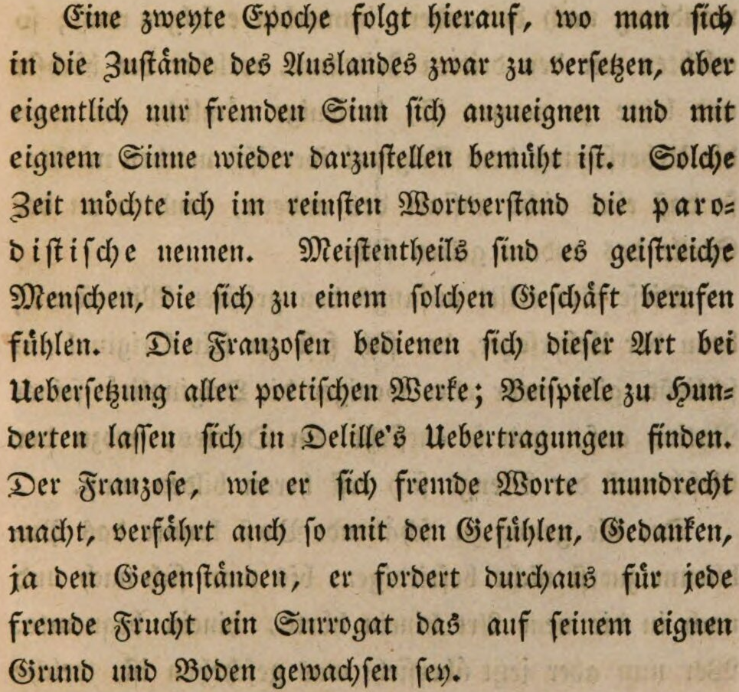
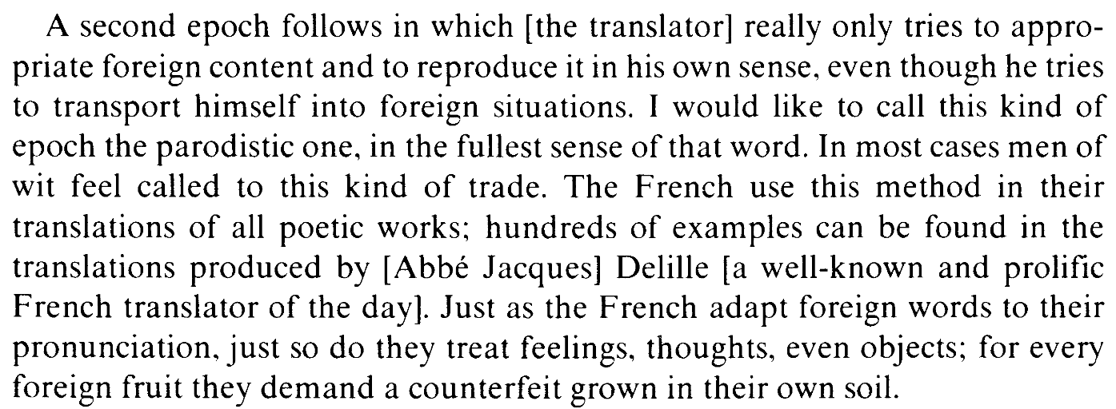
Goethe on retranslation: second step
Lefevere, A. (1977). Johann Wolfgang Goethe, 1749–1832. In Translating
Literature: the German Tradition from Luther to Rosenzweig, pp. 35-39.
Van Gorcum.
Goethe, Johann Wolfgang von (1819/1827) Noten und Abhandlungen zu besserem Verständnis des West-östlichen Divans. Vol. 6 of Goethe’s Werke, Stuttgart: Cotta, 237-239.

Slide 8
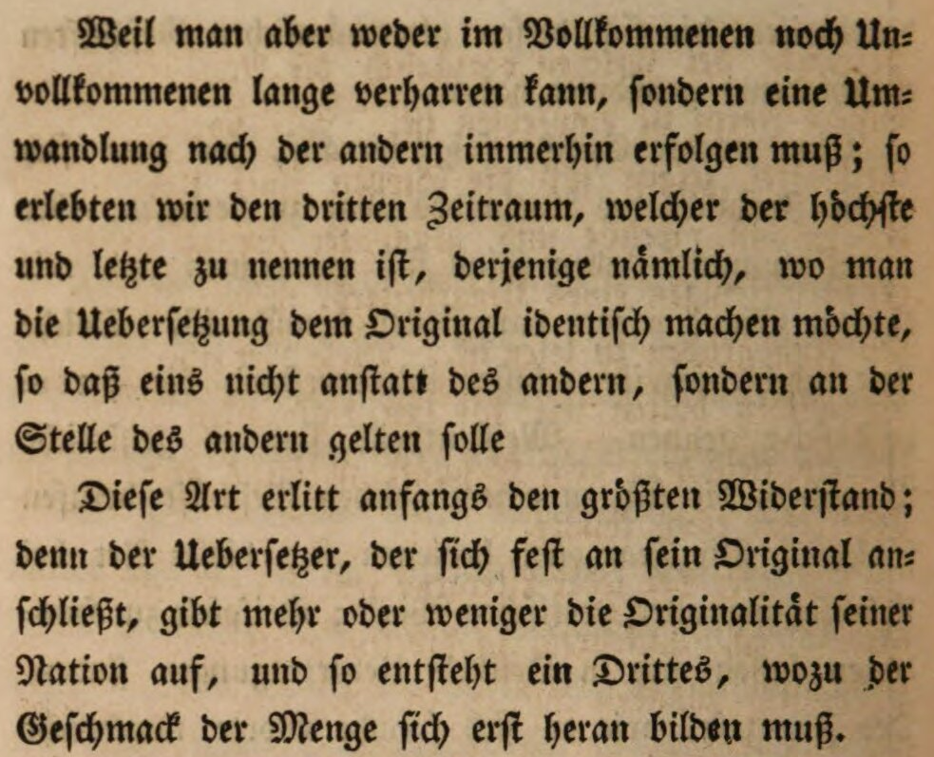
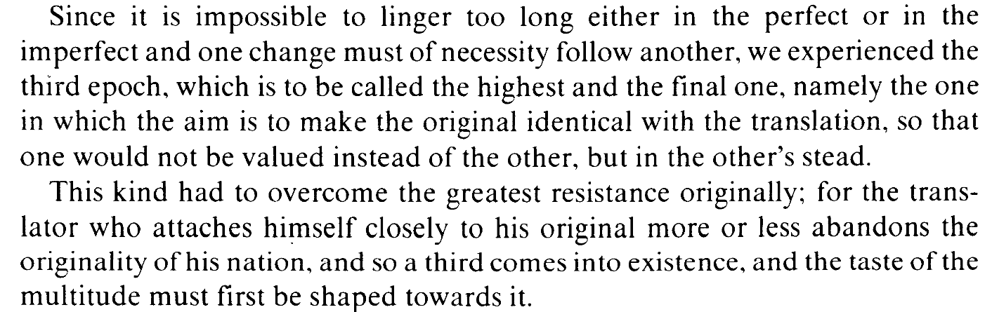
Goethe on retranslation: third step
Example: Voss translating Homer into hexameters.
Lefevere, A. (1977). Johann Wolfgang Goethe, 1749–1832. In Translating
Literature: the German Tradition from Luther to Rosenzweig, pp. 35-39.
Van Gorcum.
Goethe, Johann Wolfgang von (1819/1827) Noten und Abhandlungen zu besserem Verständnis des West-östlichen Divans. Vol. 6 of Goethe’s Werke, Stuttgart: Cotta, 237-239.

Slide 9
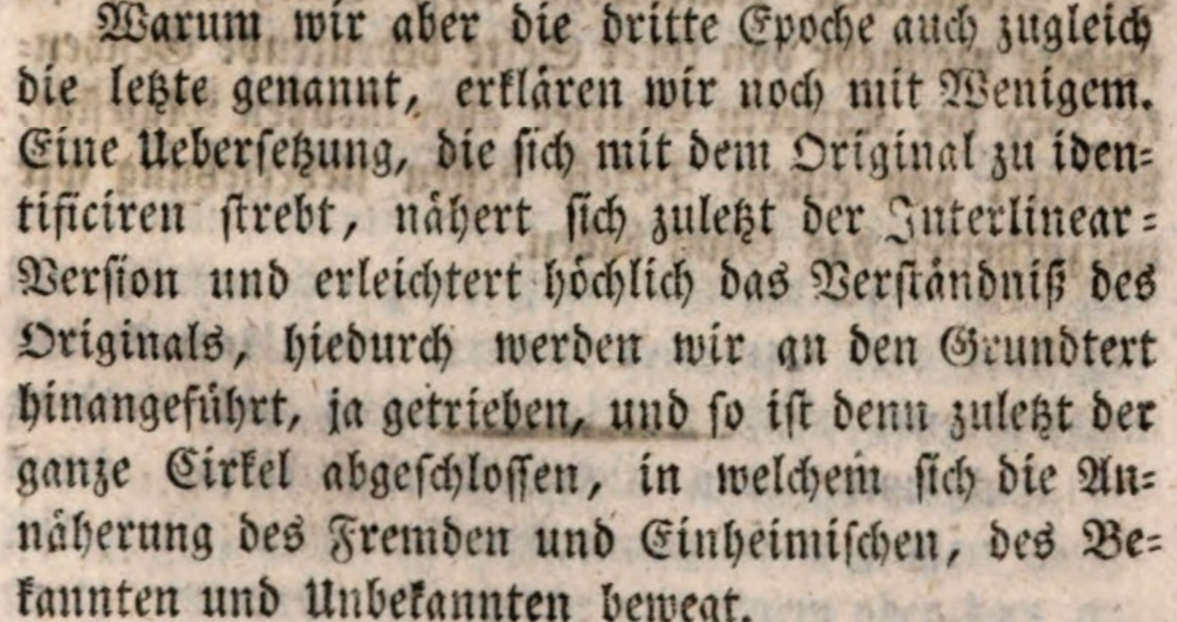
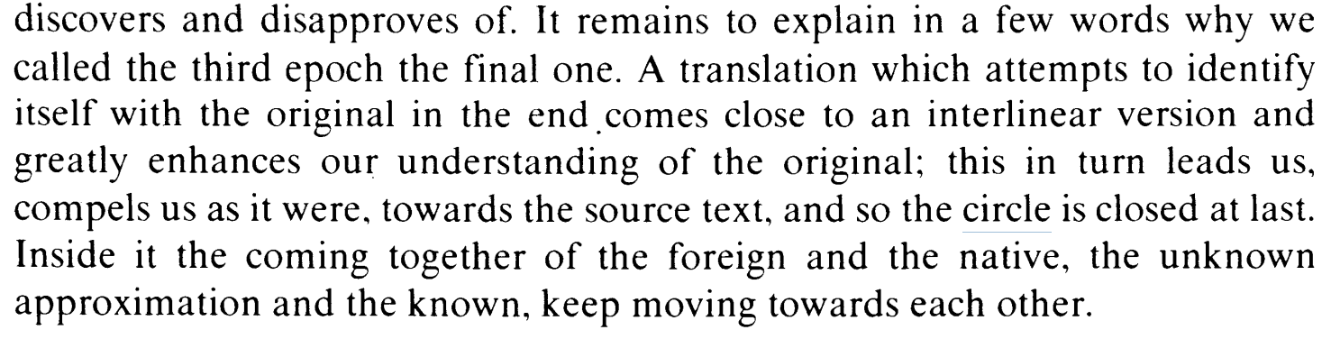
Goethe on retranslation: third step
Lefevere, A. (1977). Johann Wolfgang Goethe, 1749–1832. In Translating
Literature: the German Tradition from Luther to Rosenzweig, pp. 35-39.
Van Gorcum.
Goethe, Johann Wolfgang von (1819/1827) Noten und Abhandlungen zu besserem Verständnis des West-östlichen Divans. Vol. 6 of Goethe’s Werke, Stuttgart: Cotta, 237-239.

Slide 10
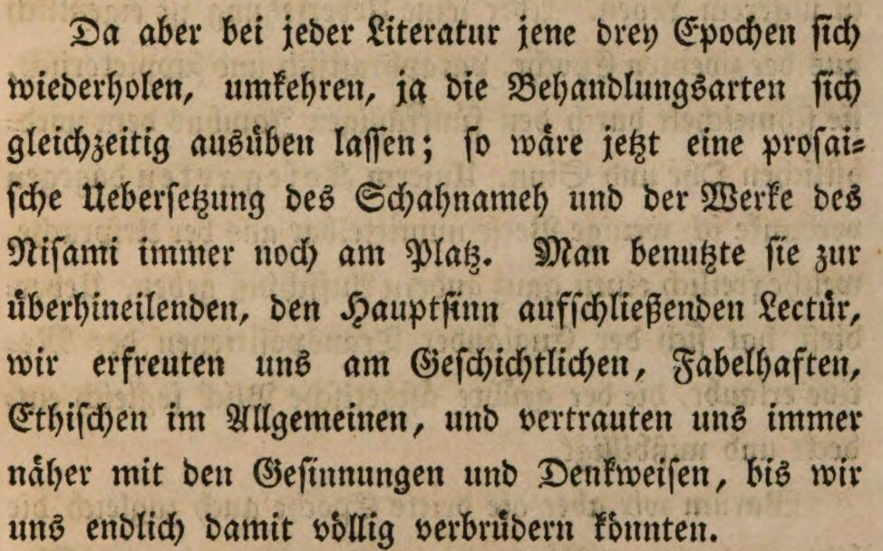
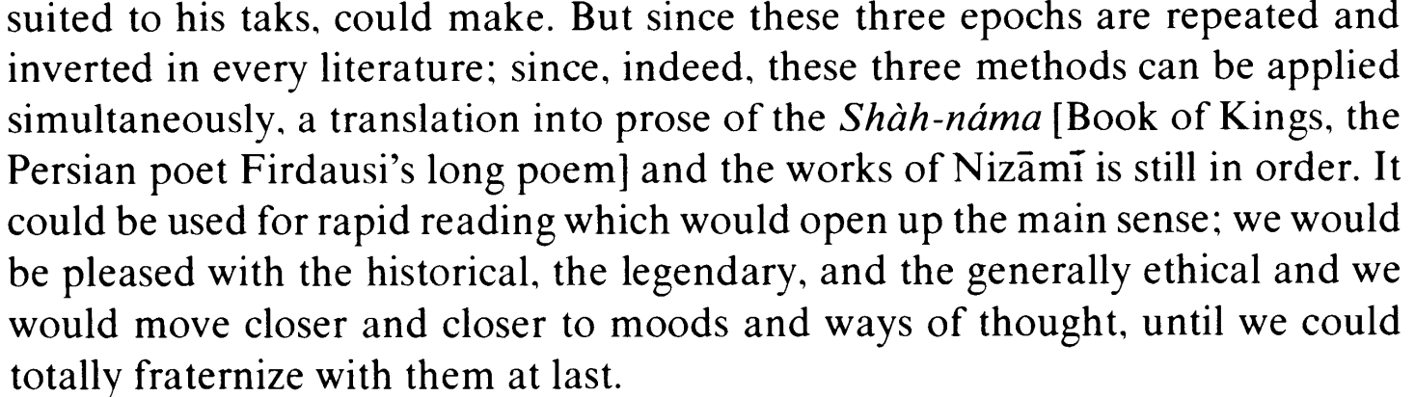
Goethe on retranslation: entropy
Lefevere, A. (1977). Johann Wolfgang Goethe, 1749–1832. In Translating
Literature: the German Tradition from Luther to Rosenzweig, pp. 35-39.
Van Gorcum.
Goethe, Johann Wolfgang von (1819/1827) Noten und Abhandlungen zu besserem Verständnis des West-östlichen Divans. Vol. 6 of Goethe’s Werke, Stuttgart: Cotta, 237-239.

Slide 11
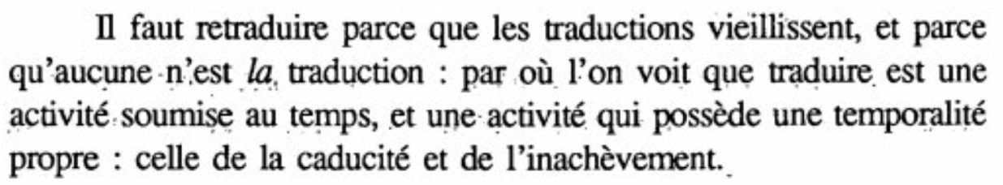
Berman on retranslation
Retranslation is necessary because translations age, and because no translation is the translation, hence we see that translation is an activity that is subservient to time, and an activity that has its own temporality: that of expiration and incompletion.
Berman, A. (1990). La retraduction comme espace de la traduction. Palimpsestes, 4, 1-7.

Slide 12
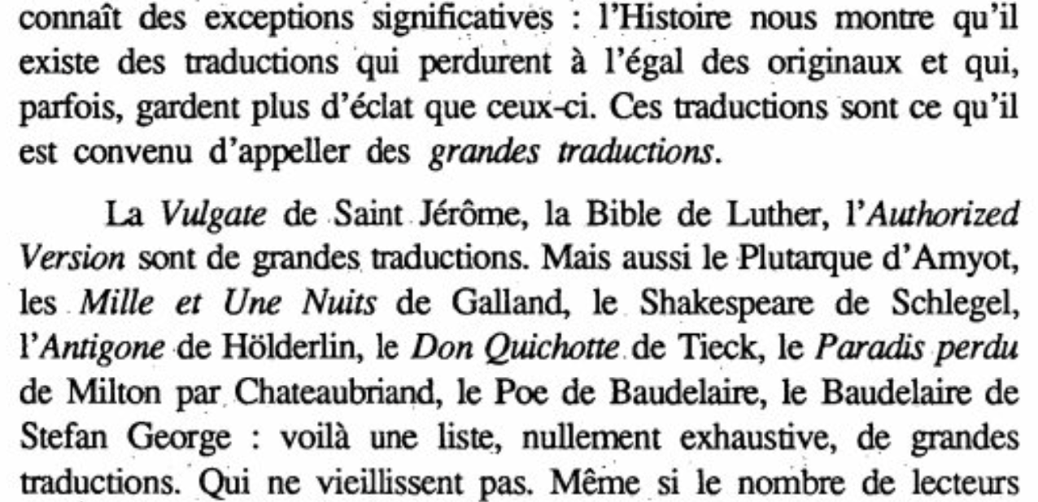
Berman on retranslation
History shows that there exist translations that last just like originals and that, sometimes, shine more brightly than them. These are the translations that are to be called [il est convenu d’apeller] great translations.
Berman, A. (1990). La retraduction comme espace de la traduction. Palimpsestes, 4, 1-7.

Slide 13
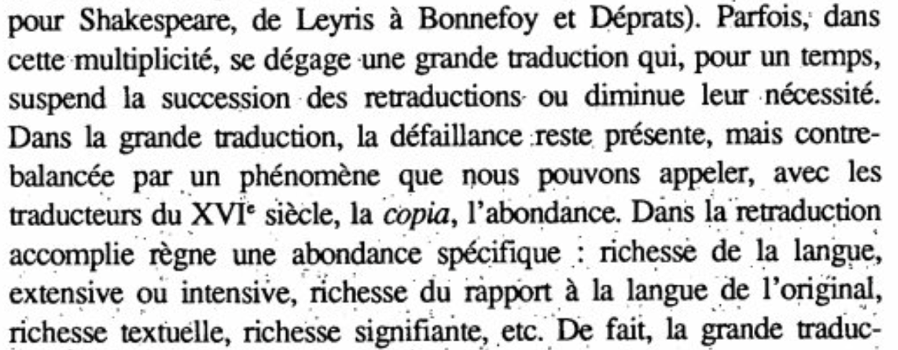
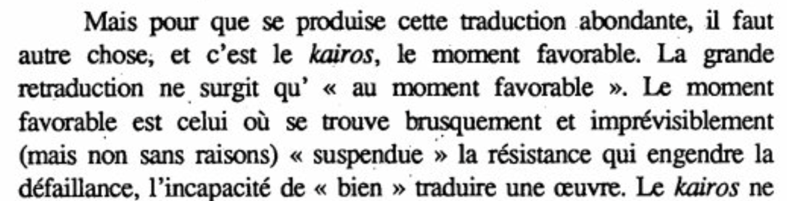
Berman on retranslation
Sometimes, in this multiplicity, there arises a great translation that, for a time, suspends the succession of retranslations or reduces the need for them. […]
The accomplished retranslation is ruled by a specific abundance: richness of the language, extensive or intensive, richness of the relation with the language of the original, textual richness, expressive richness, etc.
And it needs something else: kairos, the favorable moment.
Berman, A. (1990). La retraduction comme espace de la traduction. Palimpsestes, 4, 1-7.

Slide 14
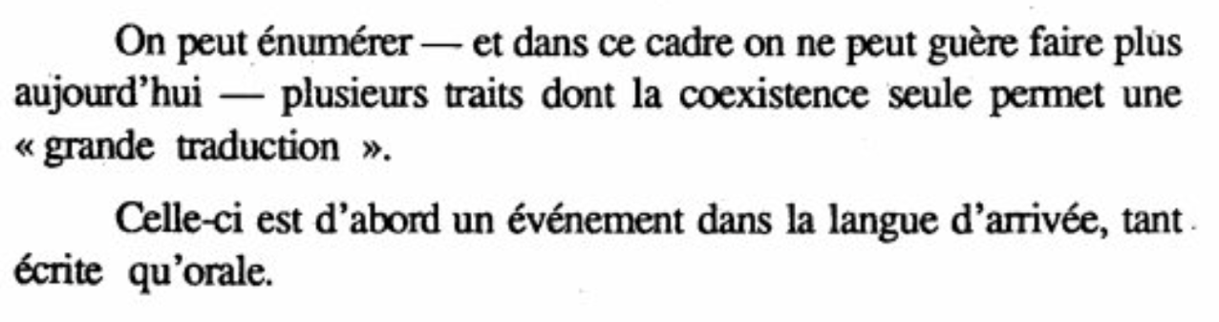
Berman on retranslation
A great translation is “first and foremost an event in the target language, both written and spoken.
Berman, A. (1990). La retraduction comme espace de la traduction. Palimpsestes, 4, 1-7.

Slide 15
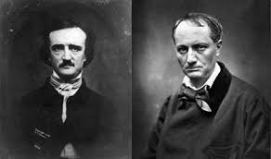
Berman on retranslation
« Il faut, c'est-à-dire je désire, qu'Edgar Poe, qui n'est pas grand-chose en Amérique, devienne un grand homme pour la France. »
Baudelaire «...ne permettait pas qu'aucun de ses amis ignorât la moindre circonstance de la biographie de son héros, et se fâchait si on ne saisissait pas du premier coup une intention comique, une allusion, une finesse...».
Lettre à Sainte-Beuve, 19 mars 1856, ibid., II, p. 1230.
C. Asselineau, Charles Baudelaire, sa vie et son œuvre (Paris: A. Lemmerre, 1869), pp. 41-42.
Bandy lists 204 French translations in the
nineteenth century.
https://www.eapoe.org/papers/misc1921/wtb19591.htm#pg0001

Slide 16
Berman’s slippage
Berman sees the “intra or juxtalinear version” as the first of Goethe’s epochs. In Goethe, it is the third.
Berman sees the “great translation” as being “an event in the target language”. In Goethe, the event is the first epoch.
For Berman, the series of small cycles is stopped because greatness intervenes. In Goethe, it is because the reading public has been formed.
In Berman, there is no reception, only agreed value – the great translator represents the other.

Slide 17
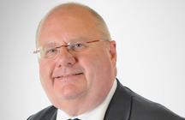
In a world of one-off immigration
If you translate for immigrants, they will not learn English.
Stopping the automatic use of translation and interpretation services into foreign languages will provide further incentive for all migrant communities to learn English, which is the basis for an individual’s ability to progress in British society. It will promote cohesion and better community relations.
Pickles, E. (2013). Translation into Foreign Languages.
Written Ministerial Statement by Communities Secretary Eric Pickles
on the Use of Translation Services by Local Authorities.
https://www.gov.uk/government/speeches/translation-into-foreign-languages

Slide 18
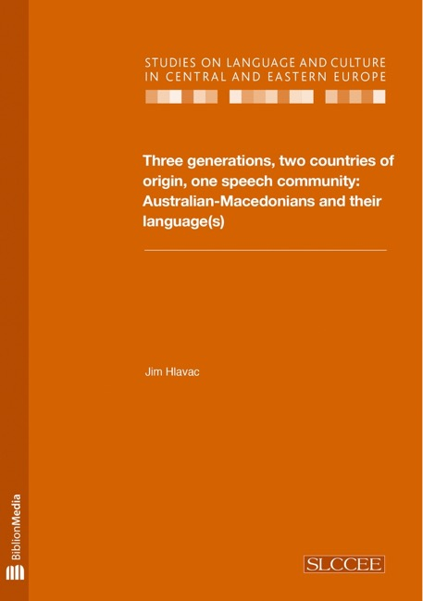
One generation helps the next
Hlavac, J. (2016). Three Generations, Two Countries of Origin, One Speech Community: Australian-Macedonians and their Language(s). Peter Lang.
Based on data gained from 103 speakers across three generations and from two countries of origin: northern Greece and the Republic of Macedonia.

Slide 19
Evidence from translators and interpreters (Rachel Macreadie’s interviews)
I'm a professional interpreter, so I naturally interpret things as I go. So I was interpreting that for my parents. (DaComR4)
And so she ran a little campaign which was targeted at the second generation and said we've got lots of information online. Essentially, go and tell your parents that it's available. (PolM4)

Slide 20
Why would the cyclical model be wrong?
First law: All sides have a fixed “homeliness”, which can be understood.
Second law: Translation changes the homes.
The slippage of retranslations is ongoing, without cyclical closure.
The incompletion, the défaillance, is in the homeliness of the receiving society.

