Slide 1
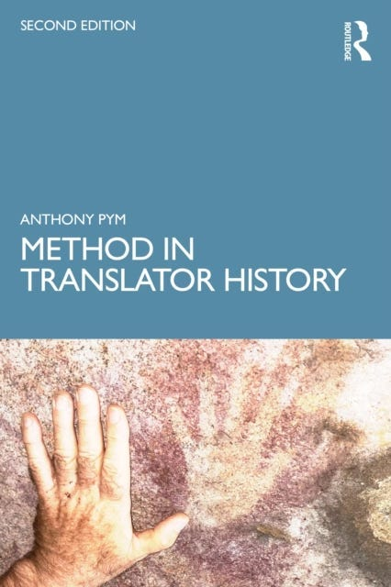
Tourism, materiality, and the creation of authenticity
Anthony Pym

Slide 2
Three receptive positions
Message
Excluded
Observational
Participative
Access
Comprehension
Action

Slide 3
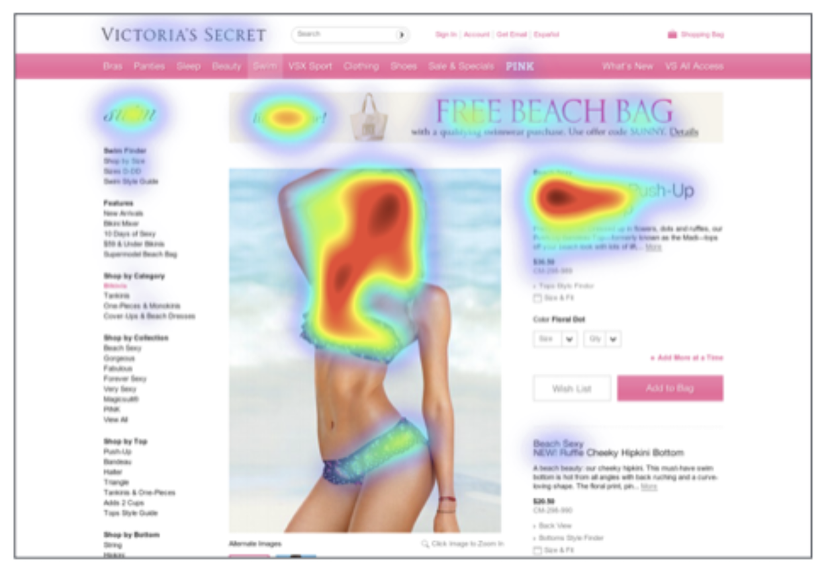
What do we learn from reception studies?

Slide 4
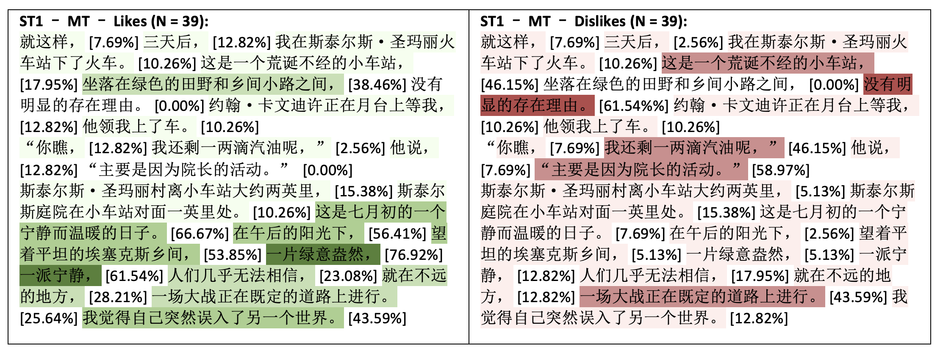
Ke Hu’s research on reader response

Slide 5
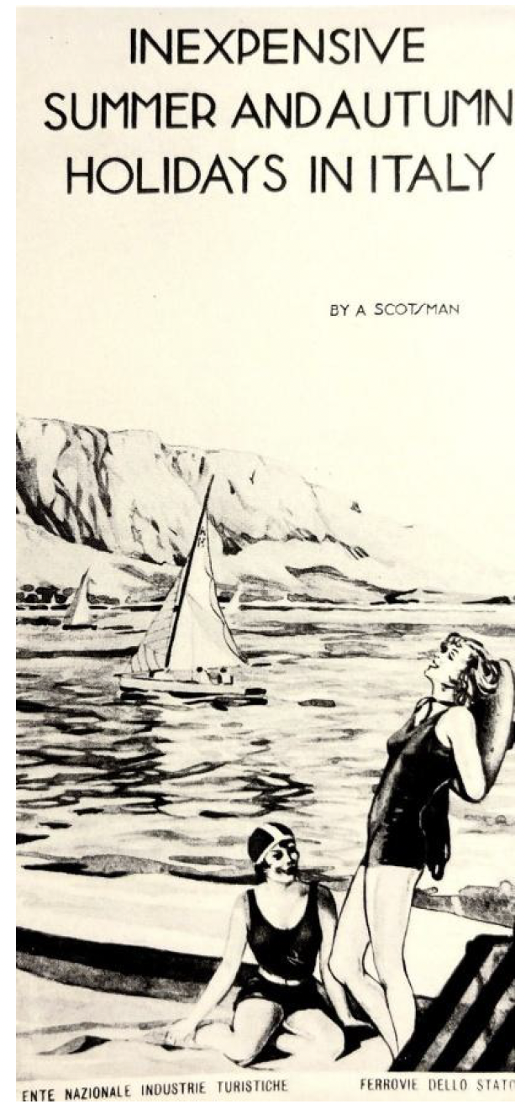
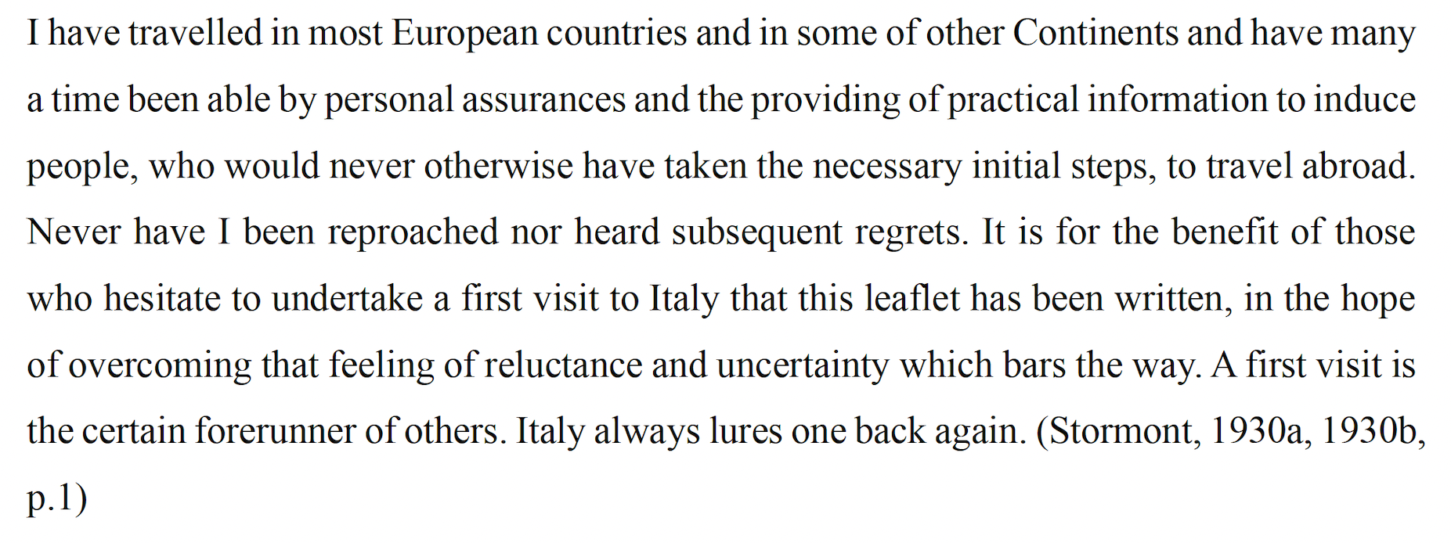
How does trust work?: Major Stormont, in Mauro, 2026, p. 138.

Slide 6

How has authenticity evolved?
Trust and authenticity can operate together.

