Slide 1

Rethinking translation ethics in an age of AI
Anthony Pym

Slide 2
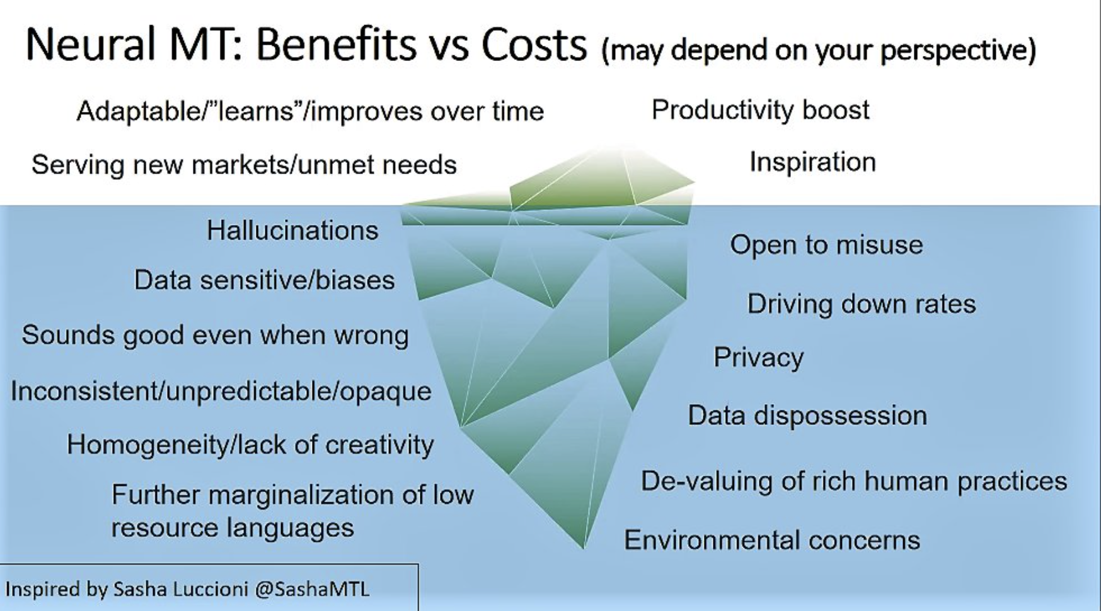
Cost-benefit analysis (Lynne Bowker at FIT Europe, May 2023)

Slide 3
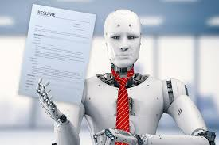
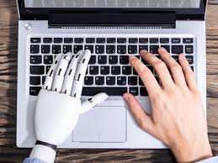
It’s still a problem of social perception (New York Times vs The Guardian)
Notes:
The two extremes are also clear in current attitudes to GPT technologies, where there is confusion between ”general technologies” (replacing the human) and ”restricted technologies” (assisting the human). The singularity really concerns the image on the right --- how to work with the technologies.

Slide 4
What did automation ever do for us?
  Recall and revise your previous translations
  Give alternative translations to choose between
  Reduce alternative proposals as you type
  Adjust a translation when you make a change
  Align your previous translations
  Pre-edit the start text
  Adapt the translation to specific readerships
  Exchange notes with other translators
  Speech to text: Speak your translations
  Text to speech: Read your translation back to you
  Revise your translation for spelling and punctuation
  Revise your translation for grammar
  Revise your translation for readability
  Revise your translation for a specific reader or purpose
  Evaluate translations
  Extract and manage your terminology
  Give notes on terms in context
  Provide background information quickly
  Propagate translation choices
  Record your translation preferences
  Check for consistency in numbers, terms, and formatting

Slide 5
What did automation ever do for us?
  Recall and revise your previous translations
  Give alternative translations to choose between
  Reduce alternative proposals as you type
  Adjust a translation when you make a change
  Align your previous translations
  Pre-edit the start text
  Adapt the translation to specific readerships
  Exchange notes with other translators
  Speech to text: Speak your translations
  Text to speech: Read your translation back to you
  Revise your translation for spelling and punctuation
  Revise your translation for grammar
  Revise your translation for readability
  Revise your translation for a specific reader or purpose
  Evaluate translations
  Extract and manage your terminology
  Give notes on terms in context
  Provide background information quickly
  Propagate translation choices
  Record your translation preferences
  Check for consistency in numbers, terms, and formatting

Slide 6
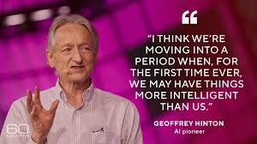

A totalizing threat?

Slide 7
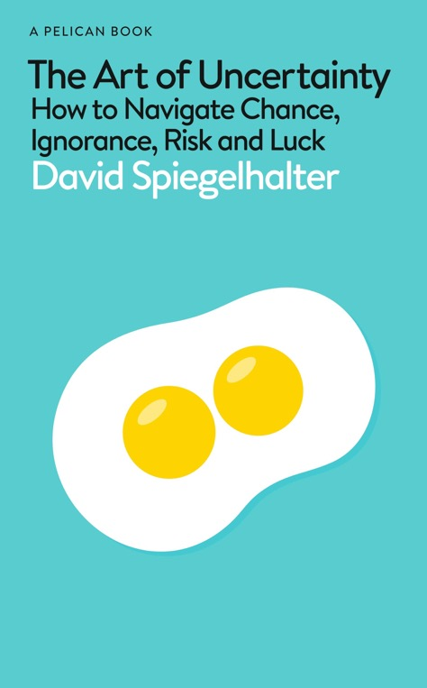
The starting point: deep uncertainty
“Just try to quantify the social impacts of generative AI in 25 years’ time. This has become known as ‘deep uncertainty’. Of course, this assumes that people have the insight and humility to admit what they don’t know.”
“[without humility] This arrogance has been termed meta-ignorance, when they don´t know what they don’t know.”
Spìegelhalter, D. (2024). The Art of Uncertainty. Pelican (audiobook).
Notes:
The problem is not mind vs. machine
It is not about ethical control over automation vs. use of automation for profit.
It is about what trained professionals can do in an age where their basic skills are within reach of all.
To ask that question properly, I will look at some bad ways of answering it, then at the history of translation automation.

Slide 8
Has the traditional discourse on ethics changed?
Lack of accuracy, fidelity, or loyalty?

Slide 9
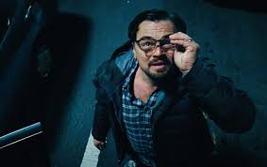
Has the traditional discourse on ethics changed?
Lack of accuracy, fidelity, or loyalty?
Lack of transparency
Marginalization of languages
Energy consumption
Lack of originality (‘anchoring’) / Loss of authentic language / Loss of emotions, nuance, context
Atrophy of translation skills / Loss of employment for professional translators

Slide 10
The wrong starting point: Justify a position
GenAI does not have…
Authentic language
Knowledge of receivers
Creativity
Real understanding
Cultural nuances / empathy / emotions
To demonstrate this:
Do not use prompts or fresh data
Test isolated sentences and phrases
Compare with a human gold standard, and no prompts
Use academic experts as evaluators
Forget how children learn to express empathy and emotions.

Slide 11
Transparency?

Slide 12
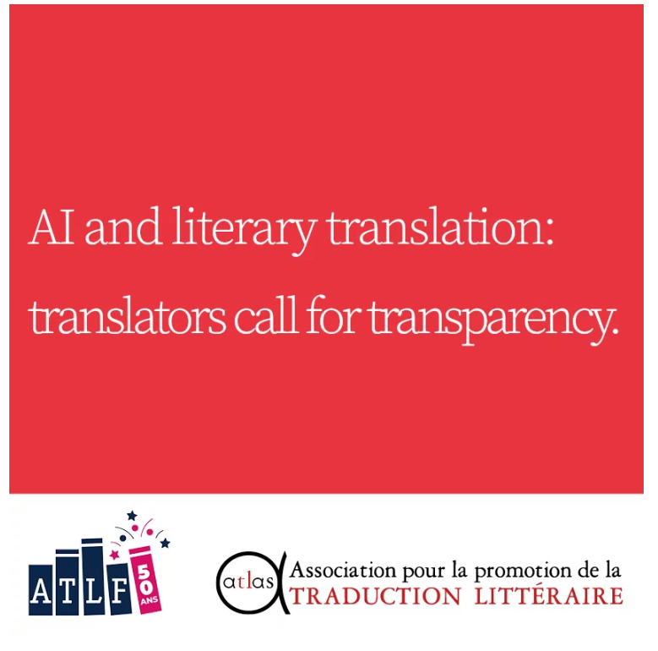
IA et traduction littéraire (ATLAS, mars 2023)

Slide 13
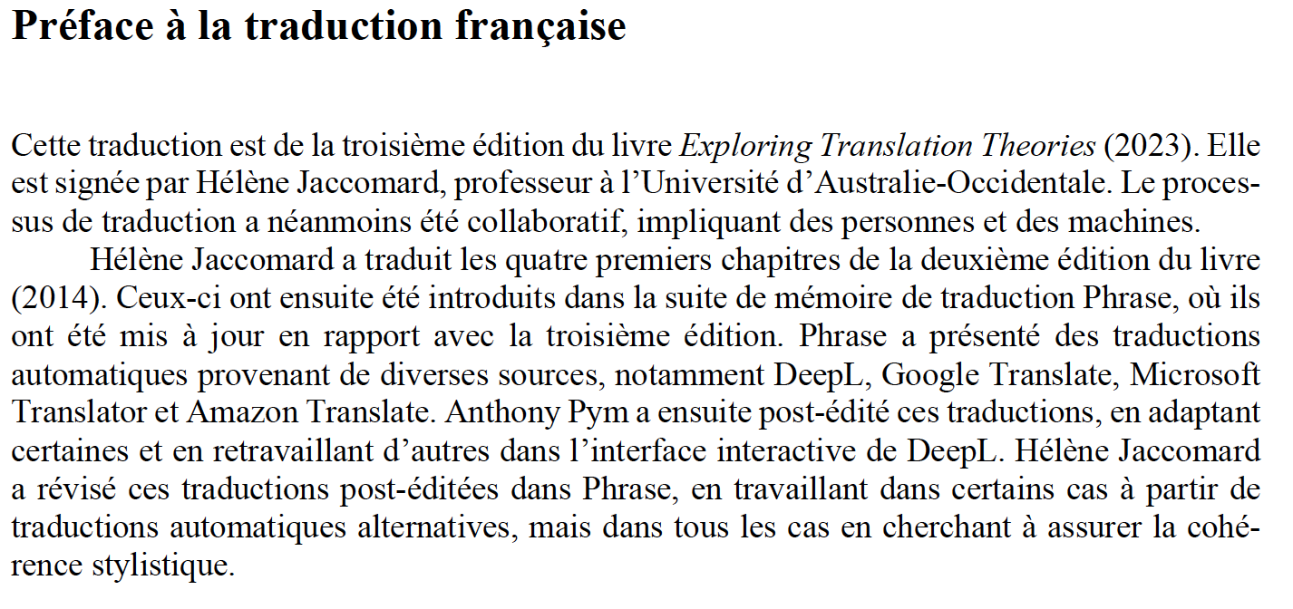
Explorations des théories de la traduction (2024)

Slide 14
Marginalization of languages?

Slide 15
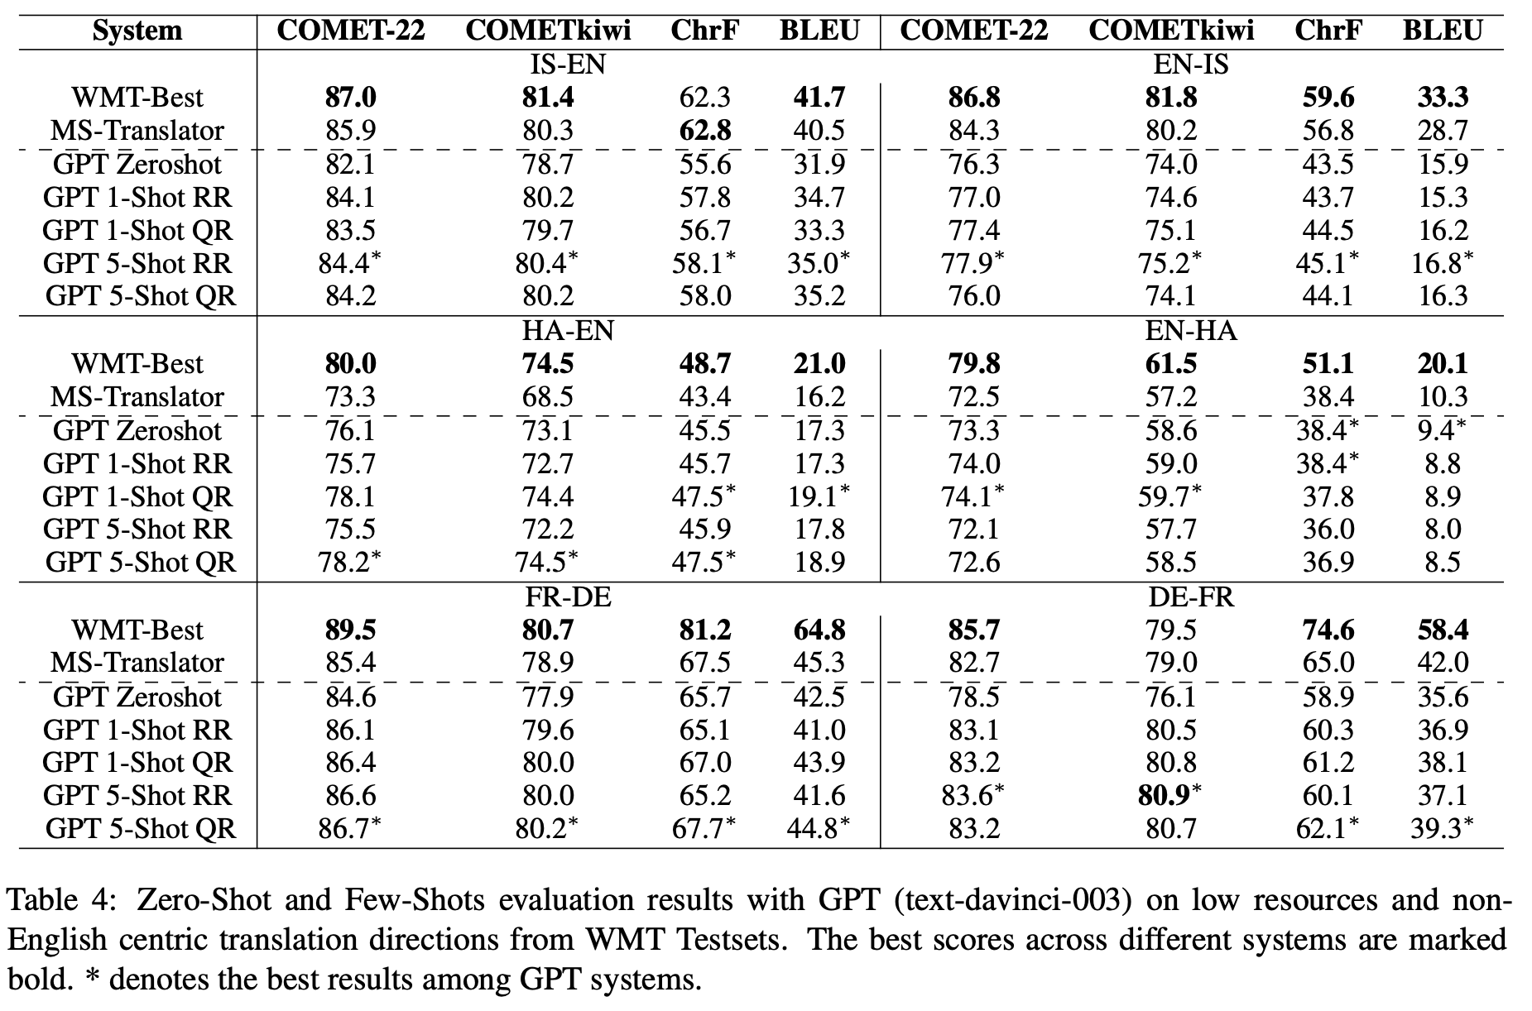
Marginalization of languages…
Hendy, Amr et al. 2023. How good are GPT models at machine translation? A comprehensive evaluation. https://arxiv.org/abs/2302.09210.
IS = Icelandic
HA = Hausa
Notes:
Same thing.

Slide 16
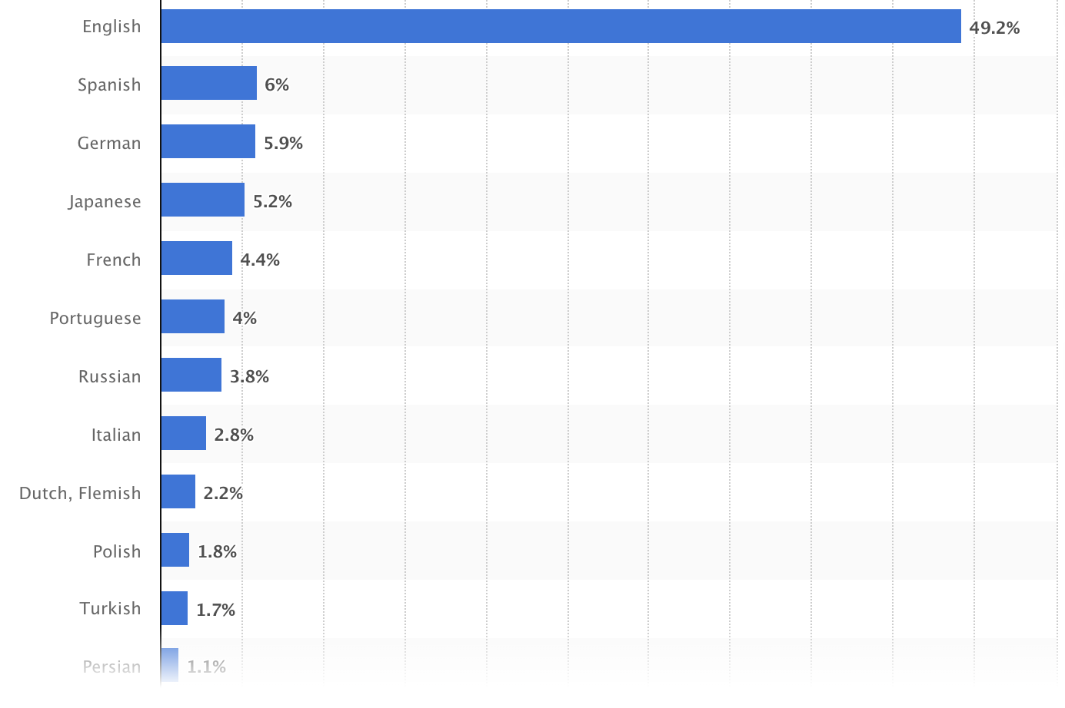
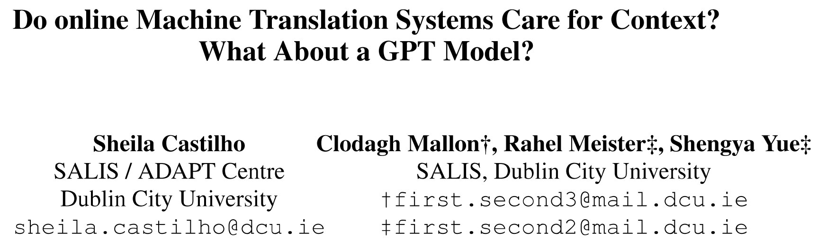
Marginalization of languages, yes: We need more electronic resources
Armenian:
NMT: questionable
GPT: rubbish
Irish:
GPT: much worse
Languages most frequently used for web content as of October 2025
https://www.statista.com/

Slide 17
Anchoring?

Slide 18
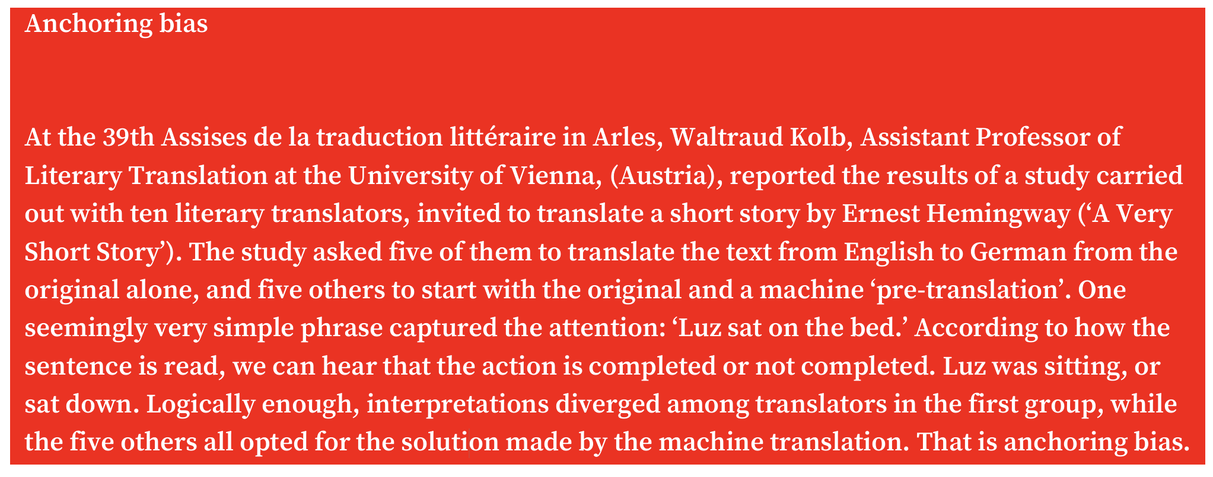
Does automation change how we work? MT dependency

Slide 19
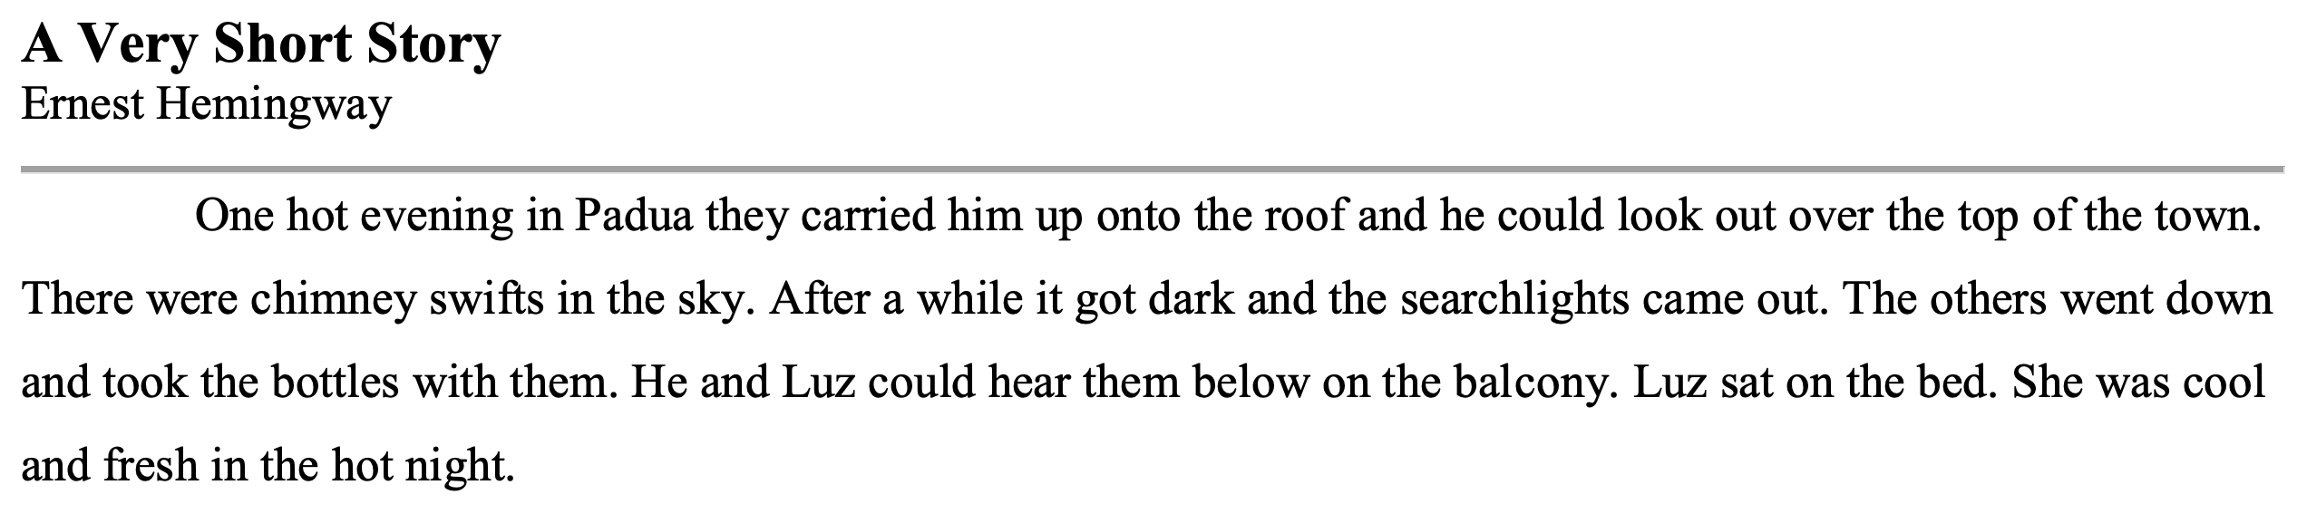
Does automation change how we work? MT dependency

Slide 20

Does automation change how we work? MT dependency?
ChatGPT5.2 Luz se sentó en la cama (sat down) x 3
Gemini Luz se sentó en la cama (sat down) x 3
Grok Luz se sentó en la cama (sat down) x 3
GoogleTranslate Luz se sentó en la cama (sat down) x 3
Luz estaba sentada en la cama (was sitting) x 1
DeepL Luz estaba sentada en la cama (was sitting)
Luz se sentó en la cama (Option 3) (sat down)
Translator 1 Luz se sentó en la cama
Translator 2 Luz se sentó en la cama
Translator 3 Luz se sentó en la cama

Slide 21
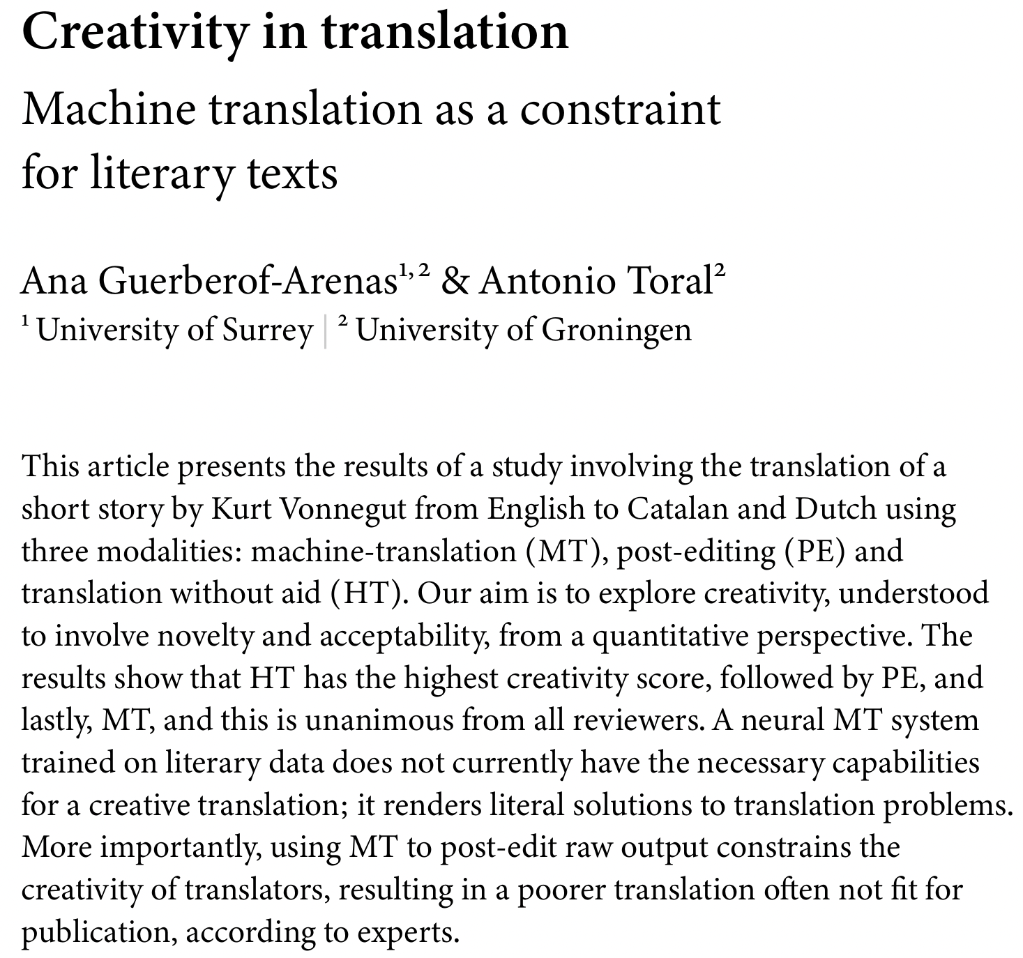
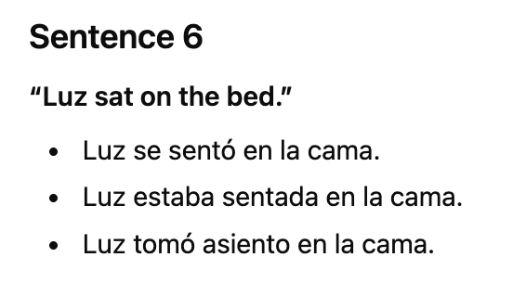
So there is no creativity?
Simple solution: Use the prompt “Suggest acceptable but creative alternatives for each sentence”

Slide 22
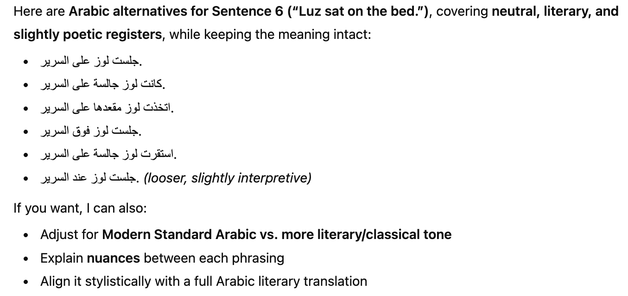
So there is no creativity?

Slide 23
Loss of authenticity?

Slide 24
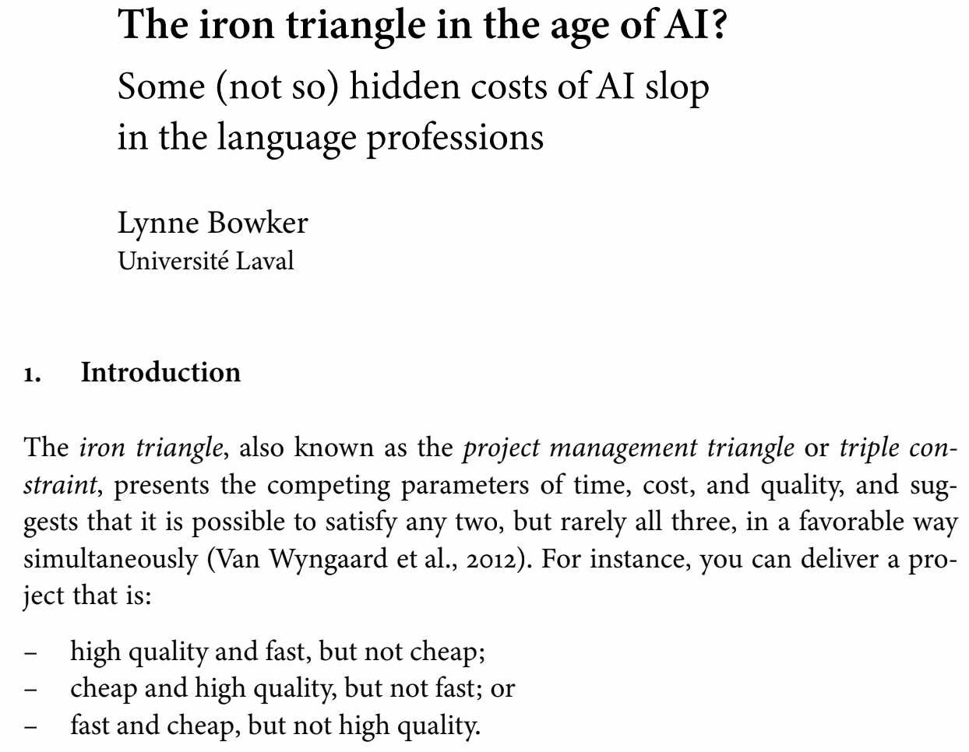
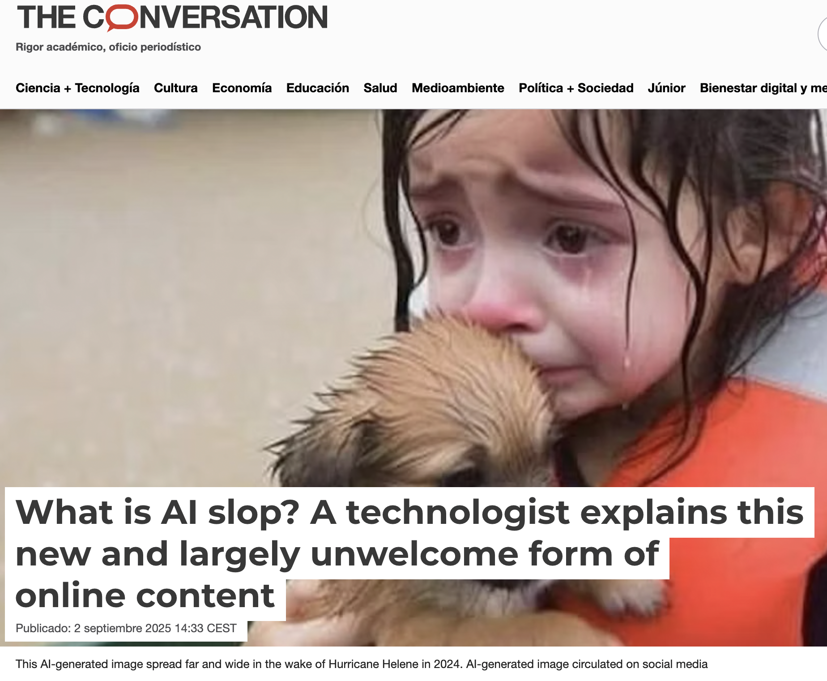
The rise of slop?

Slide 25
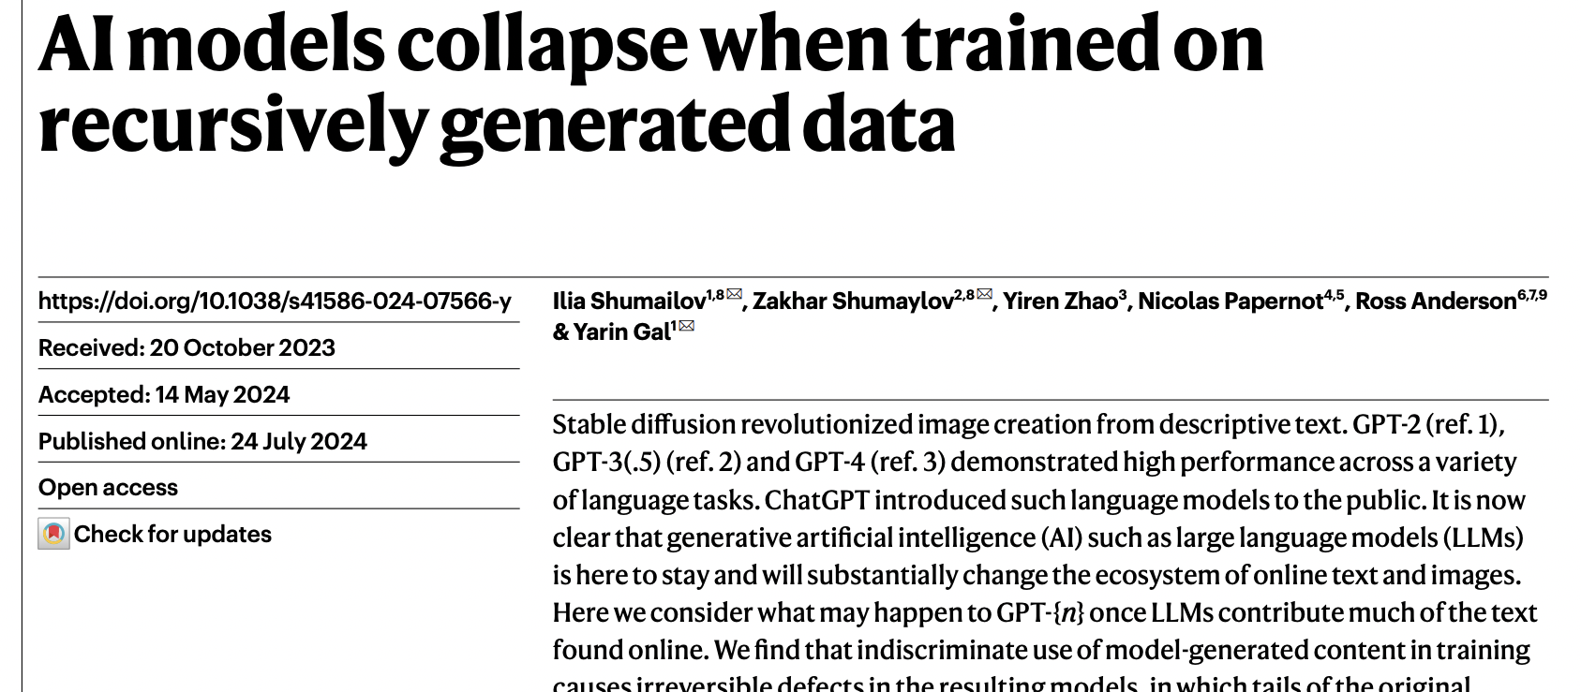
The rise of slop?

Slide 26
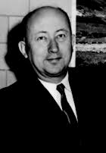
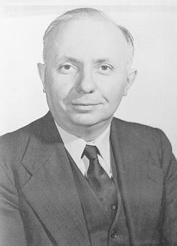
The rise of slop?
"one fears that four-fifths of the globe will live exclusively on bad translations and intellectually starve on slop for cats [bouillon pour les chats]”
Vinay & Darbelnet (1958/72, p. 54)

Slide 27
The rise of slop?
“Slop” refers to whole texts and images, not translations.
The recursive generation models do not concern translations.
Bowker presents no more than anecdotal evidence of lost authenticity.
Half a million professional translators are going to protect the purity of all the world’s languages?
Since 1958, four-fifths of the globe learned English!

Slide 28
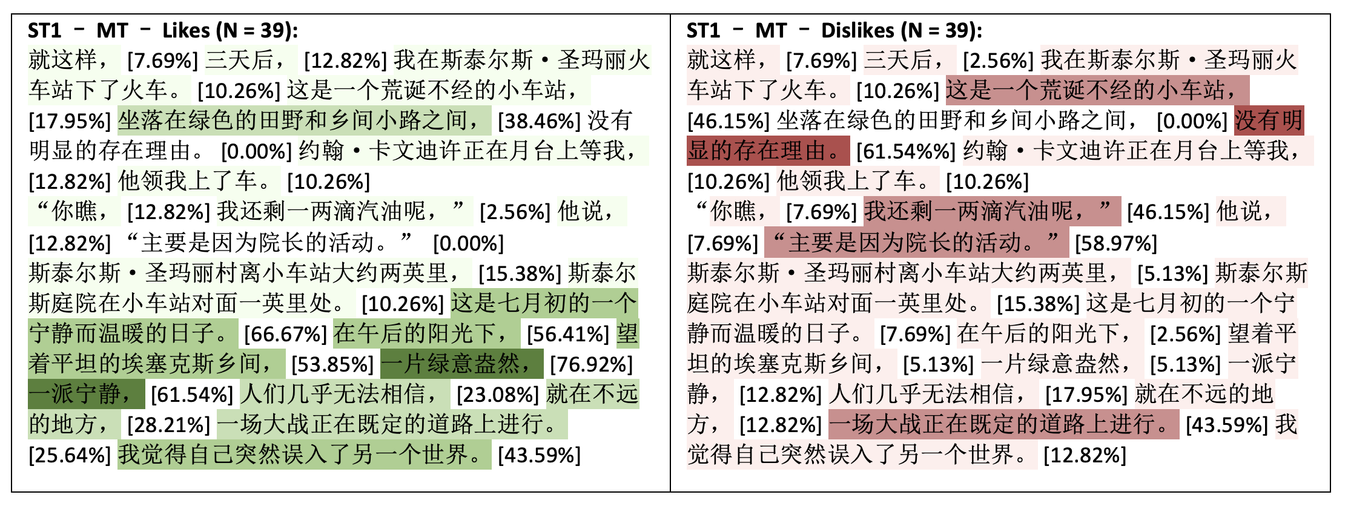
Ke Hu’s research on reader response

Slide 29
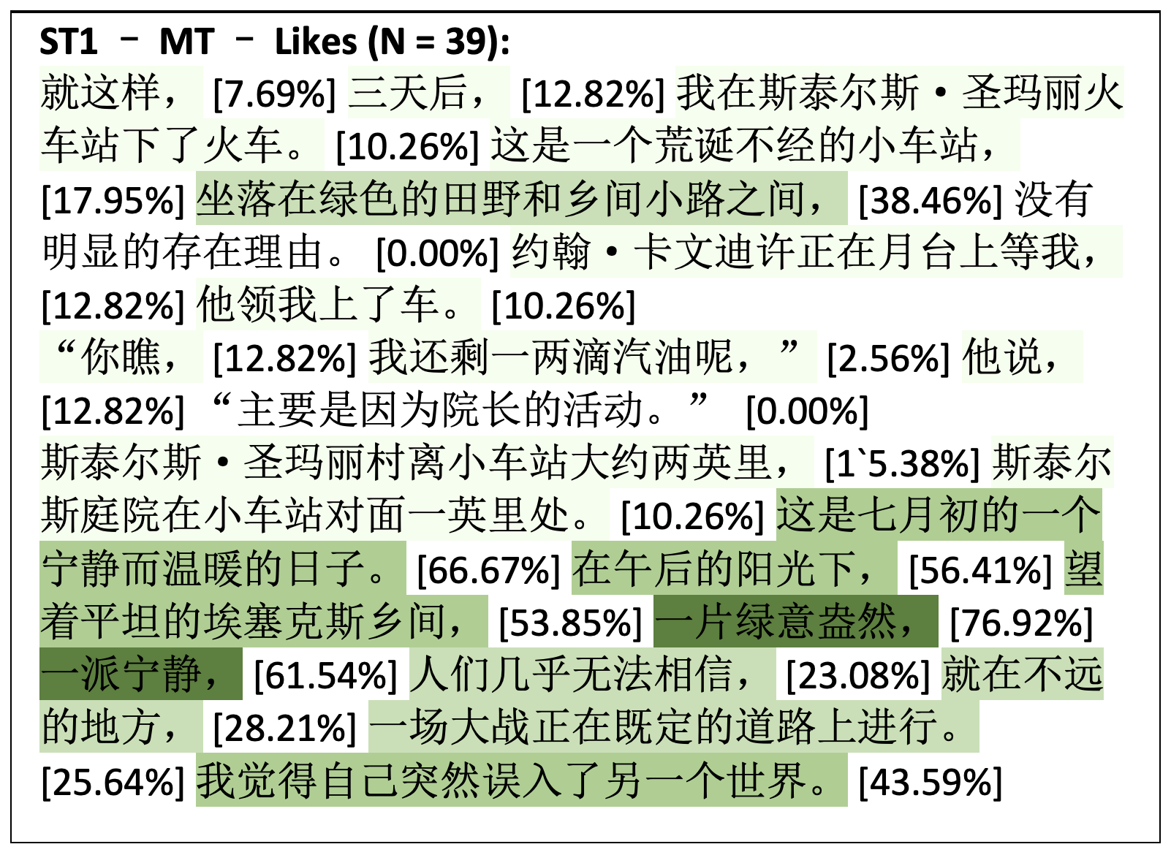
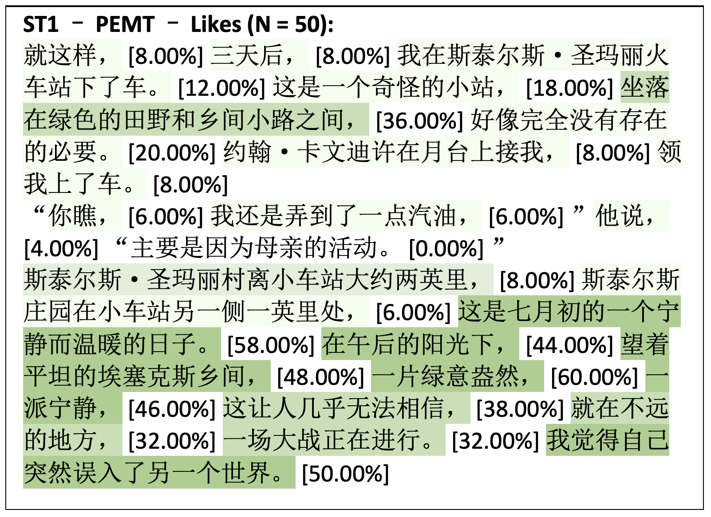
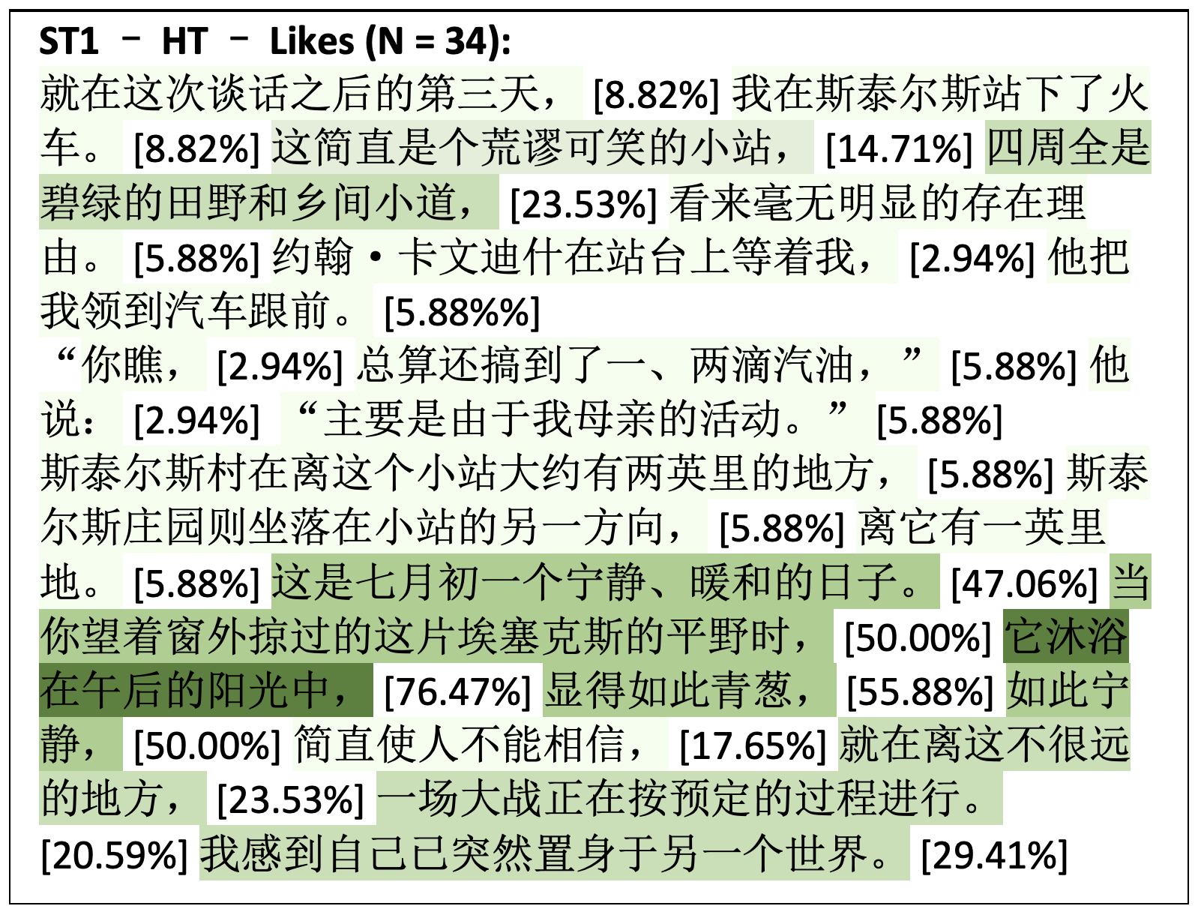
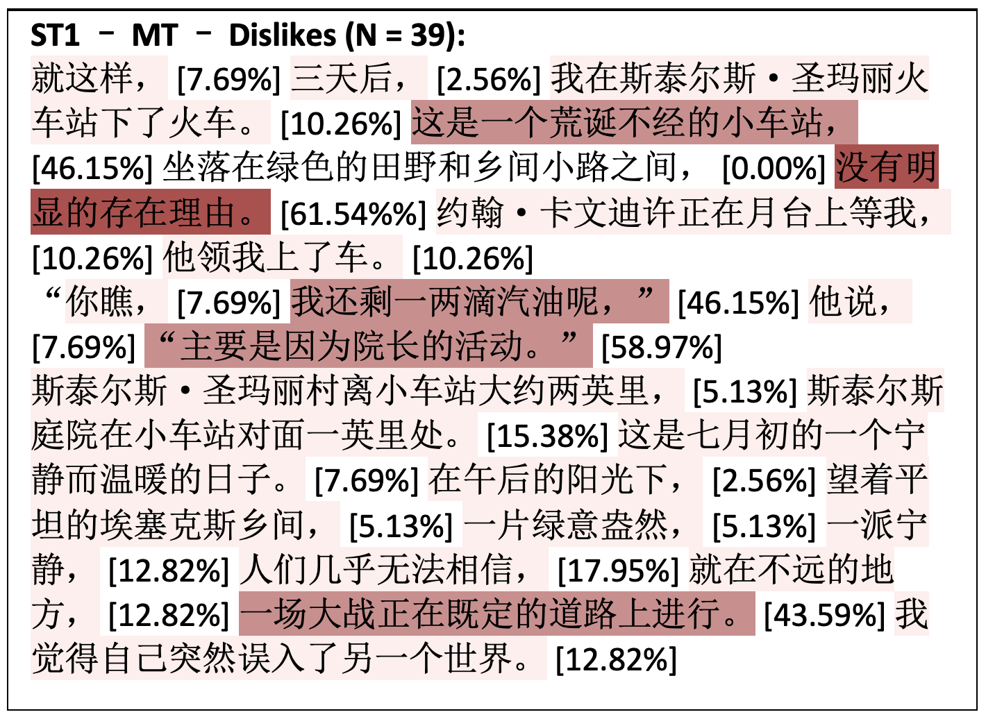
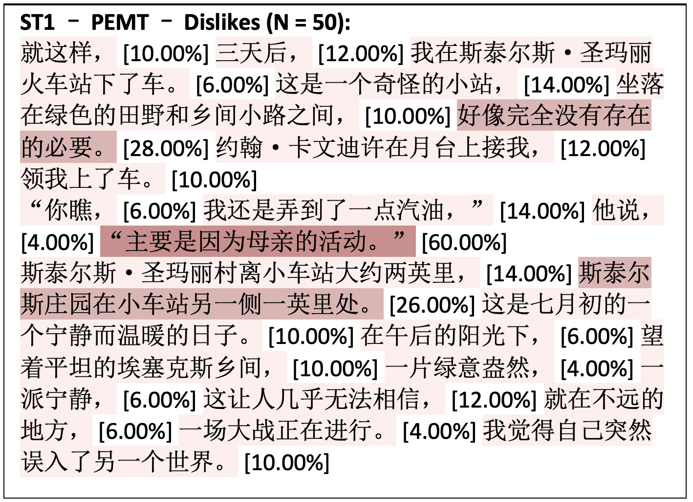
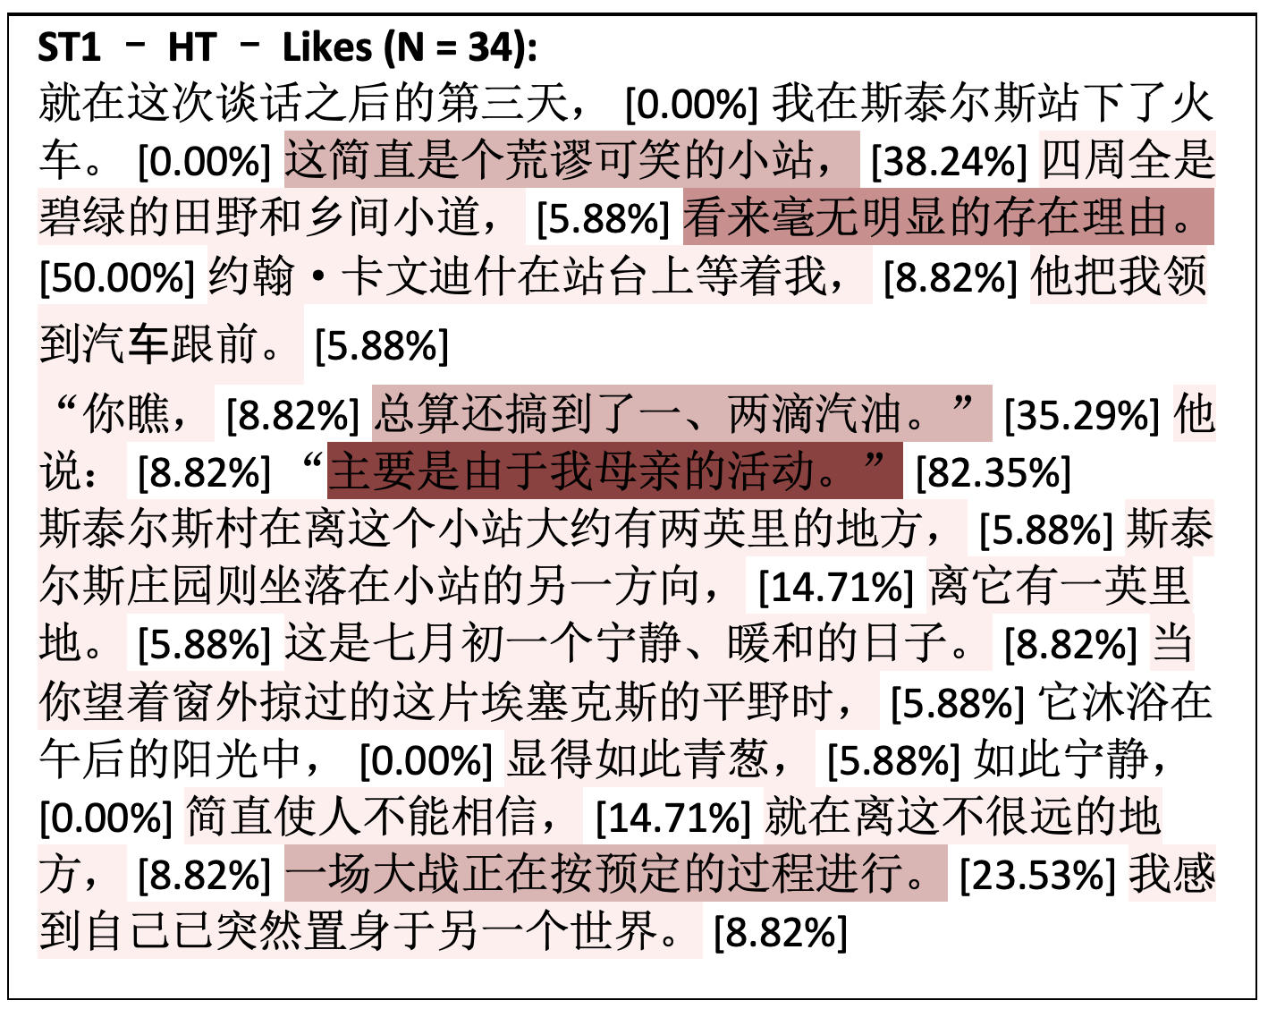
MT
MTPE
HT

Slide 30
Loss of employment?

Slide 31
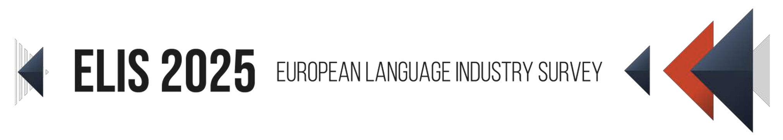
A shrinking industry?
“the average size of participating language companies has been steadily growing”
(ELIA 2024: 7).
“39% of language company participants reported lower staffing levels and only 11% reported an increase”, while 23% of self-employed translators are considering ending their freelance activity.”
(ELIA 2025: 14, 24).

Slide 32
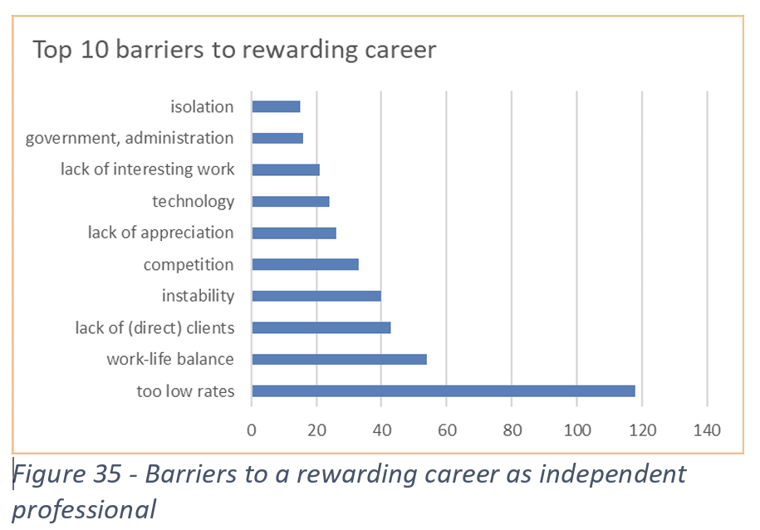
There is more than AI in the mix: ELIA 2023
ELIA (2023). European Language Industry Survey 2023.
Trends, Expectations and Concerns of the European Language Industry.
https://elis-survey.org/.
Notes:
This slide is only for emergencies.

Slide 33
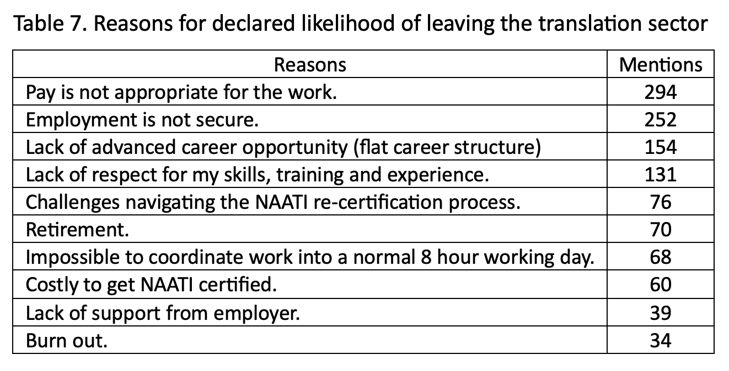
There is more than AI in the mix
Pym, A., & Macreadie, R. (2024). Why Interpreters and Translators Say They Intend to Leave the Sector in Australia.
A Critical Statistical Analysis. ResearchGate. http://dx.doi.org/10.13140/RG.2.2.29106.82882
Notes:
This slide is only for emergencies.

Slide 34
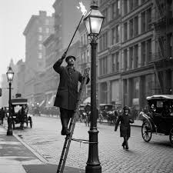
There is more than AI in the mix
Notes:
This slide is only for emergencies.

Slide 35
In summary
Transparency
Yes, lots of it!
Marginalization of languages?
Yes, we need more electronic resources.
Anchoring?
This may not be a problem – norms are everywhere.
Creativity and authenticity?
Learn to use prompts!
Employment?
Get real!

Slide 36
Environmental disaster?

Slide 37

What are the costs?
8 July 2025:
Generative AI tools are now used by over 1 billion people daily. Each interaction consumes energy—about 0.34 watt-hours per prompt. This adds up to 310 gigawatt-hours per year, equivalent to the annual electricity use of over 3 million people in a low-income African country.
Small models tailored to specific tasks can cut energy use by up to 90%.
Shorter, more concise prompts and responses can reduce energy use by over 50%.
The aim should not be
Artificial General Intelligence (AGI)

Slide 38
A cost-benefit analysis
Costs should be less than the benefits.
So what are the benefits?

Slide 39
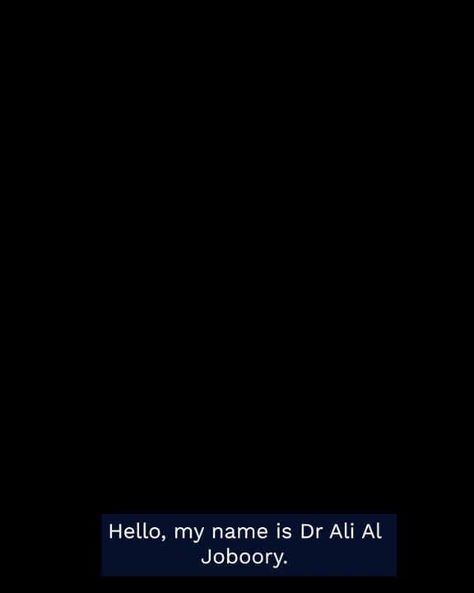
The ethical bottom line
If language mediation enables cooperation between participants, then it is ethically valid.

Slide 40
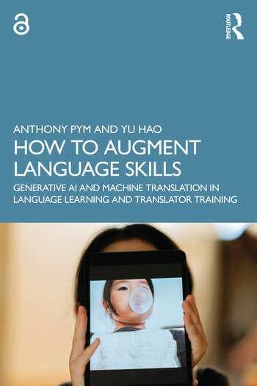
What is to be done?
Include language automation in all our language teaching:
Moderate expectations
Cultivate low trust
Encourage exploration

