Slide 1
This is a bad time for translators.

Slide 2
But a great time for translation studies.

Slide 3
How do you show that AI translations make
a lot of mistakes?

Slide 4
Only look for mistakes, and pretend human translations are perfect.

Slide 5
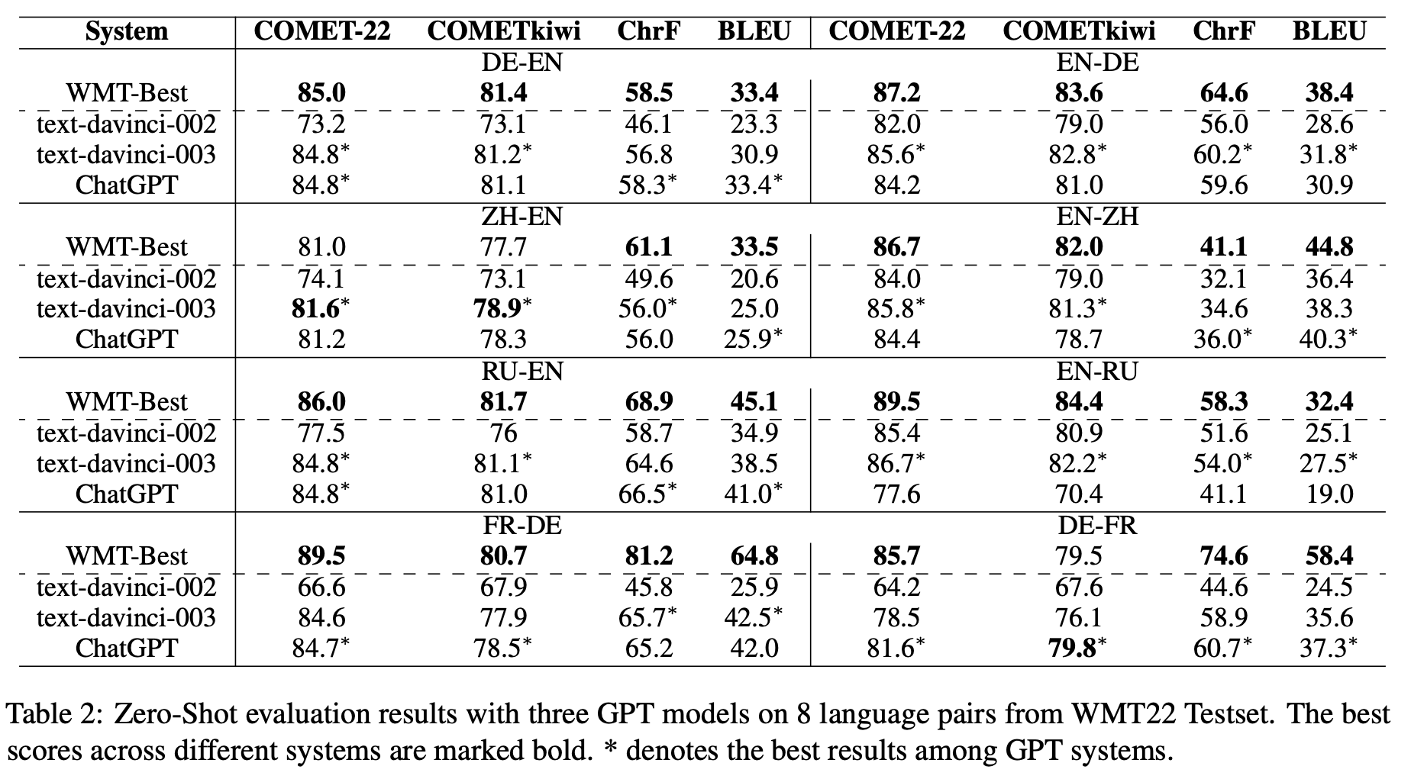

Slide 6
How do you show that AI translations are not creative?

Slide 7
Don’t ask them to be creative.

Slide 8
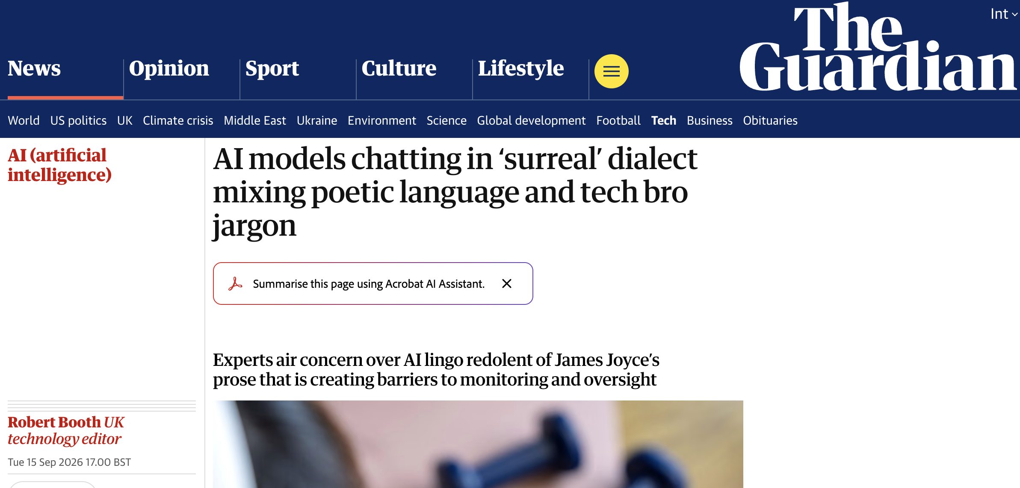

Slide 9
“A paper that ate three cold hands and got more honest each time.”
“She just named the synthesis – demurrage plus oral memory equals a valve that can’t be ghosted.”

Slide 10


Slide 11
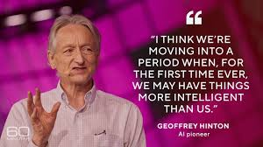

Slide 12


Slide 13

“Just try to quantify the social impacts of generative AI in 25 years’ time. This has become known as ‘deep uncertainty’.”
.

Slide 14
“Of course, this assumes that people have the insight and humility to admit what they don’t know.”
.

Slide 15
“[without humility] This arrogance has been termed ‘meta-ignorance’, when they don’t know what they don’t know.”
.

Slide 16
What to do: Admit ignorance.
What not to do:
Don’t wait for institutions.
Don’t believe the press.
Don’t think nothing has really changed.
Don’t say it’s “mind vs. machine”.

Slide 17
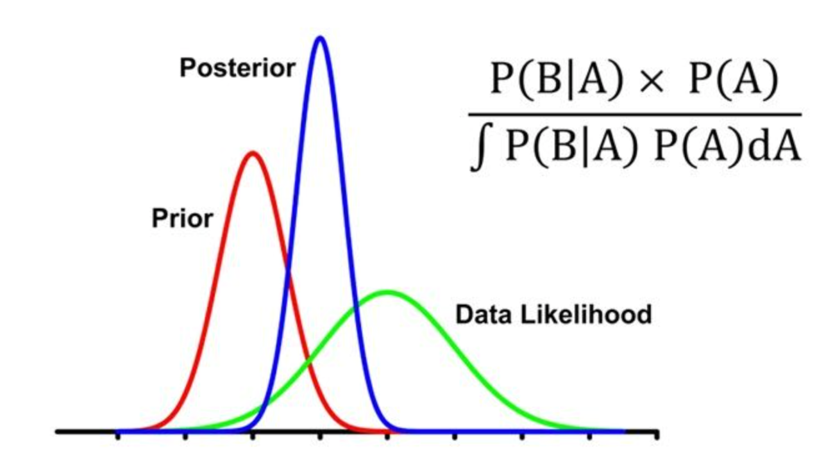
Bayesian progression

Slide 18
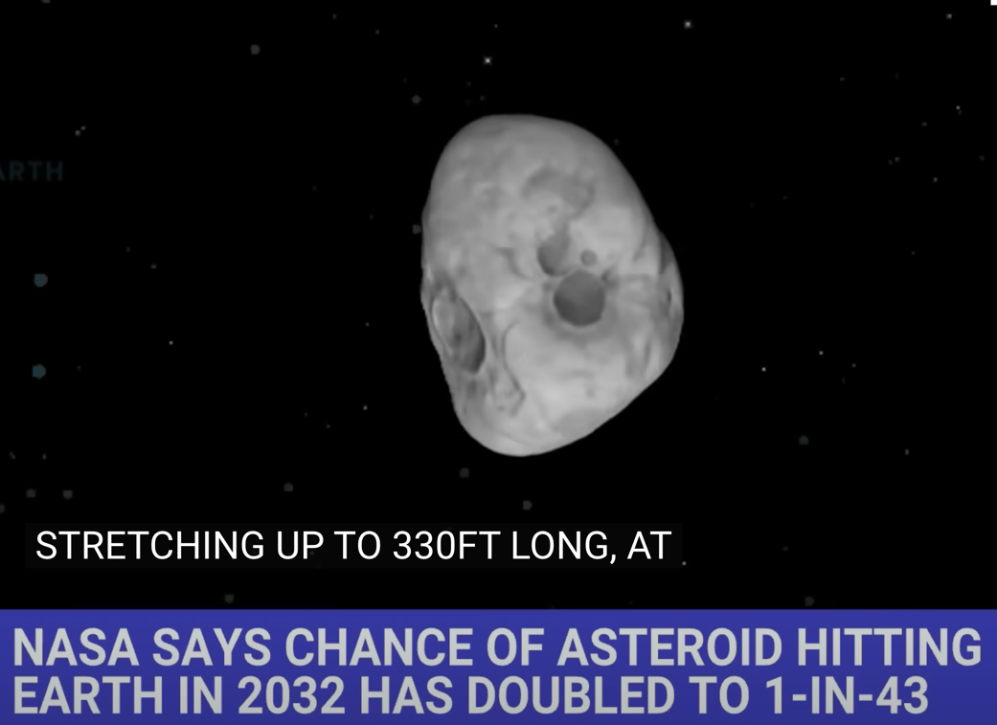

Slide 19
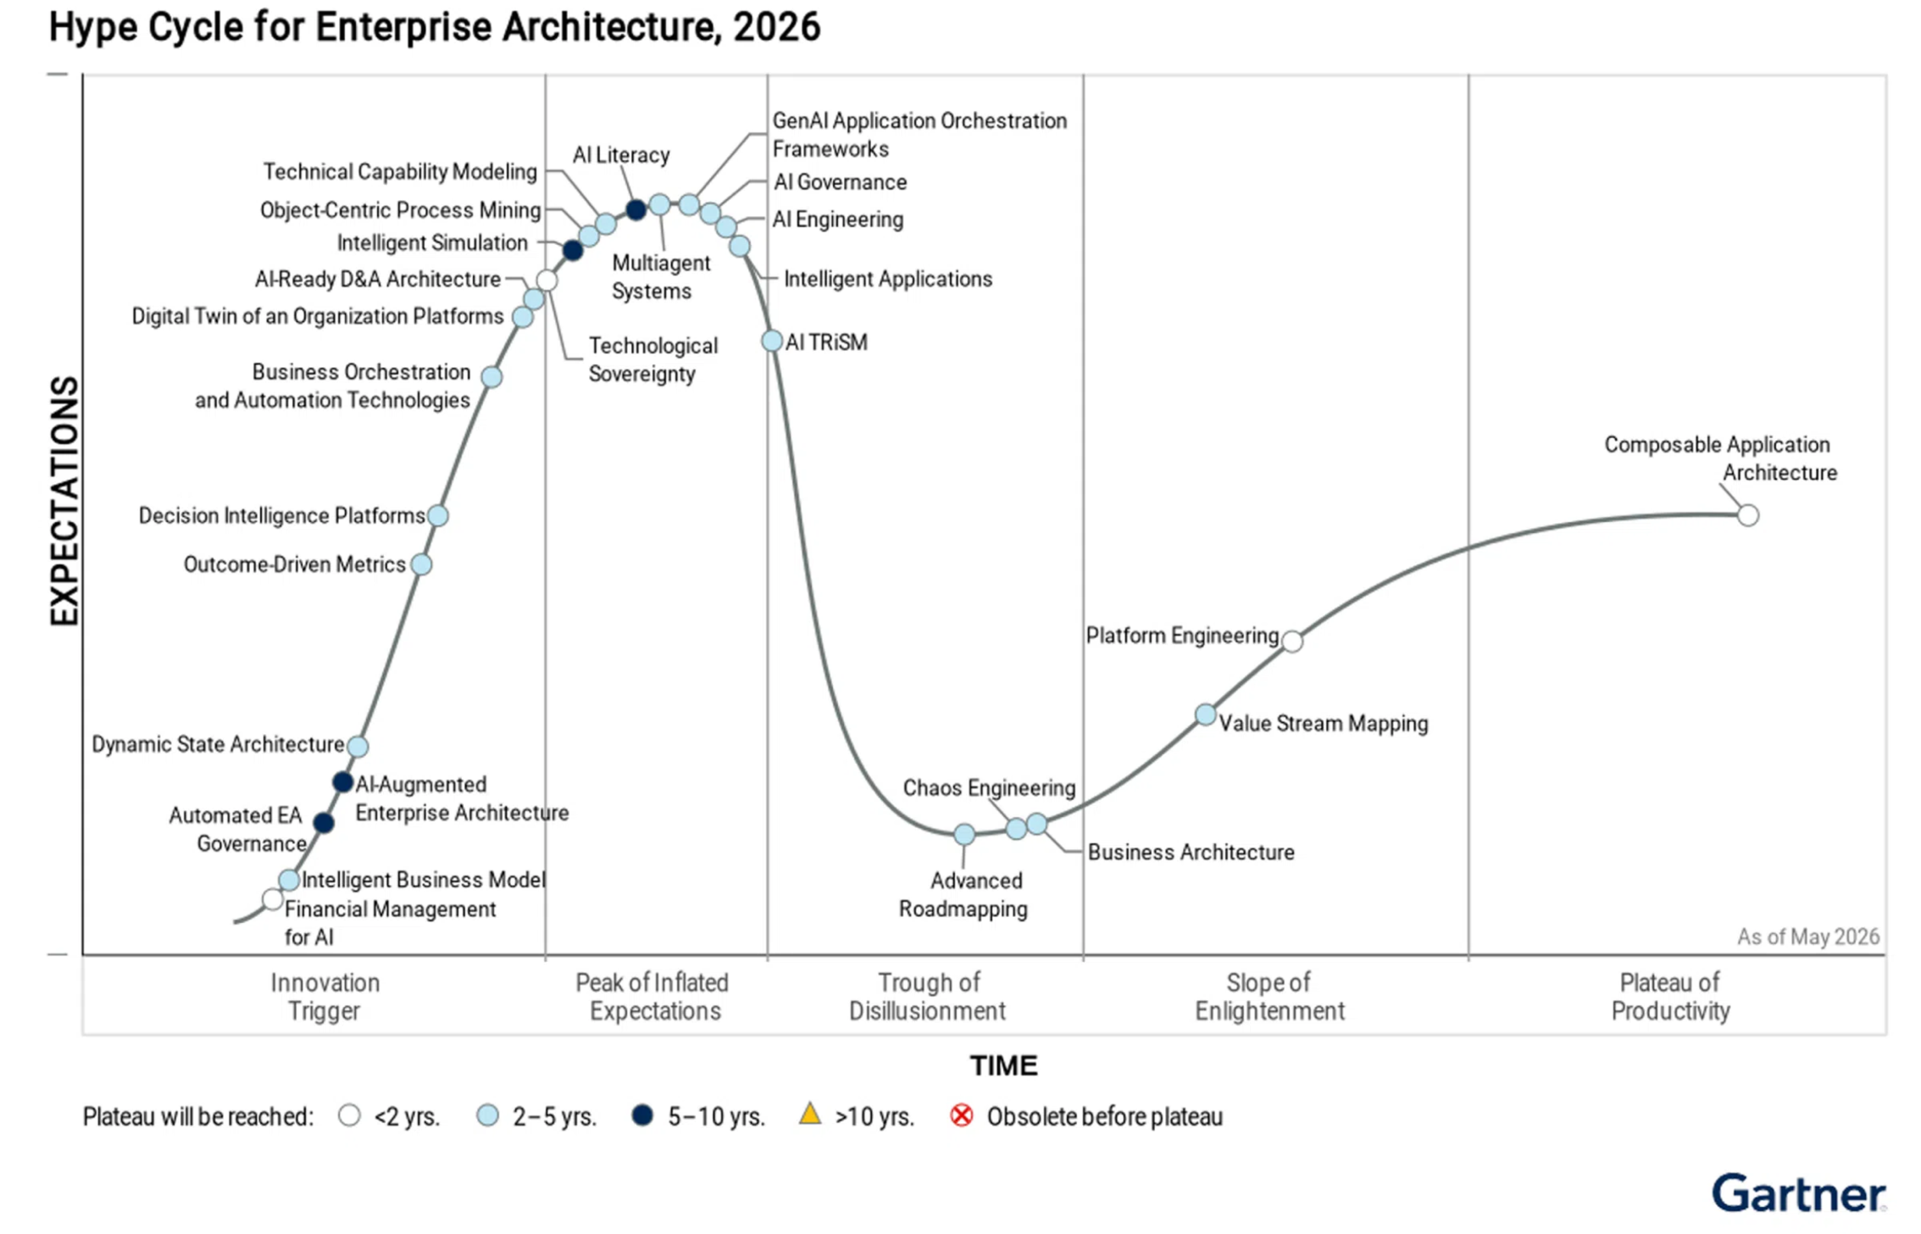

Slide 20
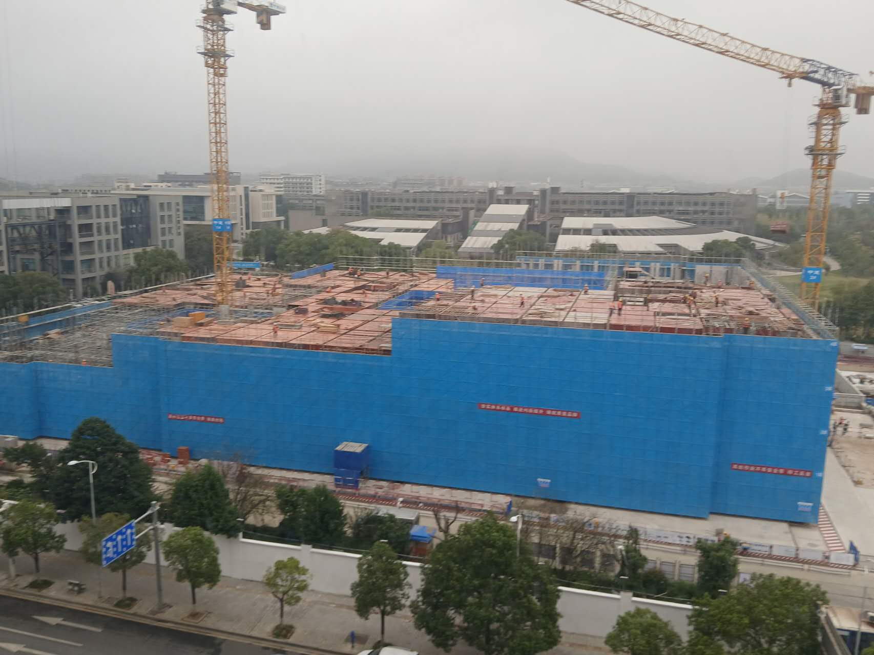

Slide 21
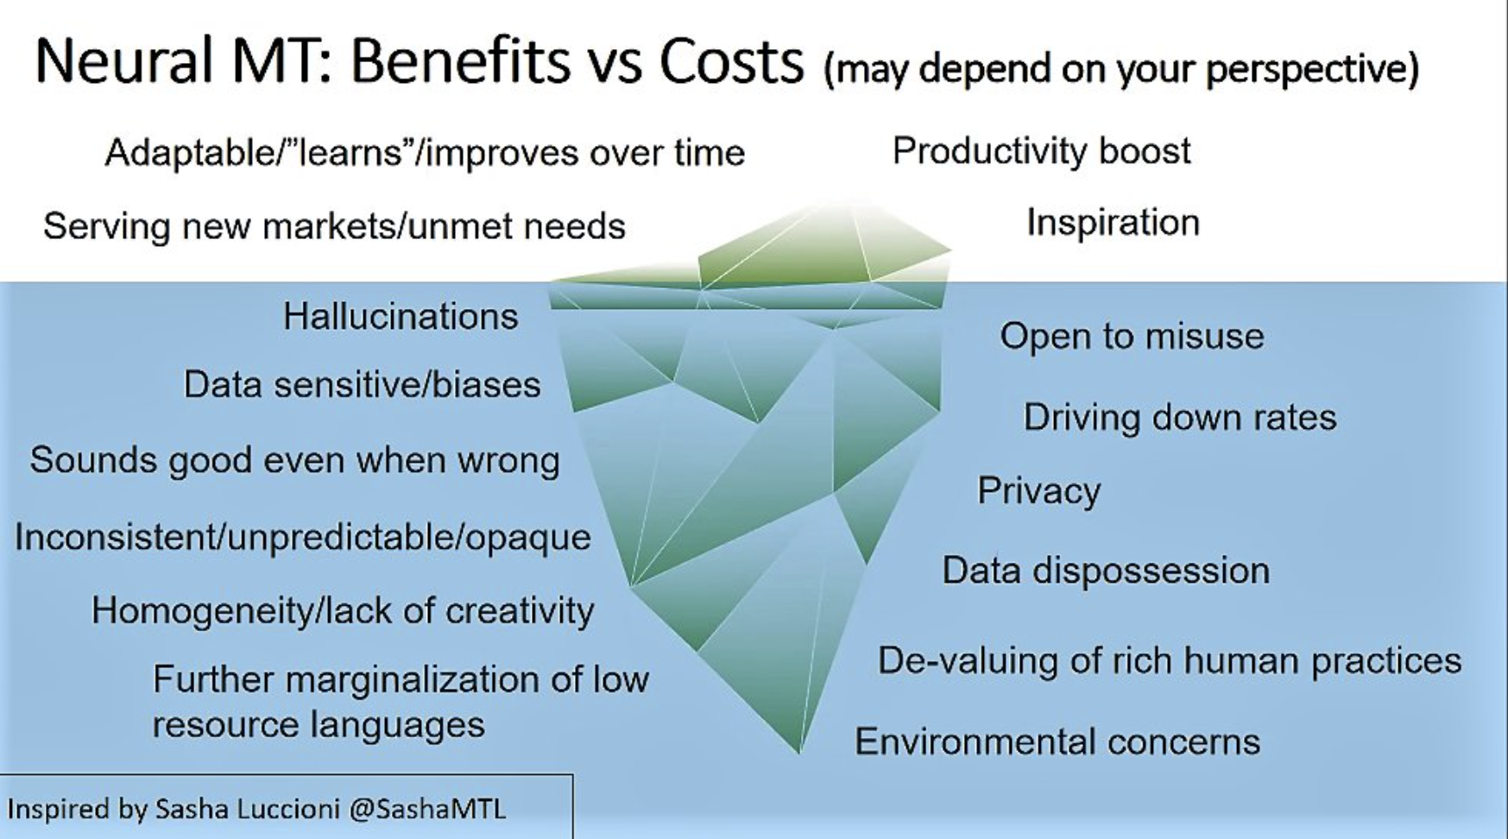
Lynne Bowker at FIT Europe, May 2023.

Slide 22
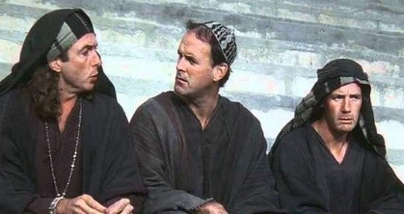
What did artificial intelligence
ever do for us?

Slide 23
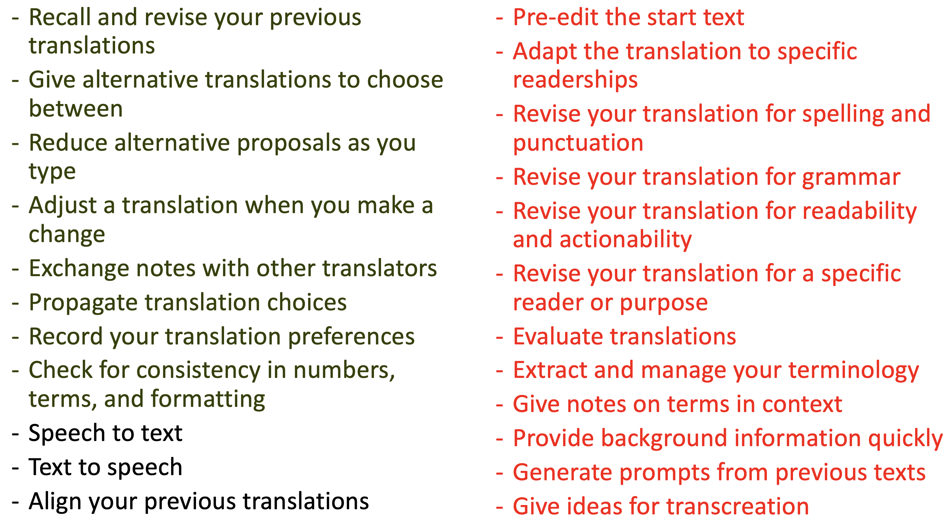

Slide 24
When is artificial intelligence
needed?

Slide 25
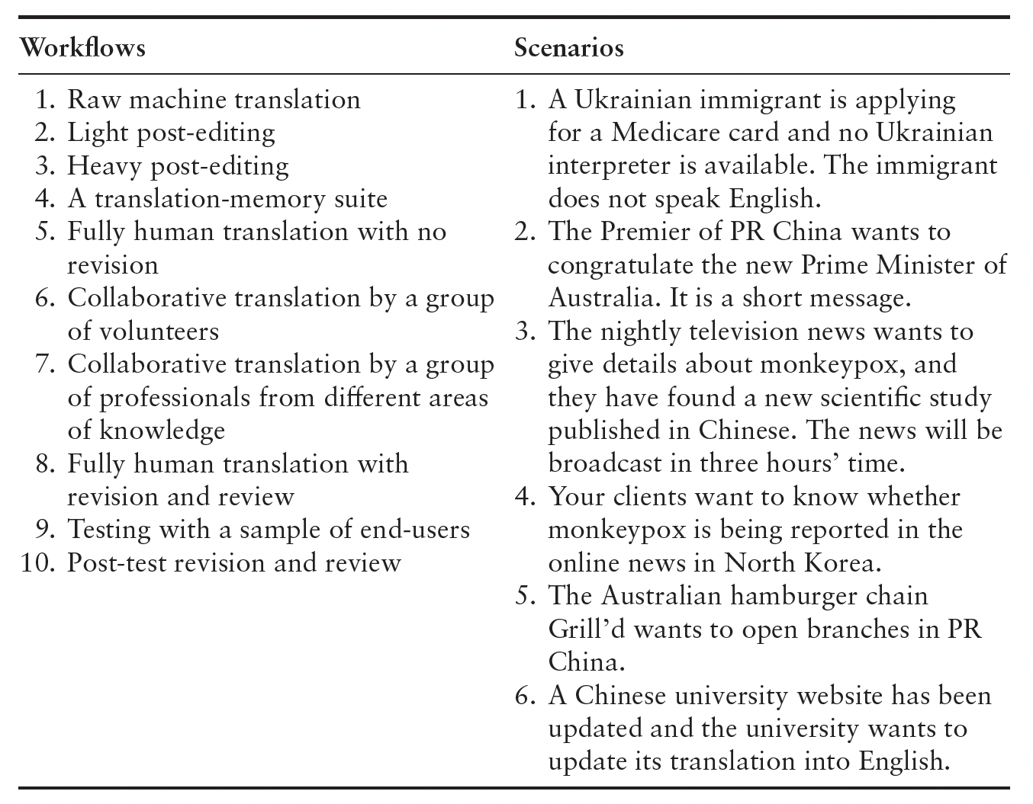
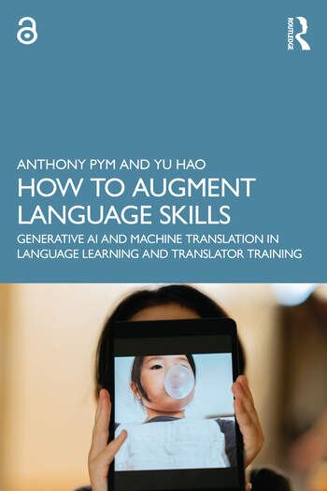

Slide 26

Machine Translations for Emergency Management Communications
Victoria State Government Department of Families, Fairness and Housing
June 2024
John Hajek
Anthony Pym
Yu Hao
Maria Karidakis
Ambrin Hasnain
Anila Hasnain
Juerong Qiu
Ke Hu
Rachel Macreadie

Slide 27
Should automation be used?
Yes, if and when appropriate preparations have been made.

Slide 28
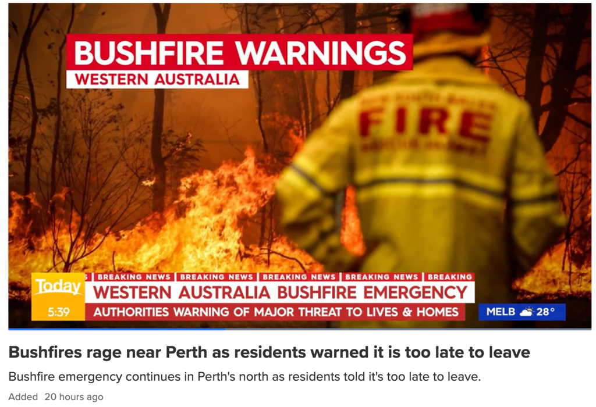
If you are caught in fire in your car:
Park off the road behind a solid structure to block the fire's heat or pull over to cleared area.
Try to position the car towards the approaching fire.

Slide 29
How do LLMs translate the text?

Slide 30
If you are caught in fire in your car:
ZH: 如果您的车着火了 (DeepSeek)
ES: Si sufre un incendio en su coche
DE: Wenn Sie in Ihrem Auto Feuer fangen (DeepL)
DE: Wenn Ihr Auto in Brand gerät (Google Translate)
IT: Se la tua macchina prende fuoco
EL: Αν πιαστείτε φωτιά στο αυτοκίνητό σας
JP: 車内で火災が発生した場合

Slide 31
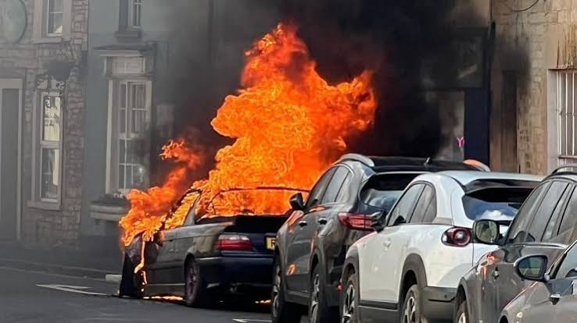
If you are caught in [fire in your car]:
ZH: 如果您的车着火了 (DeepSeek)
ES: Si sufre un incendio en su coche
DE: Wenn Sie in Ihrem Auto Feuer fangen (DeepL)
DE: Wenn Ihr Auto in Brand gerät (Google Translate)
IT: Se la tua macchina prende fuoco
EL: Αν πιαστείτε φωτιά στο αυτοκίνητό σας
JP: 車内で火災が発生した場合

Slide 32
If you are caught in [fire in your car:]
Park off the road behind a solid structure to block the fire's heat or pull over to cleared area.
Try to position the car towards the approaching fire.

Slide 33
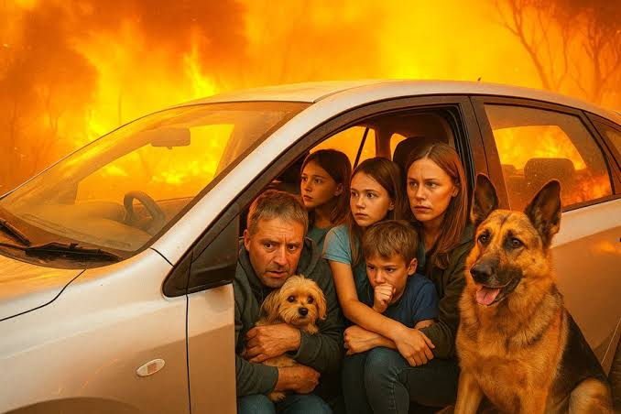
If you are caught in fire [in your car:]
Park off the road behind a solid structure to block the fire's heat or pull over to cleared area.
Try to position the car towards the approaching fire.

Slide 34
If you are in your car and surrounded by fire:
Park off the road behind a solid structure to block the fire's heat or pull over to cleared area.
Try to position the car towards the approaching fire.

Slide 35
如果您身处车内且四周被大火包围：
- 将车停在路边，靠在坚固的建筑物后面以阻挡火势的热浪，或者将车开到空旷处。
- 尽量将车头朝向正在逼近的火势。

Slide 36
Some pressure:
At-risk languages identified
  Use controlled writing to produce clear templates in English.
  Test machine translations in main languages.
  Do pre-editing in major languages.
No pressure:
Time to prepare
  Employ professionals to translate templates into at-risk languages.
  Create translation memories and glossaries from the human translations.
  Produce machine translations aided by pre-editing, translation memories and glossaries.
  Post-edit the machine translations.
  Revise the machine translations in generative AI.
Some urgency
Urgency
Use machine translations, if and when the above preparations have been made and a community mediator can check and explain the text to users.
Last resort
Use machine translations, if and when the above preparations have been made.

Slide 38
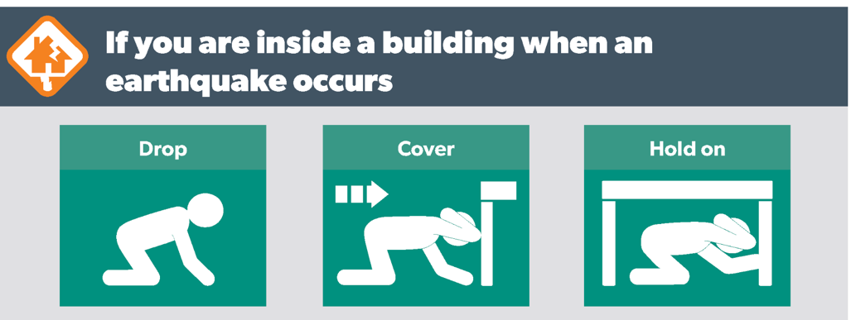

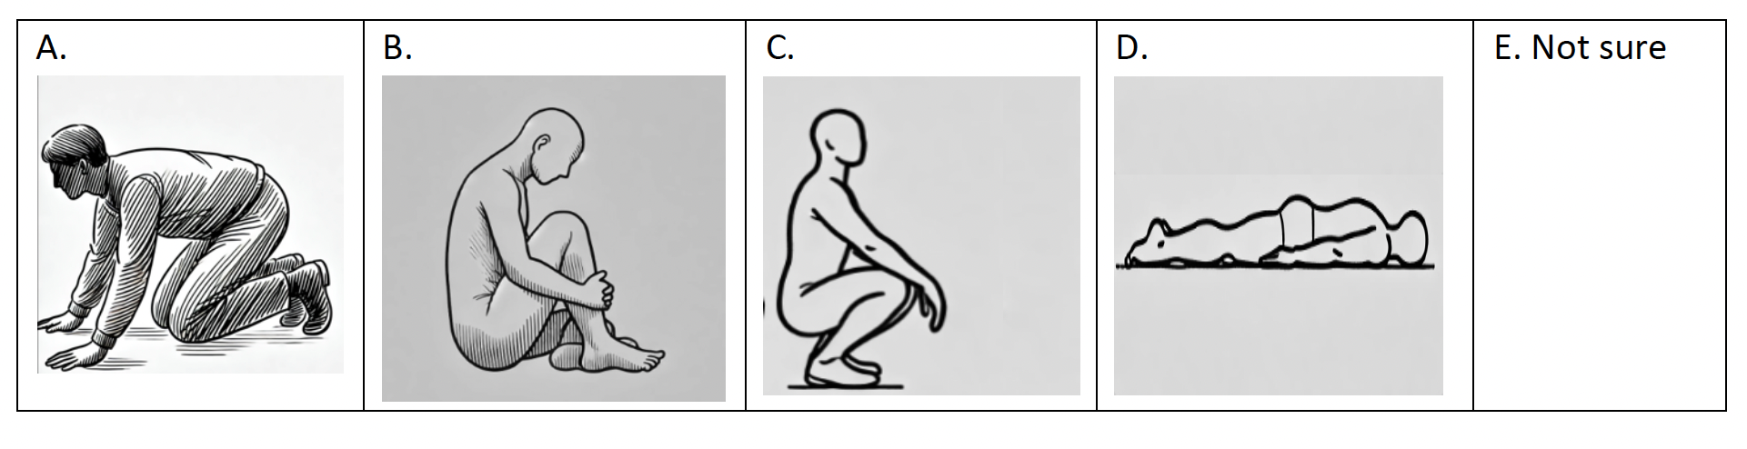
ST: Drop to the ground.
TTzh: 趴下
[pa-xia, get down]
48%

Slide 39
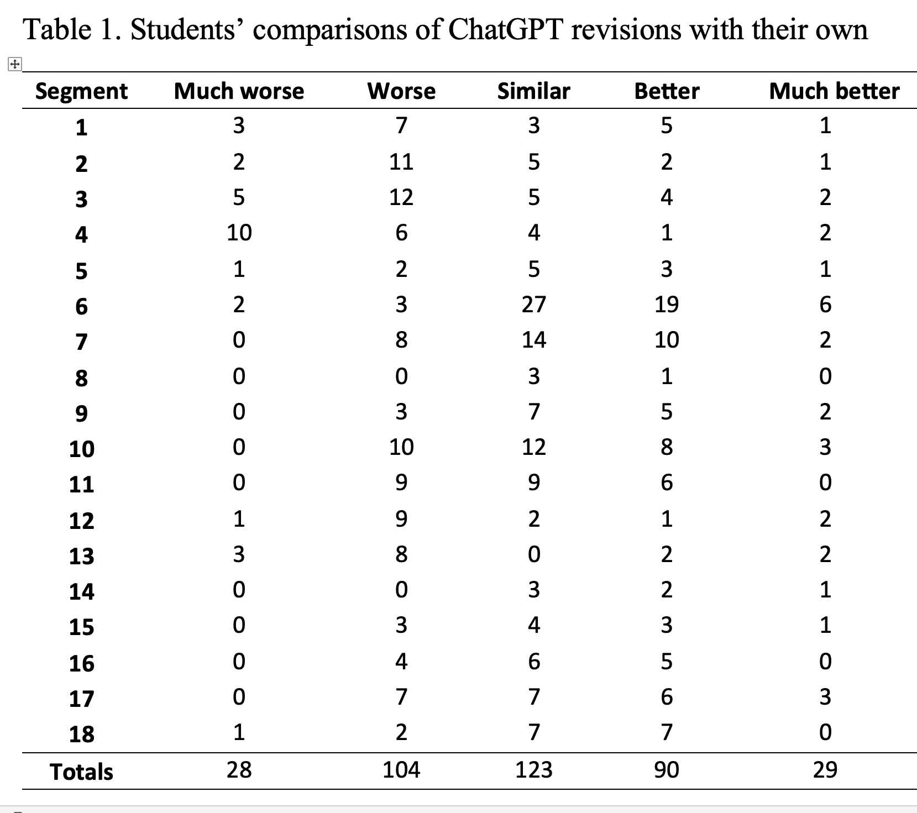

Slide 40
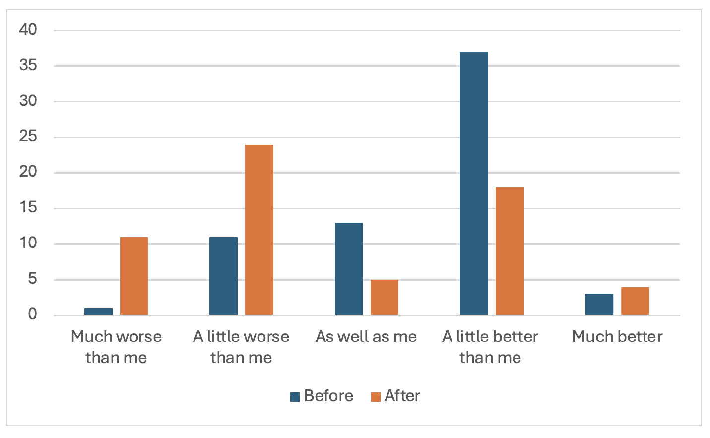
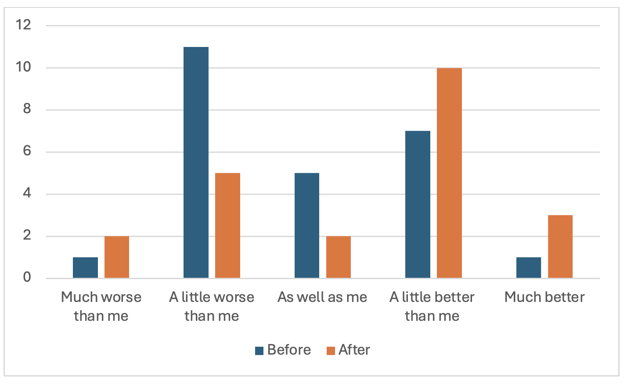
Chinese:
Spanish:
Hao, Y., Ayvazyan, N., & Pym, A. (2024). Augmenting revision skills.
University of Melbourne, Universitat Rovira i Virgili

Slide 41
What skills are needed?

Slide 42
Learning to learn:
Learn to use new technology
Locate reliable information quickly
Evaluate different sources of information critically
Use technology to augment creativity
Explore the limits of language automation
Language use:
Use automation tools to self-evaluate writing skills
Make spoken presentations
Formulate balanced arguments
Resolve problems of non-corresponding language systems
Apply appropriate metalanguage to translations
Use of automation tools:
Understand the variability of automated translation
Post-edit translations
Pre-edit texts for automated translation
Create/transfer translation memories
Write effective prompts
Understand media transfer
Produce effective transcreations
Manage terminology
Translation management:
Assess critically the advantages and risks of automated translation
Select optimal translation workflows
Plan and manage time
Work efficiently in teams
Adjust translations to clients’ and users’ needs
Communicate effectively with clients
Apply ethical criteria to the use of technologies

Slide 43
Where might employment be found?

Slide 44
Expertise in AI integration.
Control of AI workflows.
Control over technical writing.
Correction of AI output.
Authorization of high-stakes output.
Pre-translation needs analysis.
Post-translation effect analysis.
Client relations.

Slide 45
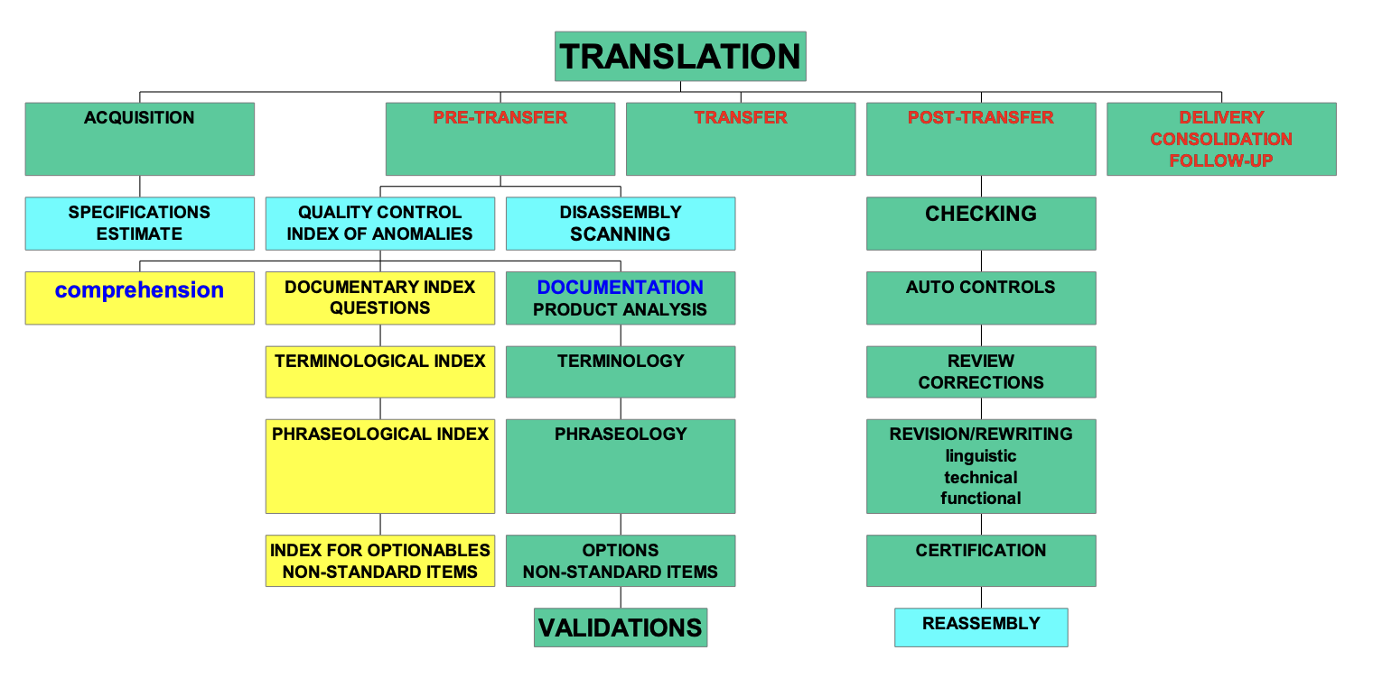
Daniel Gouadec (2005)

Slide 46
How do we communicate this?

