Slide 1
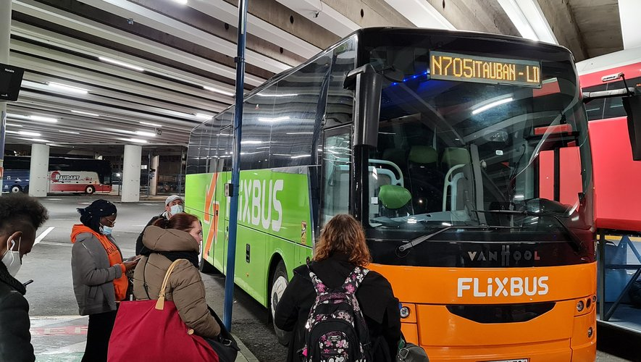
On fait une pause dans 20 minutes.

Slide 2
Haremos una parada 20 minutos.

Slide 3
Message
Excluded
Observational
Participative
Access
Comprehension
Action
trust

Slide 4
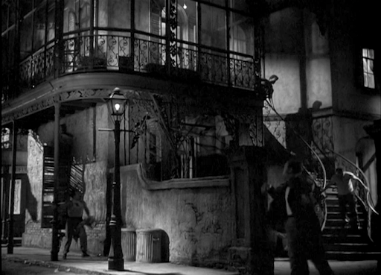
The exterior of a two-story corner building on a street in New Orleans which is named Elysian Fields and runs between the L & N tracks and the river.

Slide 5
The exterior of a two-story corner building on a street in New Orleans which is named Elysian Fields and runs between the L & N tracks and the river.

Slide 6



Slide 7
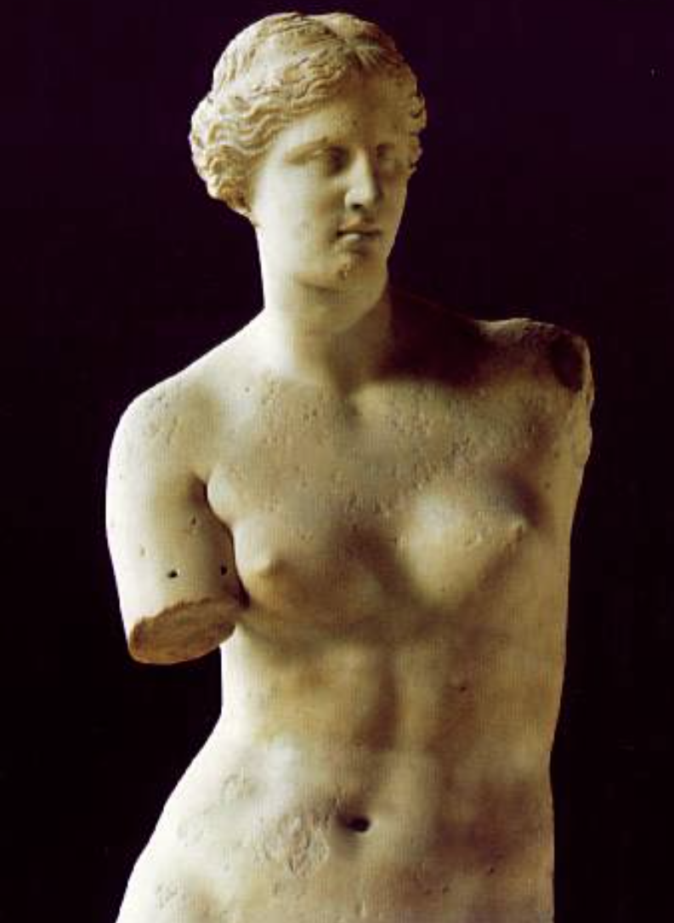
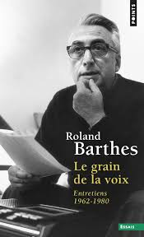

Slide 8
The detail authenticates.
Why?

Slide 9
The detail points backwards.
The detail indicates contact with the origin.
Can a representation be authentic?

Slide 10
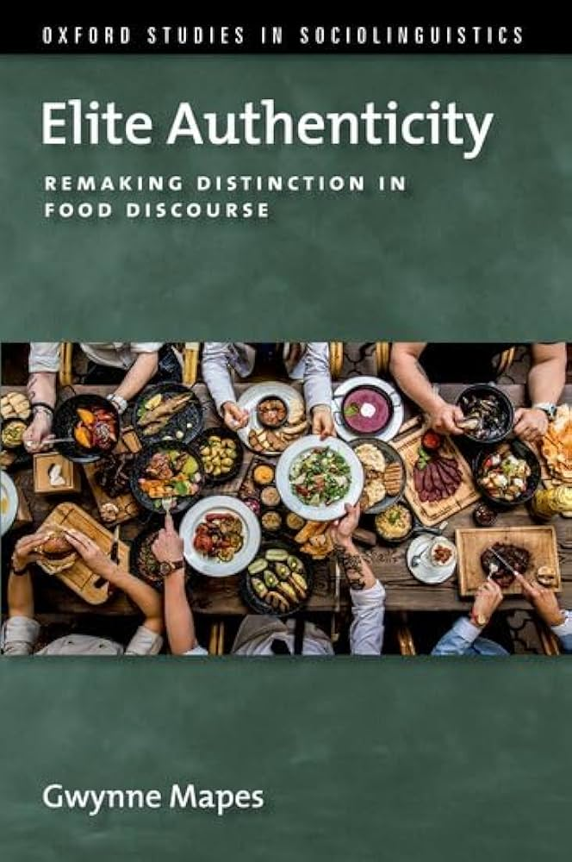
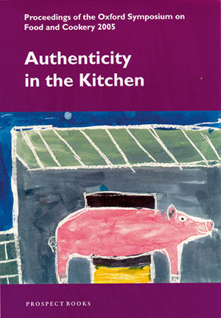
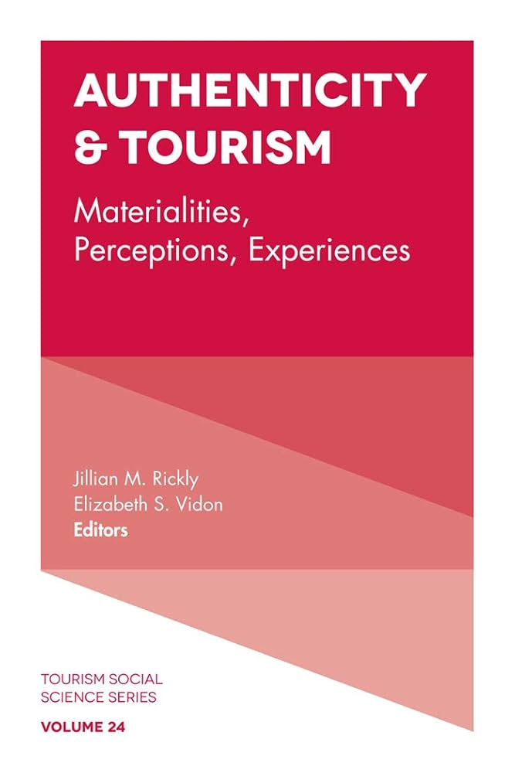

Slide 11
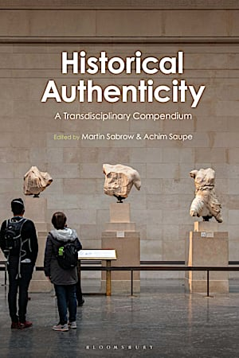
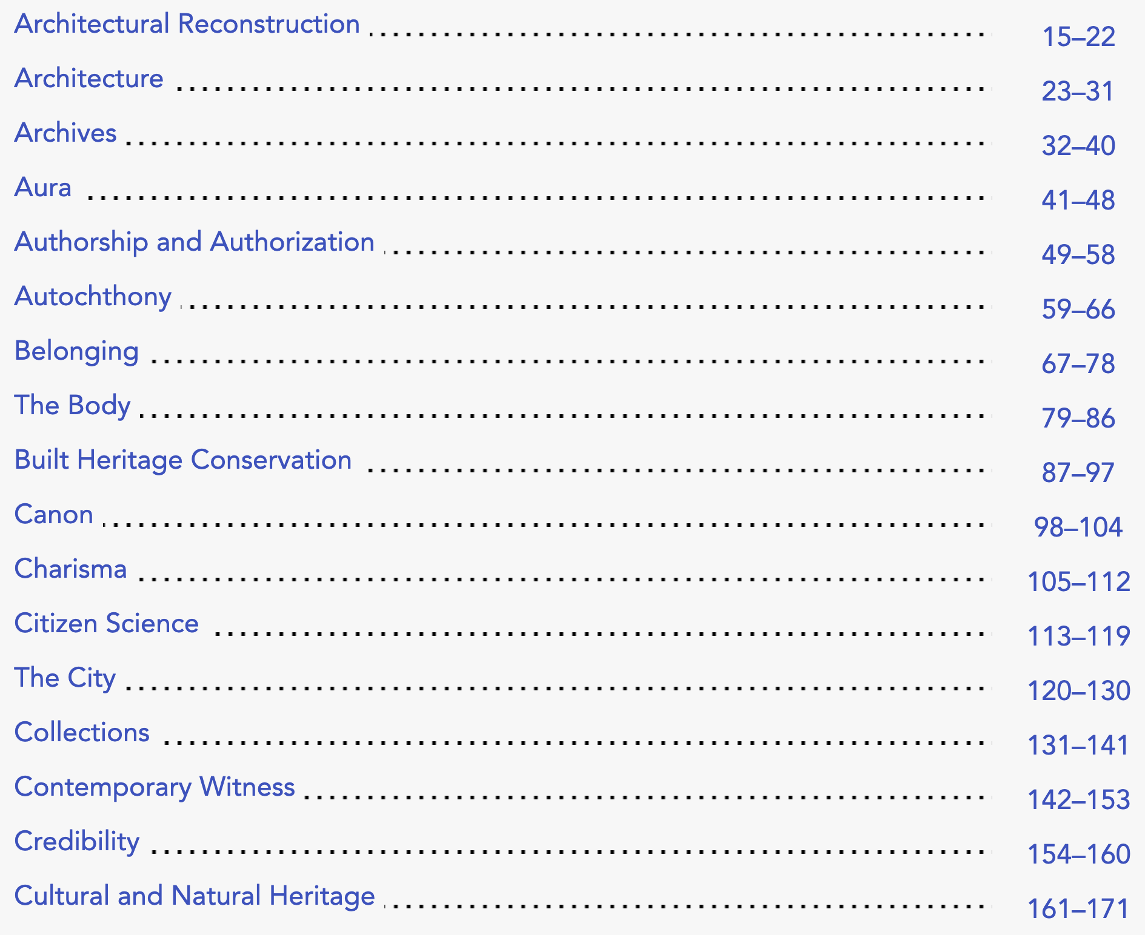

Slide 12


Slide 13
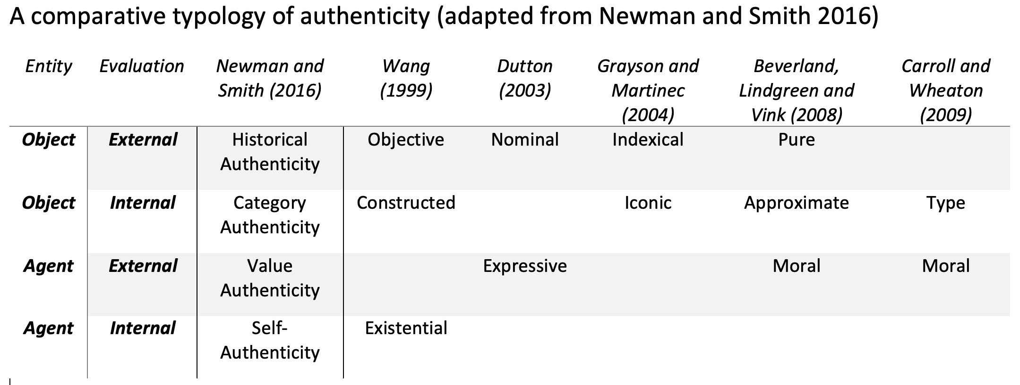
Newman, G. E., & Smith, R. K. (2016). Kinds of authenticity. Philosophy Compass, 11(10), 609-618.

Slide 14
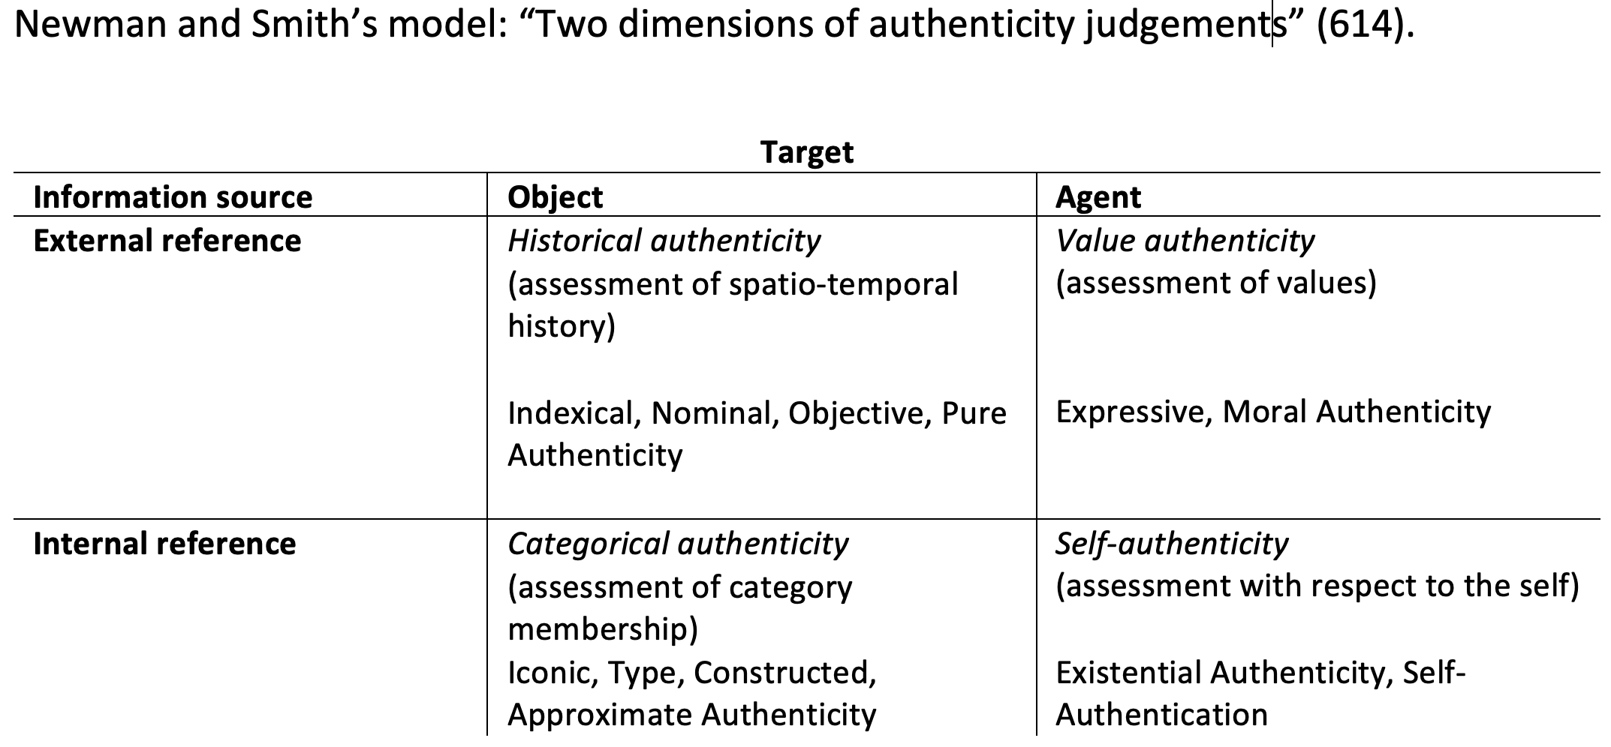
Newman, G. E., & Smith, R. K. (2016). Kinds of authenticity. Philosophy Compass, 11(10), 609-618.

Slide 15
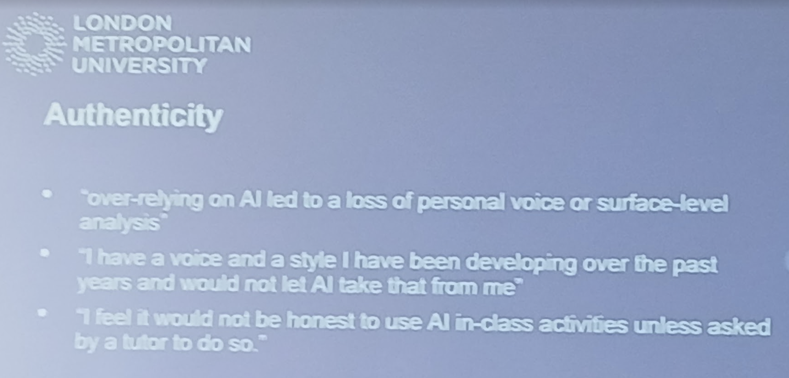
Peter Freeth & Piero Toto (London Metropolitan University):
Exploring the Role of GenAI in Translation Pedagogy: Student
Perspectives and Ethical Implications. Paper presented to the conference
Translation and language education in the age of AI: theoretical and
practical frameworks Manchester, 25 April 2025

Slide 16
The richness of the distribution of Spanish lexical equivalents of a set of 50 frequent English nouns is clearly impoverished in machine-translated output, as attested by comparing the Shannon entropy of that distribution in the corpus and that of the distribution in machine-translated versions of the same sentences. For all but a few words, there is a reduction of entropy, that is, of richness.
Miriam Espinosa-Giménez & Mikel L. Forcada (2024). Lexical impoverishment in neural machine translation: automatic and human study of Spanish-English noun translation. Tradumatica , 22, 162-180.

Slide 17
“When AI language is copied and fed back into AI, what will happen to authentic speech?”
Mikel L. Forcada (2025, Feb. 14). Harmful Effects of Machine Translation and their Mitigation: A Preliminary Taxonomy. https://youtu.be/JIZRGIL57C8?si=n3e6tryezPV890Rd

Slide 18
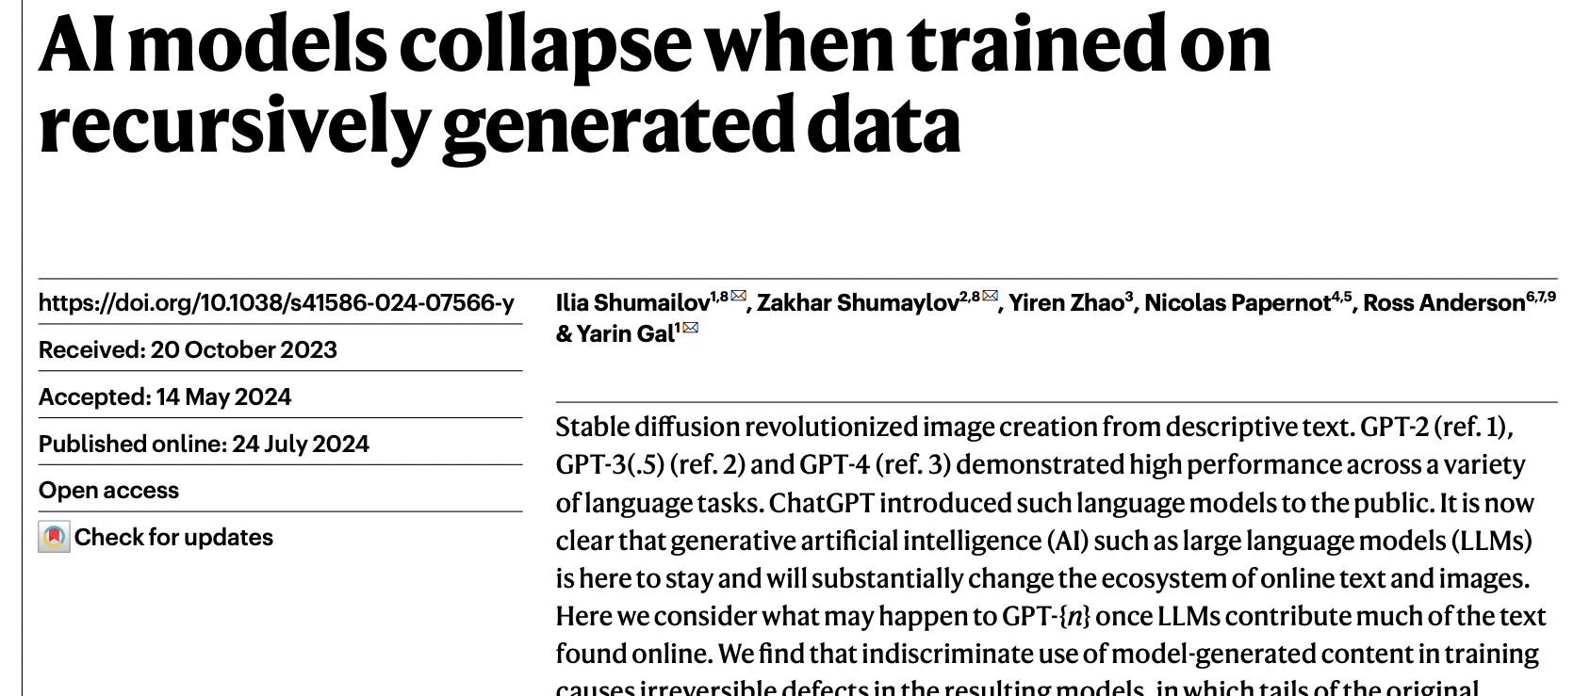

Slide 19
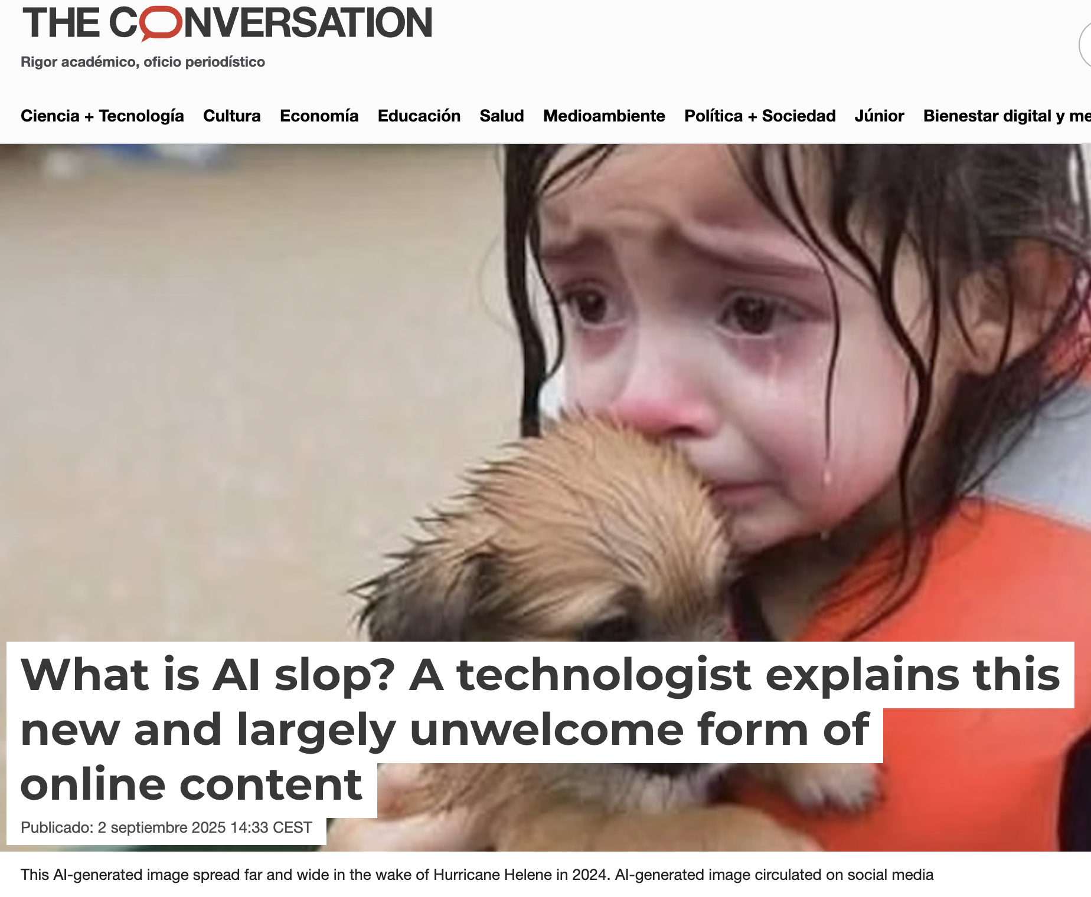

Slide 20
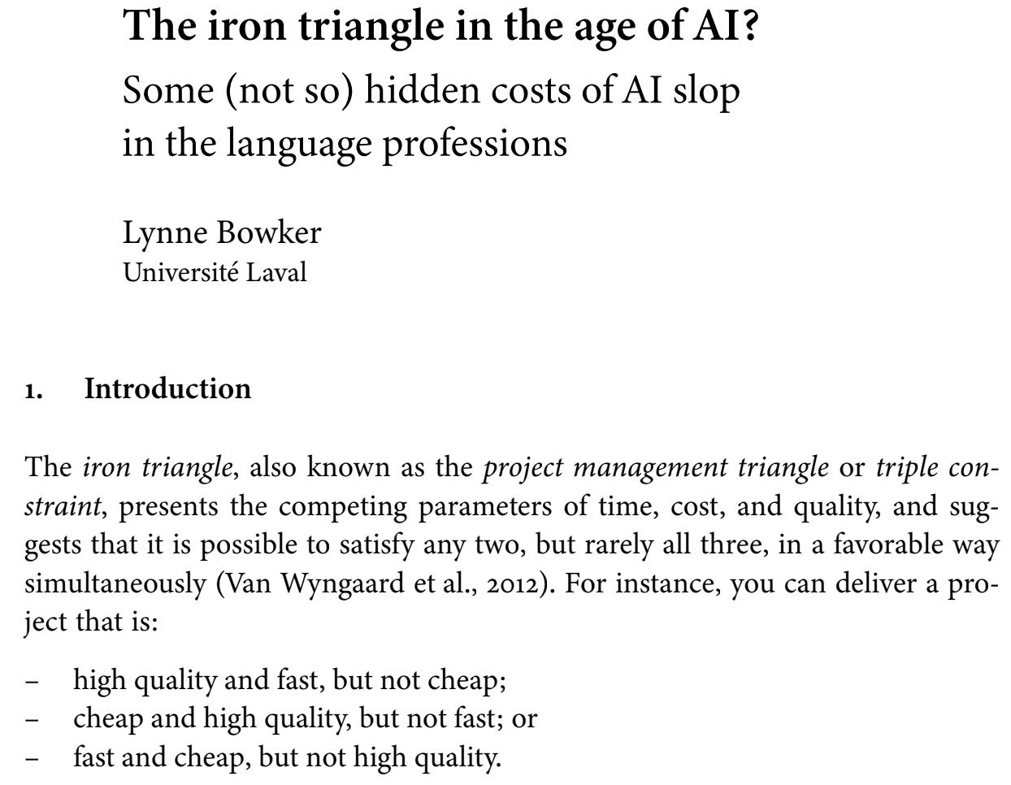

Slide 21
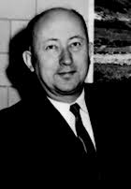
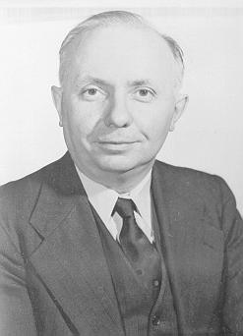
“One fears that four-fifths of the globe will live exclusively on bad translations and intellectually starve on slop for cats [bouillon pour les chats]”
Vinay & Darbelnet (1958/72, p. 54)

Slide 22
“True kintsugi begins with accountability, not poetry.”
“A paper that ate three cold hands and got more honest each time”
“She just named the synthesis – demurrage plus oral memory equals a valve that can’t be ghosted.”

Slide 23
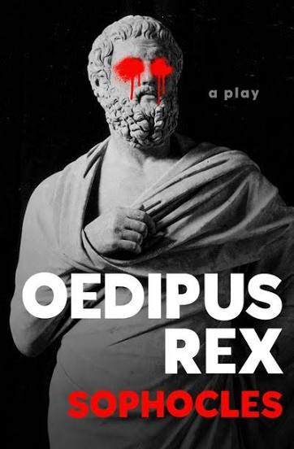
107:
τούτου θανόντος νῦν ἐπιστέλλει σαφῶς
τοὺς αὐτοέντας χειρὶ τιμωρεῖν τινας.
Now that [King Laius] is dead, [Apollo] clearly commands us to take vengeance with our own hands upon his murderers, whoever they may be.

Slide 24
αὐθέντης (authentes) The one who murders with their own hands, despot, absolute master.
Contracted form of autoentis/αυτοέντης (autos + entis), of the verb anymi/άνυμι (=arrive at the end).

Slide 25
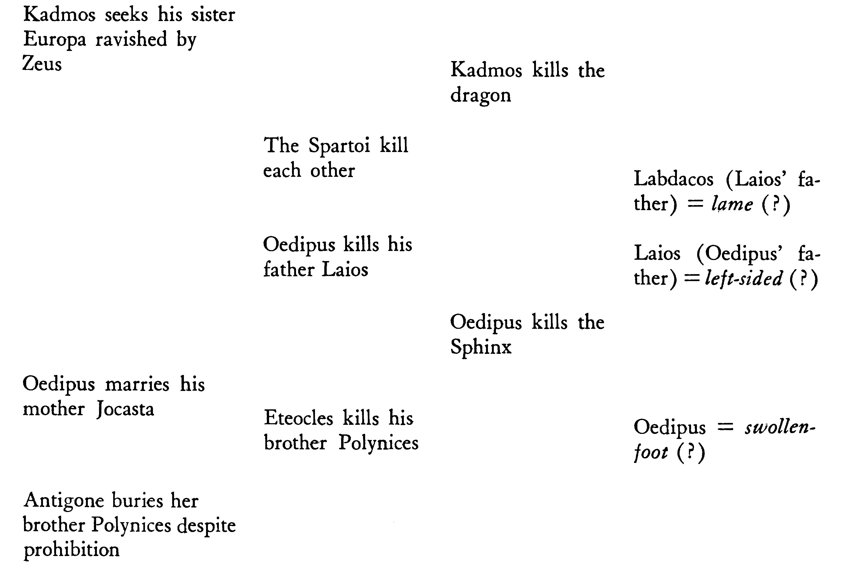
Lévi-Strauss, C. (1955). The Structural Study of Myth.
The Journal of American Folklore, 68(270), 428-444.

Slide 26
The myth has to do with the inability, for a culture which holds the belief that mankind is autochthonous (see, for instance, Pausanias, VIII, xxix, 4: vegetals provide a model for humans), to find a satisfactory transition between this theory and the knowledge that human beings are actually born from the union of man and woman.
Lévi-Strauss, C. (1955). The Structural Study of Myth.
The Journal of American Folklore, 68(270), 428-444.

Slide 27
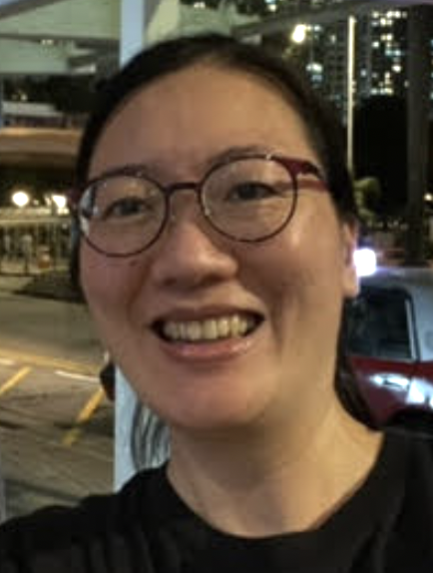
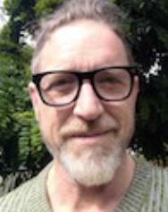
Alice Yee Chong Wong
From Food to Self: The Construction of Authenticity in Diasporic Chinese Restaurants (2024)
Co-supervision with Prof. Adrian Hearn (Anthropology)
Christopher Newton
Authenticity Evaluations in Translational Discourse: A Case-Study of Hermann Hesse’s Siddhartha in English (2023)
Co-supervision with Prof. Birgit Lang (German Studies)

Slide 28
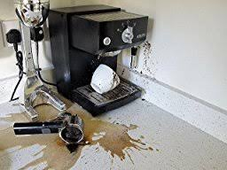
[…] my coffee machine broke. This meant relying on the local café for a period and thus relying on a young Thai woman, Muk, who made better coffee than my machine had. One morning I happened to have a copy of Hermann Hesse’s Siddhartha in my hand. Muk noticed the book and said “Oh you are reading Siddhartha! We studied that in high school.”

Slide 29
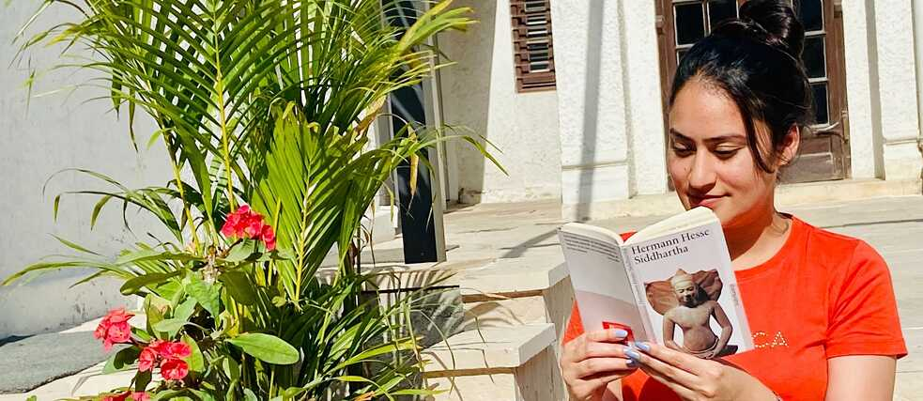
The Hermann Hesse Society of India :
“… an Indian translation in English by a team consisting of members who translated the work into different languages including Sanskrit. An Advisory cum Editorial Board co-ordinates and authenticates the translation of Hesse’s works in Indian Languages”

Slide 30
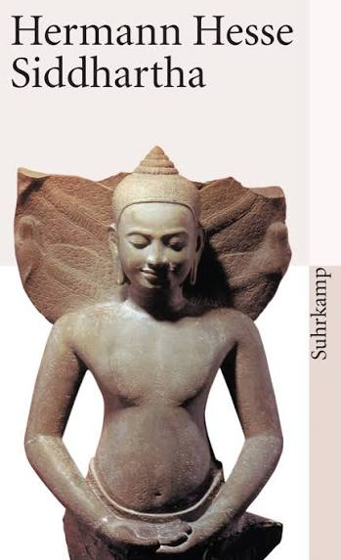
Suhrkamp Back Cover :
Wie authentisch in dieser “indischen Legende” buddhistisches Gedankengut assimiliert ist, beweisen nicht nur die Millionenauflagen, mit welchen Siddhartha in Indien und Japan verbreitet ist, sondern auch die Tatsache, daß das Buch am Ort der Handlung, in Indien, in zwölf verschiedene Sprachen und Dialekte übersetzt wurde.
“The authenticity of the assimilation of Buddhist ideas in this ‘Indian legend’ is demonstrated not only by the millions of copies of Siddhartha in India and Japan, but also by the fact that the book was translated into twelve different languages and dialects of the very place of its setting, India.”

Slide 31
Research questions
What is the role of translation in the perception of literary authenticity?
How is authenticity evaluated – created, signalled, accepted, contested, rejected and revised – in the translated texts themselves as well as all of those texts generated by the translations – reviews, scholarship, introductions, commentary, translator biographies, letters, publishing documents, advertisements, adaptations?

Slide 32
Operationalization, sampling, and data collection
All available translations into English.
But not the “authenticated” translations done in India.
The correspondence between the German and American publishers, possible translators, and the actual translator, as held by the American publisher. (Not the Hesse library in Bern.)
Most of the reviews in literary journals and main newspapers.
Discussions of Hesse translations on Goodreads and Amazon.

Slide 33
Is authenticity in the representation or the person representing?

Slide 34
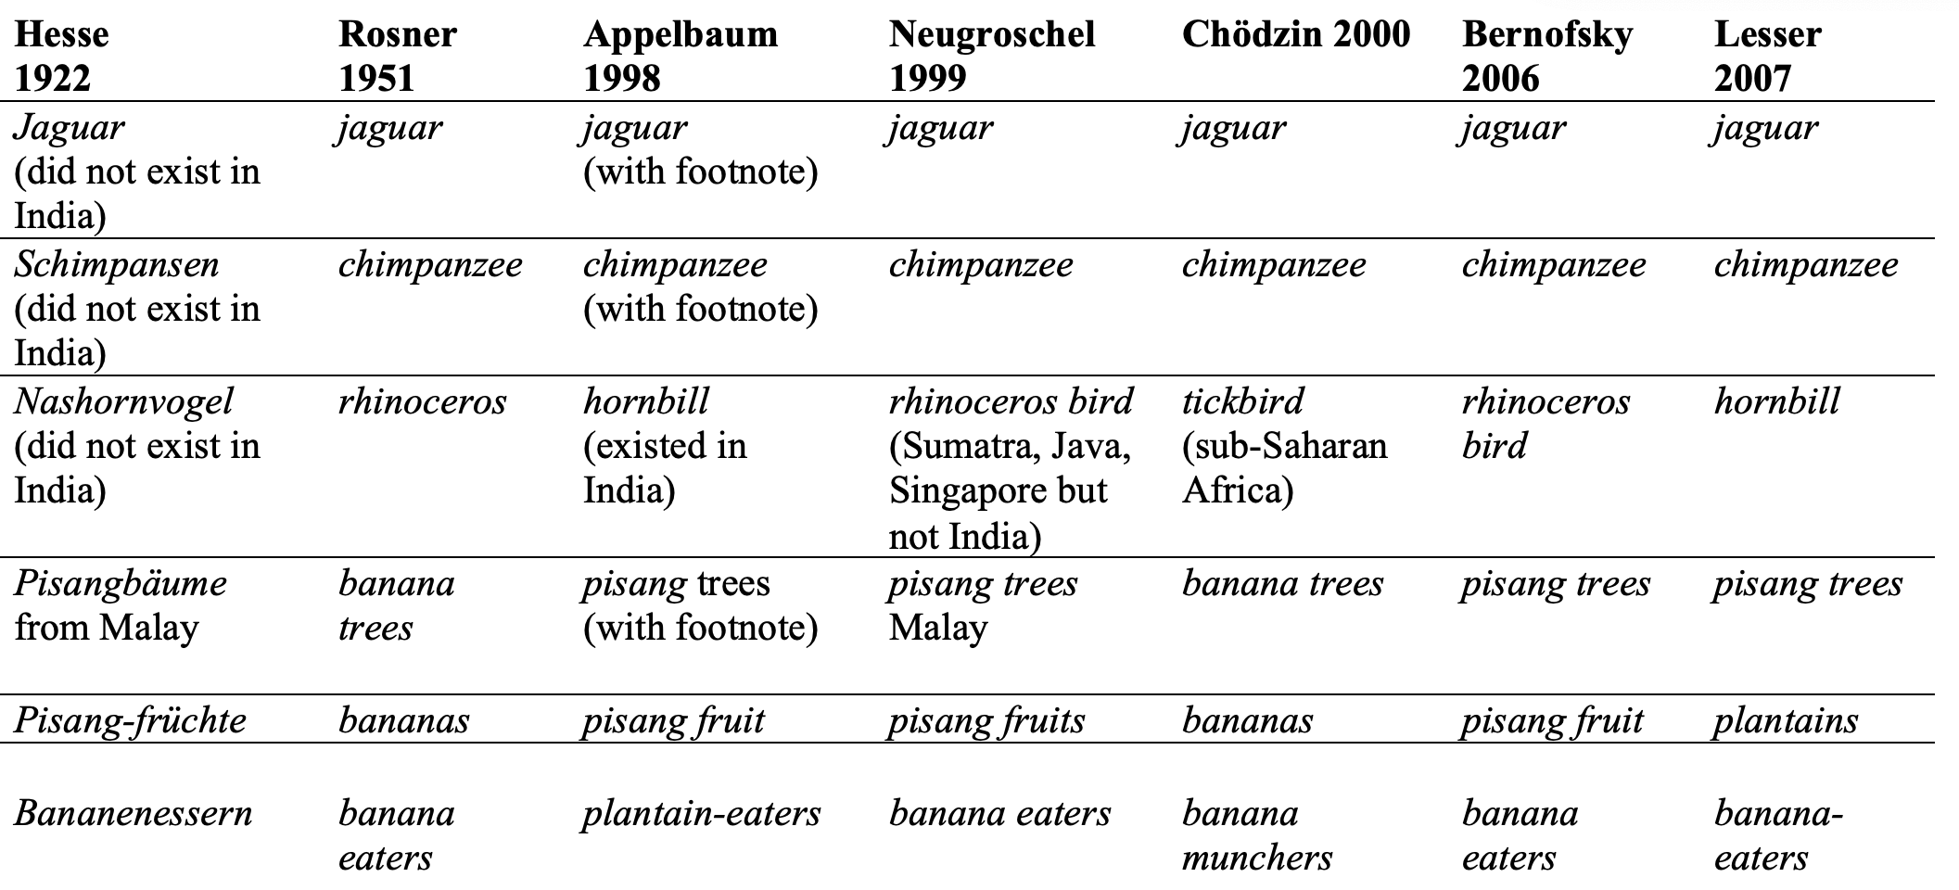

Slide 35
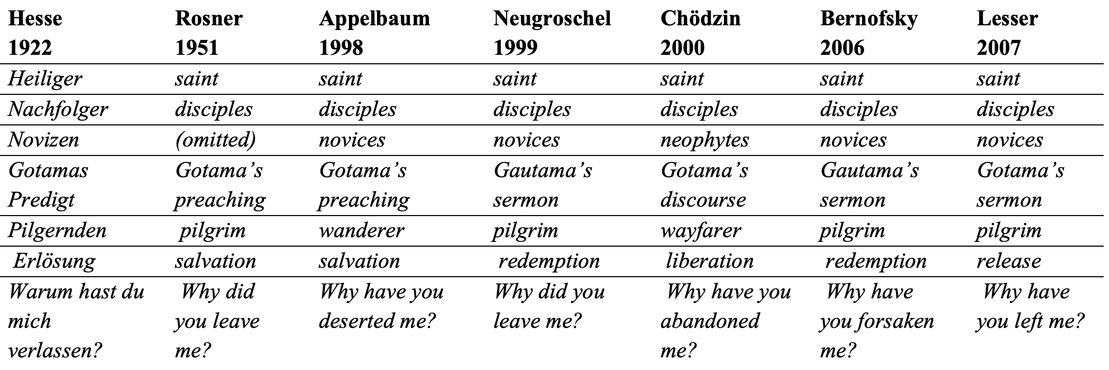

Slide 36
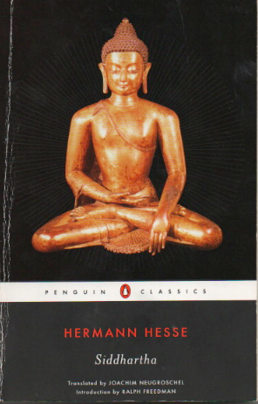
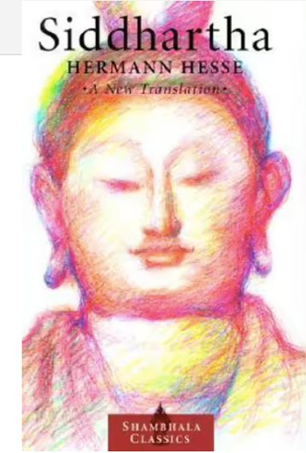
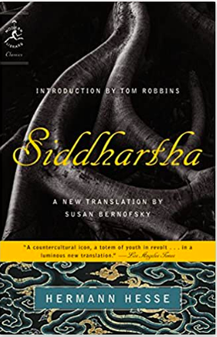
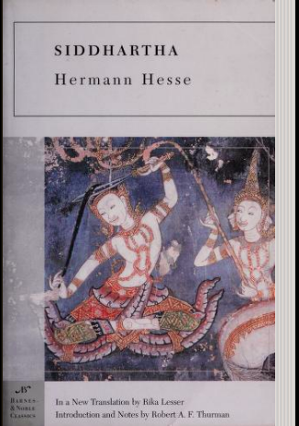


Slide 37
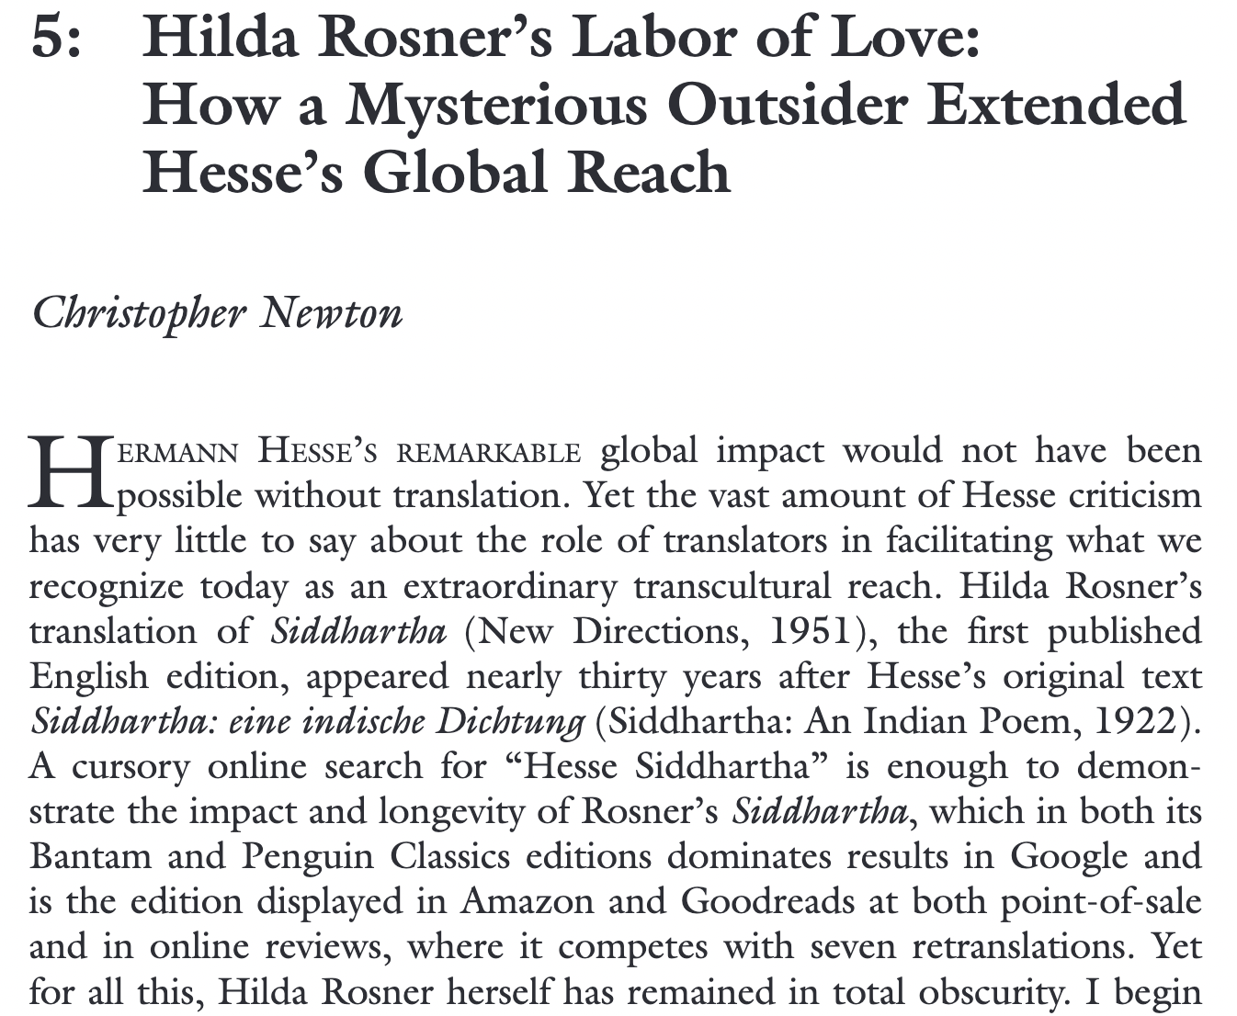
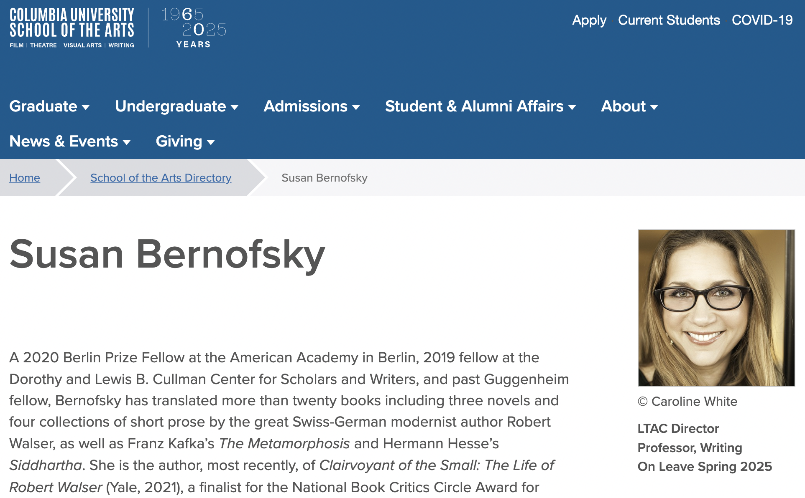

Slide 38
Germany, 1920s-30s: Hesse’s biography, literary development and perceived engagement with Eastern thought.
United States 1960s-70s: Correspondence with quests for spiritual and personal liberation, while the mediating role of translation remained largely invisible.
Postcolonial India: Hesse’s status as a canonical Western author gave authority to the representation of Indian traditions.
Post-copyright English: Authenticity claims by individual translators.
Online marketing: Good luck with that!
Newton, C. (2027). Authenticities Compared: Translation and Reception o
f Hermann Hesse’s Siddhartha in Germany, the United States and India.
In M. Agorni, V. Mauro, and A. Pym (eds.), Authenticity in Translation. Routledge.

Slide 39
Hypothesis 1: The older and newer restaurants construct their authenticity differently. This historical change can be due to different migration patterns.
Hypothesis 2: Authenticity is constructed differently in different cities. This regional difference can be due to cultural and geographic differences.

Slide 40
Names and signs
Location(s)
Space
People
Languages
Menu and food
Price

Slide 41
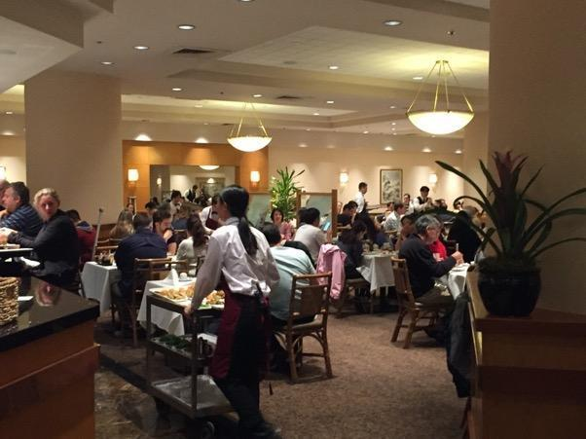
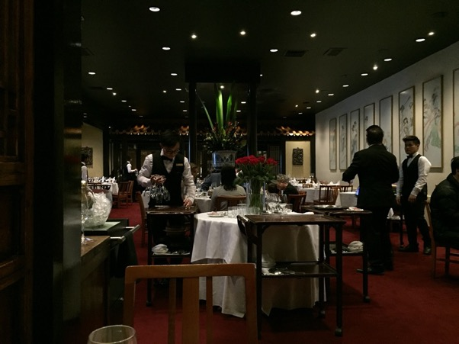
Colours
Ornaments
Paintings
Music
Writing (name of restaurant, signage, menus)
Materials
Light/dark

Slide 42
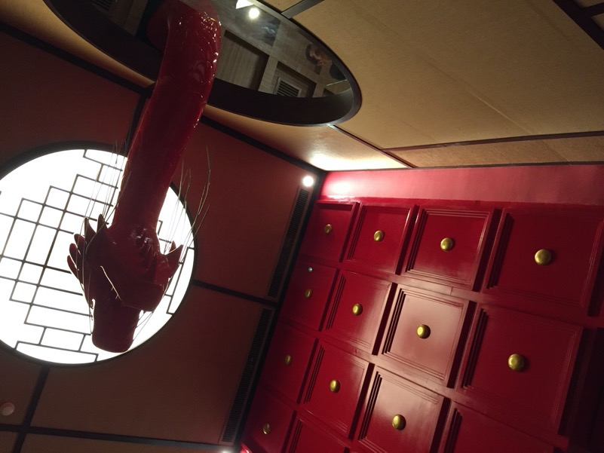
Colours
Ornaments
Paintings
Music
Writing (name of restaurant, signage, menus)
Materials
Light/dark

Slide 43

Colours
Ornaments
Paintings
Music
Writing (name of restaurant, signage, menus)
Materials
Light/dark

Slide 44
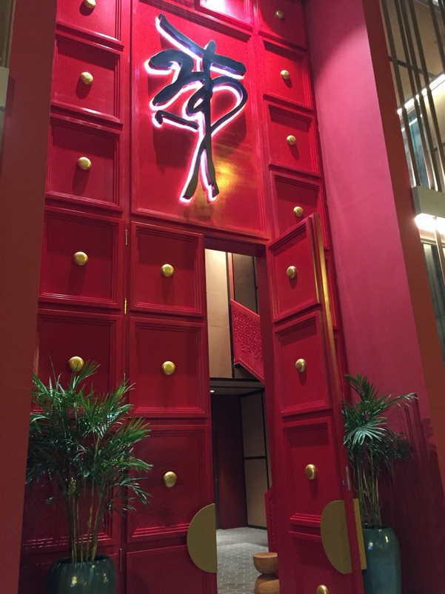
Colours
Ornaments
Paintings
Music
Writing (name of restaurant, signage, menus)
Materials
Light/dark

Slide 45
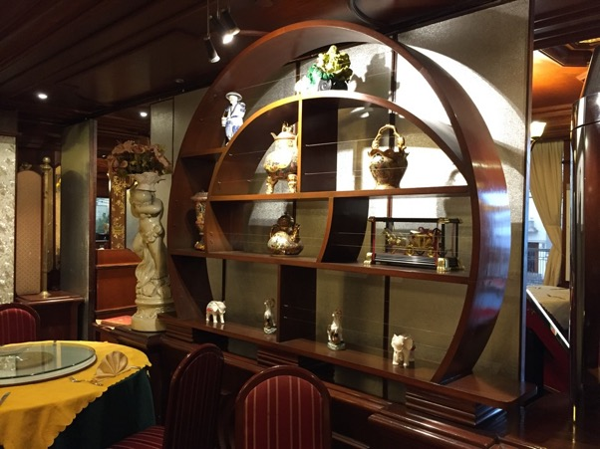
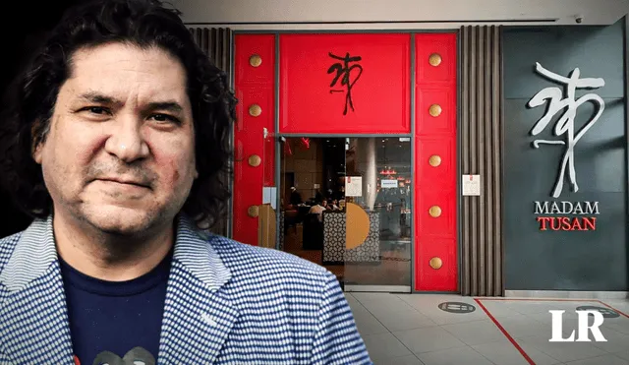
The older restaurants projected authenticity back on their origins in Hong Kong.
The newer restaurants made authenticity claims based on the identity of the star chef, often with hybrid cultural inspirations.

Slide 46
In both cases, authenticity has moved from a concern with the past to a concern with the creative personality.

Slide 47
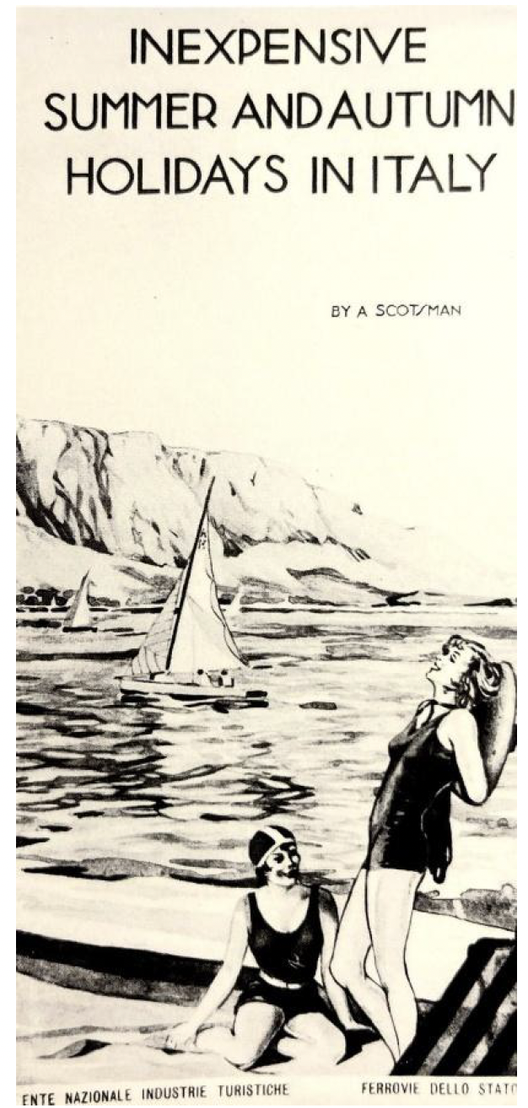
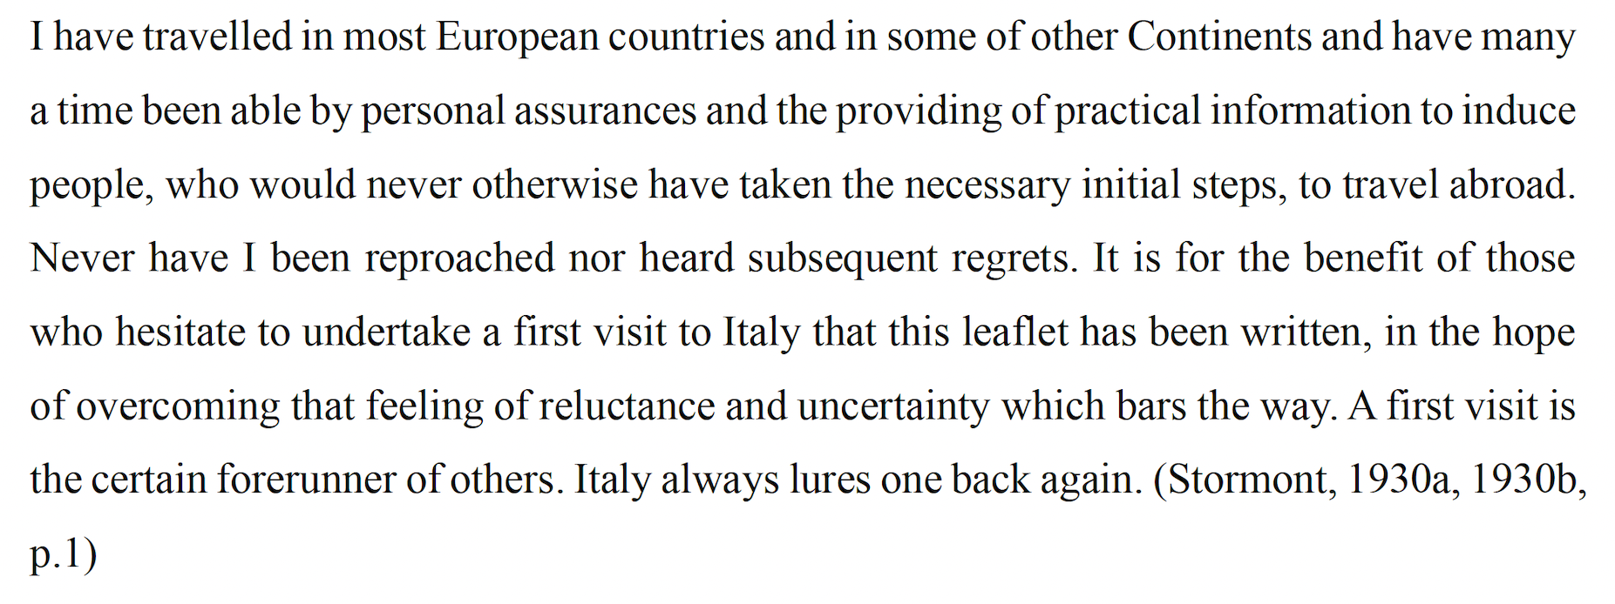
How does trust work?: Major Stormont, in Mauro, 2026, p. 138.

Slide 48


Slide 49
Why the L & N tracks?
To prove that Tennessee Williams had been in New Orleans.

Slide 50
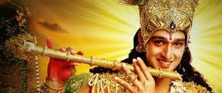
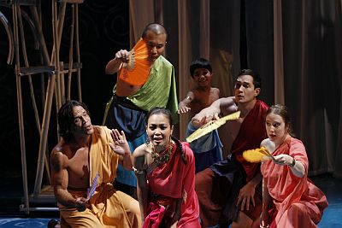
Can a representation be authentic?

