Slide 1
Localization
Anthony Pym

Slide 2
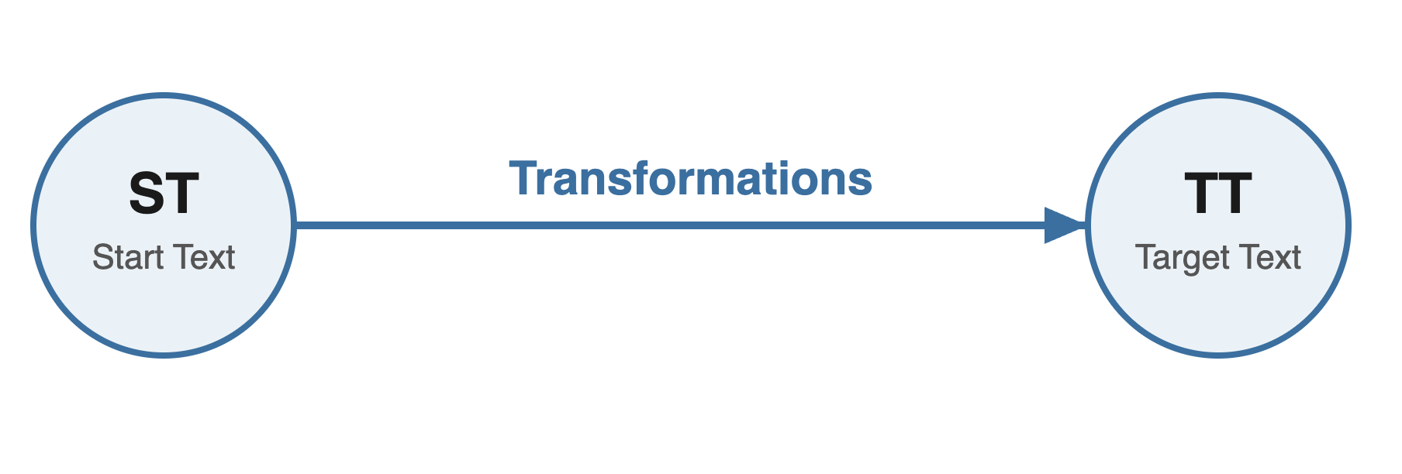

Slide 3
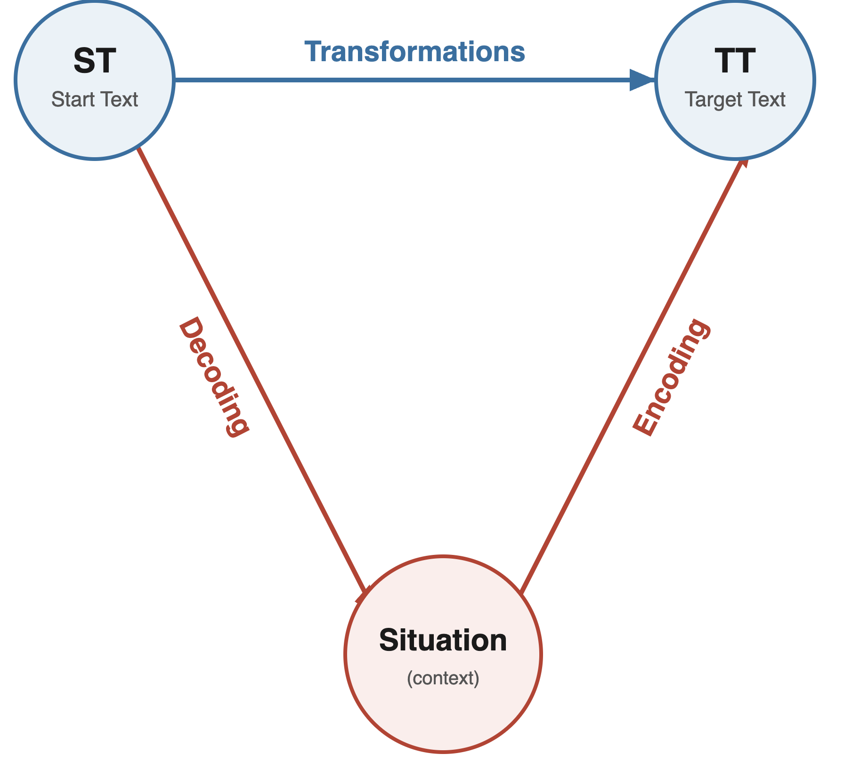

Slide 4
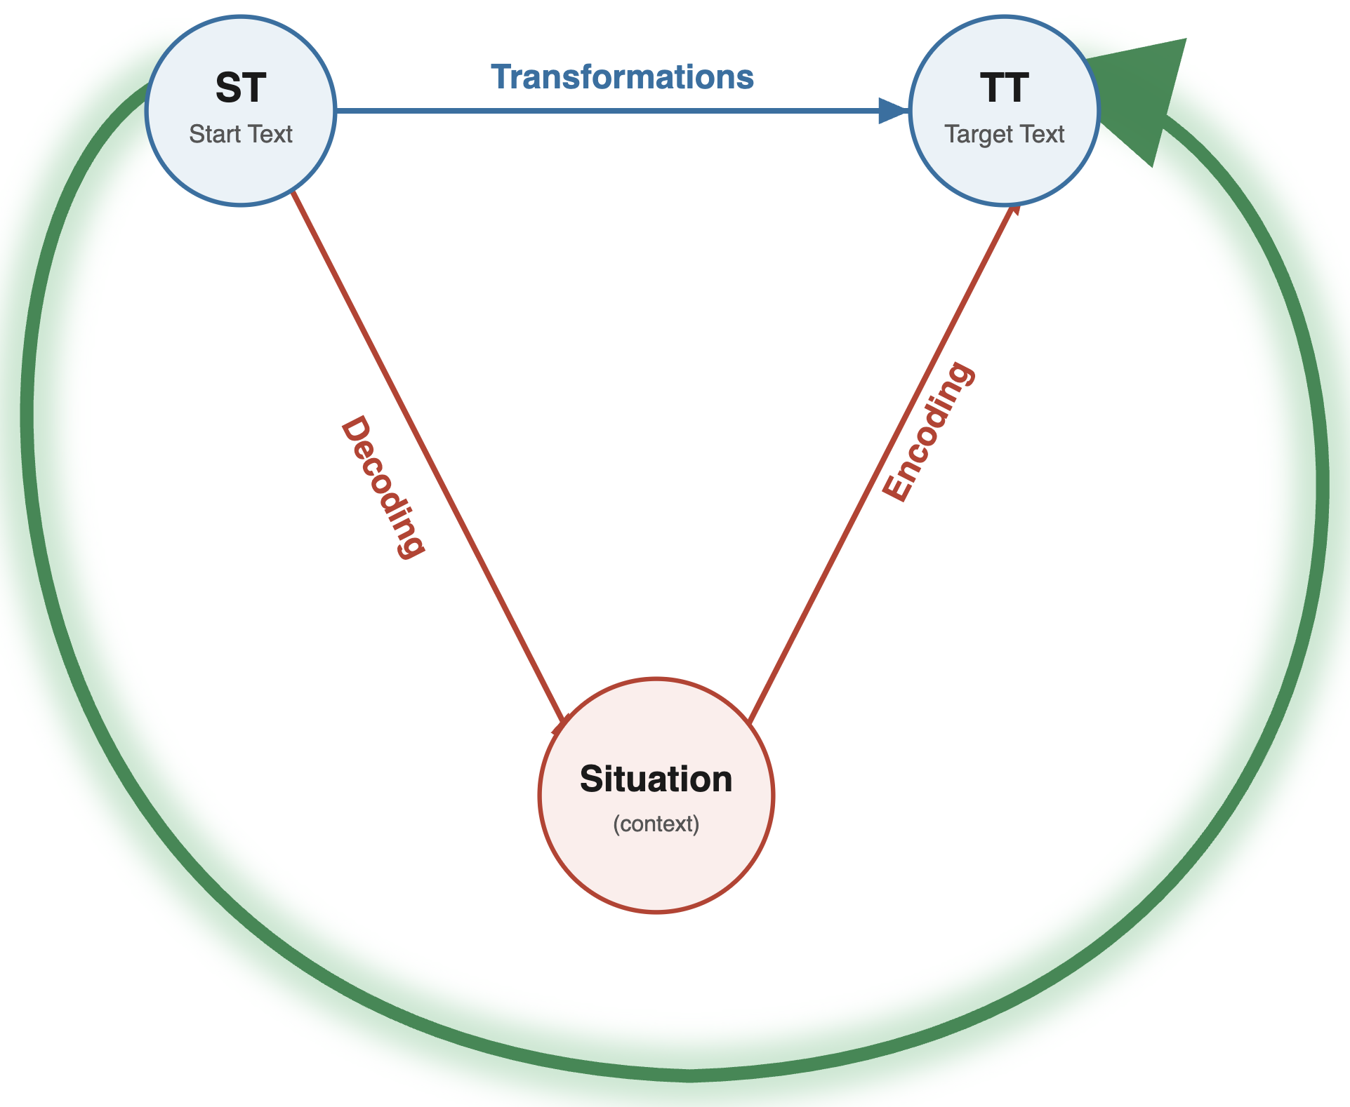

Slide 5
When you get a translation to do, ask what it is for.

Slide 6

Welcome to Dragon NaturallySpeaking, the world’s most acclaimed large-vocabulary continuous-speech dictation system. With Dragon NaturallySpeaking you can compose e-mail messages, create reports, draft letters, edit proposals, create reports, and more, all by speaking to your computer instead of typing.

Slide 7


Slide 8
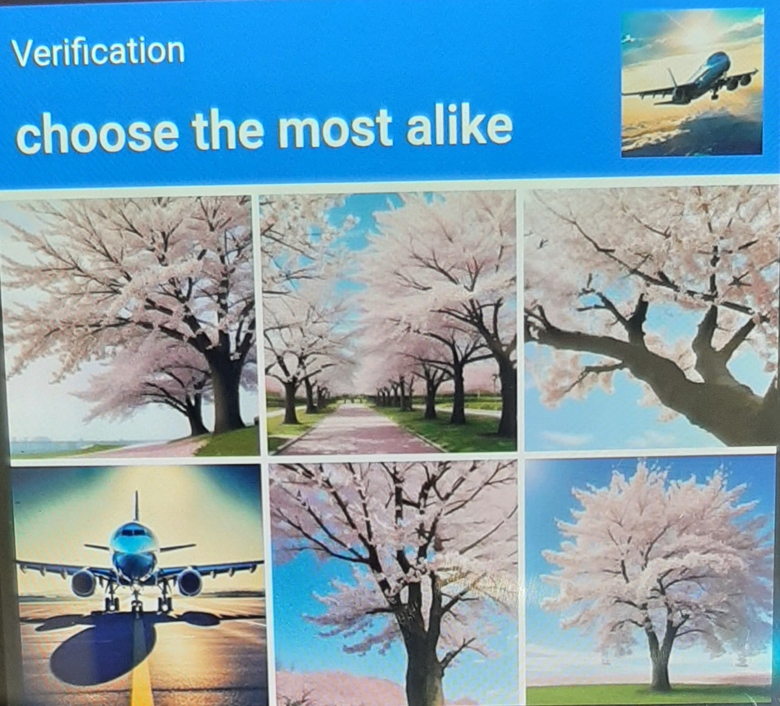

Slide 9


Slide 10
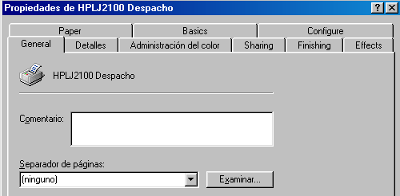

Slide 11
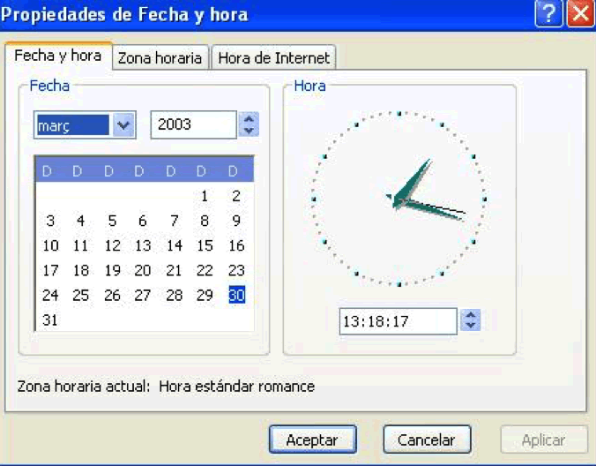

Slide 12
Localization: taking a product and tailoring it to an individual local market (i.e., ‘locale’)
Translation: converting user-visible natural-language strings from one language to another.
Localization = translation + factor X

Slide 13
Internationalization (e.g., character encoding)
Adaptation (e.g., dates, time, currency conventions)
Product reengineering (e.g., hot keys)
Product testing
Project management

Slide 14

Don’t think like this

Slide 15
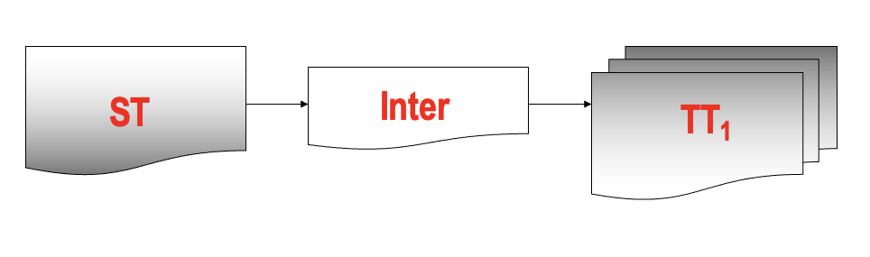
Think like this

Slide 16
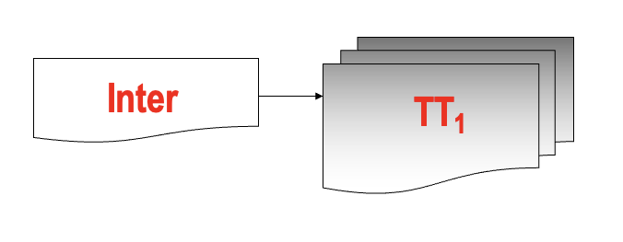
And like this

Slide 17
The internationalized version grows

Slide 18
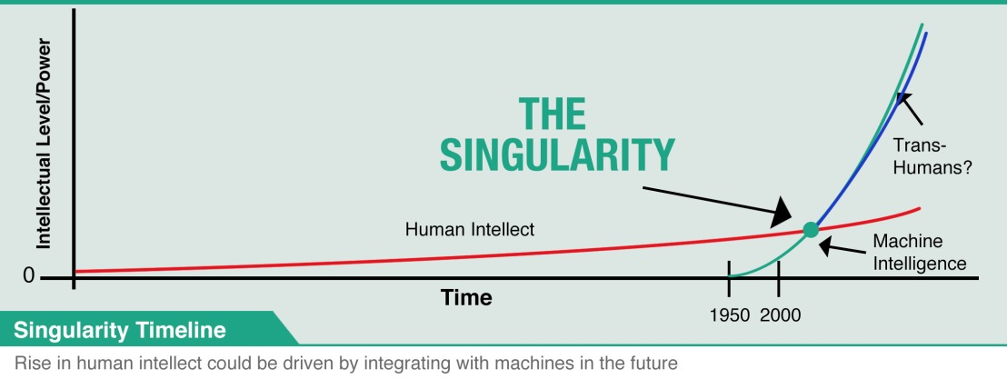
The internationalized version grows

Slide 19
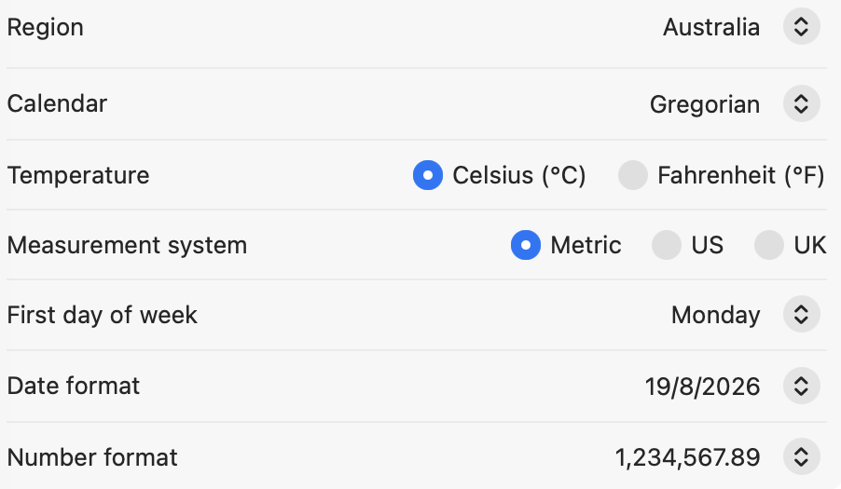
What is a locale?

Slide 20
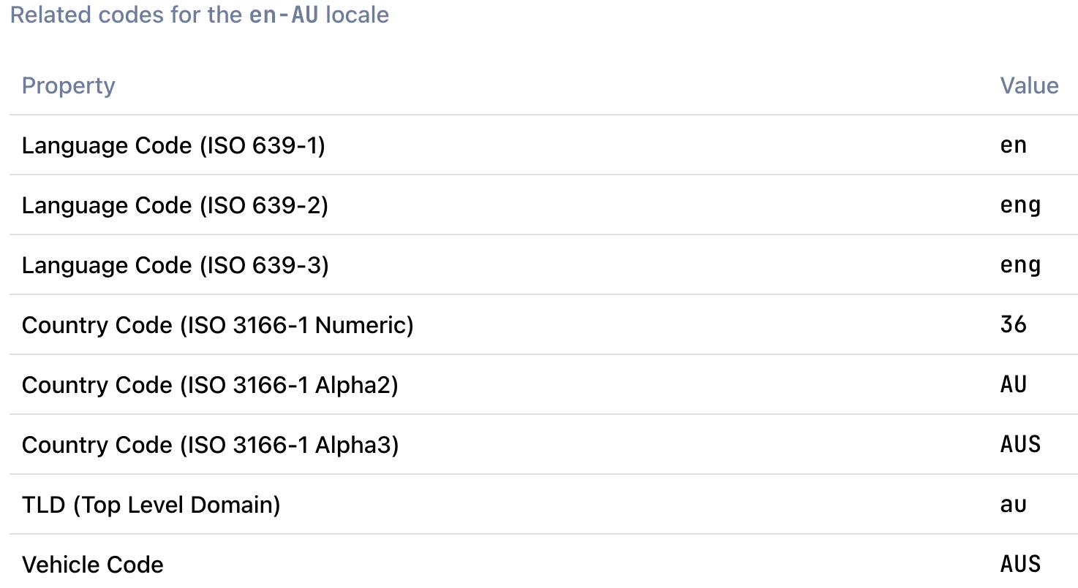
What is a locale?

Slide 21
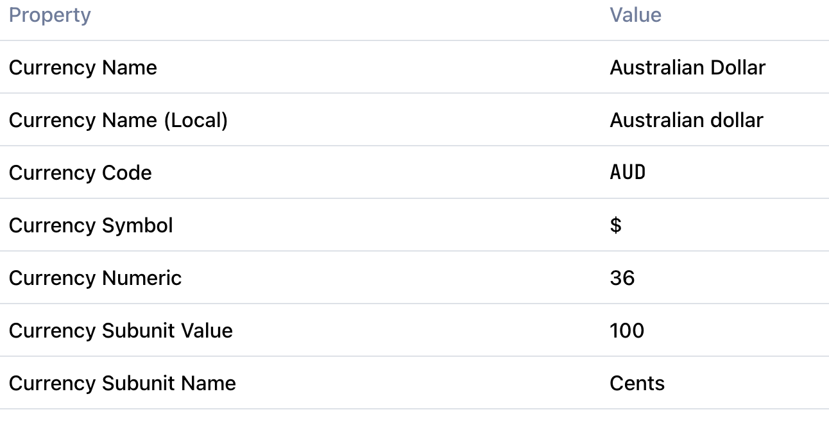
What is a locale?

Slide 22
Placeholders
Times
Prices
Currency exchanges
Information chunks
Terms

Slide 23
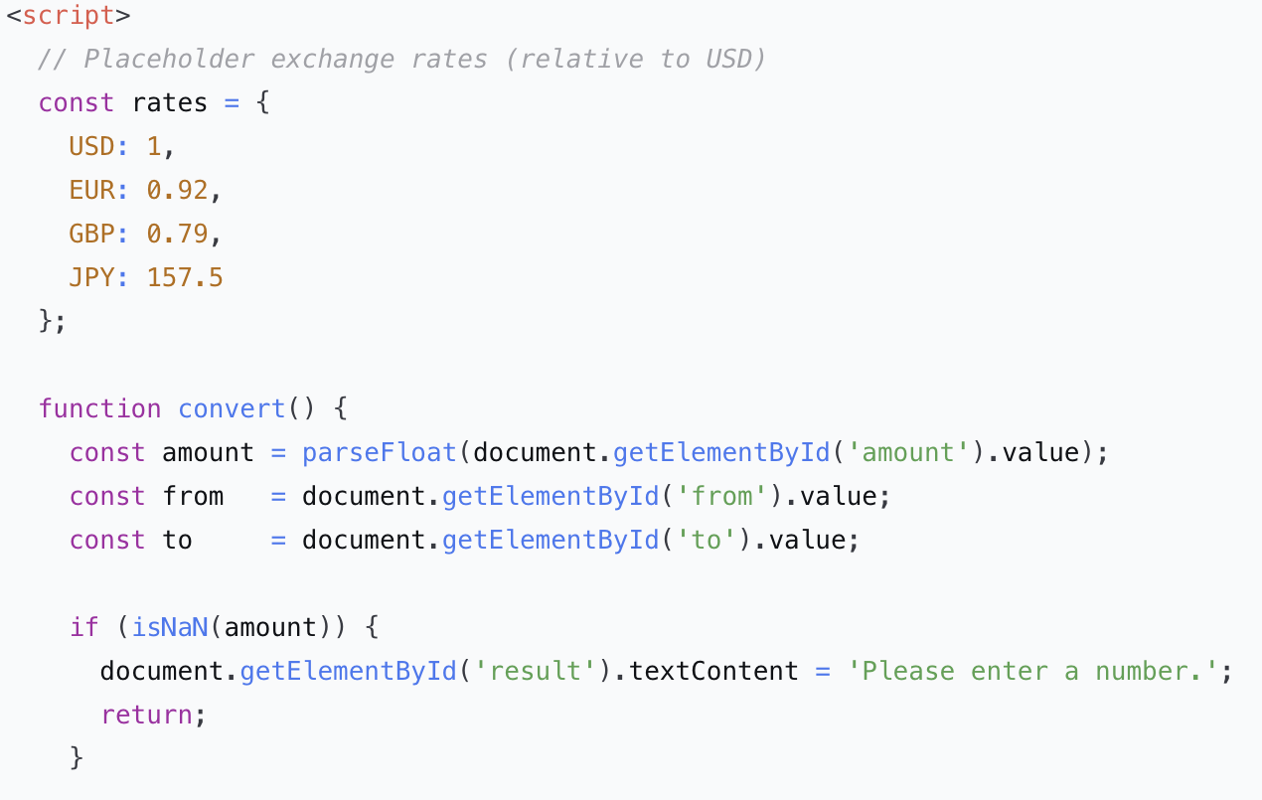

Slide 24

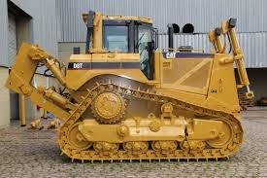
Caterpillar Technical English
About 70,000 terms
Restricted syntax
Very specific style sheets

Slide 25
How language “chunks” are used
Welcome to Dragon NaturallySpeaking, the world’s most acclaimed large-vocabulary continuous-speech dictation system. With Dragon NaturallySpeaking you can dictate to your computer instead of using the computer to enter and revise text.

Slide 26
How language “chunks” are used
Welcome to Dragon NaturallySpeaking, the world’s most acclaimed large-vocabulary continuous-speech dictation system. With Dragon NaturallySpeaking you can dictate to your computer instead of using the computer to enter and revise text.

Slide 27
Two pages later
Welcome to Dragon NaturallySpeaking, the world’s most acclaimed large-vocabulary continuous-speech dictation system. With Dragon NaturallySpeaking you can dictate to your computer instead of typing.

Slide 28
And later
Welcome to Dragon NaturallySpeaking, the world’s most acclaimed large-vocabulary continuous-speech dictation system. With Dragon NaturallySpeaking you can compose e-mail messages, create reports, draft letters, edit proposals, and more, all by speaking to your computer instead of typing.

Slide 29
Language workers find employment in:
Controlled writing
Terminology
Multilingual rewriting
Cleaning of multilingual translation memories
Integration of MT (localization kits)
Project management

Slide 30
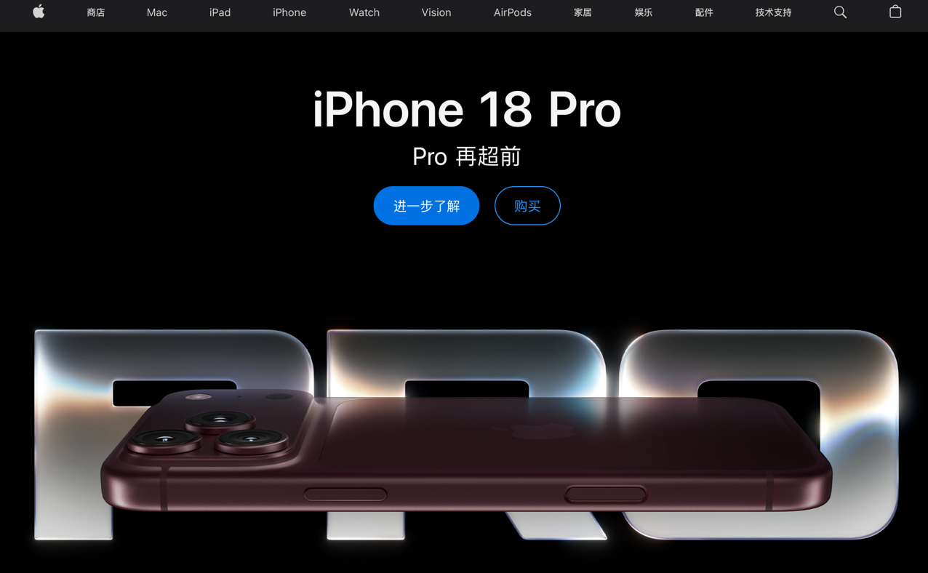
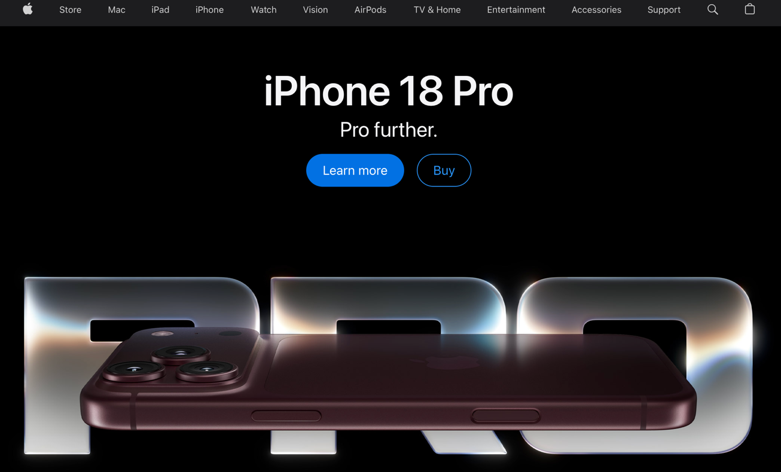
Standardization

Slide 31
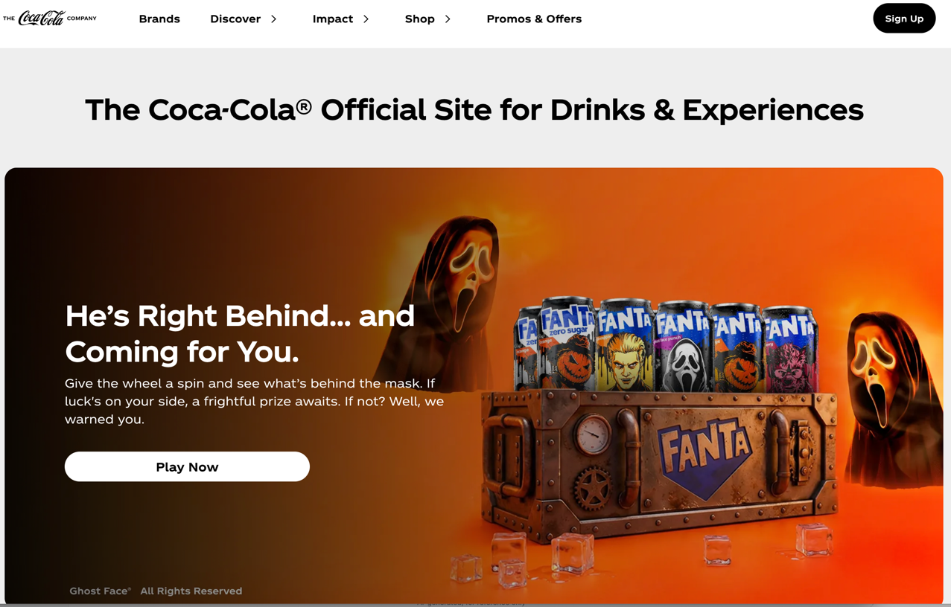
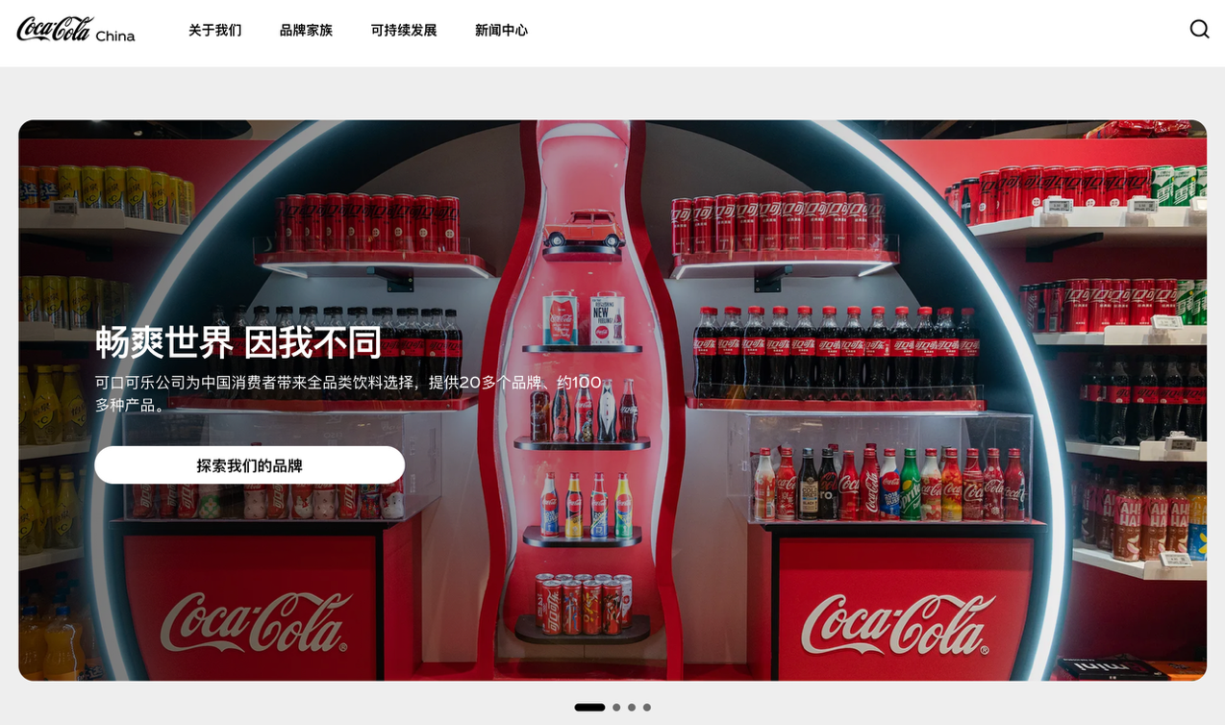
Adaptation

Slide 32


Slide 33


Slide 34
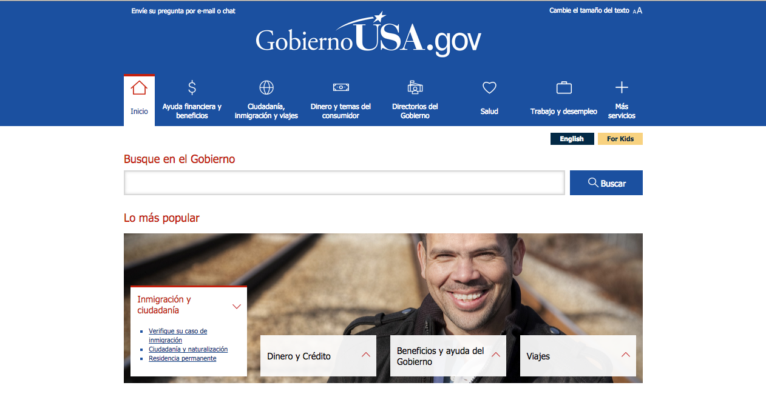

Slide 35
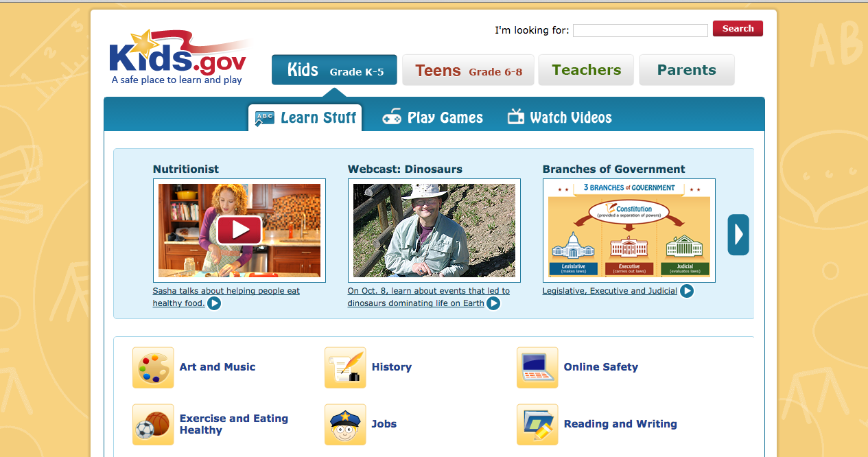

Slide 36

Ikea PR China

Slide 37

Ikea PR China

Slide 38

Ikea Taipei

Slide 39

Ikea Hong Kong

Slide 40

Ikea Indonesia

Slide 41

Ikea Indonesia

Slide 42

Ikea UK

Slide 43

Ikea US

Slide 44

Ikea Australia

Slide 45
Hypotheses
The most global product is the most symbolically domesticated.
There is a clear distinction between standardization and adaptation in parts of the same webpage.
There is a clear professional distinction between natural-language replacement (‘translation’) and complete localization.
The less interesting work is at the level of natural-language replacement (‘translation’).
LLMs can do the natural-language replacement.

Slide 46
For a given sector (banks, fashion shops, education, cars), select one company that has a multilingual website and another company in the same sector that has a monolingual website.
Compare the two.
Which one uses the most translation?
Which one uses the most standardization?
Which one uses the most adaptation?
Are there signs of internationalization?

Slide 47
What does localization do?
Globalization/localization may maintain or enhance linguistic diversity.
At the same time, it spreads similitude in technologies and thus in lifestyles.
Consumers are positioned in locales that mean they cannot easily become discourse producers.

