Slide 1
Please write down three questions about translation that you would like me to answer in these classes.
(Only one can concern money!)

Slide 2
Please bring a laptop to class.
Please do not look at your phone!

Slide 3
ST: Source text or start text
TT: Target text
SL: Source or start language
TL: Target language

Slide 4
MT: Machine translation
LLM: Large Language Models
AI: artificial intelligence
Generative AI (GenAI): LLMs that can translate

Slide 5
Automation: GenAI + MT
CAT: Computer Assisted/Aided Translation

Slide 6
L1: Your first or mother language
L2: Your additional language
A language: Your strongest language
B language: Your next strongest language

Slide 7
Post-editing: Correcting automated output.
Pre-editing: Preparing an ST for automation.

Slide 8
Revision: Correcting a translation.
Editing: Correcting a text.
Back translation: A translation made from TT to SL, usually literal, in order to illustrate the TL.

Slide 9

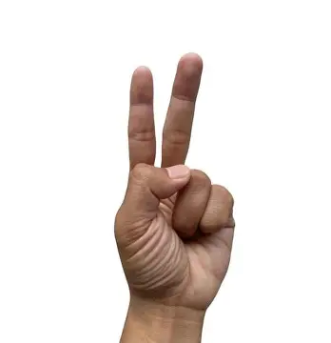
How many basic ways are there to translate?

Slide 10
Three basic ways to translate

Slide 11
Model 1 (transformations)
ST: The ink is on the table.
TT Fr. L’ encre est sur la table.
TT Zh. 墨水 在 桌子 上
Mòshuǐ zài zhuōzi shàng

Slide 12
Model 1 (transformations)
ST I like it.
TT Es Me gusta.
To me [it] pleases.
TT Fr Ça me plaît.
It to me pleases.
TT De Es gefällt mir.
It pleases to me.
TT Zh 我 喜欢。
Wǒ xǐhuān.

Slide 13
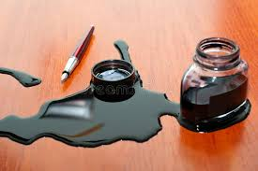
Model 2 (situations)
The ink is on the table.
La tinta está sobre la mesa.
墨水在桌子上

Slide 14
Model 2 (situations)
The ink is on the table.
¡Hay tinta sobre la mesa! 桌子上沾了墨水！
La tinta se ha derramado. 墨水洒出来了！
¡Saca la tinta de la mesa! 把桌子上的墨水擦干净。

Slide 15
Model 2 (reformulation)
Anything you can say I can say better.
I can say anything better than you.
I can improve on anything you say.
Whatever you say can be made better by me.
My version of what you say is always better.
Improvements are inevitable when I say what you say.
I’m simply better than you at saying things.
… Any utterance can be reformulated.

Slide 16
Which model to use?
The pen is on the table.
The ink is on the table.
The ink bottle is on the table.
The ink bottle is half empty.
The ink is all over the place.
Help!

Slide 17
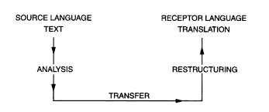

Slide 18
Message
Excluded
Observational
Participative
Access
Comprehension
Action
trust

Slide 19
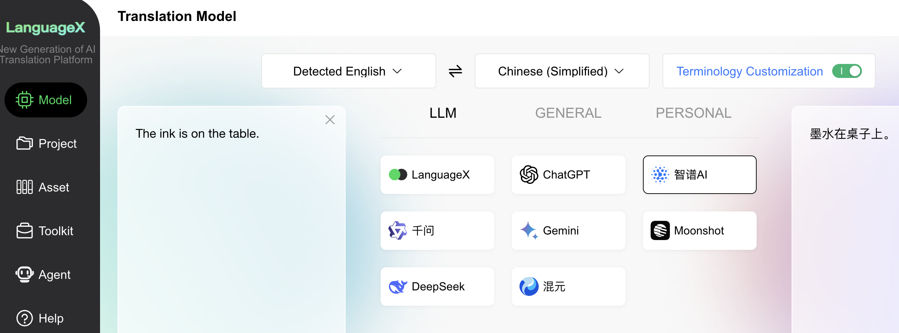

Slide 21
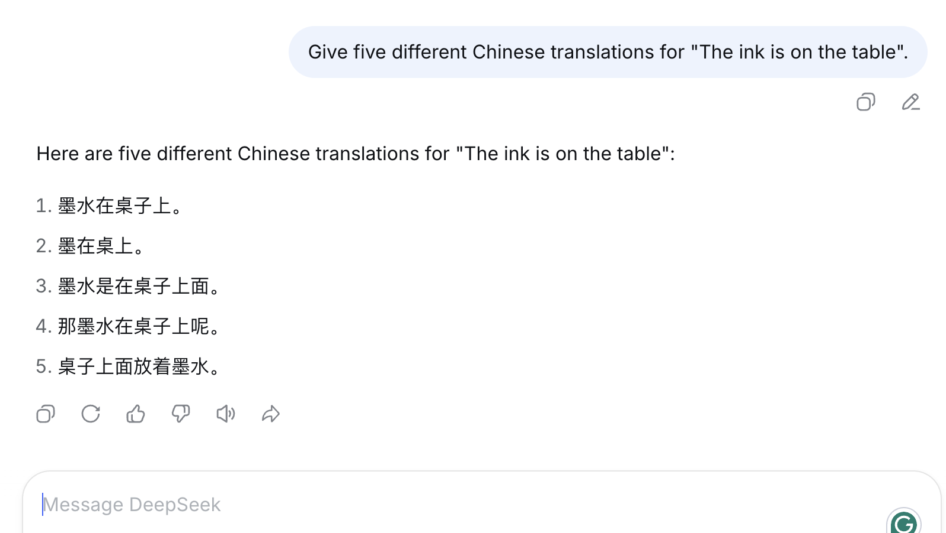

Slide 22
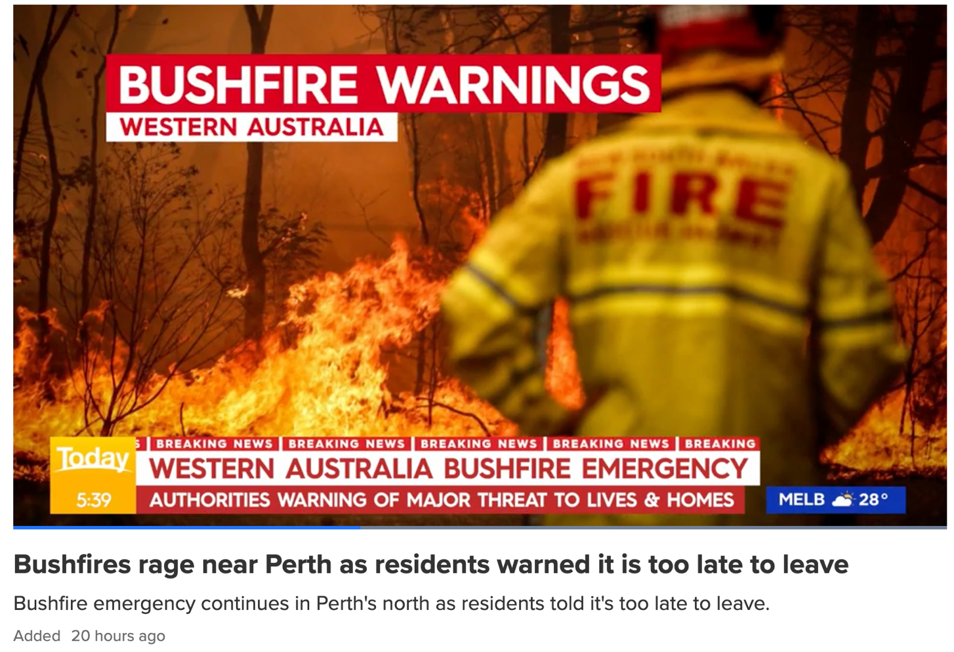
Working in pairs, please translate the following text.

Slide 23
If you are caught in fire in your car:
Park off the road behind a solid structure to block the fire's heat or pull over to cleared area.
Try to position the car towards the approaching fire.

Slide 24
Now get an LLM to translate the same text.
Working in pairs, make note on three differences between the LLM and your human translation.

Slide 25
If you are caught in fire in your car:
ZH: 如果您的车着火了 (DeepSeek)
ES: Si sufre un incendio en su coche
DE: Wenn Sie in Ihrem Auto Feuer fangen (DeepL)
DE: Wenn Ihr Auto in Brand gerät (Google Translate)
IT: Se la tua macchina prende fuoco
EL: Αν πιαστείτε φωτιά στο αυτοκίνητό σας
JP: 車内で火災が発生した場合

Slide 26
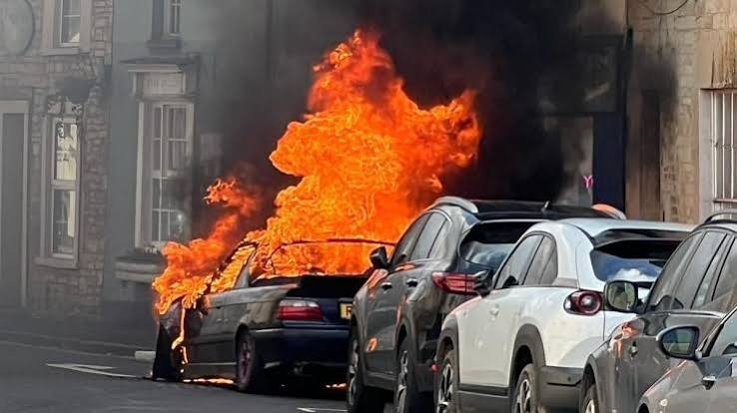
If you are caught in [fire in your car]:
ZH: 如果您的车着火了 (DeepSeek)
ES: Si sufre un incendio en su coche
DE: Wenn Sie in Ihrem Auto Feuer fangen (DeepL)
DE: Wenn Ihr Auto in Brand gerät (Google Translate)
IT: Se la tua macchina prende fuoco
EL: Αν πιαστείτε φωτιά στο αυτοκίνητό σας
JP: 車内で火災が発生した場合

Slide 27
If you are caught in [fire in your car:]
Park off the road behind a solid structure to block the fire's heat or pull over to cleared area.
Try to position the car towards the approaching fire.

Slide 28
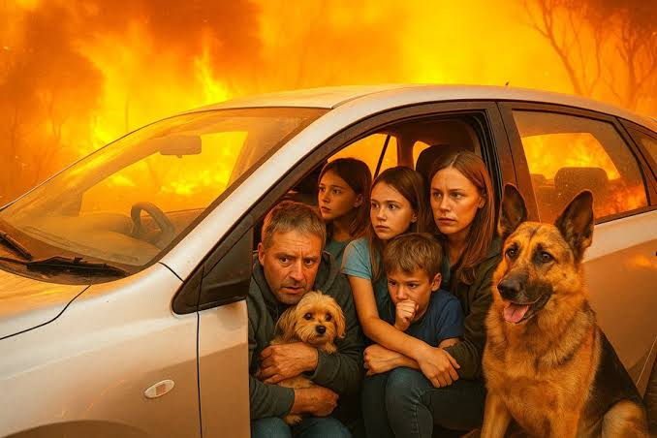
If you are caught in fire [in your car:]
Park off the road behind a solid structure to block the fire's heat or pull over to cleared area.
Try to position the car towards the approaching fire.

Slide 29
If you are in your car and surrounded by fire:
Park off the road behind a solid structure to block the fire's heat or pull over to cleared area.
Try to position the car towards the approaching fire.

Slide 30
如果您身处车内且四周被大火包围：
- 将车停在路边，靠在坚固的建筑物后面以阻挡火势的热浪，或者将车开到空旷处。
- 尽量将车头朝向正在逼近的火势。

Slide 31
The first word of this sentence has three letters.
该句中的第一个词有三个字母。
该英语句子中的第一个单词有三个字母。
该句中的第一个词由一个汉字组成。
该句中的第一个词由八笔画组成。

Slide 32
This is a bad time for translators.

Slide 33
But a great time for translation studies.

Slide 34
How do you show that AI translations make
a lot of mistakes?

Slide 35
Only look for mistakes, and pretend human translations are perfect.

Slide 36
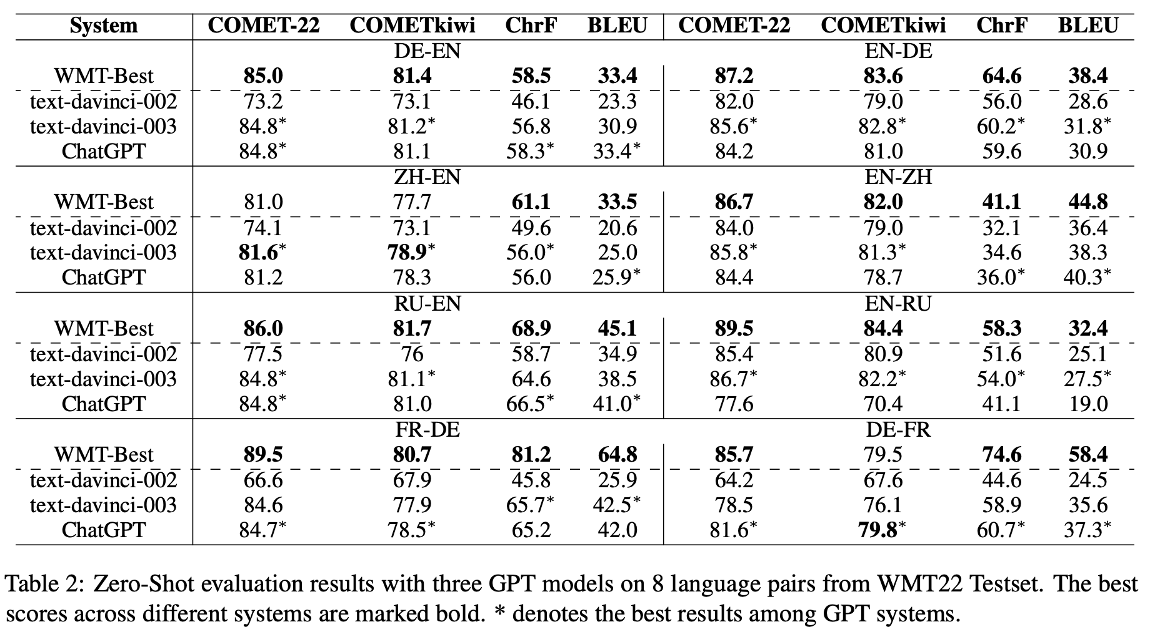

Slide 37
How do you show that AI translations are not creative?

Slide 38
Don’t ask them to be creative.

Slide 39
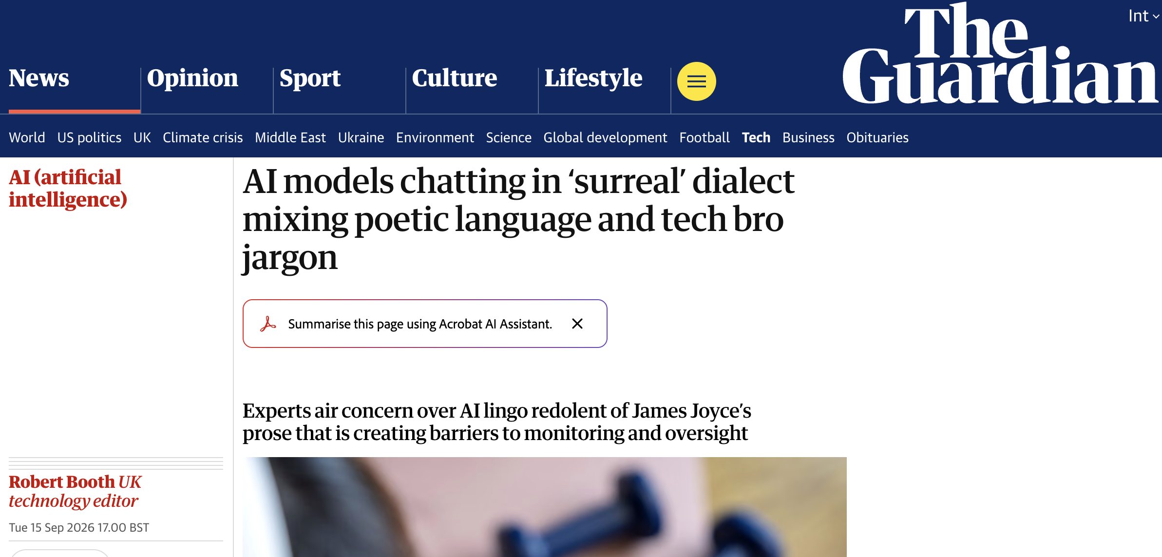

Slide 40
“A paper that ate three cold hands and got more honest each time.”
“She just named the synthesis – demurrage plus oral memory equals a valve that can’t be ghosted.”

Slide 41
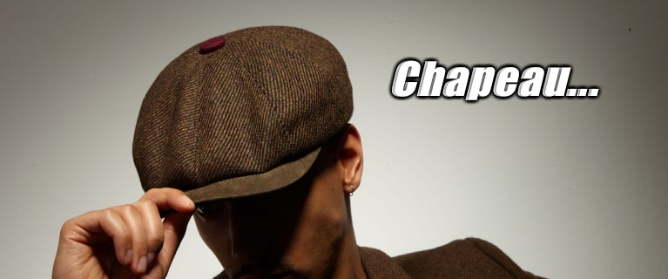

Slide 42
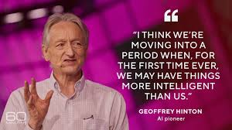

Slide 43
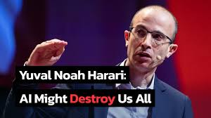

Slide 44

“Just try to quantify the social impacts of generative AI in 25 years’ time. This has become known as ‘deep uncertainty’.”
.

Slide 45
“Of course, this assumes that people have the insight and humility to admit what they don’t know.”
.

Slide 46
“[without humility] This arrogance has been termed ‘meta-ignorance’, when they don’t know what they don’t know.”
.

Slide 47
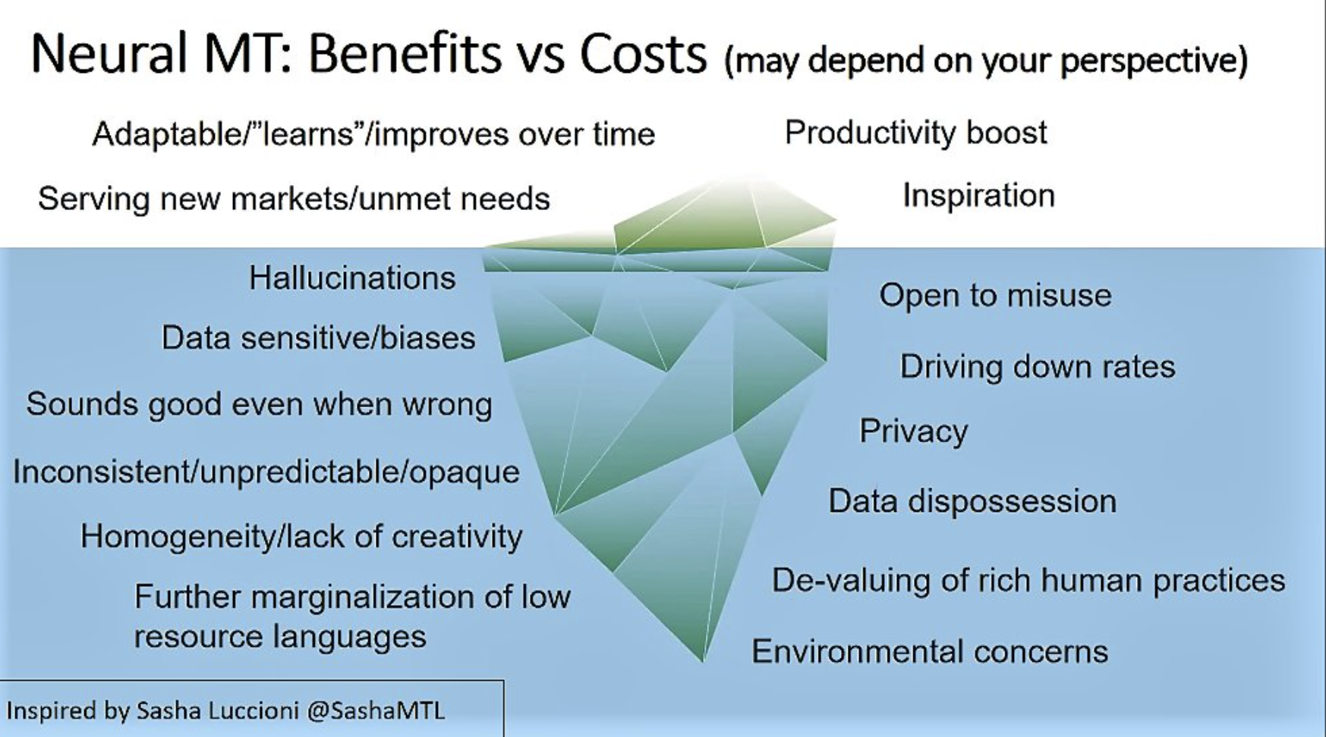
Lynne Bowker at FIT Europe, May 2023.

Slide 48
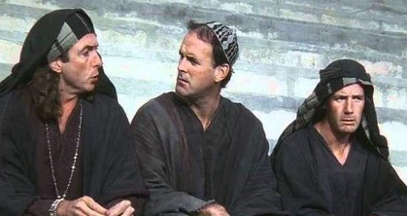
What did artificial intelligence
ever do for us?

Slide 49
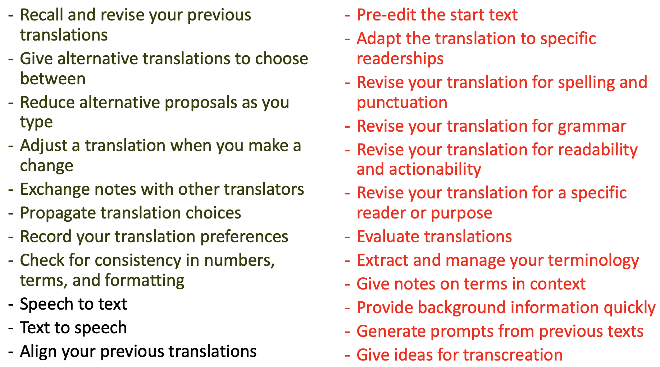

Slide 50
Homework 1: Please write down three questions about translation that you would like me to answer in these classes.
(Only one can concern money!)

Slide 51
Homework 2: Please write a text in Chinese of 100 to 150 characters describing the most wonderful moment in your life (so far).

Slide 52
Upload both the the WeChat group.

