Slide 1
At the end, please write three questions about translation that you would like me to answer in these classes.
(Only one can concern money!)

Slide 2
Please bring a laptop to class.
Please do not look at your phone!

Slide 3
ST: Source text or start text
TT: Target text
SL: Source or start language
TL: Target language

Slide 4
MT: Machine translation
LLM: Large Language Models
AI: artificial intelligence
Generative AI (GenAI): LLMs that can translate

Slide 5
Automation: GenAI + MT
CAT: Computer Assisted/Aided Translation

Slide 6
Post-editing: Correcting automated output.
Pre-editing: Preparing an ST for automation.

Slide 7
Revision: Correcting a translation.
Editing: Correcting a text.
Back translation: A translation made from TT to SL, usually literal, in order to illustrate the TL.

Slide 8


How many basic ways are there to translate?

Slide 9
Model 1 (transformations)
ST: The ink is on the table.
TT Fr. L’ encre est sur la table.
TT Zh. 墨水 在 桌子 上
Mòshuǐ zài zhuōzi shàng

Slide 10

Model 2 (situations)
The ink is on the table.
La tinta está sobre la mesa.
墨水在桌子上

Slide 11
Model 2 (situations)
The ink is on the table.
¡Hay tinta sobre la mesa! 桌子上沾了墨水！
La tinta se ha derramado. 墨水洒出来了！
¡Saca la tinta de la mesa! 把桌子上的墨水擦干净。

Slide 12
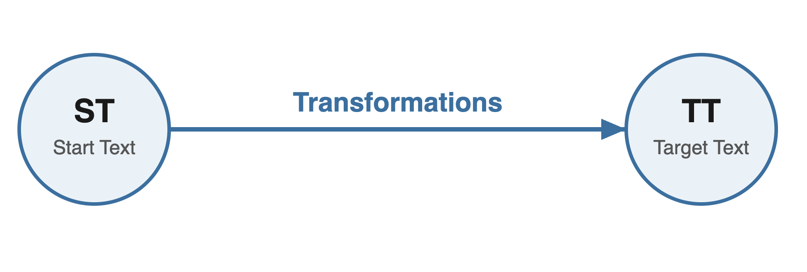

Slide 13
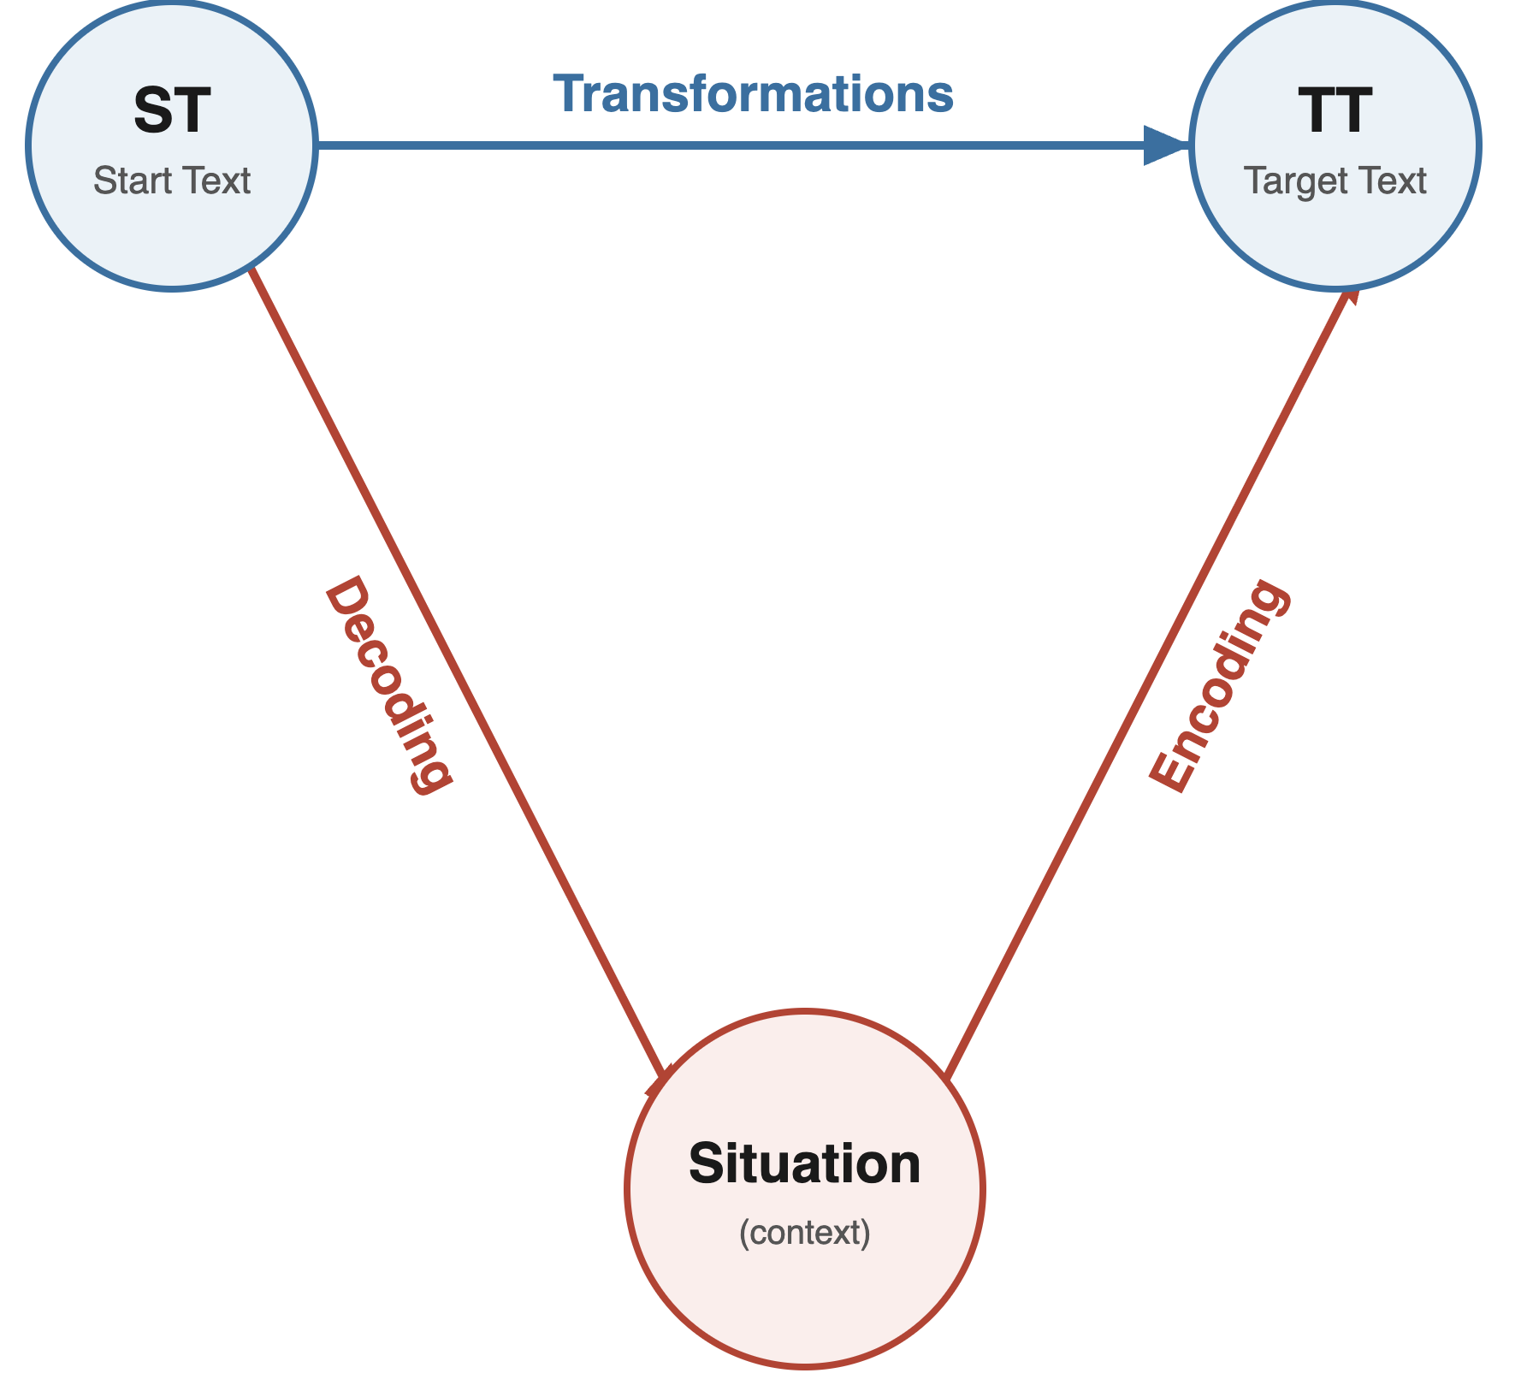

Slide 14
Message
Excluded
Observational
Participative
Access
Comprehension
Action
trust

Slide 15
If you want the translation to perform in a situation,
first you have to ask what the translation is supposed to do.

Slide 16
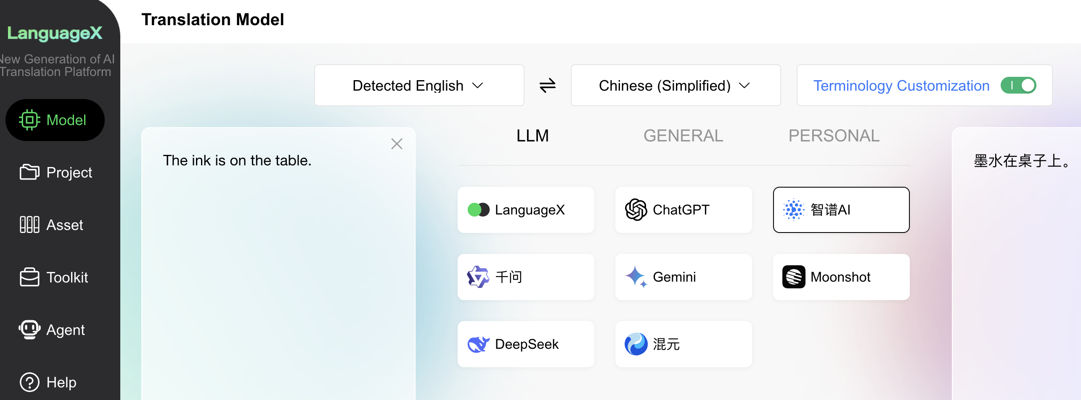

Slide 18
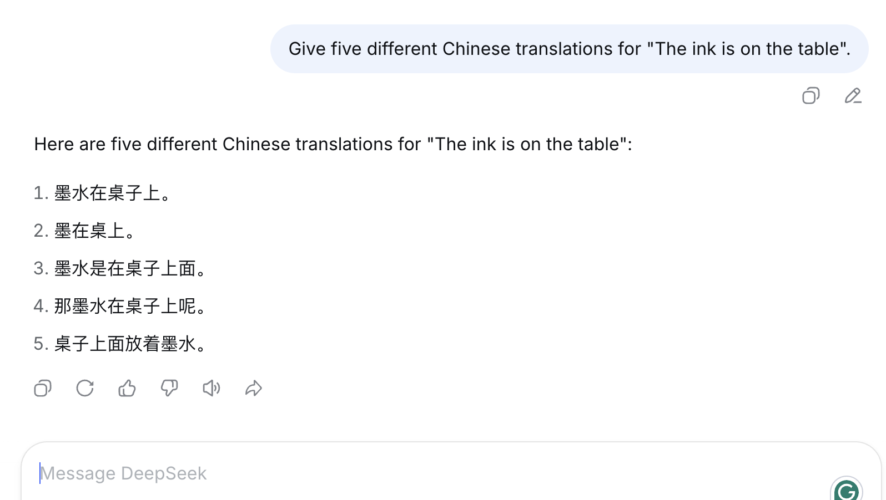

Slide 19
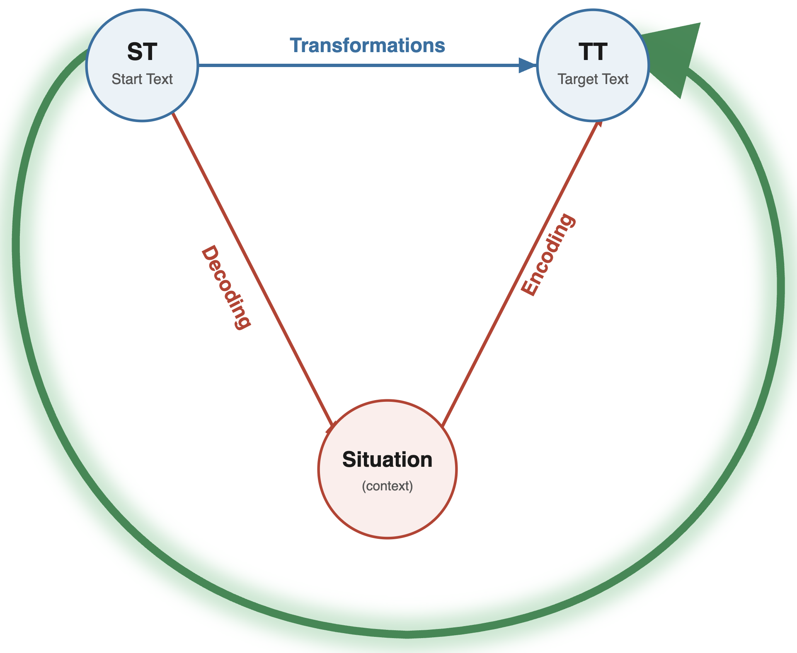

Slide 20

Welcome to Dragon NaturallySpeaking, the world’s most acclaimed large-vocabulary continuous-speech dictation system. With Dragon NaturallySpeaking you can compose e-mail messages, create reports, draft letters, edit proposals, create reports, and more, all by speaking to your computer instead of typing.

Slide 21

A crash course in twentieth-century Western translation theory
Equivalence
Solutions
Purposes
Science
Uncertainty
Automation
Cultural Translation

Slide 22
Why equivalence became a mess
Equivalence = no change
Equivalence = terminology
Equivalence = use corresponding idioms
Equivalence = change the text to maintain the function
Equivalence = whatever translators do

Slide 23





Master of Translation
The basic equivalence formula:

Slide 24



Master of Translation
The basic equivalence formula, plus purpose:

Slide 25

Master of Translation
The basic equivalence formula, plus different purposes:

Slide 26
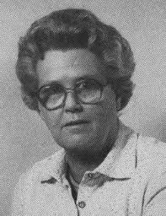
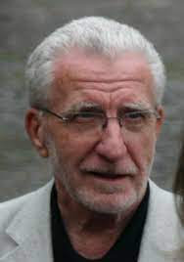
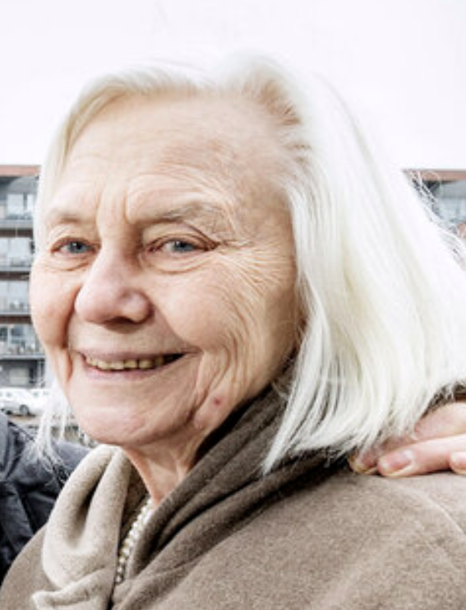
A paradigm shift:
Reiss, Katharina, & Hans J. Vermeer (1984). Grundlegung einer allgemeinen Translationstheorie. Tübingen: Niemeyer.
Holz-Mänttäri, Justa (1984) Translatorisches Handeln. Theorie und Methode. Helsinki: Academia Scientiarum Fennica.

Slide 27
Equivalence means “same function” (Funktionskonstanz).
But most TTs have a new function or purpose, for a new client and for a new receiver (on the target side).
Equivalence is therefore a special case.

Slide 28
The main concepts of Skopos theory:
The dominant factor in a translation is its purpose [Skopos] (Reiss & Vermeer 1984).
The source text is thus dethroned.
The same text can be translated in different ways for different purposes.
All strategies are legitimate if they achieve the purpose.
The translator is an expert who decides on the basis of the instructions or brief (commission, Auftrag).

Slide 29
Translatorial action (from Christiane Nord)

Slide 30
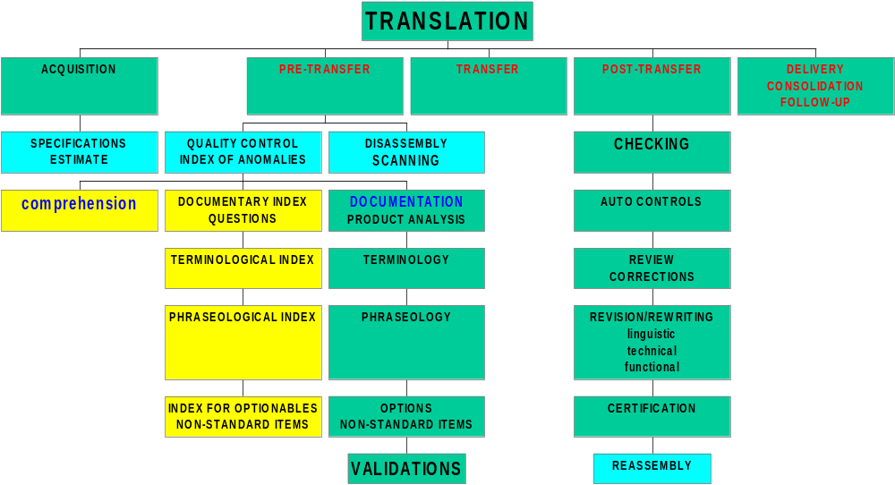
Getting the instructions (from Daniel Gouadec)

Slide 31
In summary:
Equivalence went out of fashion because: 1) it was a mess, 2) it did not address hermeneutics, and 3) it did not contemplate different purposes.
Skopos (“purpose”) theory seems to solve this problem because it says that everything depends on what the translator (or the client) wants to achieve.

Slide 32
In summary:
Equivalence concerns texts; Skopos concerns people.
Ask not, “What does this mean?”, ask “What do you want to do with this text?”

Slide 33
Skopos theory can be tested
Can the same text be translated in different ways for different purposes?

Slide 34
Skopos theory can be tested
Sir James Watts used his economic wealth to become a gentleman, although this was not without contradictions. When he entered Parliament, he fought for equality, but he sent his son John to Eton. His son would become accustomed to the ways of the upper social class. However, when Sir James died in 1898, his widow could not afford to send John to Eton anymore.

Slide 35
Skopos theory can be tested
Translate for:
A: A general history book
B: A coffee-table book of photographs
C: A book on moral philosophy
D: A biography of Sir James Watts

Slide 36
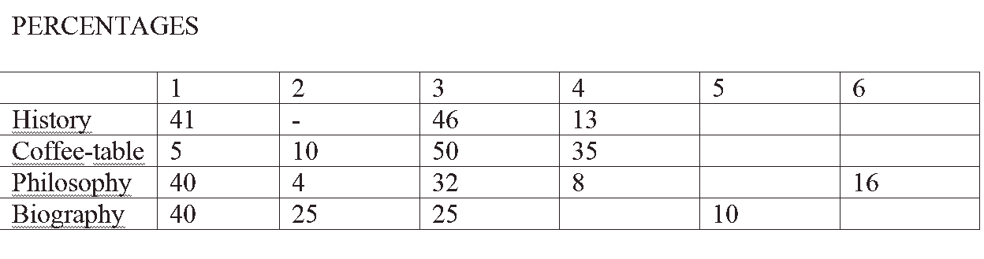
1 = Eton / Eton
2 = Eton / THAT school or similar
3 = Eton SCHOOL / Eton
4 = PRESTIGIOUS school Eton / Eton
5 = a prestigious school LIKE Eton
6 = a prestigious school / Ivy league school

Slide 37
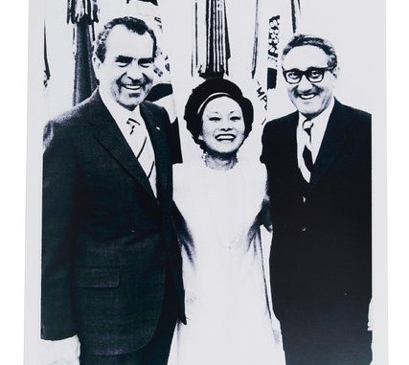
A. An obituary in the major broadsheet newspaper in your language
Anna Chennault was one of the most influential powerbrokers of the twentieth century. Also known as Chen Xiangmei, she was a stylish fixture on Washington DC's political circuit - but also an unofficial diplomat who skilfully navigated 20th-century politics. She met John F Kennedy, Richard Nixon, Henry Kissinger, Deng Xiaoping and Chiang Kai-shek. All were reportedly impressed by the woman dubbed by the Washington Post as the "legendary steel butterfly”.

Slide 38
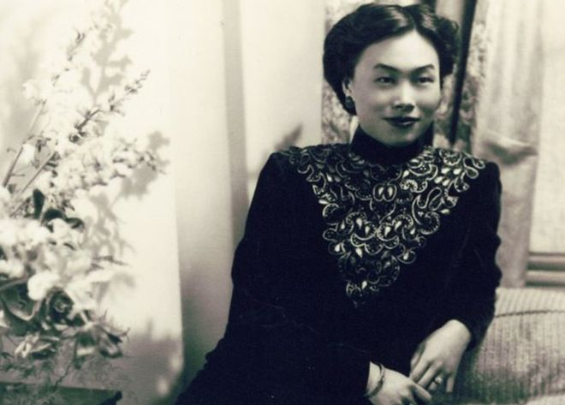
A. An obituary in the major broadsheet newspaper in your language
Anna Chennault was one of the most influential powerbrokers of the twentieth century. Also known as Chen Xiangmei, she was a stylish fixture on Washington DC's political circuit - but also an unofficial diplomat who skilfully 20th century politics. She met John F Kennedy, Richard Nixon, Henry Kissinger, Deng Xiaoping and Chiang Kai-shek. All were reportedly impressed by the woman dubbed by the Washington Post as the "legendary steel butterfly”.

Slide 39
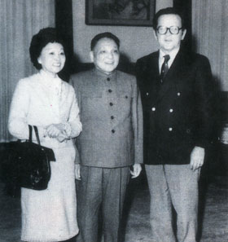
B. A history book for young teenagers
Anna Chennault was one of the most influential powerbrokers of the twentieth century. Also known as Chen Xiangmei, she was a stylish fixture on Washington DC's political circuit - but also an unofficial diplomat who skilfully 20th century politics. She met John F Kennedy, Richard Nixon, Henry Kissinger, Deng Xiaoping and Chiang Kai-shek. All were reportedly impressed by the woman dubbed by the Washington Post as the "legendary steel butterfly”.

Slide 40
B. A history book for young teenagers
Anna Chennault was one of the most influential powerbrokers of the twentieth century. Also known as Chen Xiangmei, she was a stylish fixture on Washington DC's political circuit - but also an unofficial diplomat who skilfully 20th century politics. She met John F Kennedy, Richard Nixon, Henry Kissinger, Deng Xiaoping and Chiang Kai-shek. All were reportedly impressed by the woman dubbed by the Washington Post as the "legendary steel butterfly”.

Slide 41
It is a definition, not a theory (no predictions).
It offers no typology of purposes.
It offers no ethical aim for translators.
The concept of purpose is essentialist, not hermeneutic.
It does not correspond to many social perceptions of translation.
It developed no research paradigm.

Slide 42
What could possibly be wrong with Skopos theory?

